Slide 1





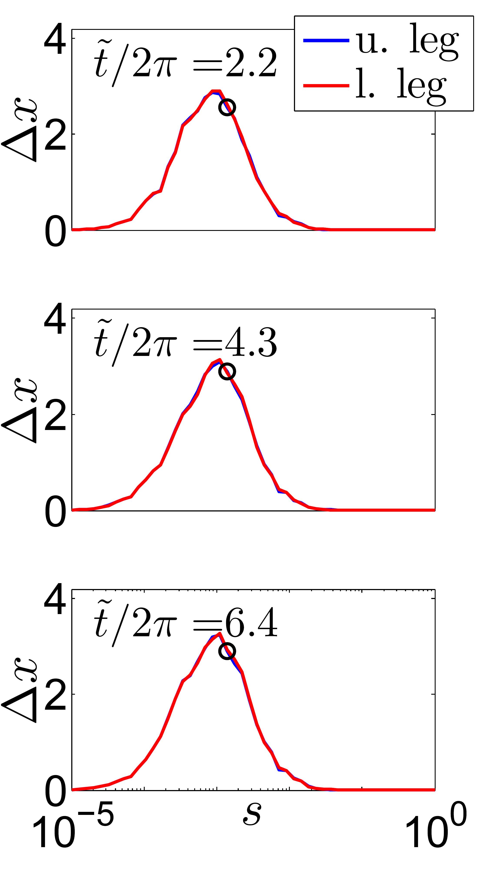
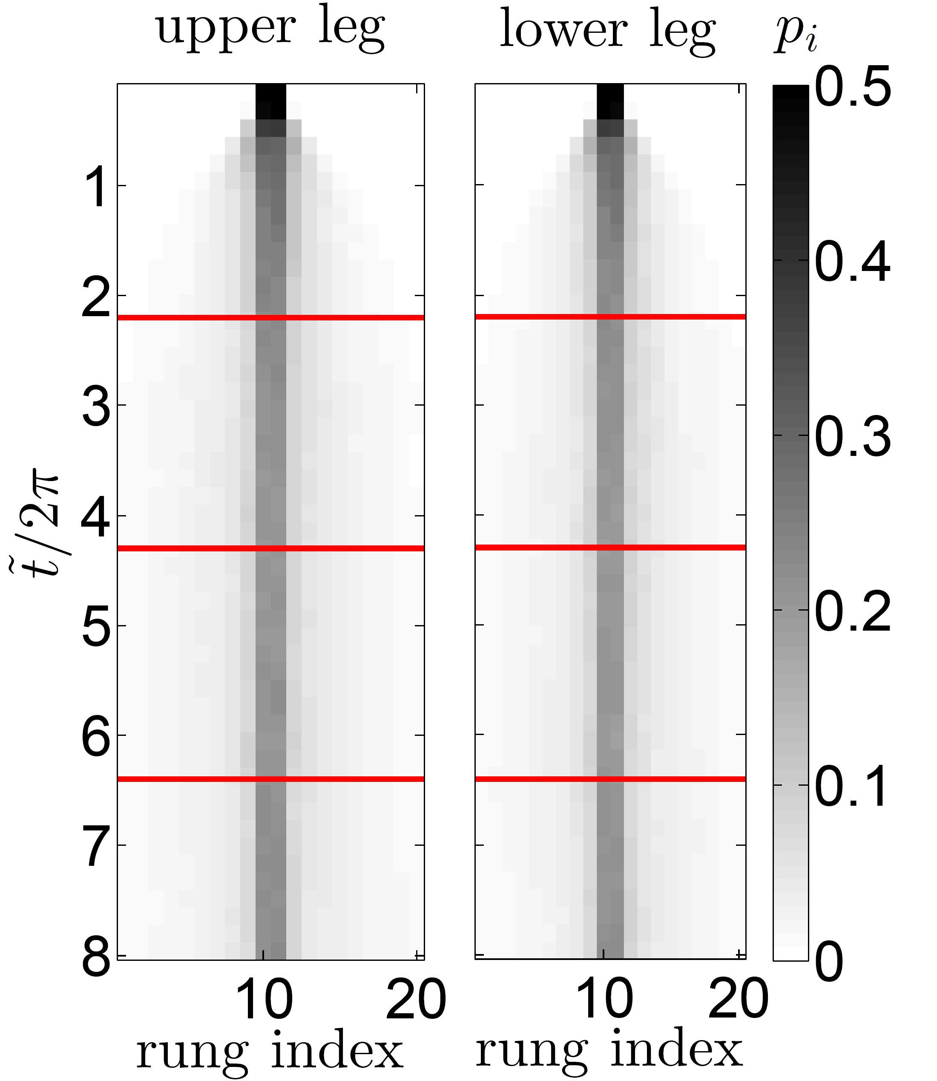



↑ ↑
↓ ↓
↓ ↓
↑ ↑
↑ ↓
↑ ↓
↓ ↑
↓ ↑
+ - -

Slide 2
↑ ↑
↓ ↓
↓ ↓
↑ ↑
↑ ↓
↑ ↓
↓ ↑
↓ ↑
+ - -

