Slide 1

Breast Cancer Detection
Kevin Mai

Slide 2
Breast Cancer is hurting people’s lives

Slide 3
Early detection and valid diagnosis is key
Physician
Diagnose
Report findings
Computer assisted algorithm
Diagnose
Report findings
Final comparison
Evaluation
Conclusive findings

Slide 4
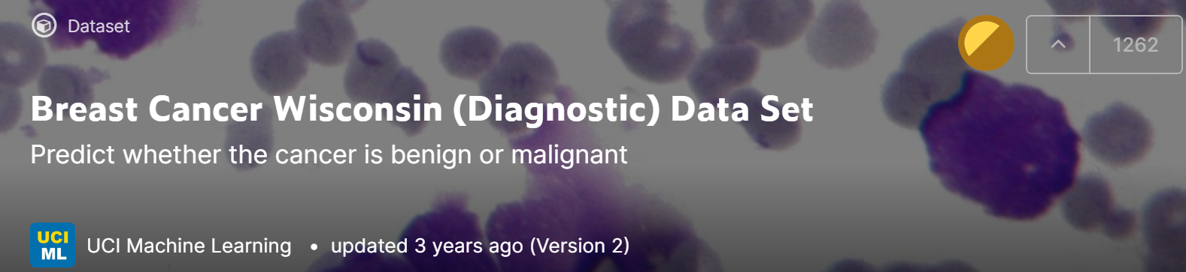
Breast Cancer Data
From UCI Wisconsin Data Set, contains 33 Columns with 569 rows of data.
Describing such features for tumors as:
Diagnosis
Smoothness
Compactness
Concavity
Fractal Dimensions

Slide 5
Identifying Prominent Features for Breast Cancer
Understand the distribution of data for Malignant or Benign cancers
For example: there is more data for malignant diagnosis
Build a graph for discovering correlations or general insights
Find the best classification model
Train data sets to predict outcome of patient based on data
Evaluate quality of model through cross-validation

Slide 6

Into the data
Looking into the data set and making sure all columns have valid data (no NaN values)
Dropped necessary columns with drop function
For example:

Slide 7
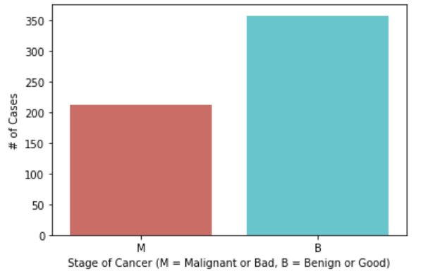
Understand patient diagnosis data
More Benign Patient data than Malignant

Slide 8
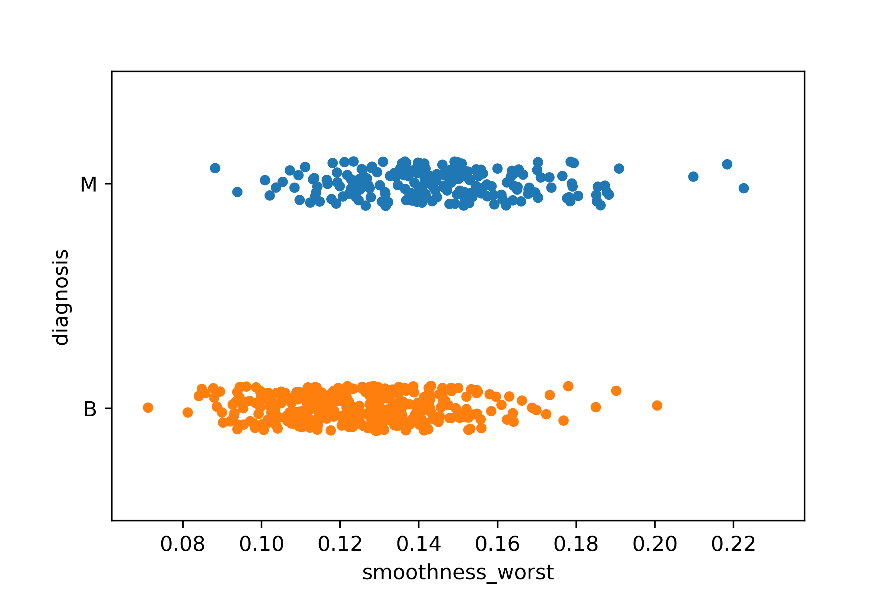
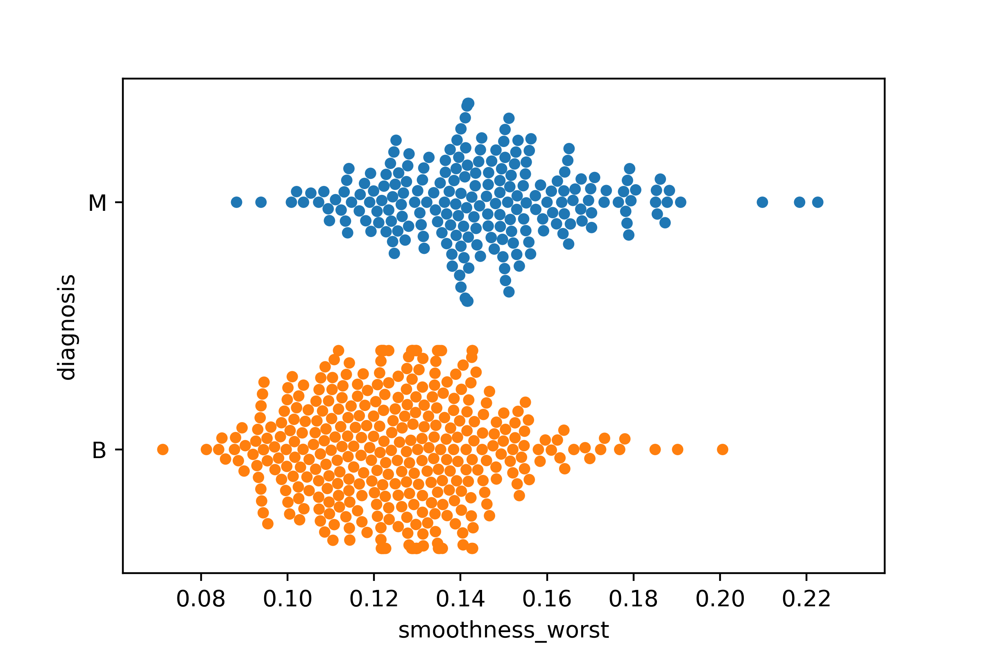
Looking at other visualizations
Strip plot displayed on smoothness due to nature of tumors being the easiest to define.
Strip plot see a distinct pattern.
Swarm plot was displayed, distinction was easier to recognize but still difficult in general to look for.

Slide 9
Choosing one feature
Tumors are not uniform or defined around edges.
Perform linear regression model

Slide 10
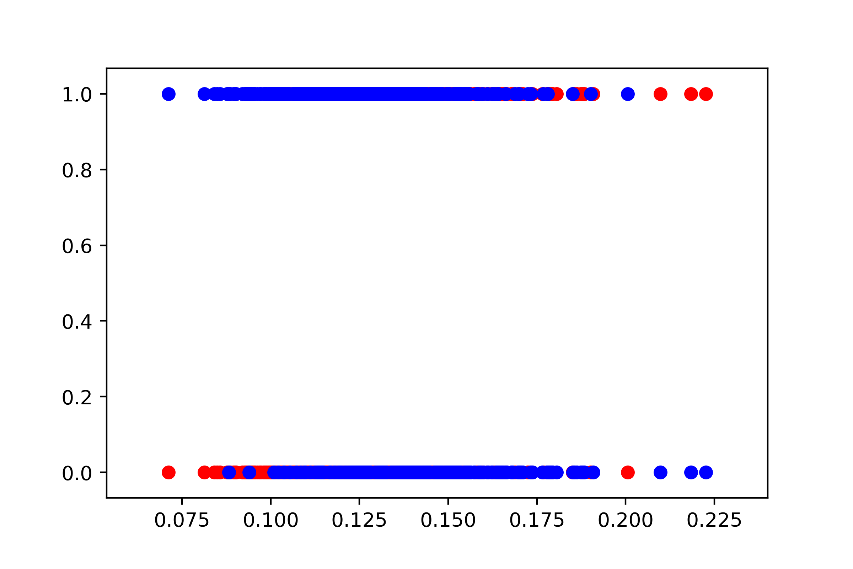
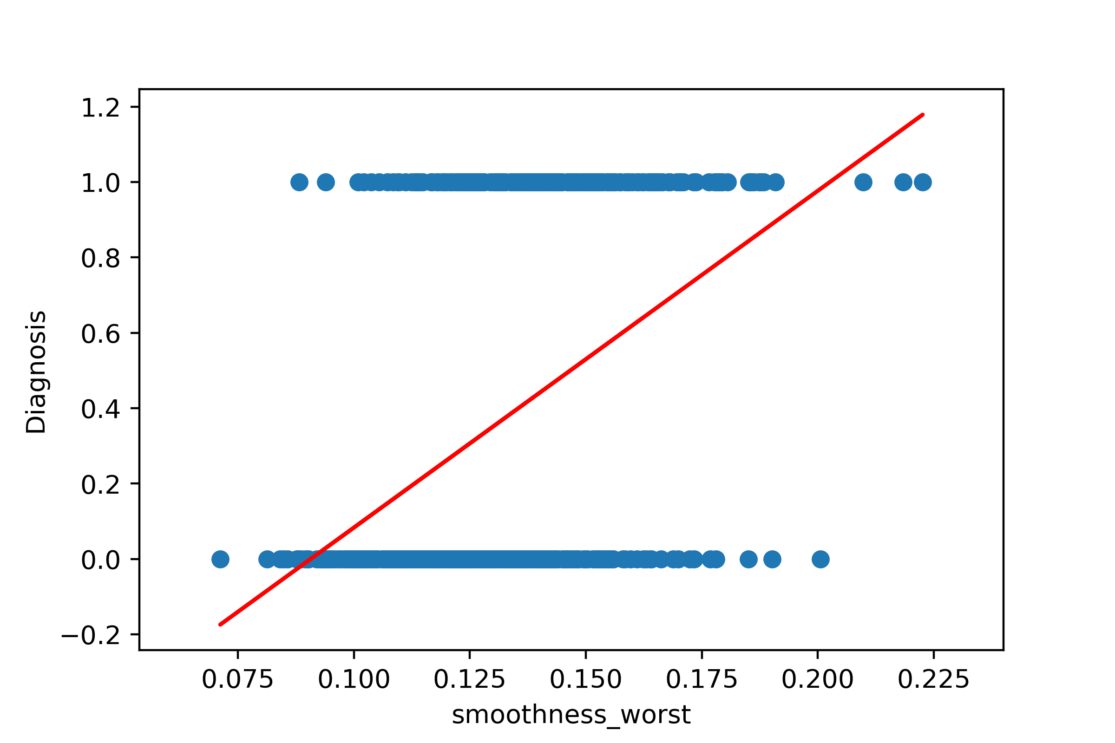
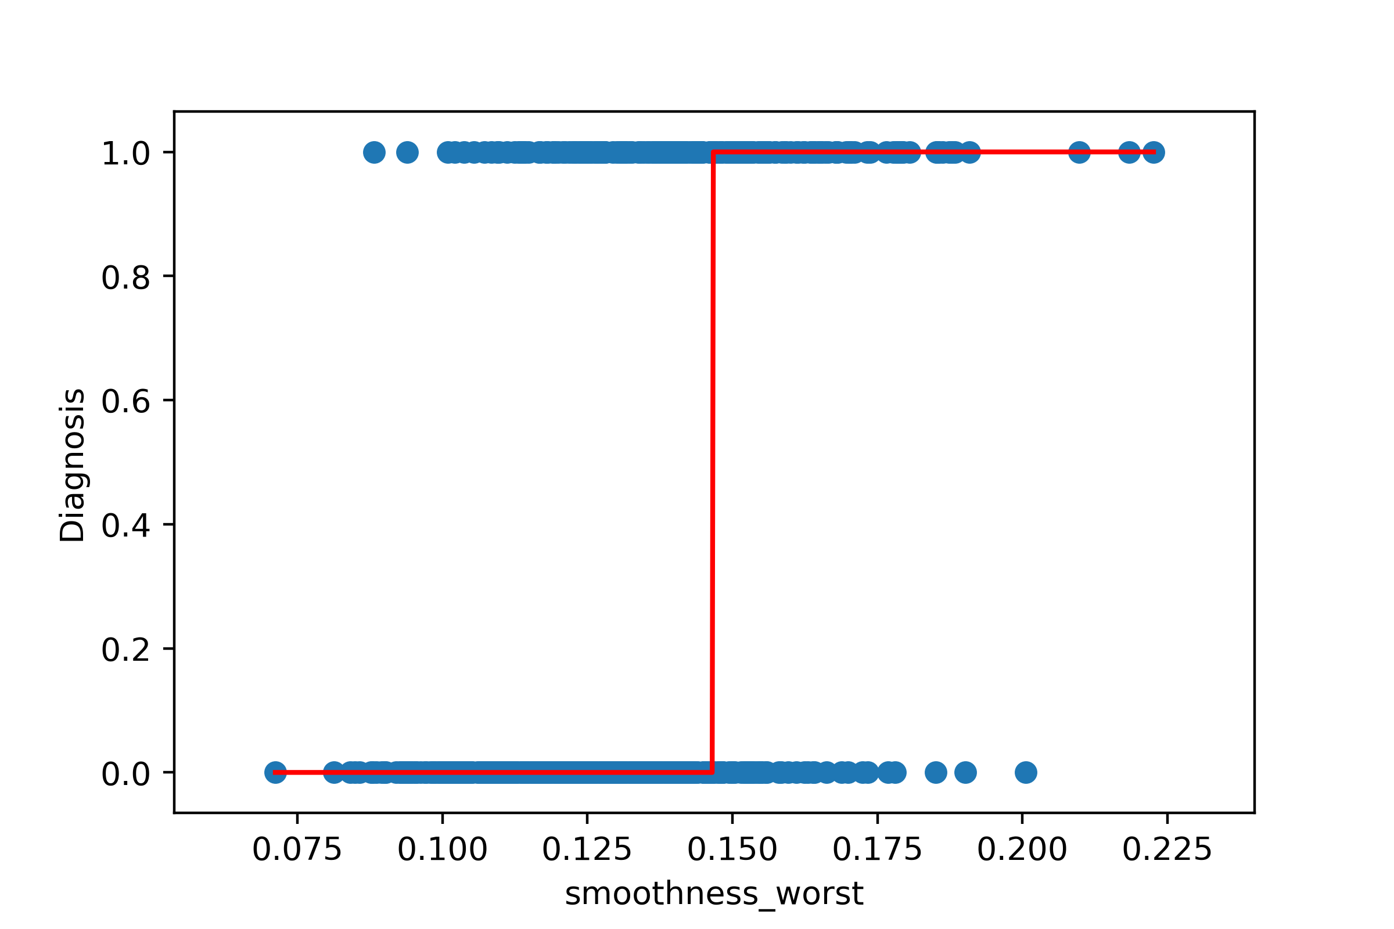
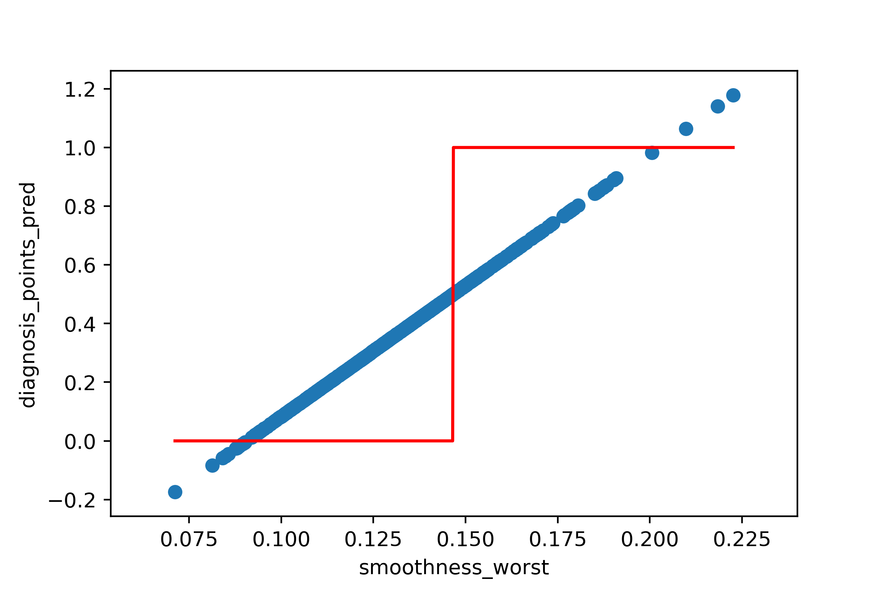
Plotting Scatter plot with focus on Linear Regression Model

Slide 11
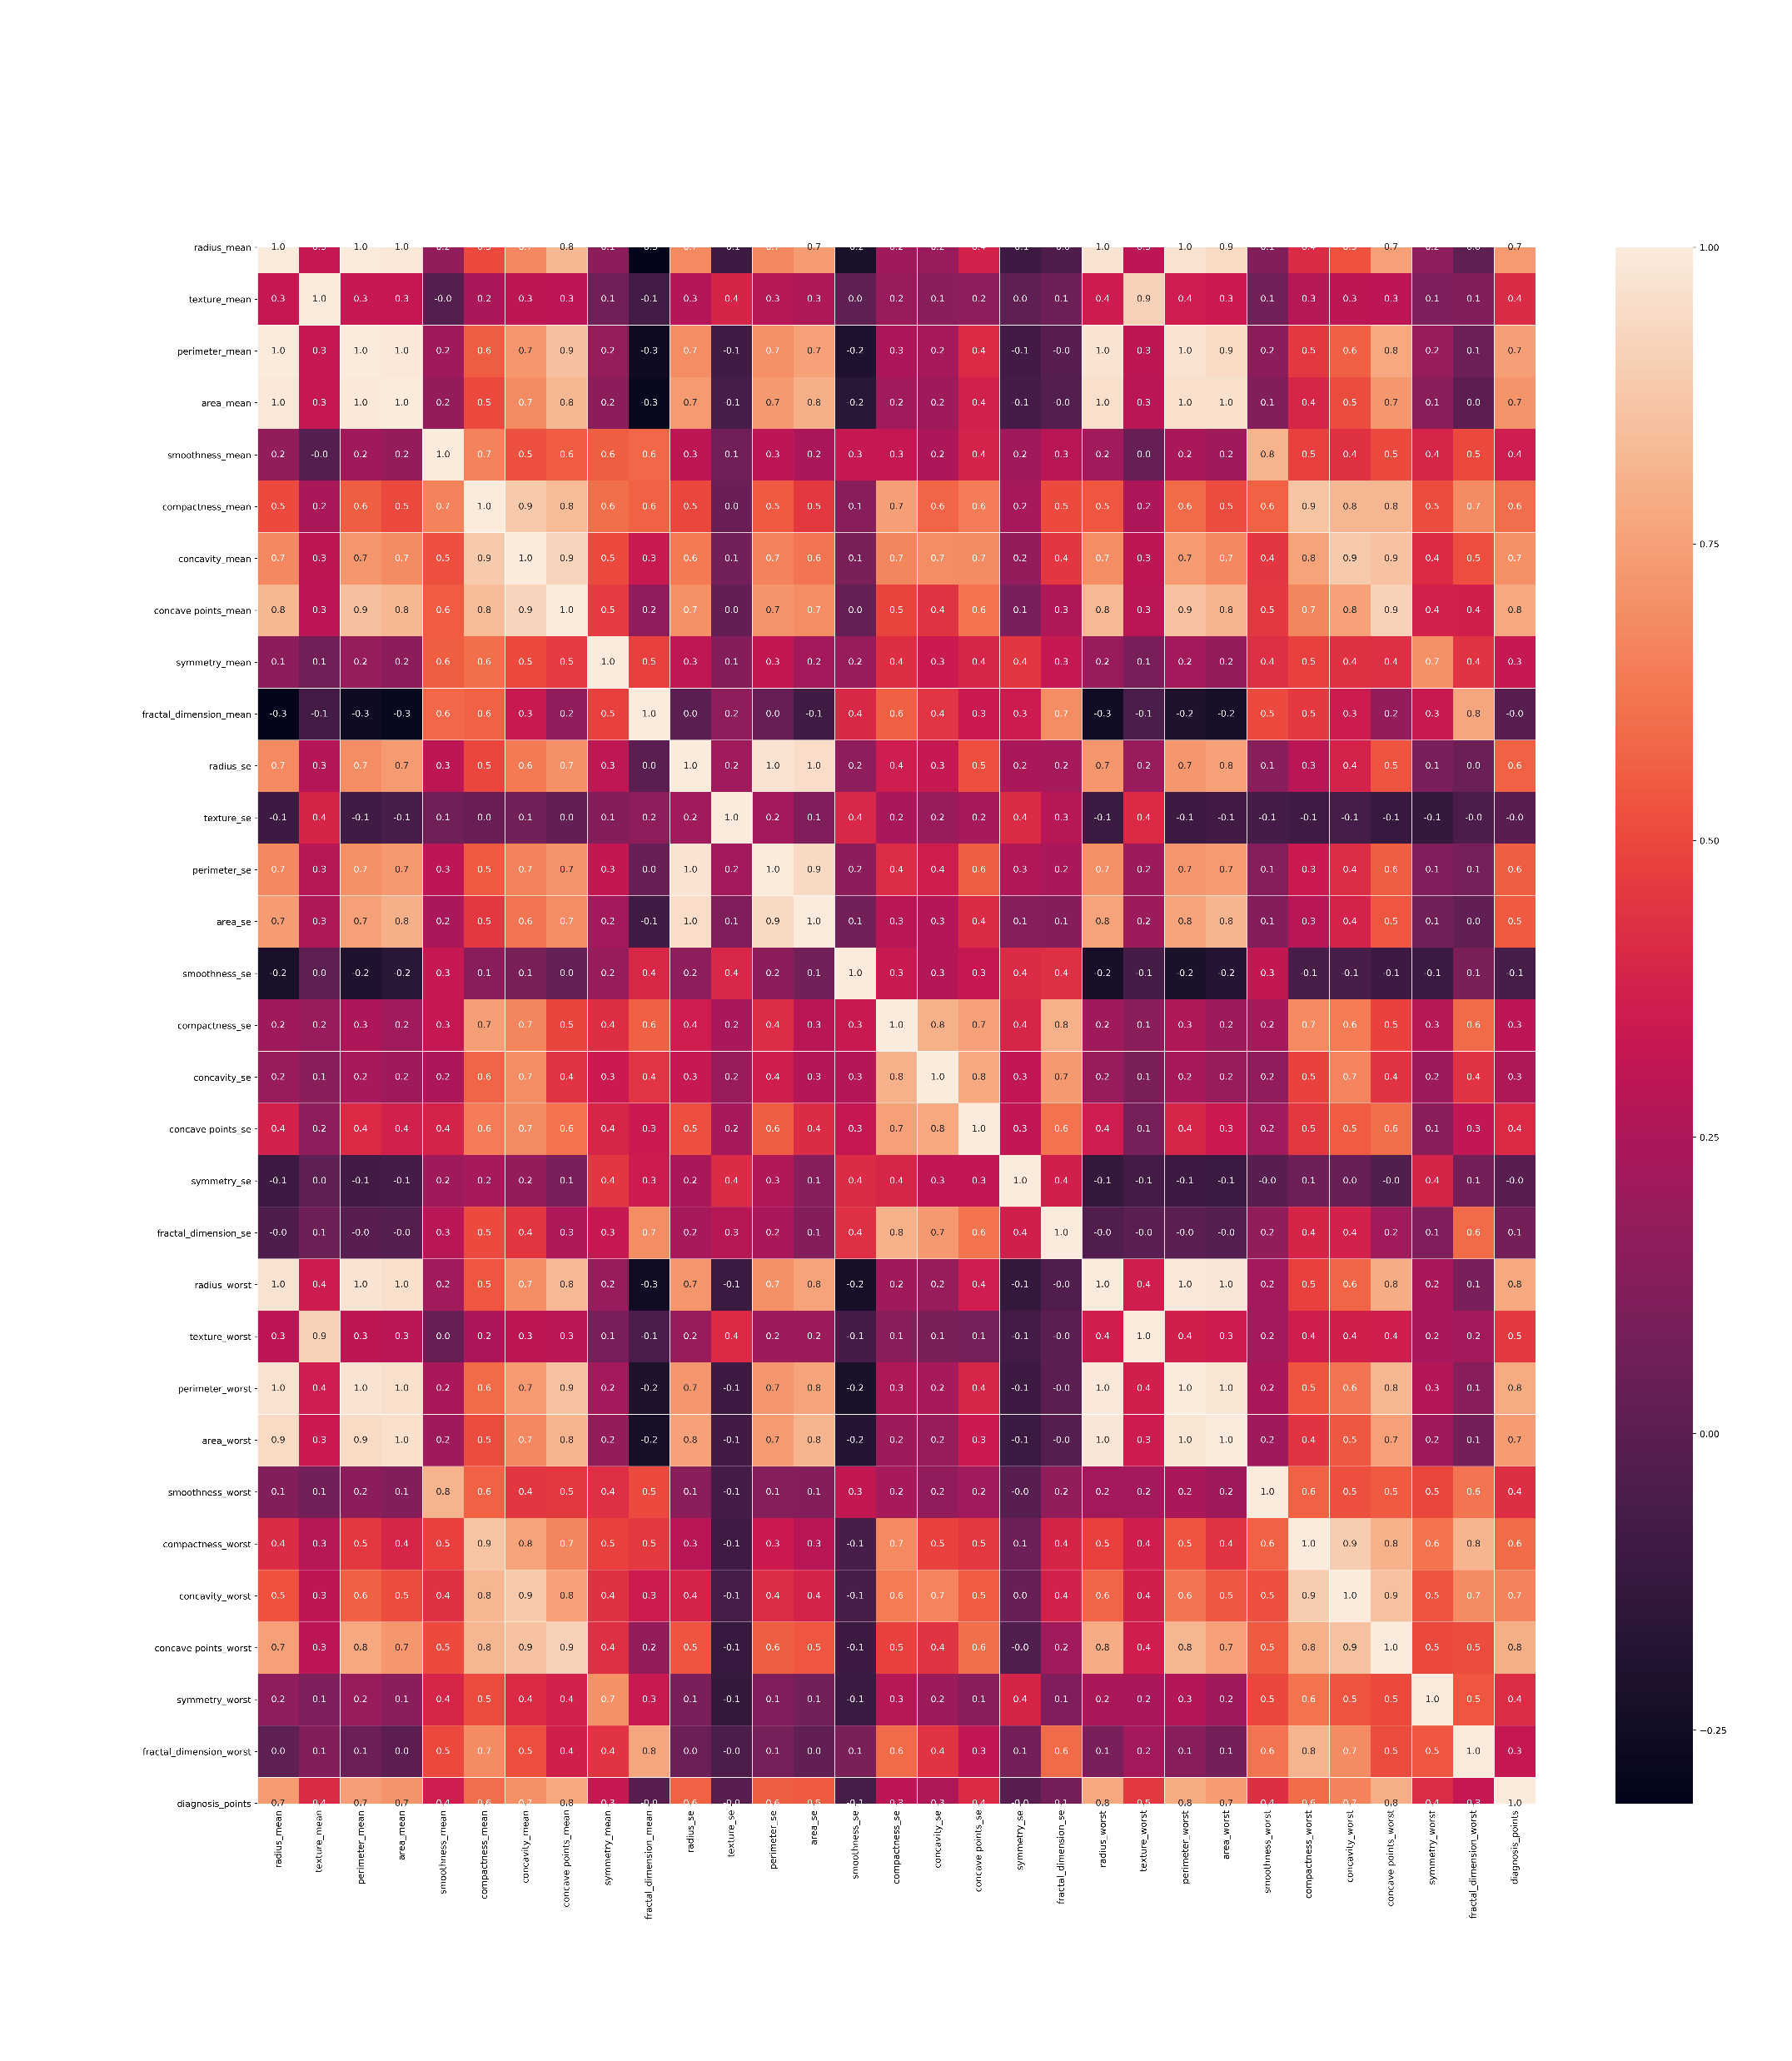
Heatmap 1.0
Plot heatmap due to picking single features is time consuming
Dropping unnecessary columns
Plotting a correlation heat map for all features.

Slide 12
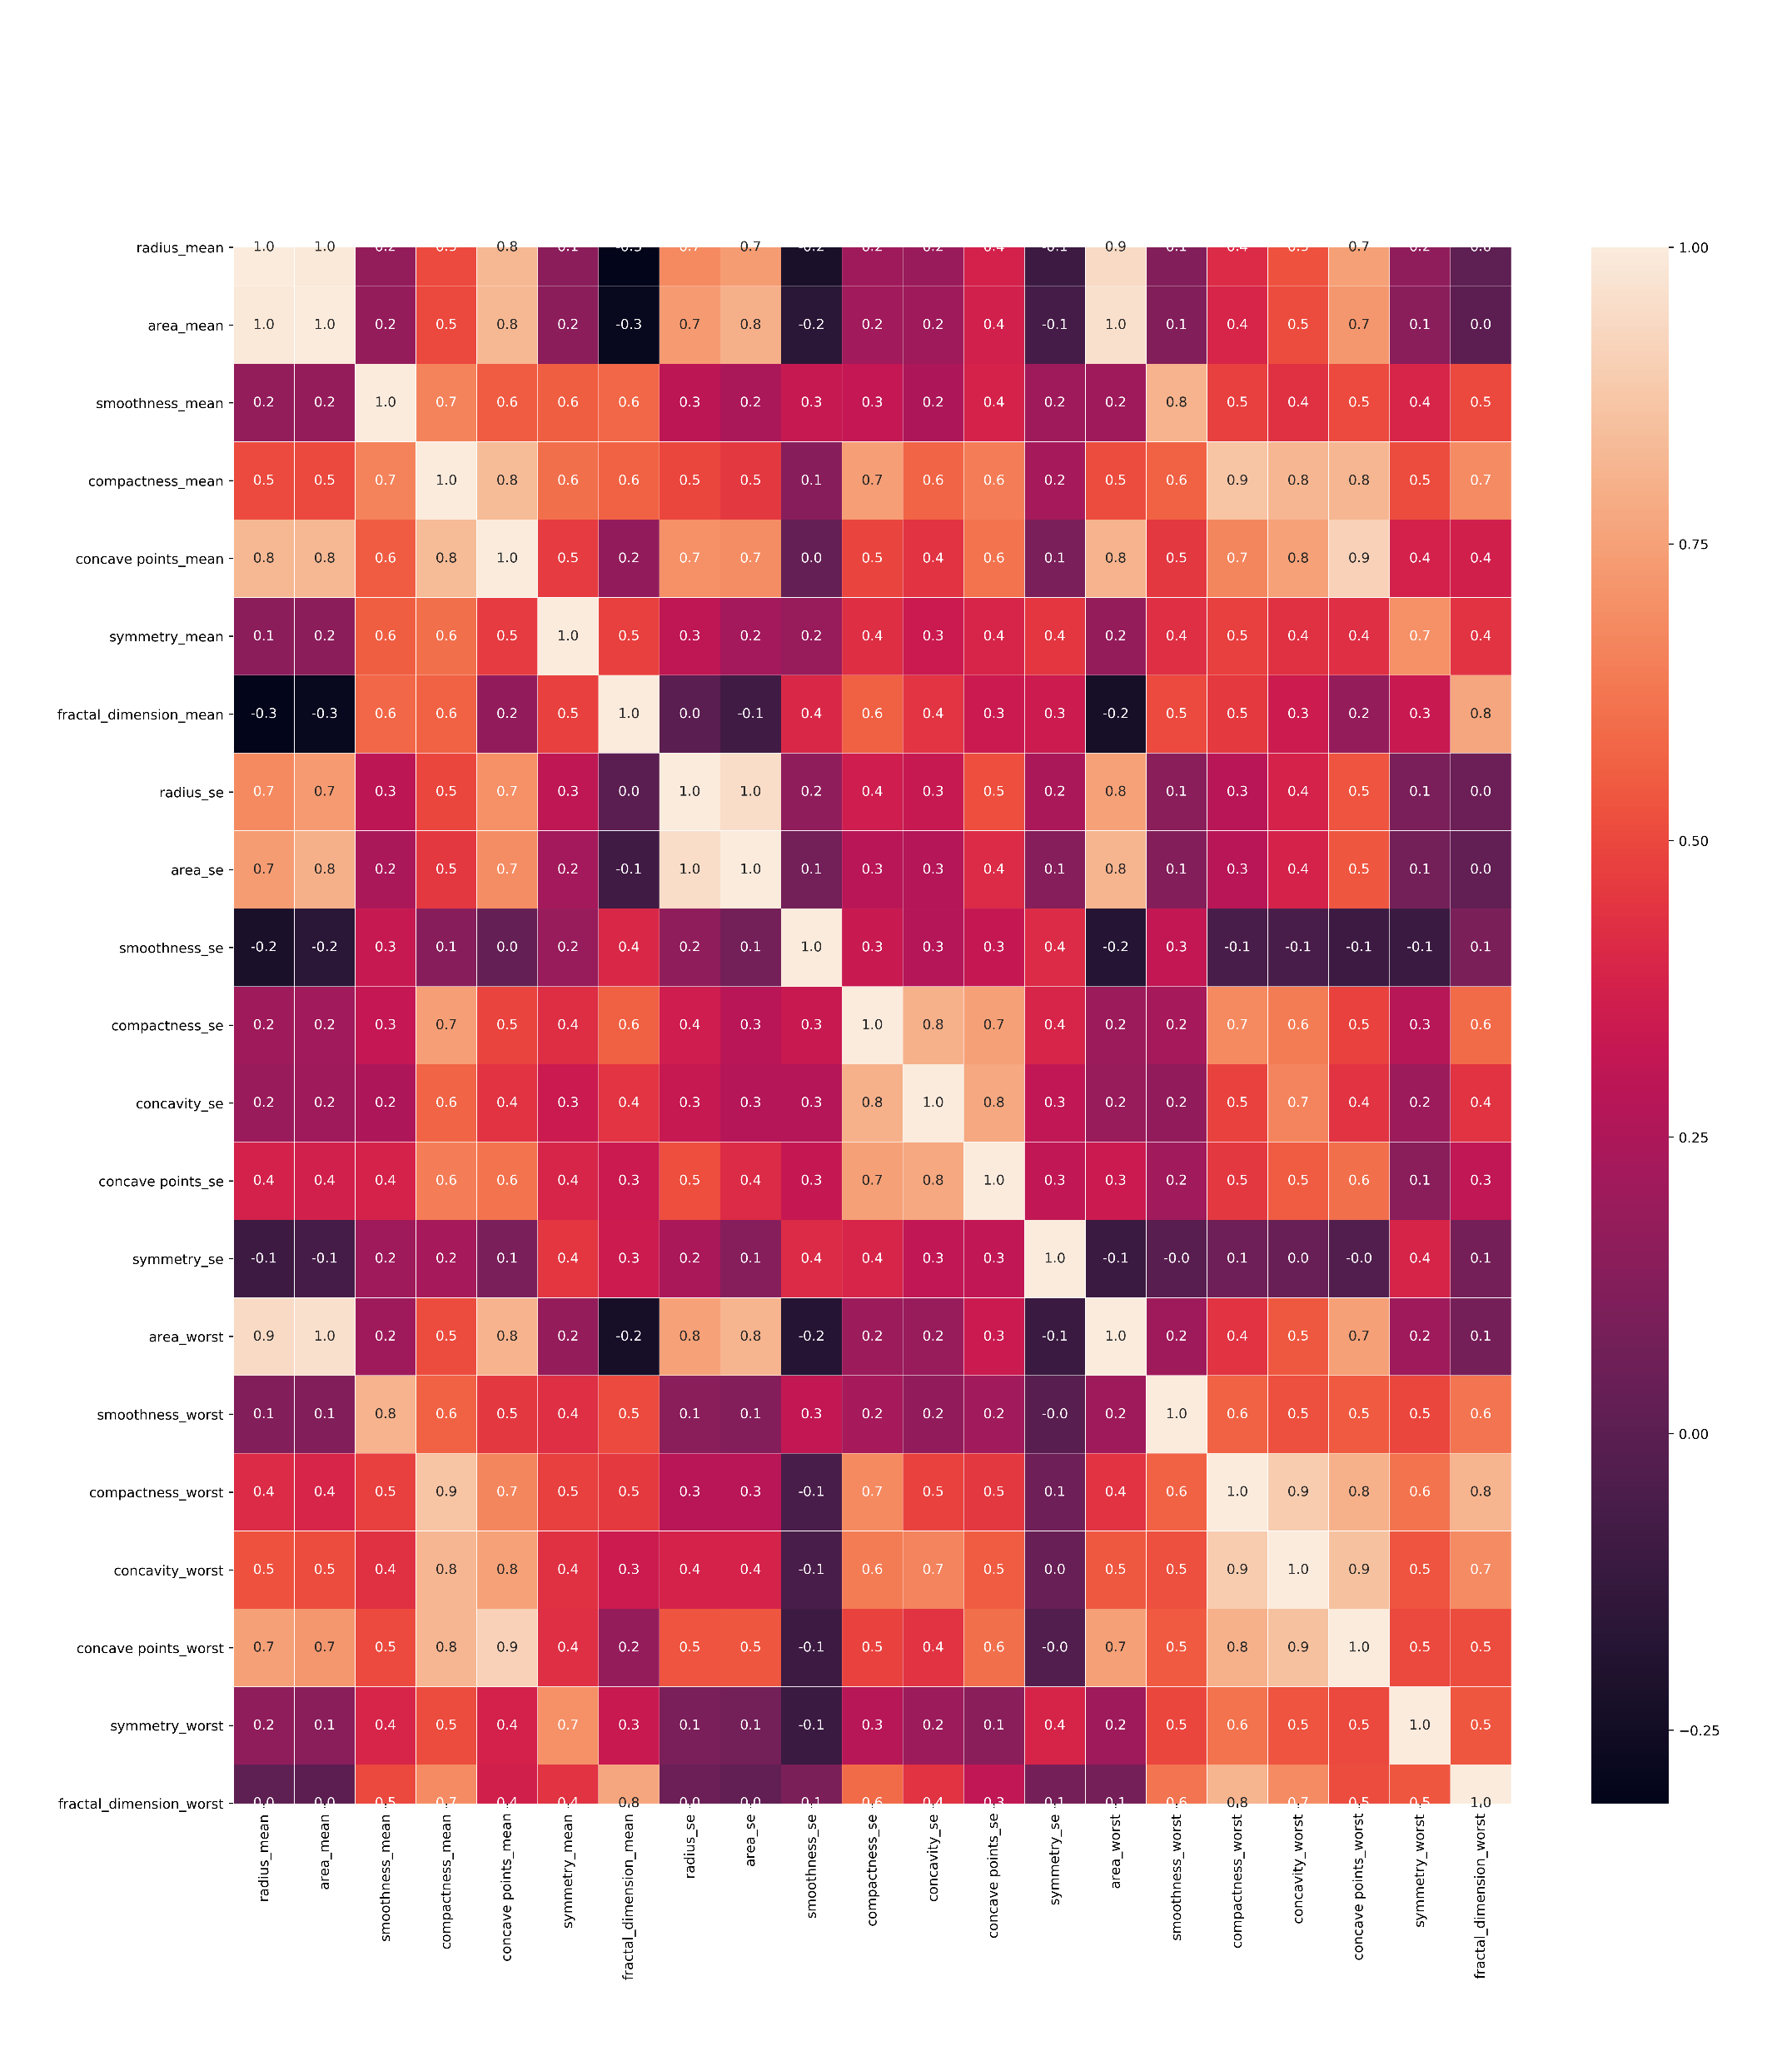
Heatmap 2.0
Used previous correlation map values
Found data with correlation > 0.9
Generated new heatmap containing 21 features

Slide 13
Features
21 / 31 features had at least 90% correlation.
List of Features:
'radius_mean','area_mean','smoothness_mean','compactness_mean','concave points_mean','symmetry_mean','fractal_dimension_mean','radius_se','area_se','smoothness_se','compactness_se','concavity_se','concave points_se','symmetry_se','area_worst','smoothness_worst','compactness_worst','concavity_worst','concave points_worst','symmetry_worst','fractal_dimension_worst’]
Apply Machine Learning methods for features

Slide 14
Decide which Machine Learning Method is best?
Cross-validation allows us to do just this!
Estimate Parameters (Train Data)
Evaluate Method (Test Data)
Average in this case 10 learning experiments with StratifiedKFold
Machine Learning Methods:
Logistic Regression
Support Vector Machines (SVM)
Decision Tree Classifier (DTC)

Slide 15
Machine Learning Methods
SVM allows Bias/Variance Tradeoff
Allows misclassification and is highly biased
Logistic Regression
Similar to Linear Regression
Best used to classify binary data (True / False) or in this case, Malignant or Benign
Decision Tree Classifier
Combines Binary data with numerical data
Uses ranked data to see which features comes to the right conclusion

Slide 17
Findings
Based on 21 features selected from the data set, the best model cross-validated by Stratified KFold is Logistic Regression, followed by Support Vector Machines, and Decision Tree Classifier.
DTC had a 100% accuracy but is most likely due to overfitting which means cross-validating is a must to avoid such problems.

Slide 18
Future
Gather more data to provide stronger and reliable results.
Use different classification models to further support current classification.

