Slide 1

Proseminar Statistical Learning
Wintersemester 21/22
Exploratory Data Analysis

Slide 2

Agenda
Categorical and Quantitative Observations
Summary statistics of Tesla Stock Price
Bar graphs
Histograms
Scatter Plots and Q-Q Plots
Patterns in Scatter Plots
Standardization Crash Course
Probability Plots
Summary and Conclusion

Slide 3
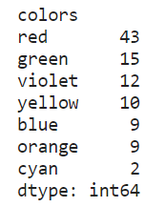
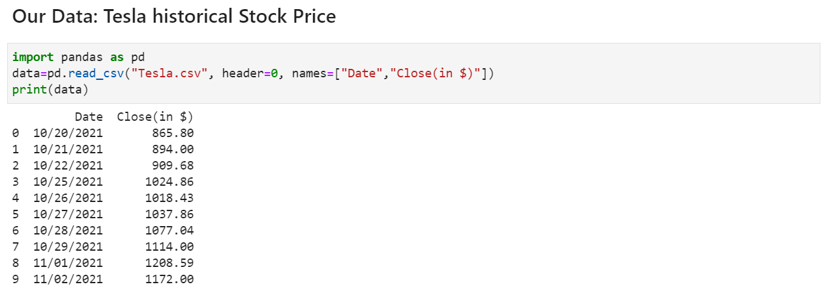

Categorical and Quantitative observations
Categorical observations:
Quantitative observations
Figure 0: ELON-MUSK.jpg (980×504) (elliberal.com)
Source: Tesla, Inc. (TSLA) Stock Historical Prices & Data - Yahoo Finance
Was this stock profitable?
How risky is this stock?
In which stock shoul I invest?

Slide 4
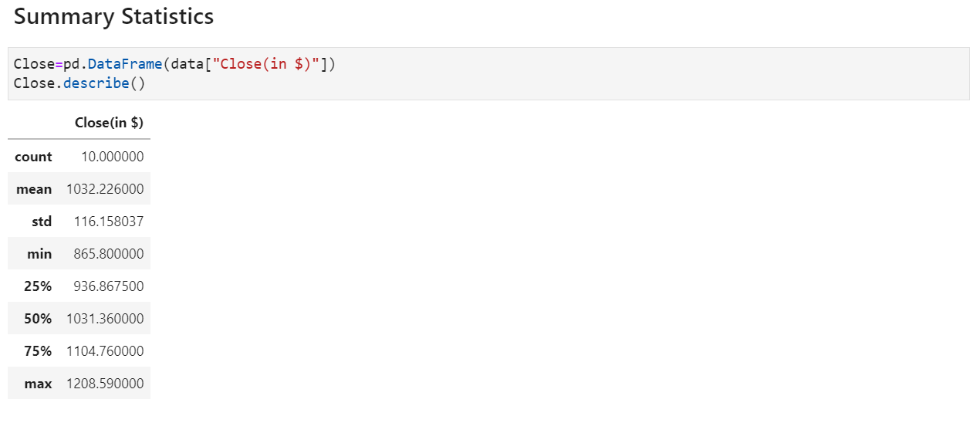
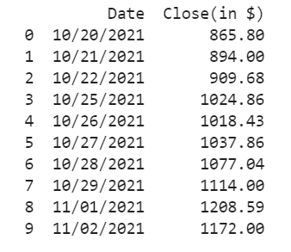
Summary statistics of Tesla Stock Price
1. Count: number of samples
10 samples

Slide 5
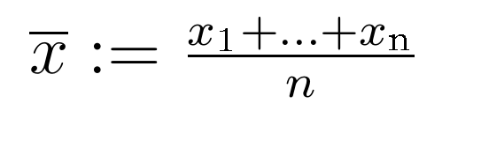
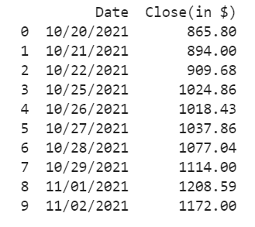

Summary statistics of Tesla Stock Price
2. Mean: ( empirical mean)

Slide 6
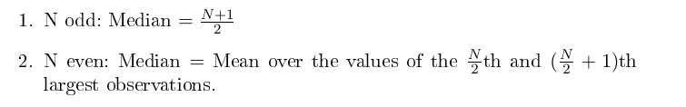
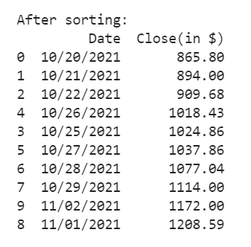
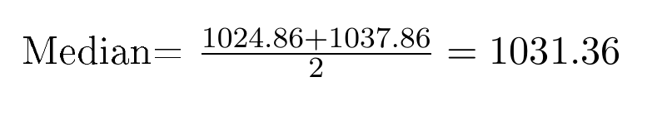
Summary statistics of Tesla Stock Price
3. Quantiles 25%, 50%, 75%
- 50% Quantile: Median
10 is even: Median= Mean over 5th and 6th largest values

Slide 7
Summary statistics of Tesla Stock Price
3. Quantiles 25%, 50%, 75%
50% Quantile: Median
25%, 75% Quantiles
- Various ways to compute Quantiles. The most used algorithms by software packages are called R-6 and R-7 (developed by Hyndman and Fan)
- describe() calculates Quantiles based on the Package NumPy: R-7

Slide 8


Summary statistics of Tesla Stock Price
3. Quantiles 25%, 50%, 75%
50% Quantile: Median
25%, 75% Quantiles
To calculate the p Quantile of a sample of size N, first calculate the real valued index h (R-7)
In R-6:

Slide 9

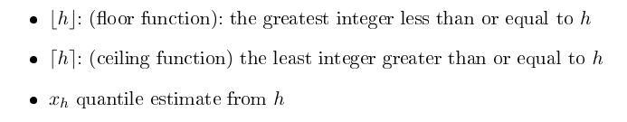
Summary statistics of Tesla Stock Price
3. Quantiles 25%, 50%, 75%
50% Quantile: Median
25%, 75% Quantiles
To calculate the p Quantile of a sample of size N, first calculate the real valued index h
R-7:
R-6:
The p Quantile is given by:

Slide 10
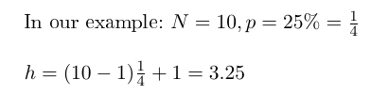
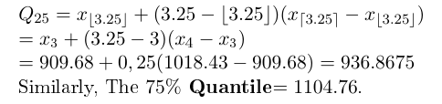
Summary statistics of Tesla Stock Price
3. Quantiles 25%, 50%, 75%
50% Quantile: Median
25%, 75% Quantiles
The 25% Quantile

Slide 11

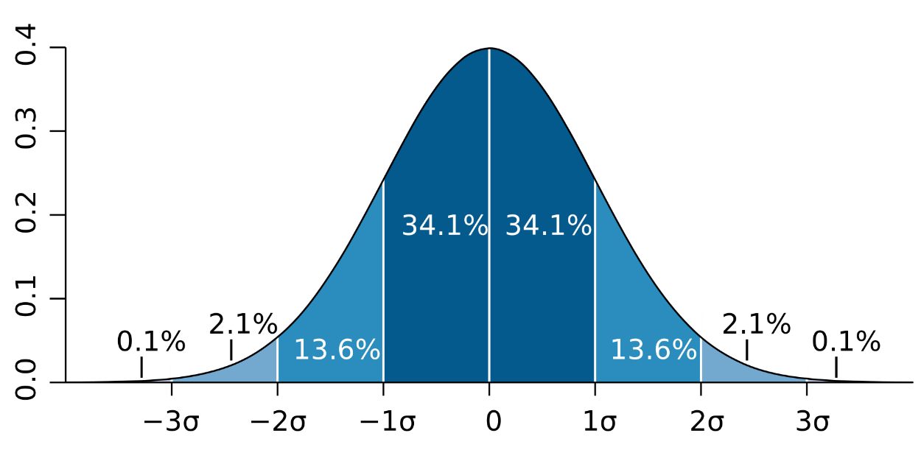

Summary statistics of Tesla Stock Price
4. Standard deviation
Other Notations: (sigma) σ, SD
5. Variance
By M. W. Toews - Own work, based (in concept) on figure by Jeremy Kemp, on 2005-02-09, CC BY 2.5, https://commons.wikimedia.org/w/index.php?curid=1903871

Slide 12
Summary statistics of Tesla Stock Price
6. Min/ Max
Min
Max

Slide 13
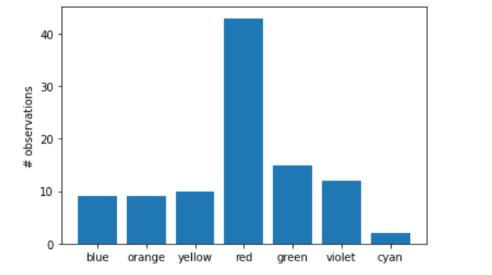
Bar graph
-Bar graphs relate to discrete densities and mainly apply to categorical observations
Figure 1: 2ExploratoryDataAnalysis (ruhr-uni-bochum.de)
- What is the color of the sun?

Slide 14
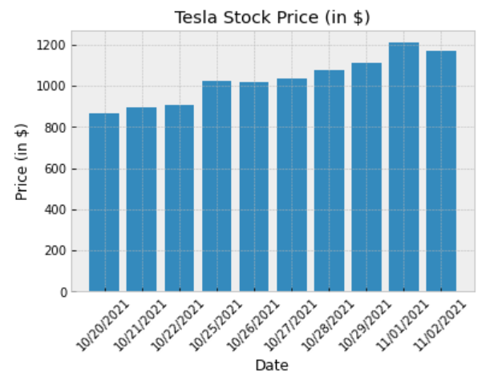
Bar graphs
For quantitative observations:
Was this stock profitable?
How risky is this stock?
In which stock shoul I invest?

Slide 15
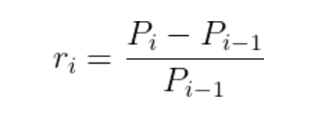
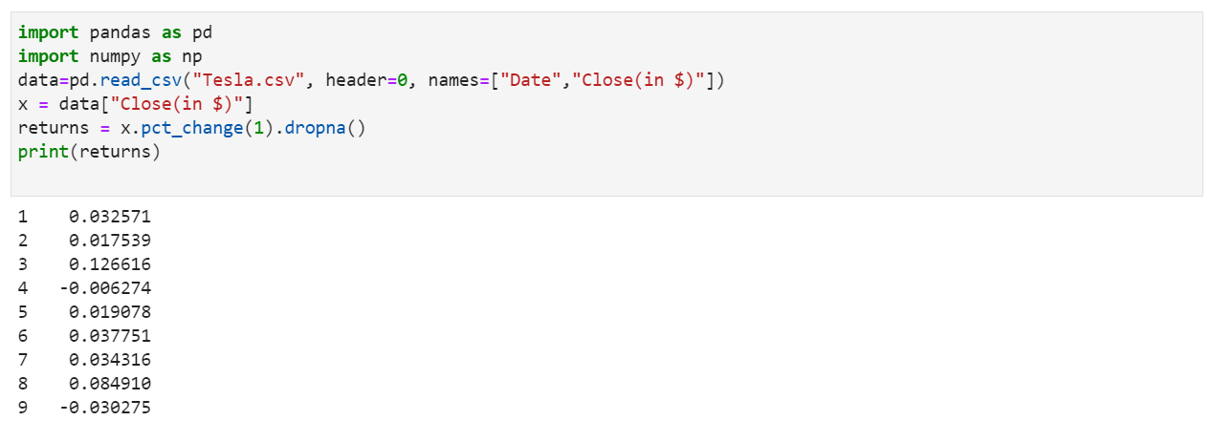
Stock Returns
In analysing a stock price, it does give us a quick idea of how the prices change everyday. However, it is more useful to work with a stock‘s returns
The daily return: the percentage change of the closing price between the two days.

Slide 16
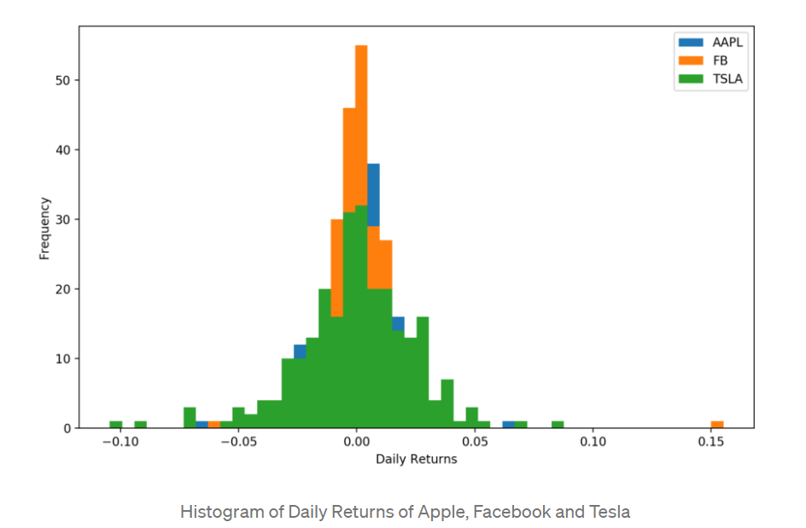
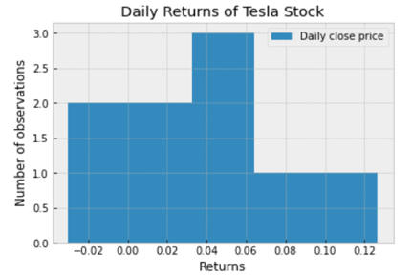
Histogram
Histogram
Period: 01.01.2016-01.01.2017
Figure 2 : Assessing the riskiness of a single stock in Python | by Bernard Brenyah | DS Biz | Medium

Slide 17
What are we missing?
We can:
Use summary statistics to get a ‚first numerical overview‘
Plot bar graphs, to see distribution across categories
Use histograms as a continuous approach
What we can‘t:
Elegantly compare two observations in one plot
Make suggestions regarding the distribution of an observation
Solution: Q-Q plots

Slide 18
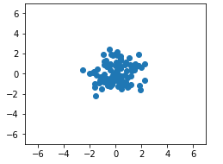
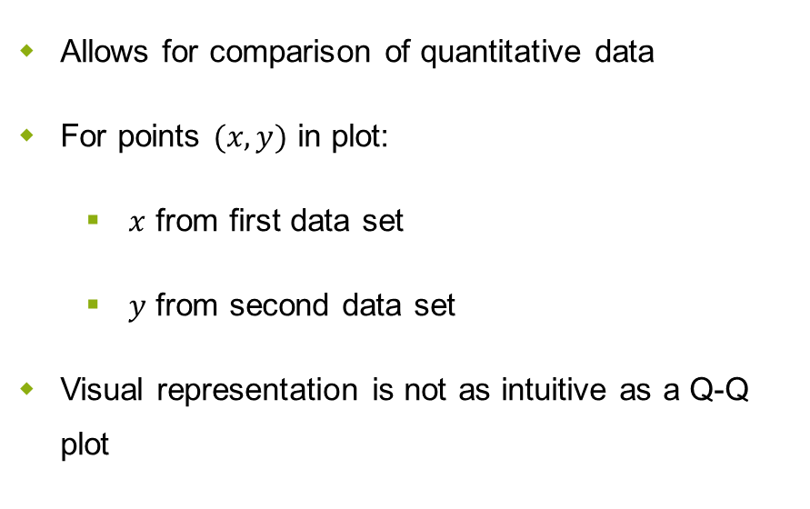
Stepping Stone to Q-Q plots: Scatter Plots
Allows for comparison of quantitative data
For points $(x,y)$ in plot:
$x$ from first data set
$y$ from second data set
Visual representation is not as intuitive as a Q-Q plot

Slide 19
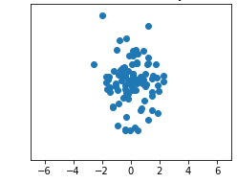
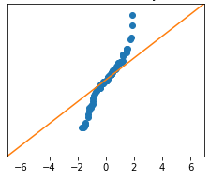

From Scatter to Q-Q Plot
Sort both sets $X,Y$ with $\left|X\right|=\left|Y\right|=n$
Plot analogously to scatter plot

Slide 20
Why Are Q-Q Plots Interesting?
Similar to scatter plots, we want to compare distributions
Scatter plot provided a point cloud, Q-Q plot generates a ‚point worm‘
Scatter plot: evaluate a point cloud with respect to a ‚disc‘
Q-Q plot: evaluate point worm with respect to diagonal line
Similarities and differences easier to spot

Slide 21
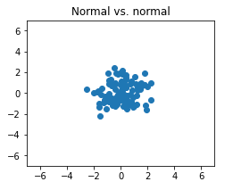
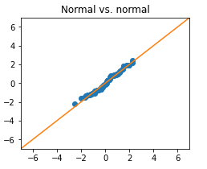
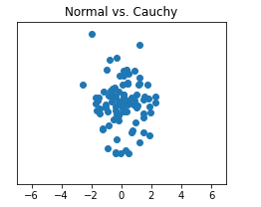
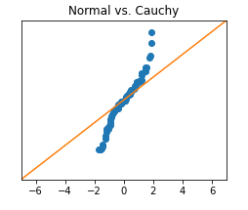
Q-Q Plots Are Easier On The Eyes

Slide 22
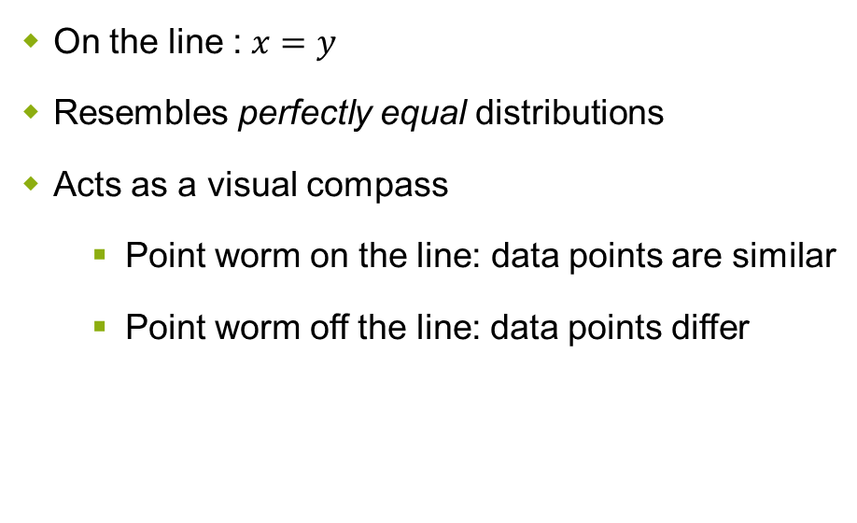
Why is this line so important?
On the line : $x=y$
Resembles perfectly equal distributions
Acts as a visual compass
Point worm on the line: data points are similar
Point worm off the line: data points differ

Slide 23
No Differences Between Observations
Point worm lies almost completely on the diagonal line
Microscopic deviations are consequence of
Minimal errors in original observation
We randomly generated a set that follows a certain theoretical distribution

Slide 24
Patterns in Q-Q Plots
Shifts
Spreads
Effect of standardization
Tails
Outliers

Slide 25
Pattern 1: Shift
Visually: Shifted parallel to diagonal line
Can shift across X- or Y-axis
Indicates: Data sets have different empirical means

Slide 26
Pattern 2: Spread
Visually: Rotation and scaling
Indicates: Standard deviation differs across data sets

Slide 27
Comparing Different Spreads
Parameter “spread“ refers to scaling of values on Y-axis!
Caution: Lower scaling across Y-axis does not equal a larger scaling across X-axis

Slide 28
Shift and Spread Combined
„Worm“ is not parallel to the diagonal line and has different slope!
Is there more to see?
Can we factor out shifts and spreads?

Slide 29
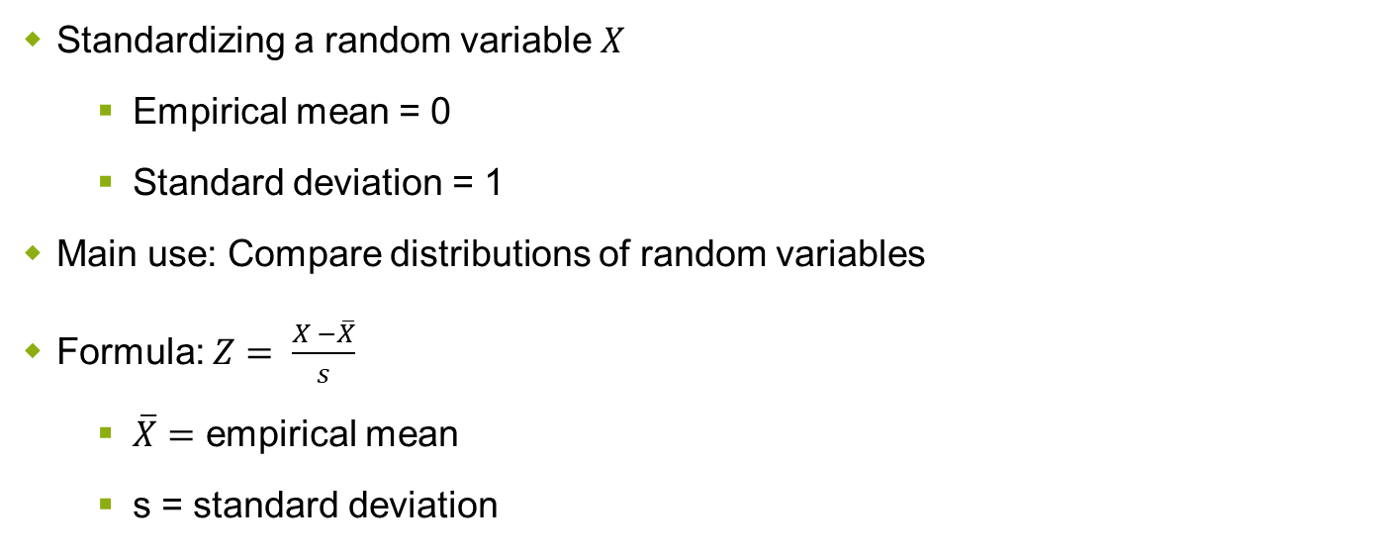
Standardization Crash Course
Standardizing a random variable $X$
Empirical mean = 0
Standard deviation = 1
Main use: Compare distributions of random variables
Formula: $Z= \frac{X −\overline{X}}{s}$
$\overline{X}=$ empirical mean
s = standard deviation

Slide 30

The Effect of Standardization
Empirical mean of both distributions is 0 $→$ No shift
Standard deviation is 1 for both $→$ No spread

Slide 31
Pattern 4: Tail
Previously the tails were masked by the spread
Larger difference for ‚extreme‘ values results in larger deviation at both ends
But, just how much 'should‘ they differ?

Slide 32
Pattern 5: Outliers
There is no axiomatic definition of an outlier!
Classification is highly contextual
Sample size
Representation of the data
What to do with outliers?

Slide 33
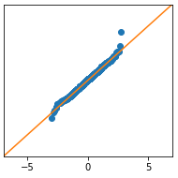
Examplary Classification of Outliers
Ignore
E.g.: One student failed with 1/100 points
Remove
E.g.: Car drove with -10 kmh
Adjust
E.g: Size given in μm not mm (factor of 1000)

Slide 34
Comparing Data to Theoretical Distributions
In Q-Q plots the second observation:
Was randomly generated
Followed a certain theoretical distribution(e.g. normal)
We can reduce ‚noise‘ by using exact values from the given distribution
This results in a probability plot

Slide 35
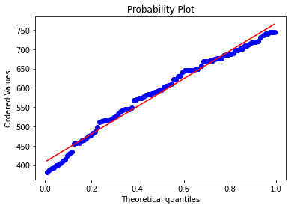
Probability Plots
We now compare to the exact values of the chosen distribution
Numerical values turned into quantiles
Interpretation is equal to Q-Q plots
Red line indicates ‚perfect match‘
Patterns and their interpretation hold
Advantage: Less randomness!

Slide 36
To Summarize
Key values to describe data
Empirical mean, standard deviation, quantiles, min & max, etc.
Bar graphs and histograms to visualize categorical and quantitative data respectively
Q-Q Plots to compare two data sets
Suggest differences and similarities
Patterns and their interpretation (shift, spread, etc.)
Probability plots for a more exact comparison to theoretical distributions

Slide 37
Thanks for listening!
We will upload resources (python files, plots, etc.) to moodle for you all to access
Python file will offer commented methods for easier plotting, to allow you to experiment

