Slide 1


MIPS Microprocessor
(Cache Circuits)‏
  Rhys Bowden, Robert Moric, Joel Stanley, Melanie Tan

Slide 2
Background/Specifications
Co-operate with Harvey Mudd College, California, to design/build MIPS-based microprocessor.
Microprocessor uses R2000 instruction set architecture (ISA), 64 bit instructions

Slide 3
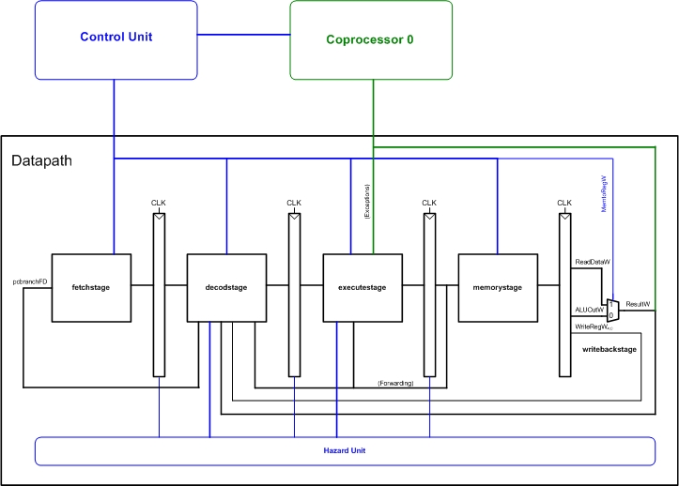
Blocks

Slide 4
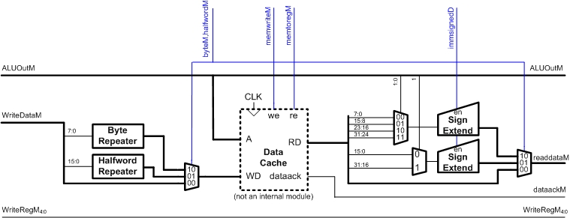
Memory Block
The Adelaide team will cover the caches

Slide 5
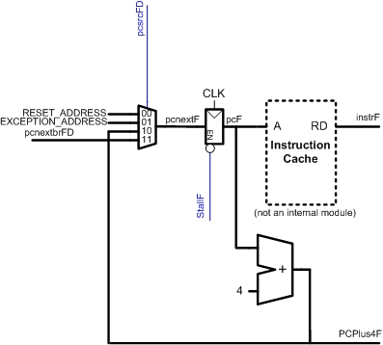
Fetch Block
The Adelaide team will cover the caches

Slide 6
Cache
The caches are direct-mapped write-back.
Direct mapped means each slot in memory can only be put in 1 location in the cache
Consequently no replacement algorithm is required.
Data is only written back to memory when it is over-written in the cache.

Slide 7
Motivation
International collaberation
Template for future students
Marketing tool
Unique opportunity
  scale
  collaberation
  budget

Slide 8
Software Testing
Rob Use pre-existing test tools – Synopsis, Cadence.
Alternatively, create a test-deck by:
Joel Parse .vcd files.
Mel Annotate Verilog with trace writes.
Rhys Use Programming Language Interface to call other software from within Verilog.

Slide 9
Cache Block
Data In/Out
Cache Controller
Data Mux’ing
Cache RAM
Mem Sys Control Signals
Additional Logic
Cache Output Signals

Slide 10
Cache Controller
Address Tag Data Logic
Bypass
Mem Sys Control Signals
Done
Controller State Logic
Other Logic
Waiting
Reading

Slide 11
Cache RAM
Cache RAM Array
Decoder64
Cache Signal Buffers
Bitline Conditioning
SRAM Array
Address Lines Ph1 & Ph2
Data IN/OUT
RAM Array Signals
Write Driver

Slide 12
Design Flow
Start
Understand interface, and logical operation
of all modules in Verilog. Familiarity with ModelSim
Become familiar with using other software
packages such as SPICE, Cadence, Snoop Gen,
other viable software that is available
Failed
Build Schematics using RTL descriptions in
Verilog code. Schematics built using Electric
Generate IRSIM and SPICE testbenches for
temporal analysis of schematics. Or use other
software packages or alternative methodology
Verify Schematics using Verilog testbenches in
ModelSim or IRSIM stimuli in Electric
Conduct temporal testing of schematics using
generated test benches to identify critical paths
Passed
Using Schematics and floorplanning diagrams,
Build the Layouts of modules using Electric
Redesign critical sections
and retest schematics
Failed
Failed
Passed
Verify Layouts using DRC, NCC, ERC
Verilog testbenches in ModelSim or
IRSIM stimuli within Electric
Change Layouts of redesigned schematics
Passed

Slide 13
Workflow
Low power
design research/
implementation
Testing of FPGA
peripherals
Compile software
for MIPS uP
Packaging design
Evaluate low power
design using
simulation tools
Testing of uP on
PCB
Prepare software
for presentation
Packaging
implementation

Slide 14
Low Power Design
Focus most significant source of power consumption.
Dynamic Power Dissipation.
Inactivate Unused Blocks.
Improving defined architecture of the MIPS microprocessor.
Same functionality with less processing.
Implemented and Evaluated.

Slide 15
Workflow
Low power
design research/
implementation
Testing of FPGA
peripherals
Compile software
for MIPS uP
Packaging design
Evaluate low power
design using
simulation tools
Testing of uP on
PCB
Prepare software
for presentation
Packaging
implementation

Slide 16
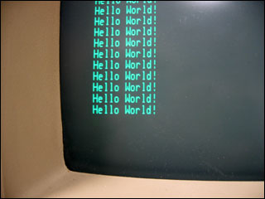
Demonstration
Port of GNU toolchain – binutils, gcc, libc
Enables port of GNU/Linux
Webserver over RS-232 console

Slide 17
Workflow
Low power
design research/
implementation
Testing of FPGA
peripherals
Compile software
for MIPS uP
Packaging design
Evaluate low power
design using
simulation tools
Testing of uP on
PCB
Prepare software
for presentation
Packaging
implementation

Slide 18
Risk Analysis
Risk
Chance
Impact
Rating
1. Project falls behind schedule
moderate
moderate
moderate
2. Communication Failure
low
high
moderate
3. Design and software bugs
moderate
moderate
moderate
4. Faulty hardware parts
low
moderate
low
5. Unavailability of resources
moderate
low
low
6. Absence of team members
low
low
low
7. Change of supervisor
high
low
moderate
8. Changing requirements
moderate
low
low
9. Fabrication grant is not awarded
low
high
moderate

Slide 19
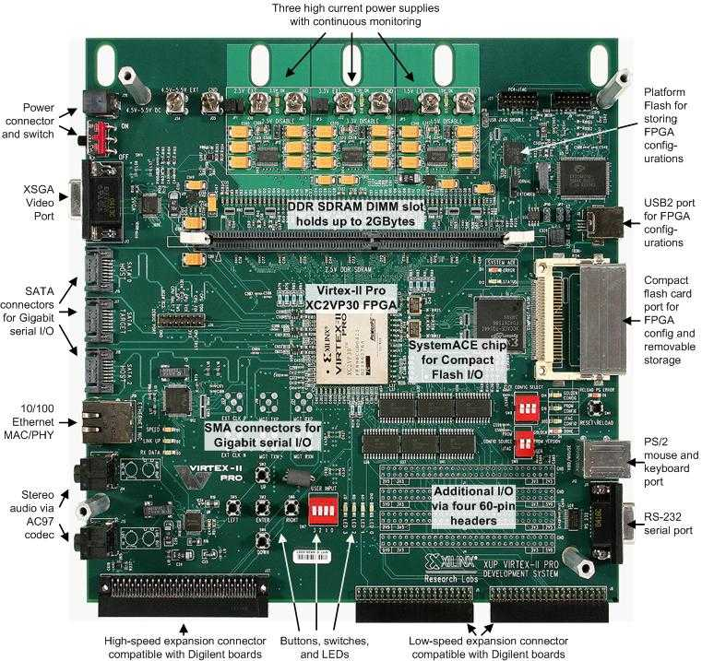
Budget
$250 per member
$1000 team budget
Xilinx Virtex II FPGA
Housing

Slide 20
Questions + Comments

