Slide 1
MIPS Microprocessor
(Cache Circuits)‏
Rhys Bowden, Robert Moric, Joel Stanley, Melanie Tan

Slide 2
Background/Specifications
Co-operate with Harvey Mudd College, California, to design/build MIPS-based microprocessor.
Microprocessor uses R2000 instruction set architecture (ISA), 32 bit instructions

Slide 3
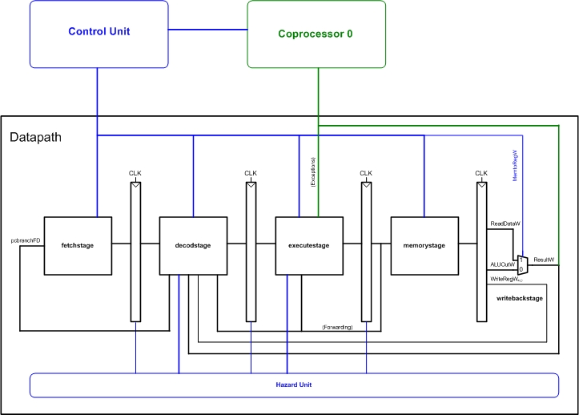
Blocks

Slide 4
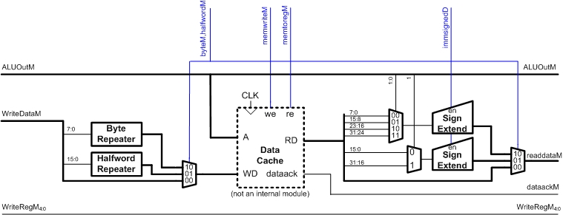
Memory Block
The Adelaide team will cover the caches

Slide 5
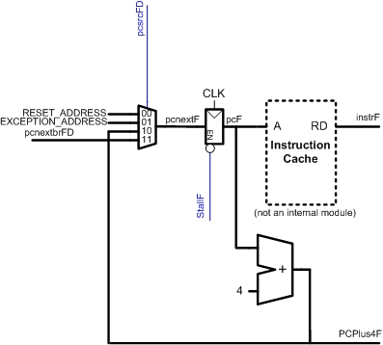
Fetch Block
The Adelaide team will cover the caches

Slide 6
Cache
The caches are direct-mapped write-back.
Direct mapped means each slot in memory can only be put in 1 location in the cache
Consequently no replacement algorithm is required.
Data is only written back to memory when it is over-written in the cache.

Slide 7
Software Testing
Rob Use pre-existing test tools – Synopsis, Cadence.
Alternatively, create a test-deck by:
Joel Parse .vcd files.
Mel Annotate Verilog with trace writes.
Rhys Use Programming Language Interface to call other functions from Verilog.

Slide 8

Motivation
International collaberation
Establish software tools for future
Marketing tool
Unique opportunity
  scale
  collaberation
  budget

Slide 9
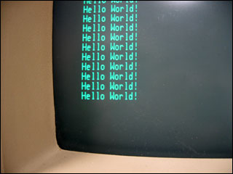
Demonstration
Port of GNU toolchain – binutils, gcc, libc
Enables port of GNU/Linux
???
Profit!

Slide 10
Risk Analysis
Risk
Chance
Impact
Rating
1. Project falls behind schedule
moderate
moderate
moderate
2. Communication Failure
low
high
moderate
3. Design and software bugs
moderate
moderate
moderate
4. Faulty hardware parts
low
moderate
low
5. Unavailability of resources
moderate
low
low
6. Absence of team members
low
low
low
7. Change of supervisor
high
low
moderate
8. Changing requirements
moderate
low
low
9. Fabrication grant is not awarded
low
high
moderate

Slide 11
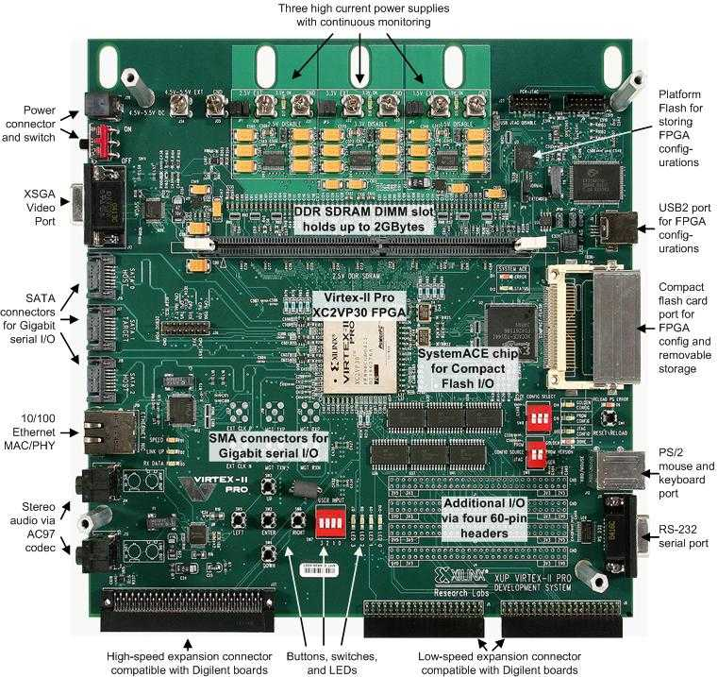
Budget
$250 per member
$1000 team budget
Xilinx Virtex II FPGA
Housing

