Slide 1
ML Assignment
Numpy Ninja Team 7

Slide 2
Outliers
Data points significantly differ from the rest of the dataset
Can appear due to experimental errors, Sampling errors or Natural outliers
Few examples:
In a dataset of regular health readings, a sudden unusual spike in heart rate or a drop in blood pressure might be a novelty outlier. These could indicate a medical condition that was not previously diagnosed or monitored.
When measuring the temperature of a city over a month, most readings fall between 80°F and 90°C. However, one reading spikes to 110°F due to a temporary heatwave, making it an outlier.
In a survey about lifestyle habits, most respondents report drinking between 1 to 3 liters of water daily. One respondent reports drinking 50 liters. This could be a data entry ( 5->50) error or a misunderstanding of the question.
Can negatively affect the statistical analysis and the training process of a machine learning algorithm resulting in lower accuracy.

Slide 3
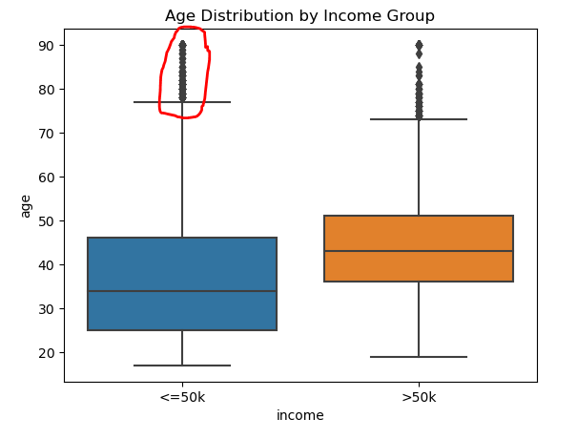
Outlier Detection : Visualization Methods
Visualization Methods
Box plots
Effectively visualize the distribution of data and highlight outliers.
Scatter plots
Help identify outliers in two-dimensional data.

Slide 4
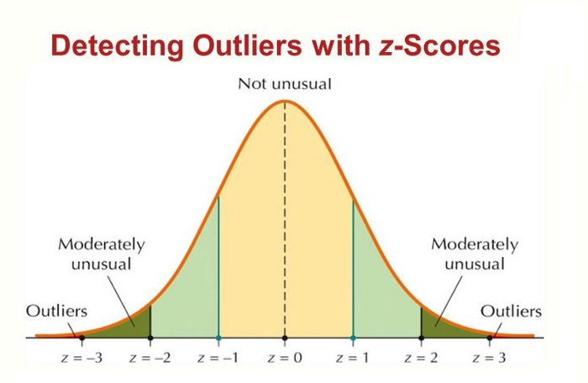
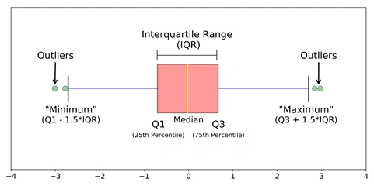
Outlier Detection : Statistical Methods
Statistical Methods
Z-score
Any data point whose Z-score falls out of 3rd standard deviation are considered outlier.
IQR (Interquartile Range)
Calculates the range between the first and third quartiles (Q1 and Q3). Data points outside 1.5 times the IQR below Q1 or above Q3 are considered outliers.

Slide 5
Outlier Treatment Techniques
Removal
Remove outliers from the dataset. This is a simple approach but can lead to loss of information if outliers are important.
Imputation
Replace outliers with more reasonable values, such as the mean, median, or a value based on a statistical model. As the mean value is highly influenced by the outlier treatment, it is advised to replace the outliers with the median value.
Quantile Based Flooring and Capping
Cap outliers to a certain threshold, such as the 95th or 99th percentile or floored at a factor below the 10th percentile value.
Transformation
Apply a transformation (e.g., log transformation) to the data to reduce the impact of outliers.

Slide 6
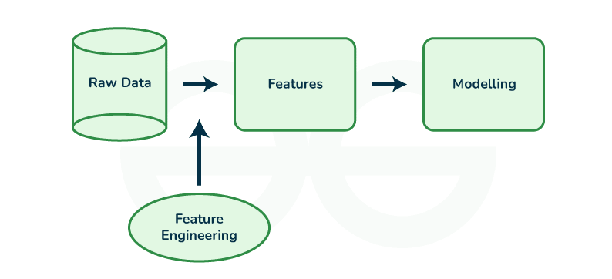
Feature Engineering
Process of creating new features or transforming existing features to improve the performance of a machine-learning model.
Involves selecting relevant information from raw data and transforming it into a format that can be easily understood by a model.
Improves model accuracy by providing more meaningful and relevant information.

Slide 7
Feature Engineering Process
Feature Creation
Process of generating new features based on domain knowledge or by observing patterns in the data.
Feature Transformation
Process of transforming the features into a more suitable representation for the machine learning model.
Feature Extraction
Process of creating new features from existing ones to provide more relevant information to the machine learning model.
Feature Selection
Process of selecting a subset of relevant features from the dataset to be used in a machine-learning model.
Feature Scaling
Process of transforming the features so that they have a similar scale.

Slide 8
Feature Engineering Techniques
Encoding
Used to transform categorical variables into numerical values.
Binning
Transform continuous variables into categorical variables
Scaling
Two techniques : Standardization and normalization
Standardization scales the variable so that it has zero mean and unit variance.
Normalization scales the variable so that it has a range of values between 0 and 1.
Feature Split
Divide single features into multiple sub-features or groups based on specific criteria.
Text Data Preprocessing
Removes stop words, stemming, and vectorization.

Slide 9
Encoding
One-Hot Encoding
Converts each category into a new binary column, with a value of 1 indicating the presence of the category and 0 indicating absence.
Label Encoding
Assigns a unique integer (label) to each category. Suitable for nominal data where categories have no inherent order (e.g., "red", "green", "blue").
Ordinal Encoding
Similar to Label Encoding but the categories are explicitly ordered based on their importance or ranking (e.g., “Low”, “Medium”, “High”).

Slide 10
Features and applied Encoding
Data Column | Feature/Target | Type | Encoding
age | Feature | Integer
workclass | Feature | Categorical | Label Encoding
fnlwgt | Feature | Integer
education | Feature | Categorical | No Encoding needed as education-num is available.
education-num | Feature | Integer
marital-status | Feature | Categorical | Label Encoding
occupation | Feature | Categorical | Label Encoding
relationship | Feature | Categorical | Label Encoding
race | Feature | Categorical | Label Encoding
sex | Feature | Binary | One-Hot Encoding
capital-gain | Feature | Integer
capital-loss | Feature | Integer
hours-per-week | Feature | Integer
native-country | Feature | Categorical | Label Encoding
income | Target | Binary
Encode ‘workclass’ using label encoding which adds a new feature ‘workclass_labeled’ and used instead of ‘workclass’ feature.
Encode ‘sex’ using one-hot encoding which adds two new features ‘sex_female’ and ‘sex_male’ and used instead of ‘sex’ feature.

