Slide 1

Computational Thinking
Computational thinking is a problem-solving methodology that involves breaking down complex problems into manageable parts and developing step-by-step solutions that a computer (or human) can follow. It is not about programming, but rather about thinking logically and systematically.
Computational thinking is a mindset for solving problems efficiently, using the same techniques that computer scientists use, but it can be applied beyond computers in real-world scenarios too.

Slide 2
Why is it useful?
Helps in developing logical and analytical thinking.
Forms the foundation for computer science and programming.
Useful in everyday life and any subject where problem-solving is needed.

Slide 3
Key Elements of Computational Thinking
Decomposition – Breaking a problem into smaller pieces.
Pattern Recognition – Finding similarities and trends.
Abstraction – Focusing on important details and ignoring the rest.
Algorithm Design – Creating a step-by-step solution.

Slide 4
Decomposition
Break a big problem into smaller parts.
Helps make a hard problem easier to solve.
Each small part is easier to understand and fix.
Like solving a puzzle one piece at a time.

Slide 5
Pattern Matching
Find things that are the same or similar.
Look for patterns or things that repeat.
Helps us know what will happen next or what to expect.
Useful in learning, solving math problems, or understanding stories.

Slide 6
Abstraction
Focus on the important stuff and ignore the rest.
Helps make one solution work for many problems.
You don’t need to think about every little detail.
Like using a map to find your way without needing every streetlight shown.

Slide 7
Algorithm
A set of steps to solve a problem.
Like a recipe you follow to cook something.
You do each step in order to reach the answer. [SEQUENCE]
If followed correctly, you’ll get the same result every time.

Slide 8
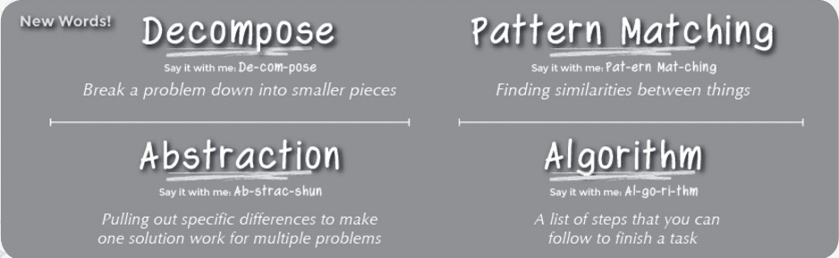
Computational Thinking

Slide 9
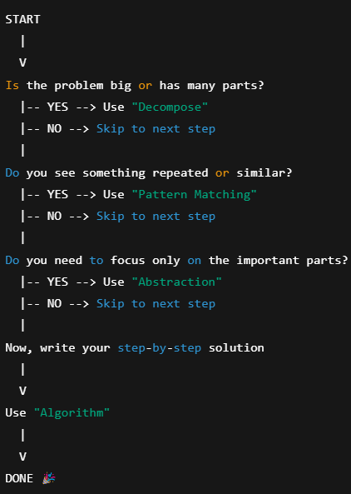
Computational Thinking Is Flexible

Slide 10
Problem
Find the sum: 1 + 2 + 3 + ... + 100
(using Computational Thinking: Decompose → Pattern Matching → Abstraction → Algorithm).

Slide 11
Decompose
Break the problem into smaller parts:
Understand what this sum means.
You are adding numbers from 1 to 100.
If you try adding one-by-one, it’s a long task.

Slide 12
Pattern Matching
Spot something repeatable:
Each number increases by 1.
Try pairing numbers:
1 + 100 = 101
2 + 99 = 101
3 + 98 = 101
…
You start noticing a pattern in the pairs.

Slide 13
Abstraction
Focus on what matters, generalize the idea:
You are making pairs of numbers: first + last, second + second last, etc.
Each pair adds up to 101
How many such pairs?
From 1 to 100 = 100 numbers → 50 pairs
✨ So you’ve just invented the formula: Sum = 50 pairs × 101 = 5050
(first term + last term) X number of terms/2

Slide 14
Algorithm
Step-by-step Instructions:
Set start = 1, end = 100
Pair the numbers from start to end:
Pair 1: 1 + 100 = 101
Pair 2: 2 + 99 = 101
…
Count how many such pairs: 100 ÷ 2 = 50
Multiply: 50 × 101 = 5050

Slide 15
Problems
2 + 4 + 6 + ... + 100
5 + 10 + 15 + ... + 100
1 + 3 + 5 + … + 99

Slide 16
Arithmetic Problem
We need to calculate the total number of days from the start of the year 2004 to the end of the year 2010.

Slide 17
Arithmetic Problem
using Computational Thinking, which includes four main steps: Decompose, Pattern Matching, Abstraction, and Algorithm.

Slide 18
Decompose
Break the big problem into smaller steps:
Step 1: Understand what “start of 2004 to end of 2010” means.
Step 2: Count how many years we are talking about.
Step 3: Figure out how many days are in each of those years.

Slide 19
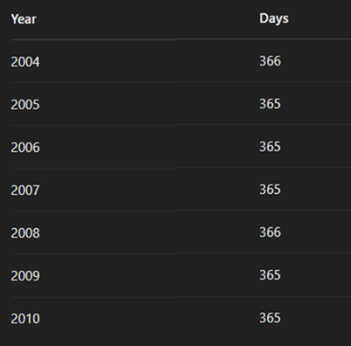
Let's Try It with the Years

Slide 20
Pattern Matching
Look for things that are the same:
Every regular year has 365 days.
Every leap year has 366 days.
Leap years follow a pattern: they happen every 4 years.

Slide 21
Leap Year Rule
If the year is divisible by 4 and not divisible by 100, it is a leap year.
Example: 2004 ➝ Divisible by 4 ✅, not divisible by 100 ✅ → Leap year
If the year is divisible by 100 and also divisible by 400, it is a leap year.
Example: 2000 ➝ Divisible by 100 ✅ and divisible by 400 ✅ → Leap year

Slide 22
Pattern Matching
👉 From 2004 to 2010, the leap years are:
2004, 2008 — These have 366 days.
The rest (2005, 2006, 2007, 2009, 2010) are regular years — 365 days.

Slide 23
Abstraction – ❌ NO (optional)
We don’t need to focus on months or holidays — just days per year. But this is optional, not essential here.
➡️ Can skip this step, since the details aren’t too complex.

Slide 24
Algorithm
Write the steps clearly to get the answer:
Step-by-step Instructions:
Start from year 2004 and go up to year 2010.
For each year, check: [LOOP]
Is it a leap year? (If yes, add 366 days)
If not, add 365 days. [SELECTION]
Add all the days together.

Slide 25
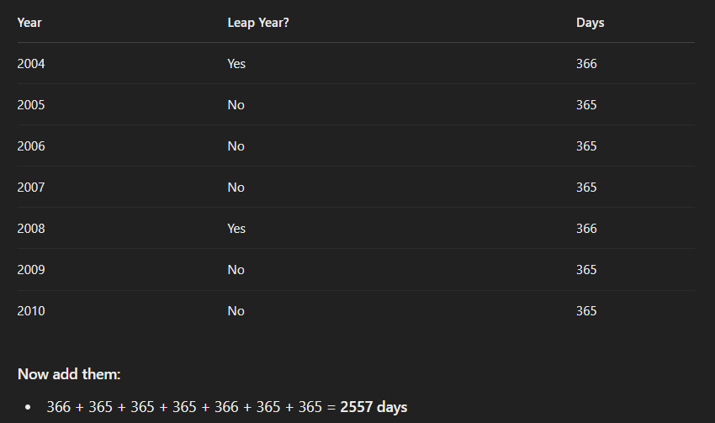
Let's Try It with the Years

Slide 26
Step-by-Step Instructions
Start with a total_days = 0.
Go through each year from 2004 to 2010 (including both).
For each year:
Check if it is a leap year.
If yes, add 366 to total_days.
If not, add 365 to total_days.
After all years are checked, print the total_days.

Slide 27
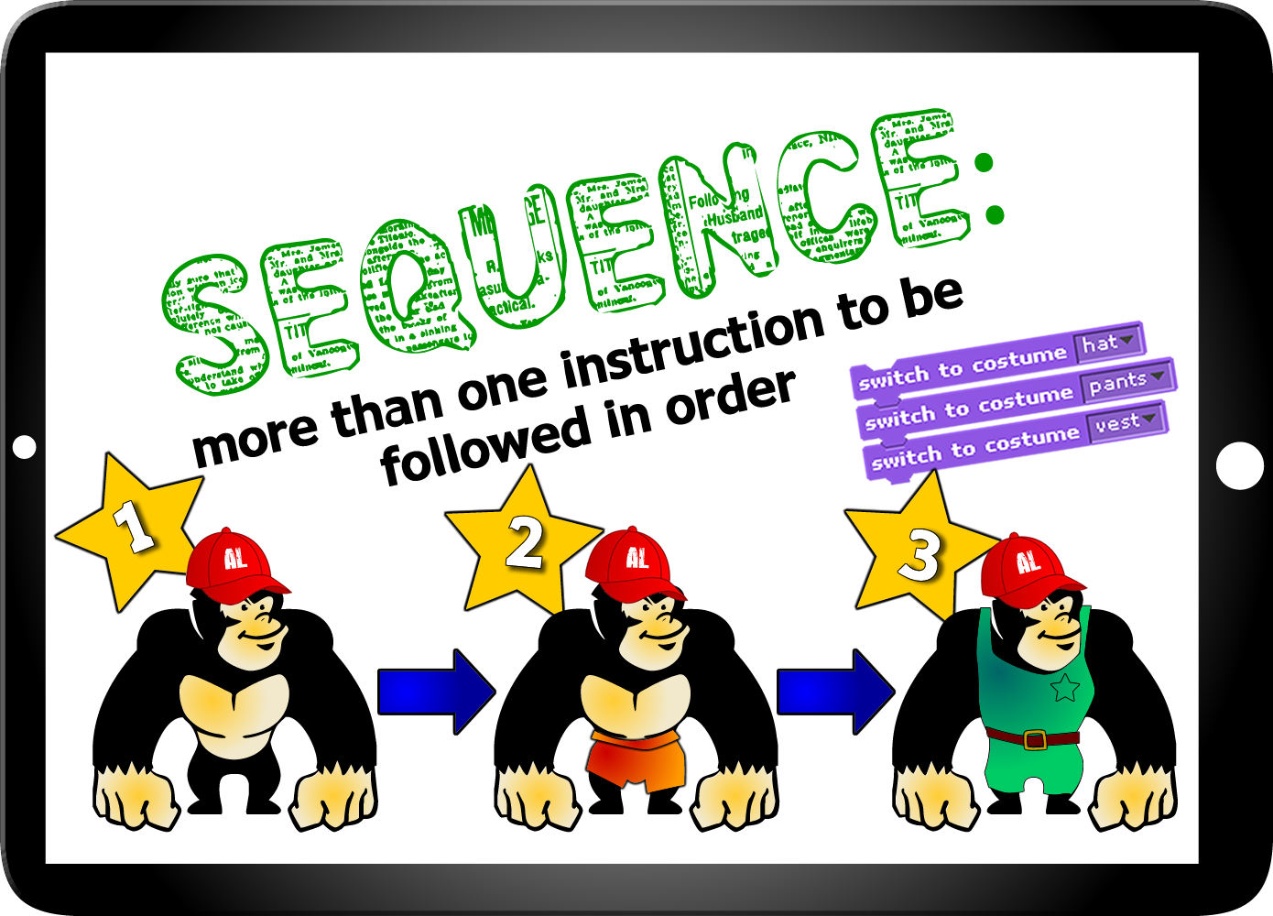
Sequence

Slide 28

Selection

Slide 29
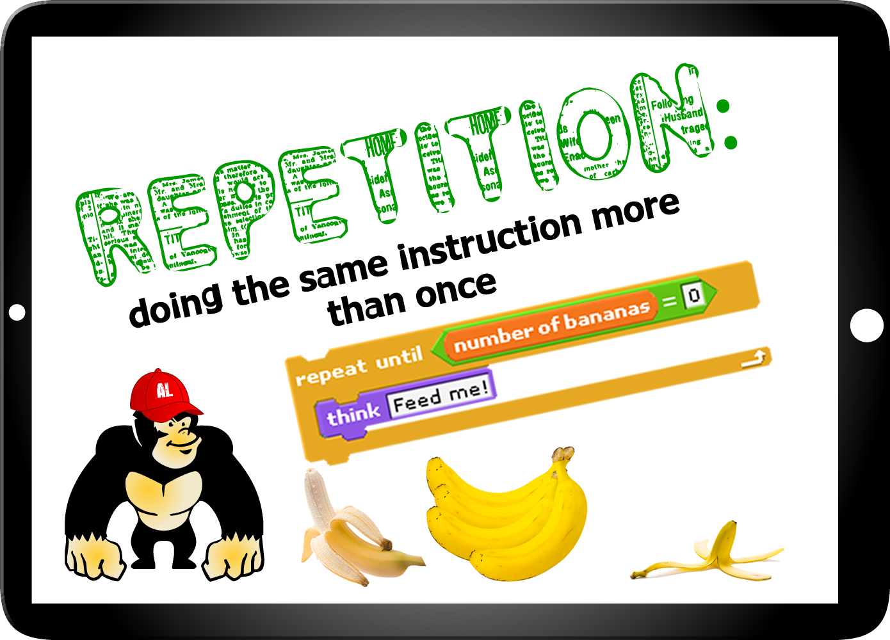
Iteration/Repeat/Loop

Slide 30
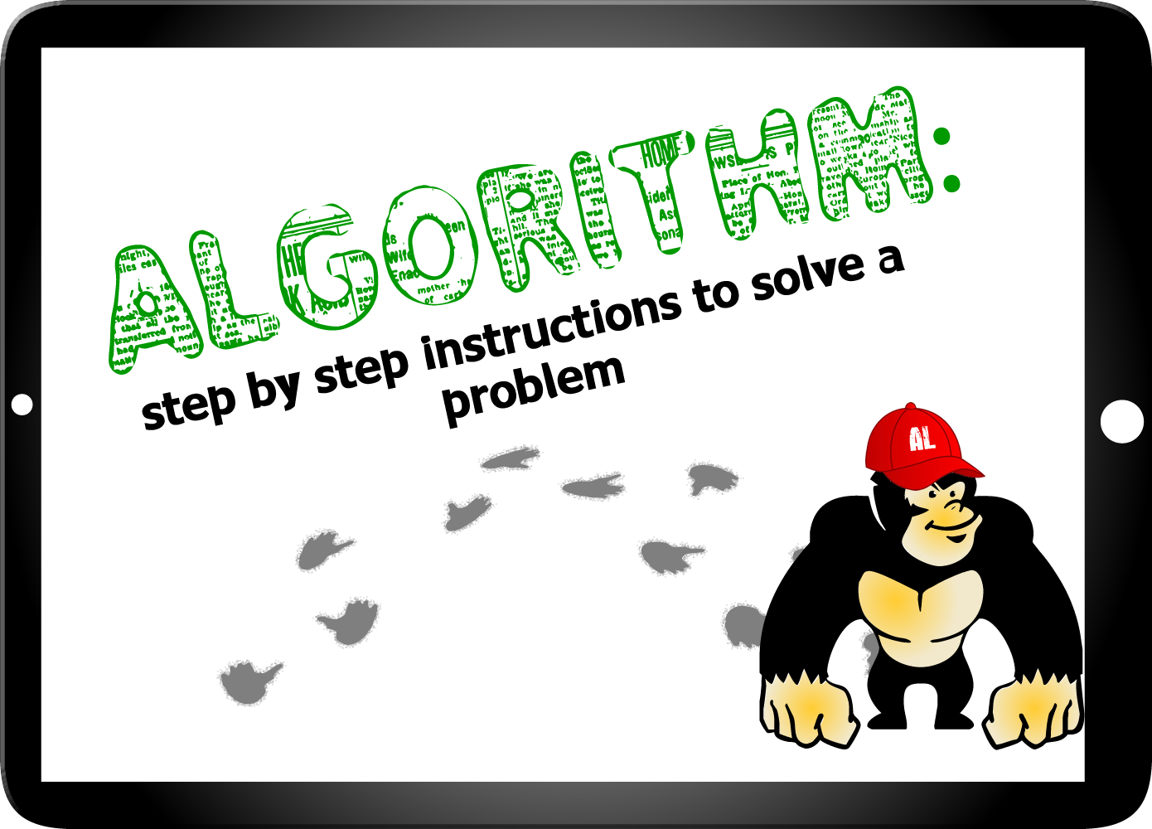
Algorithm

Slide 31
Basic Operations
There are three basic operations
Sequence
Selection
Iteration/Repetition/Loop

