Slide 1

STUDY AND ANALYSES OF TRANSPORTATION POLLUTION ACROSS THE US
ABILASH SIVAKUMAR
MURALEEDHARAN RAJAGOPLAN
SATHYA PRAKASH
IE6200 SEC 06 - ENG. PROBABLITY & STATISTICS (BATCH-14)

Slide 2
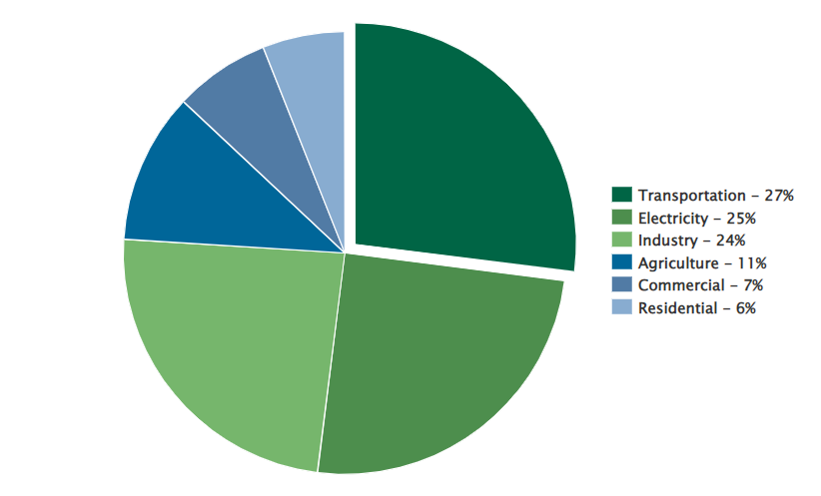
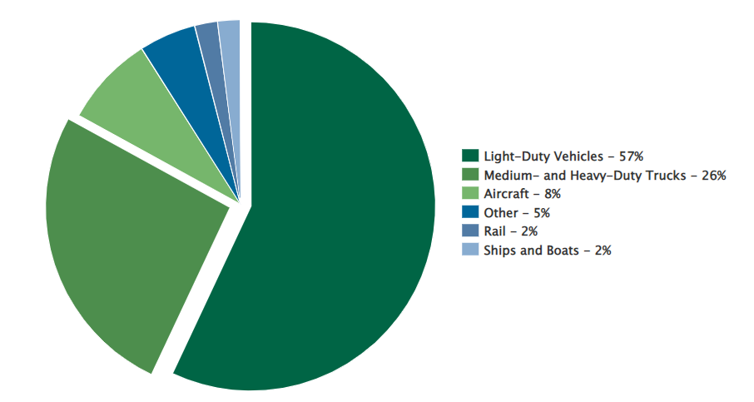
INTRODUCTION:
Pollution is taken as a main objective because it is the common problem for all not limited to human beings but to entire planet.
To monitor and control pollution, the US government is spending 1000 billion Dollars/annum in average. And the country’s ultimate agenda is to reduce carbon emissions.
Considering only Transport pollution(27%), since it is the largest contributor among others.
U.S. Emissions by Sector
U.S. Transportation Sector Emissions by Source

Slide 3





Data-Description:
Data of 5 different categories of US states for the years 2018, 2019, 2020.
Pollution data: Among transportation pollution only light-duty vehicles and medium and heavy-duty trucks are considered for its major contributors.
Transportation data: Both Private and Public Vehicle registrations are considered.
Population: From the total population, only people above the age of 18 are filtered, since they are officially eligible to buy/register/drive a vehicle.
Land Area: Total land area in Square Kilometres is taken into consideration for this analysis.
Per Capita Income: The Per Capita Income of each state is collected from the US Economic data.

Slide 4
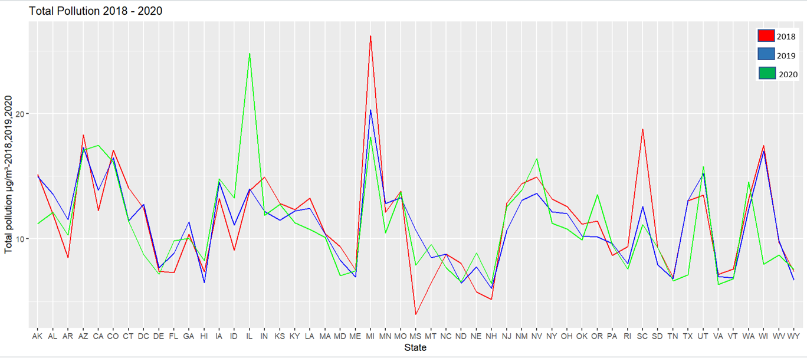
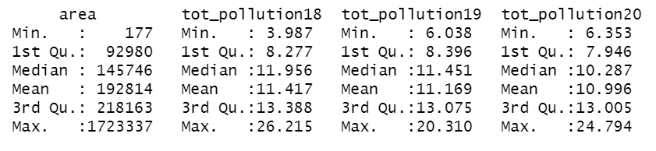
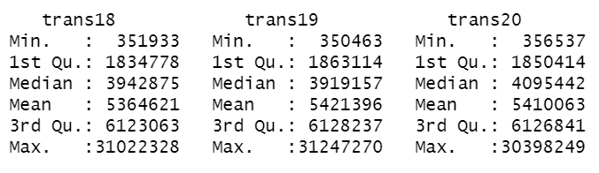
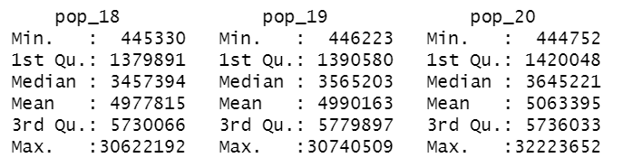
DATASET SUMMARY

Slide 5
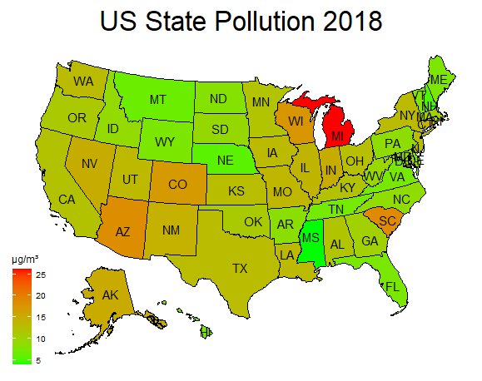
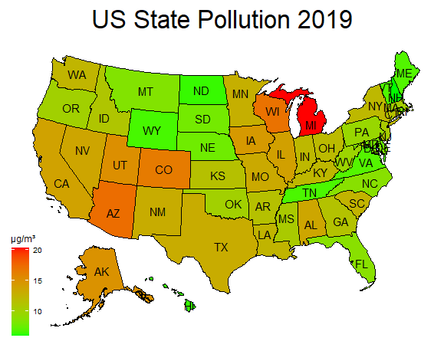
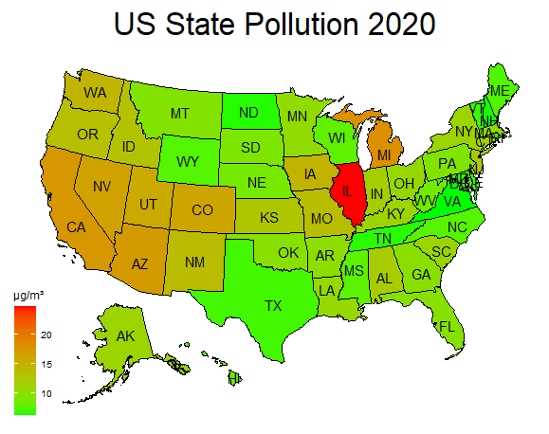
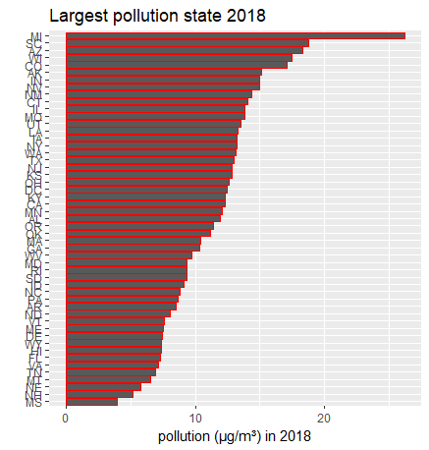
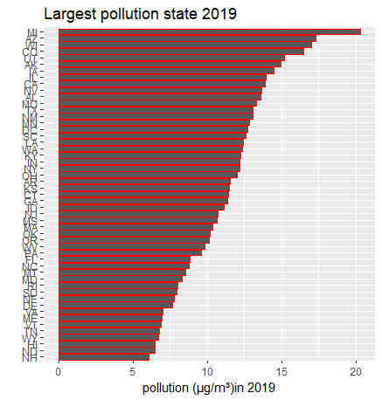
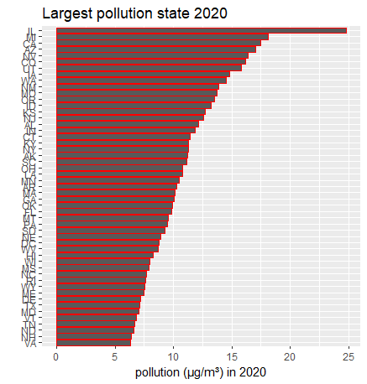
POLLUTION IN EACH STATE

Slide 6
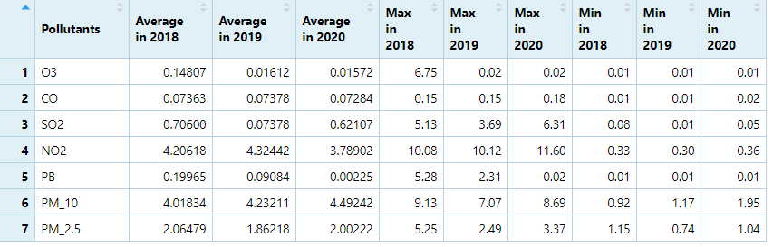
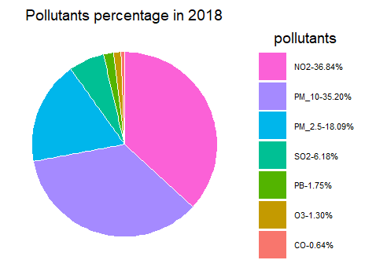


POLLUTANTS IN EACH YEAR
On considering the average of pollutants in each year, PM10 shows an upward trend in all three years and NO2 shows a downward trend in the respective years.

Slide 7
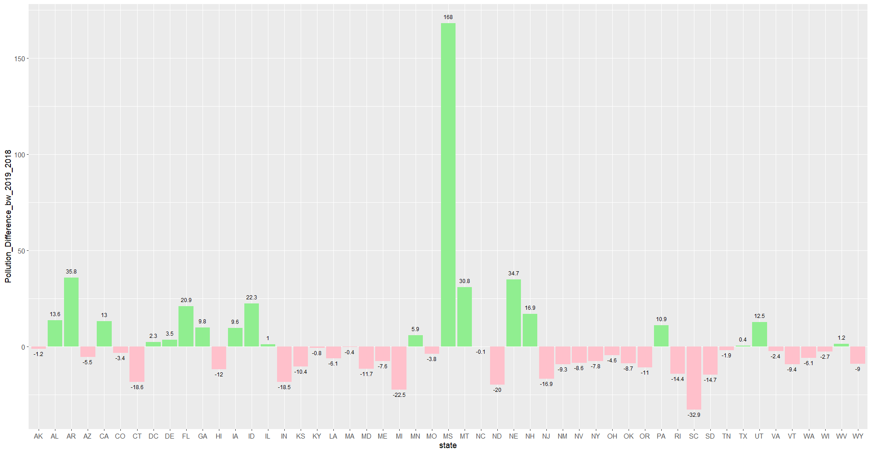
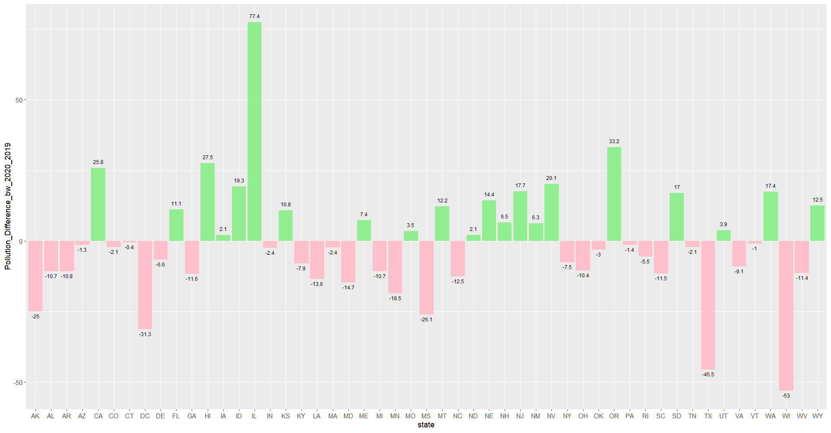
POLLUTION DIFFERENCE BETWEEN THE SUCCESSIVE YEARS
Pollution difference between 2018 and 2019
Pollution difference between 2019 and 2020

Slide 8
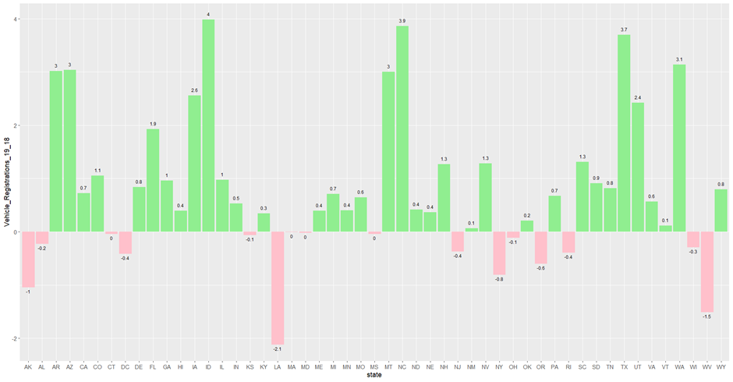
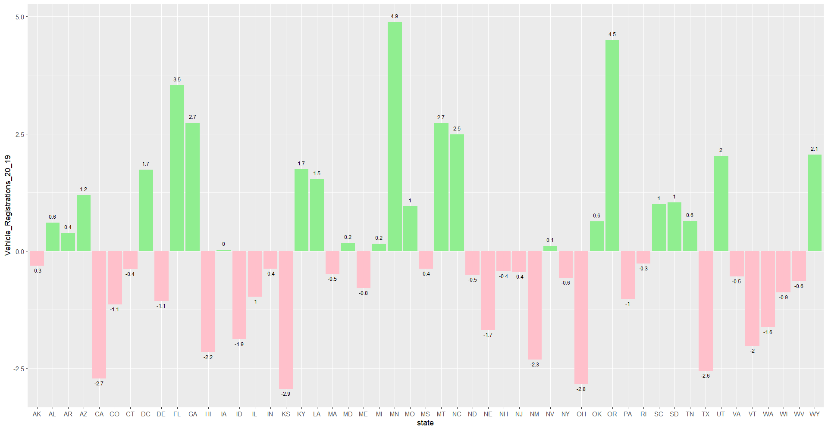
VEHICLE REGISTRATION BETWEEN THE SUCCESSIVE YEARS
Vehicle registration between 2018 and 2019
Vehicle registration between 2019 and 2020

Slide 9
CORRELATION BETWEEN POPULATION AND POLLUTION
On running a correlation test between the population and pollution for the years 2018-20. The following are the obtained results.
Year 2018 - r=0.17, p=0.25
Year 2019 - r=0.25, p=0.078
Year 2020 - r=0.25, p=0.074
The result obtained is negligible or weak correlation between population and pollution. So, the common ideology that if the population increases, the pollution also increases does not satisfy here.

Slide 10
CONCLUSION
In order to reduce the carbon foot print, and to observe the current trend in automotive emissions, the pollution data for the years 2018,19 and 20 has been taken into consideration with specific focus to light duty vehicles and medium and heavy-duty trucks across the states of US. The following tests have been conducted to observe the trends and correlation among the data.

