Slide 1
Obstacle Avoidance Robot
Rishi Kumar. S
Prakash.A
Nayeemur Rahman.M

Slide 2
INTRODUCTION
Robotics is an interesting and fast growing field. Being a branch of engineering, the applications of robotics are increasing with the advancement of technology…
Our project consists of an Arduino based robot that uses Ultrasonic Sensors to detect obstacles and avoid collisions automatically ,

Slide 3
Objectives
Navigate safely by avoiding obstacles comes ahead.
Detecting the exact path by checking the sensor readings in different angles.
Send status of the robot movement (using Bluetooth module) to the nearby android phone when the robot is in automatic mode.
Navigate in manual mode by receiving signals from the phone.

Slide 4
Components
An Arduino UNO board is used to build this robot
An Ultrasonic sensor is used to detect any obstacle ahead of it.
A Motor driver IC and 2 motors are used for controlling the movement of the robot.
A Servo motor is also used in this project.
The Ultrasonic sensor is then mounted on the servo
A Bluetooth module is also used in this project

Slide 5
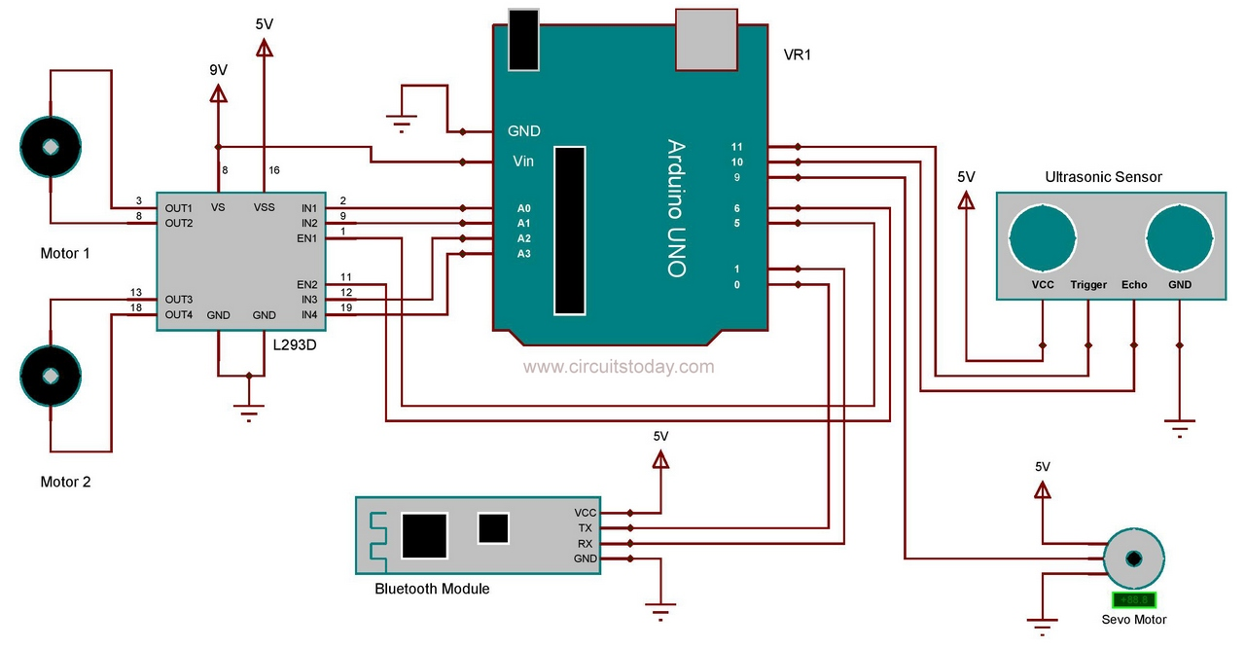
Assembling

Slide 6
The Ultrasonic sensor has 4 pins: Vcc, Trig, Echo and Gnd. Vcc and Gnd are connected to the supply pins of the Arduino. Trig is connected to the 11th pin and Echo is connected to 10th pin of the Arduino.
Motor driver is a 16 pin IC which can drive two motors simultaneously. 1st and 9th pin are the enable pins, which are connected to the 5th and 6th pins of the Arduino board. Pins 2 and 7 are control inputs from microcontroller for first motor. They are connected to pins A0 and A1 of Arduino respectively. Similarly, pins 10 and 15 are control inputs from microcontroller for second motor. They are connected to pins A2 and A3 of Arduino.
Bluetooth module is connected to the RX and TX pins of Arduino. It is used here for controlling the robot with your android phone.

Slide 7
working
When the robot is powered on, both the motors of the robot will run normally and the robot moves forward. During this time, the ultrasonic sensor continuously calculate the distance between the robot and the reflective surface.
This information is processed by the Arduino. If the distance between the robot and the obstacle is less than 30 cm, the Robot stops and scans in left and right directions for new distance using Servo Motor and Ultrasonic Sensor.

Slide 8
If the distance towards the left side is more than that of the right side, the robot will prepare for a left turn. But first, it backs up a little bit and then moves in the desired direction. Similarly, if the right distance is more than that of the left distance, the Robot prepares right rotation. This process continues forever and the robot keeps on moving without hitting any obstacle.
Whilst in manual mode the robot is controlled using the Bluetooth signals coming from an android device using the application path finder

Slide 9
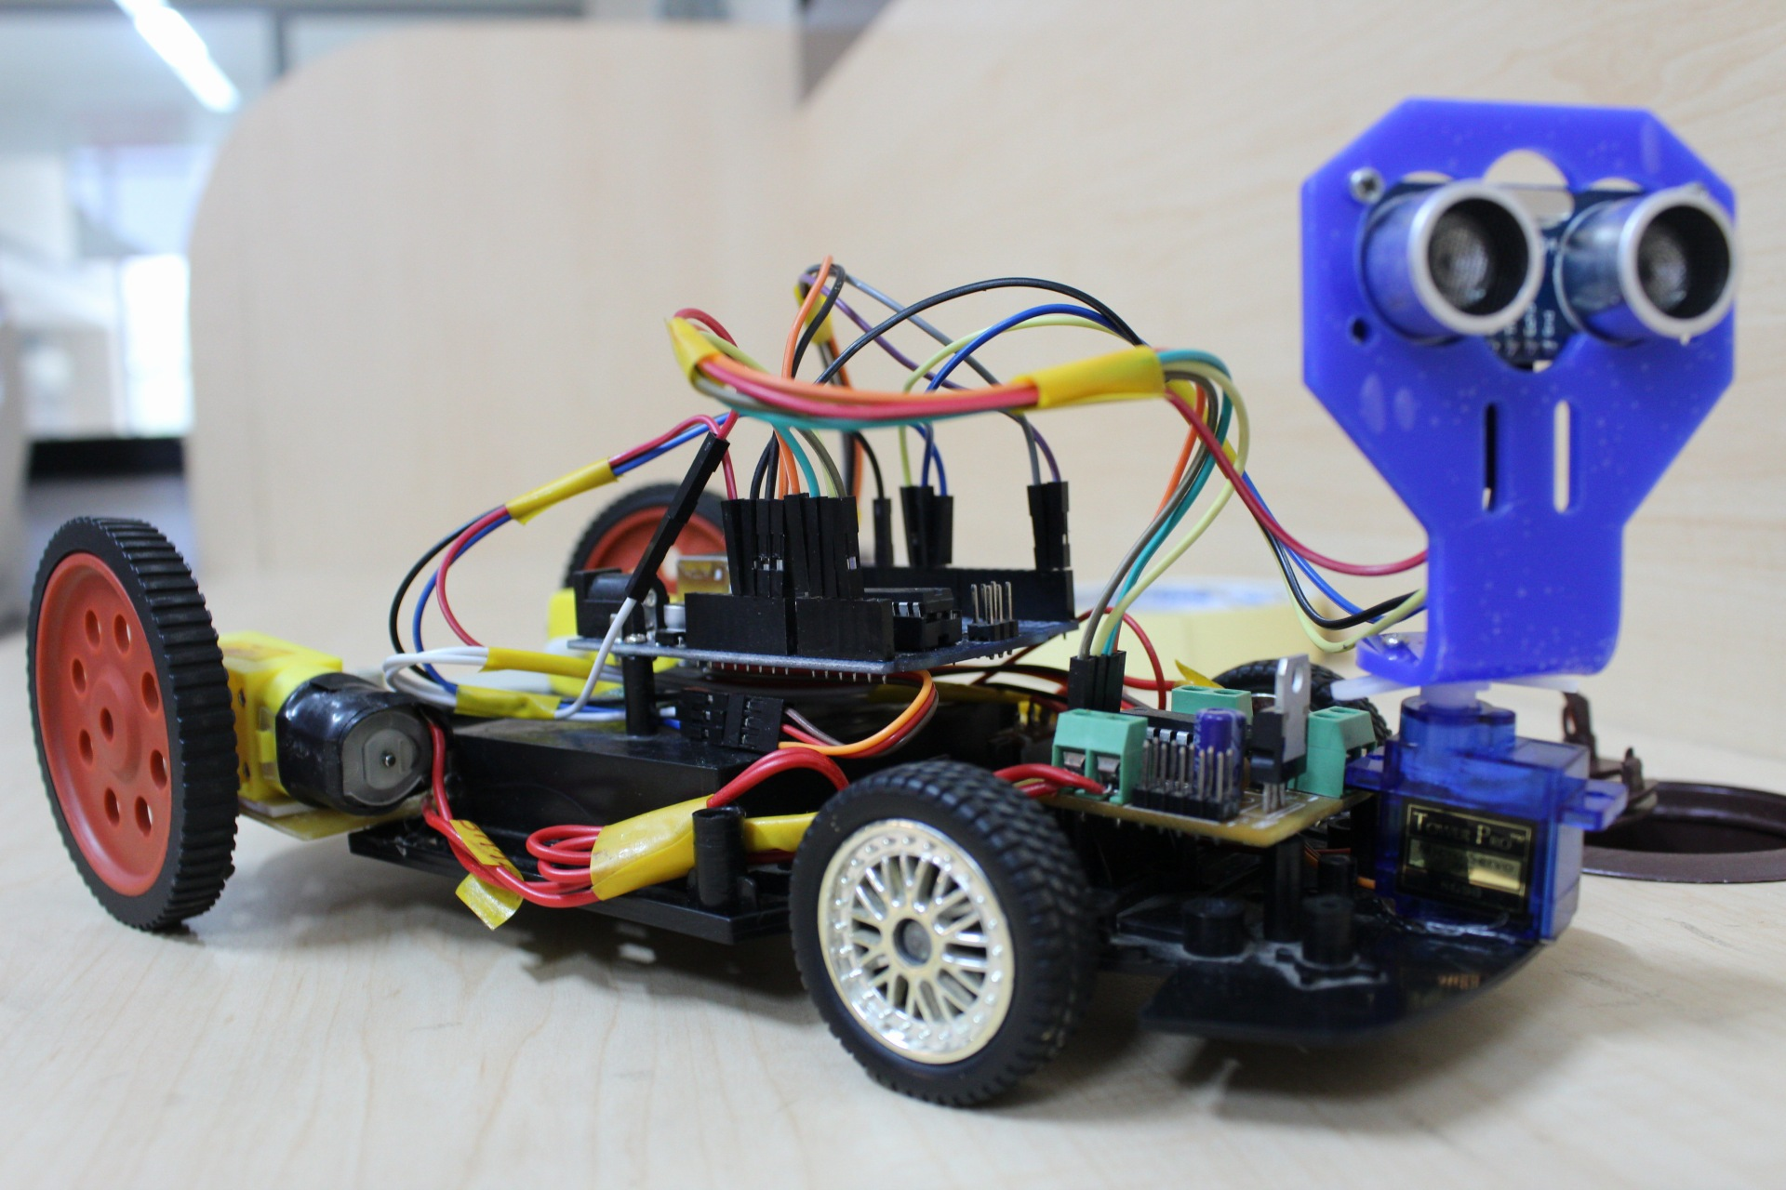
Wall-e

Slide 10
THE END

