Slide 1
Python Programming - V
By Ginni Aggarwal
CDAC Noida

Slide 2
Python Functions
• In Python, function is a group of related statements that perform a specific task.
• Functions help break our program into smaller and modular chucks.
• As our program grows larger and larger, functions make it more organized and manageable.
• Furthermore, it avoids repetition and makes code reusable.

Slide 3

Syntax of Function
Components of function definition:
• Keyword def marks the start of function header
• A function name to uniquely identify it.
• Parameters (arguments) through which we pass values to a function. They are optional.
• A colon (:) to mark the end of function header.
• Optional documentation string (docstring) to describe what the function does
• One or more valid python statements that make up the function body.
• An optional return statement to return a value from the function.

Slide 4
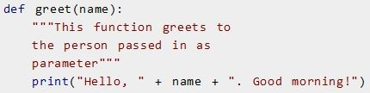

Example of a function

Slide 5
Function Call
• Once we have defined a function, we can call it from another function, program or even the Python prompt.
• To call a function we simply type the function name with appropriate parameters.

Slide 6
Docstring
• The first string after the function header is called the docstring and is short for documentation string.
• It is used to explain in brief, what a function does.
• Although optional, documentation is a good programming practice.
• In the previous example, we have a docstring immediately below the function header.
• We generally use triple quotes so that docstring can extend up to multiple lines.
• This string is available to us as doc attribute of the function.

Slide 7

Docstring

Slide 8

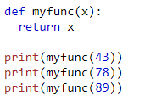

The return statement
• The return statement is used to exit a function and go back to the place from where it was called.

Slide 9
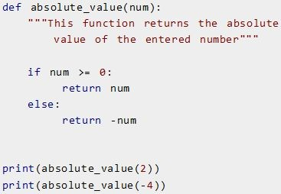

Example of return

Slide 10

Example of return None

Slide 11
Scope and Lifetime of variables
• Scope of a variable is the portion of a program where the variable is recognized.
• Parameters and variables defined inside a function is not visible from outside. Hence, they have a local scope.
• Lifetime of a variable is the period throughout which the variable exits in the memory.
• The lifetime of variables inside a function is as long as the function executes.
• They are destroyed once we return from the function.
• Hence, a function does not remember the value of a variable from its previous calls.

Slide 12
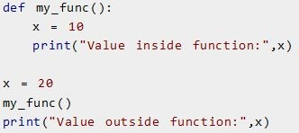

Example
Scope of a variable inside a function

Slide 13
Types of Functions
• Basically, we can divide functions into the following two types:
1. Built-in functions - Functions that are built into Python.
2. User-defined functions - Functions defined by the users
themselves.

Slide 14
Python Programming User-defined Functions
• Functions that we define ourselves to do certain specific task are referred as user-defined functions.
user-defined function is a function written by the user to write any program code and execute specific actions.
• Functions that readily come with Python are called built-in functions.
• •

Slide 15
Advantages of user-defined functions
• User-defined functions help to decompose a large program into small segments which makes program easy to understand, maintain and debug.
• If repeated code occurs in a program. Function can be used to include those codes and execute when needed by calling that function.
• Programmers working on large project can divide the workload by making different functions.

Slide 16
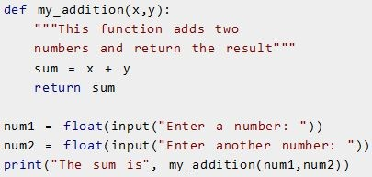

Example of a user-defined function

Slide 17
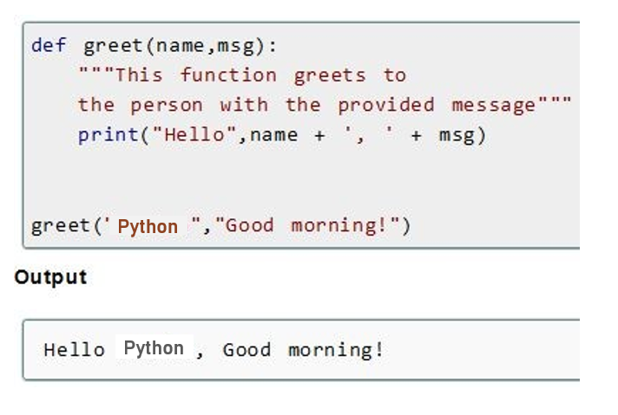

Slide 18
Python Function Arguments

Slide 19
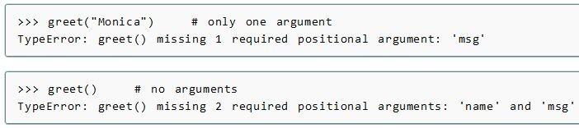
Python Function Arguments
• if we call greet function with different number of arguments, the interpreter will complain.
• Below is a call to this function with one and no arguments along with their respective error messages.
Python

Slide 20
Variable Function Arguments
• In previous example, function had fixed number of arguments.
• In Python there are other ways to define a function which can take variable number of arguments.
• Three different forms of this type are:
1. Default Arguments
2. Keyword Arguments
3. Arbitrary Arguments or Variable-length arguments

Slide 21
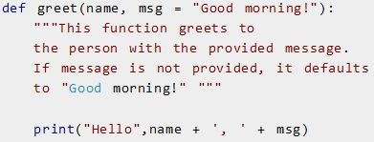
Default Arguments
• Function arguments can have default values in Python.
• We can provide a default value to an argument by using the assignment operator (=).

Slide 22
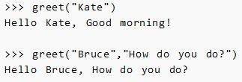
Default Arguments

Slide 23
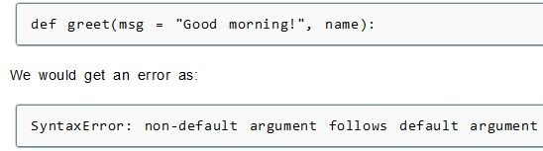
Default Arguments
• Any number of arguments in a function can have a default value.
• But once we have a default argument, all the arguments to its right must also have default values.
• This means to say, non-default arguments cannot follow default arguments.

Slide 24
Keyword Arguments
• When we call a function with some values, these values get assigned to the arguments according to their position.
• For example, in the above function greet(), when we called it as greet("Bruce","How do you do?"), the value "Bruce" gets assigned to the argument name and similarly "How do you do?" to msg.
• Python allows functions to be called using keyword arguments.
• When we call functions in this way, the order (position) of the arguments can be changed.

Slide 25

Keyword Arguments
Following calls to the above function are all valid and produce the same result

Slide 26
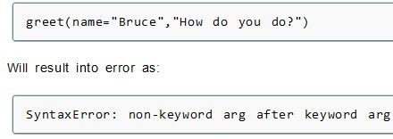
Keyword Arguments
• we can mix positional arguments with keyword arguments during a function call.
• But we must keep in mind that keyword arguments must follow positional arguments.
• Having a positional argument after keyword arguments will result into errors.
• Example:

Slide 27
Arbitrary Arguments or Variable-length arguments
• Sometimes, we do not know in advance the number of arguments that will be passed into a function.
• Python allows us to handle this kind of situation through function calls with arbitrary number of arguments.
• In the function definition we use an asterisk (*) before the parameter name to denote this kind of argument.

Slide 28
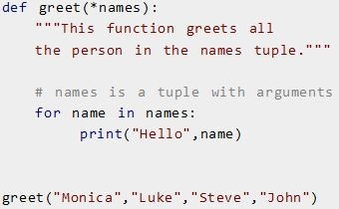

Example.

Slide 29
Python Recursion
• Recursion is the process of defining something in terms of itself.
• A physical world example would be to place two parallel mirrors facing each other.
• Any object in between them would be reflected recursively.

Slide 30
Python Recursive Function
• In Python, a function can call other functions.
• It is even possible for the function to call itself.
• These type of construct are termed as recursive functions.

Slide 31
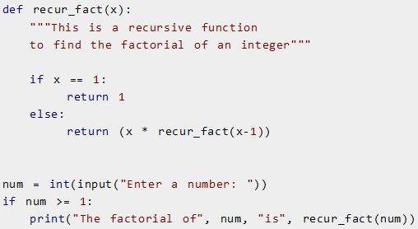

Example of recursive function:
To find the factorial of an integer:

Slide 32
Advantages of recursion
• Recursive functions make the code look clean and elegant.
• A complex task can be broken down into simpler sub-problems using recursion.
• Sequence generation is easier with recursion than using some nested iteration.

Slide 33
Disadvantages of recursion
• Sometimes the logic behind recursion is hard to follow through.
• Recursive calls are expensive (inefficient) as they take up a lot of memory and time.
• Recursive functions are hard to debug.

