Slide 1
Division
Harder Than Multiplication Because
Quotient Digit Selection/Estimation
Can Have Overflow Condition – Divide by Small Number OR even Worse – Divide by Zero
Other Than These Problems
  Shift and Subtract Algorithms
  Array Based Algorithms

Slide 2
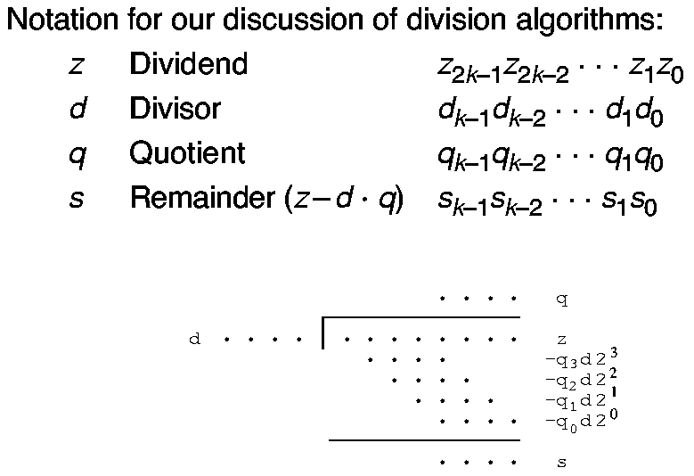
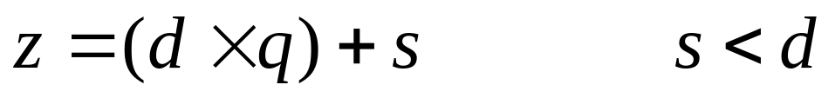
Division Notation
2k by k Bit Division – Dot Diagram

Slide 3
Sequential Division
Repeated Subtractions vs. Repeated Additions
Partial Remainder Initialized to z, s⁽⁰⁾=z
Step j, Select Next Quotient Digit q_{k-j}
Product q_{k-j} d (equals either 0 or d) is Shifted
Result Subtracted From Partial Remainder
Thus, as Complex as Multiplication with ADDITIONAL Constraint that Quotient Digit Selection is Required

Slide 4
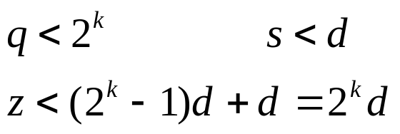
Overflow
Quotient of 2k-bit Value Divided by k-bit Number can Result in Width Greater than k
Overflow Check Needed Before Division is Attempted
For Unsigned Division:
High-order k Bits of z Must be Strictly Less Than d
This Check Also Detects the Divide-by-zero Condition

Slide 5
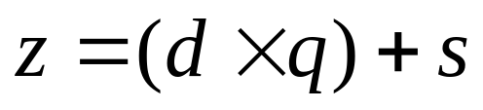
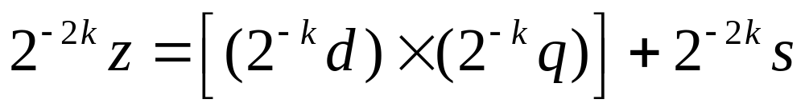
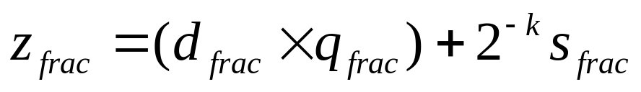
Fractional Division
Integer Division Characterized by:
Multiplying Both Sides by 2^{-2k}:
Letting 2k and k Bit Inputs be Fractions:
Thus, Can Divide Fractions Just Like Integers Except:
Must Shift Final Remainder to Right by k Digits
Condition for No Overflow z_{frac} < d_{frac}

Slide 6
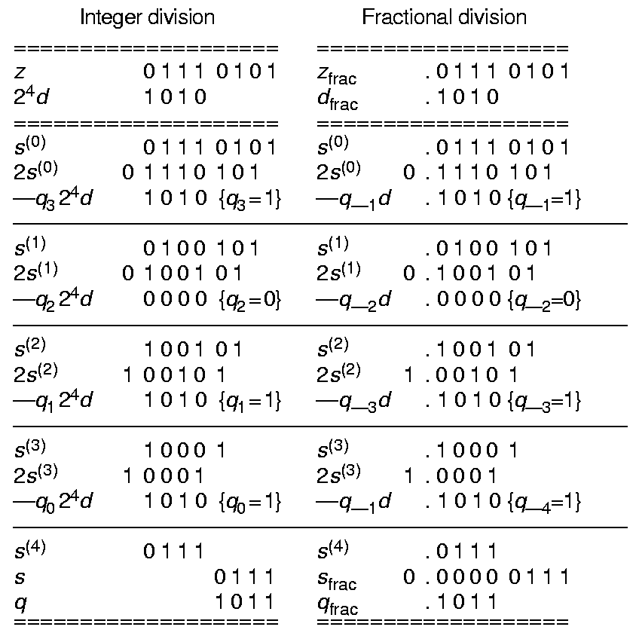
Fractional Division Examples

Slide 7
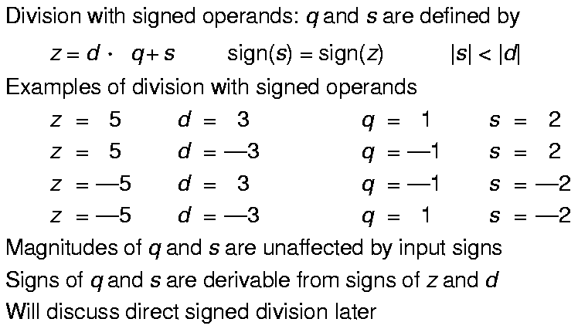
Division with Signed Operands

Slide 8
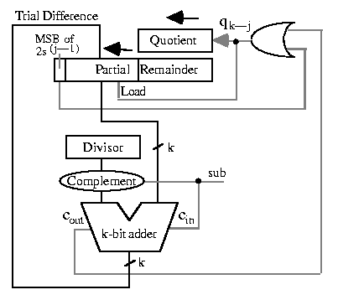
Sequential Restoring Division

Slide 9
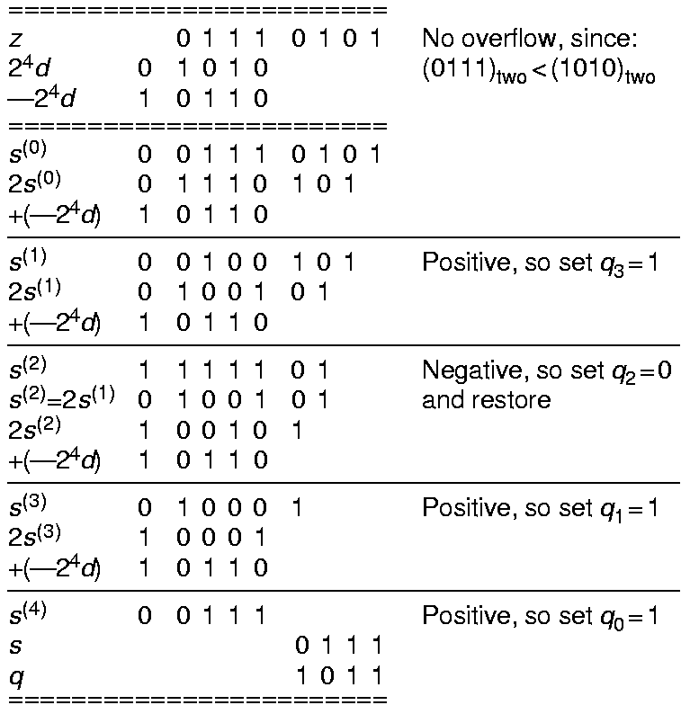
Unsigned Restoring Example

Slide 10
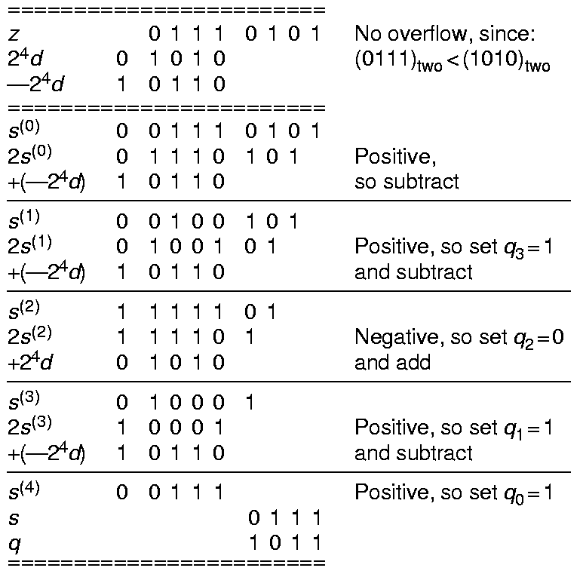
Non-restoring Division Example

Slide 11
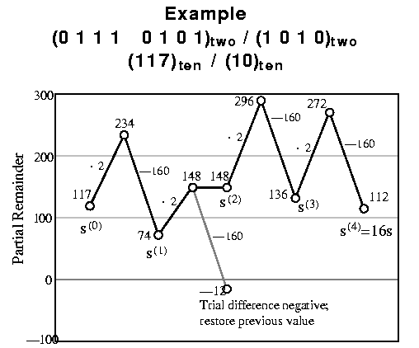
Partial Remainder (Restoring)

Slide 12
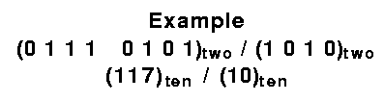
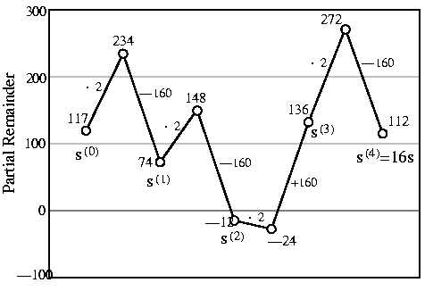
Partial Remainder (Non-restoring)

Slide 13
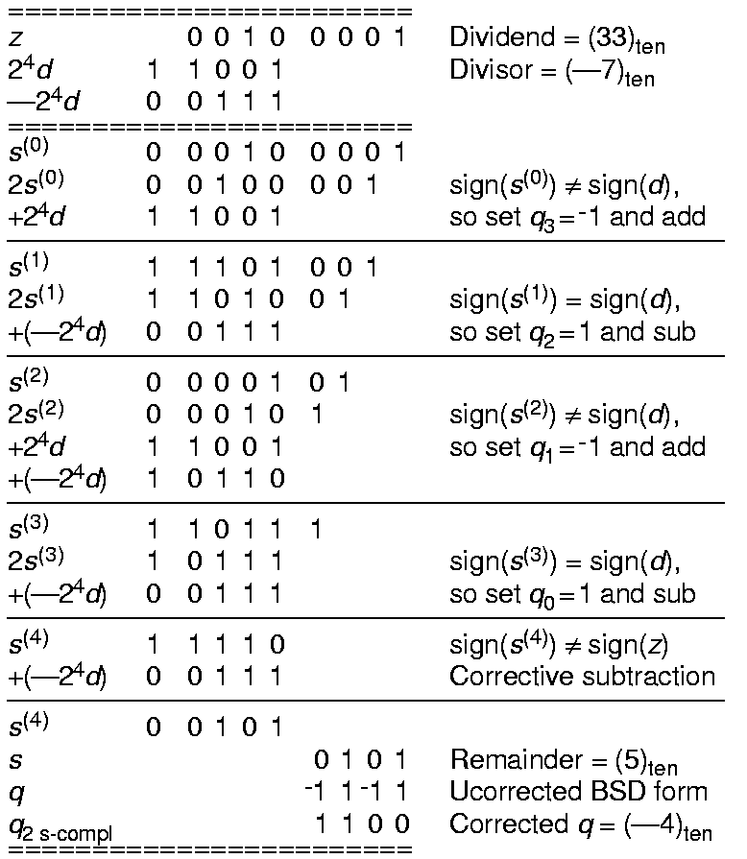
Non-restoring Division (Signed)

Slide 14
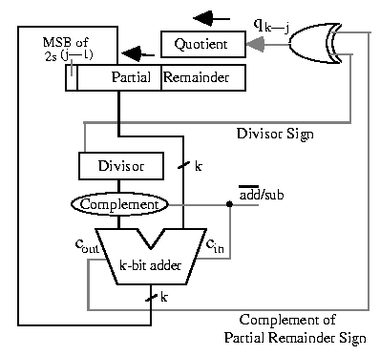
Non-restoring Divider

Slide 15
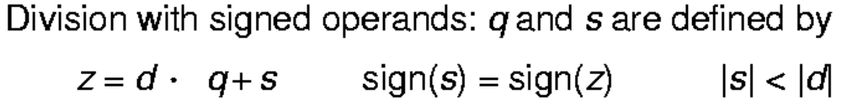
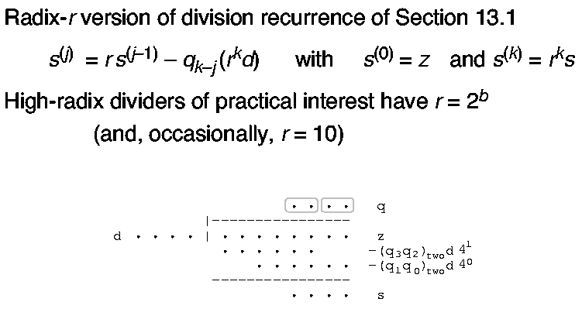
Basics of High-Radix Division

Slide 16
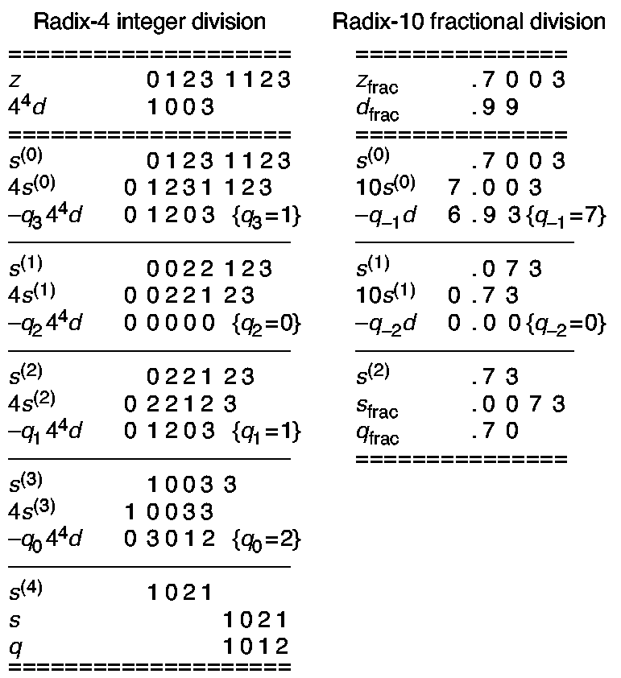
Division Examples

Slide 17
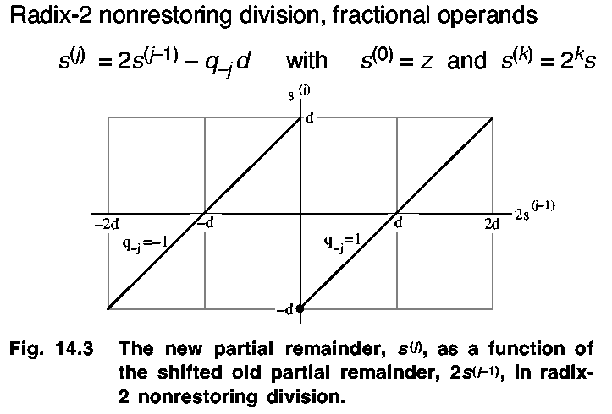
Radix-2 SRT Division

Slide 18
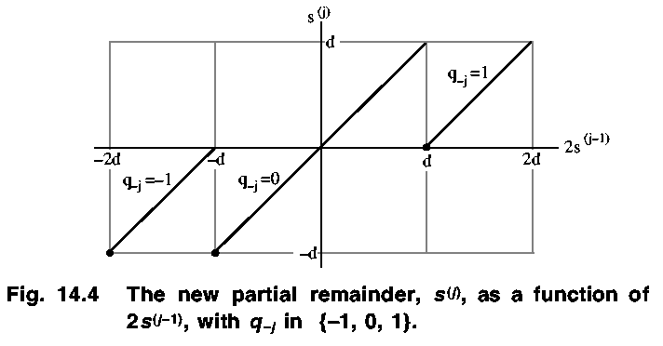
Radix-2 SRT Division

Slide 19
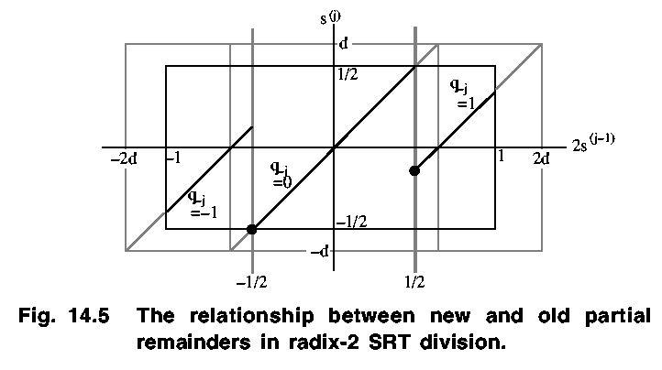
Radix-2 SRT Division

Slide 20
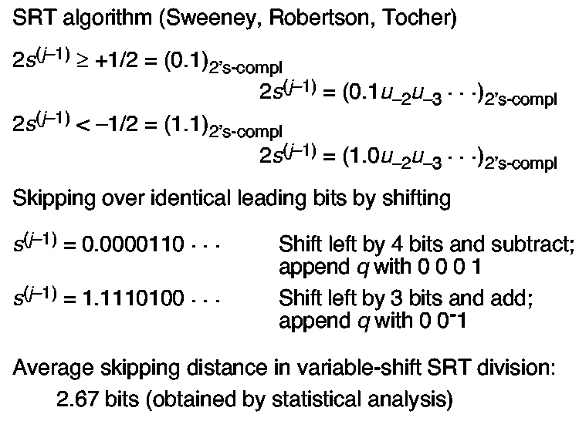
SRT Algorithm

Slide 21
SRT Algorithm
• Divisor normalized to d ≥ ½
• Restrict partial remainder to [ -½, ½) instead of [-d,d)
• Initially may need to shift z to right, then double q and s at end
• All subsequent partial remainders in range [ -½, ½) using
quotient digit selection rule:
If 2s^{(j-1)} < - ½
Then q_{–j} = -1
Else if 2s^{(j-1)} ≥ - ½
then q_{–j} = 1
else q_{–j} = 0
endif
endif
• Just two comparisons needed with constants – ½ and + ½

Slide 22
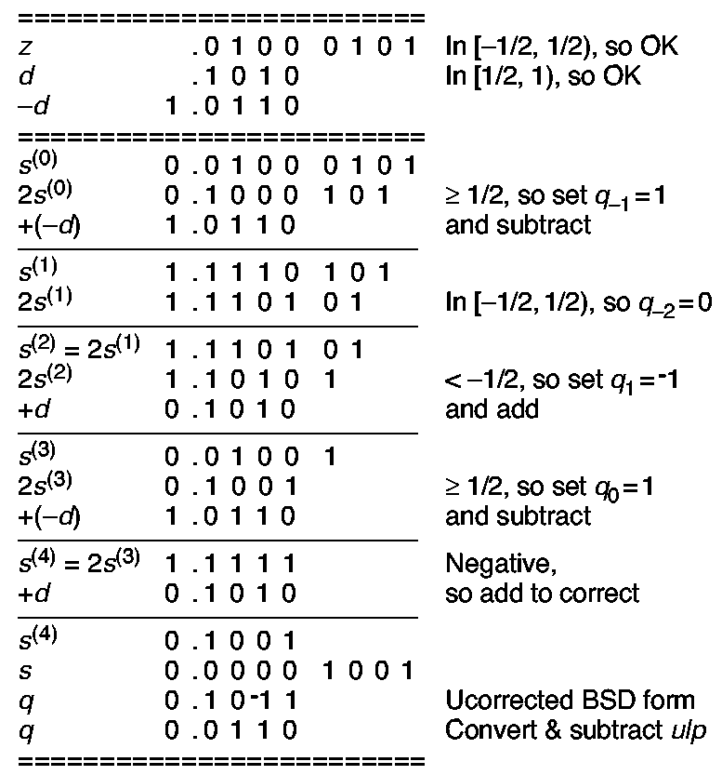
SRT Example-Unsigned Radix-2
Comparison
on
No, In [-½, ½), so q₋₃ = 0.
Also, q₋₄ = -1

Slide 23
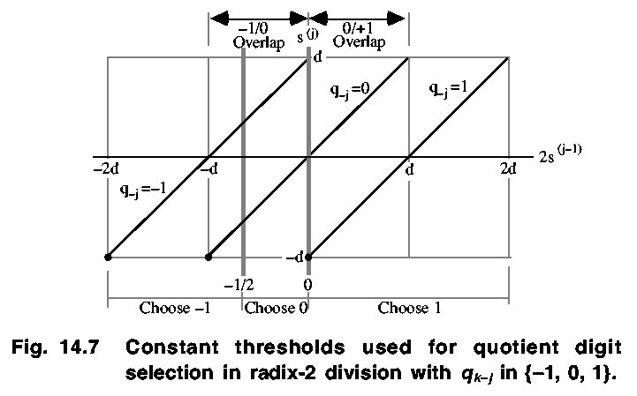
Using Carry-Save Adders

Slide 24
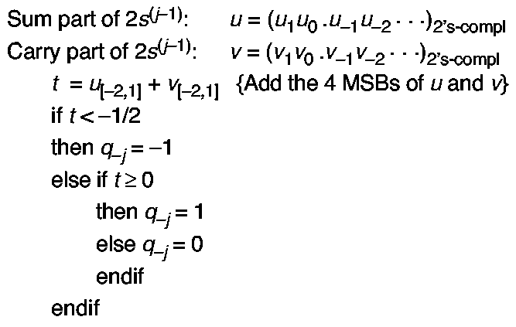
Quotient Digit Selection

Slide 25
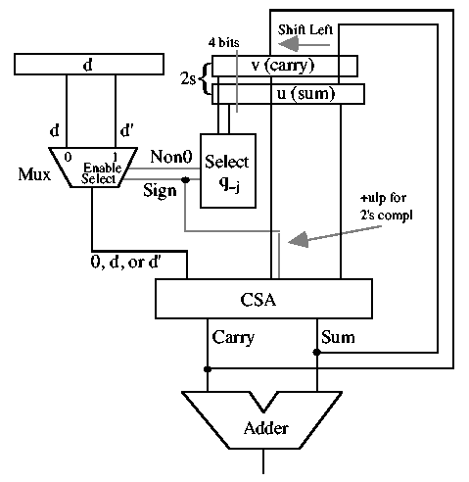
Radix-2 Divider; Stored-Carry

Slide 26
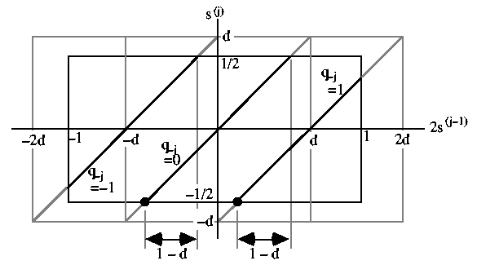
Overlap Regions – Radix-2 SRT

Slide 27
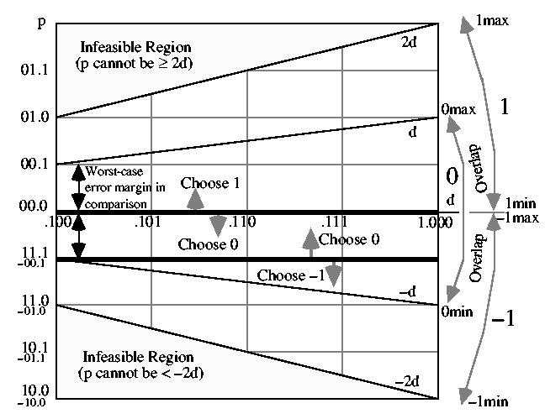
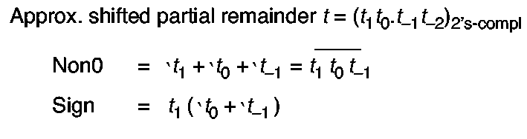
p-d Plot – Radix-2 Division

Slide 28
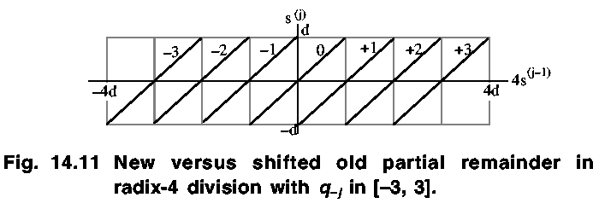
Radix-4 Division

Slide 29
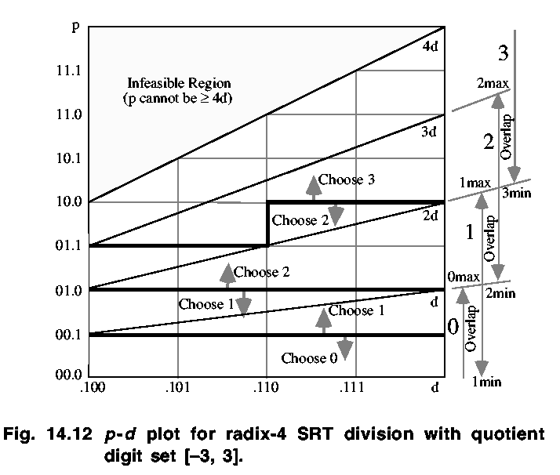
p-d Plot – Radix-4 Division

Slide 30
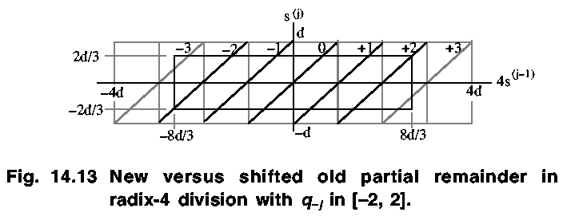
Radix-4 Division

Slide 31
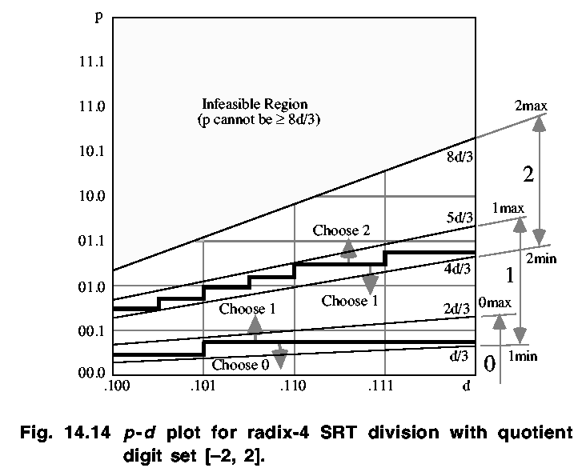
p-d Plot – Radix-4 Division

Slide 32
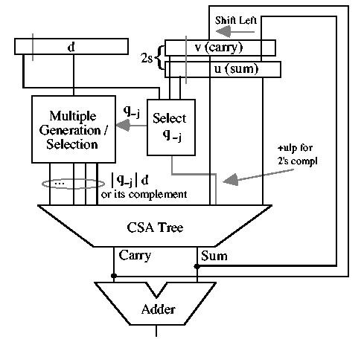
Radix-r Divider; Stored-Carry

