Slide 1
Big billone
File created on: 10/25/2026 7:37:55 PM

Slide 2


Slide 3


Slide 4
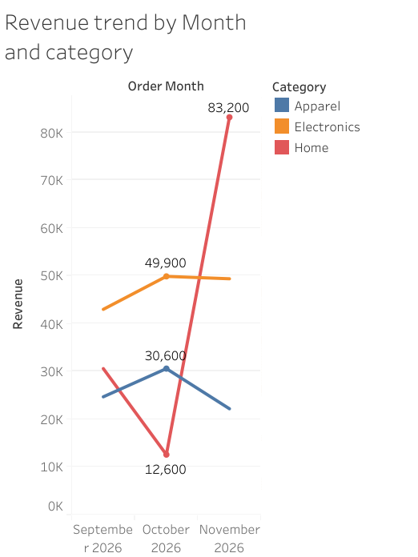

Slide 5
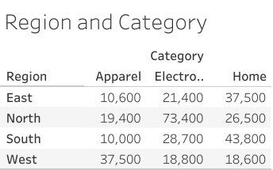

Slide 6
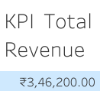

Slide 7


Slide 8
