Slide 1
FINAL SBA-JAVA AWS-S2
Karthick Rajendran
458459

Slide 2
Microservice API Details
Authentication API
Outreach Management API
Service Discovery –Registry
Service API Gateway
Service Config Server

Slide 3
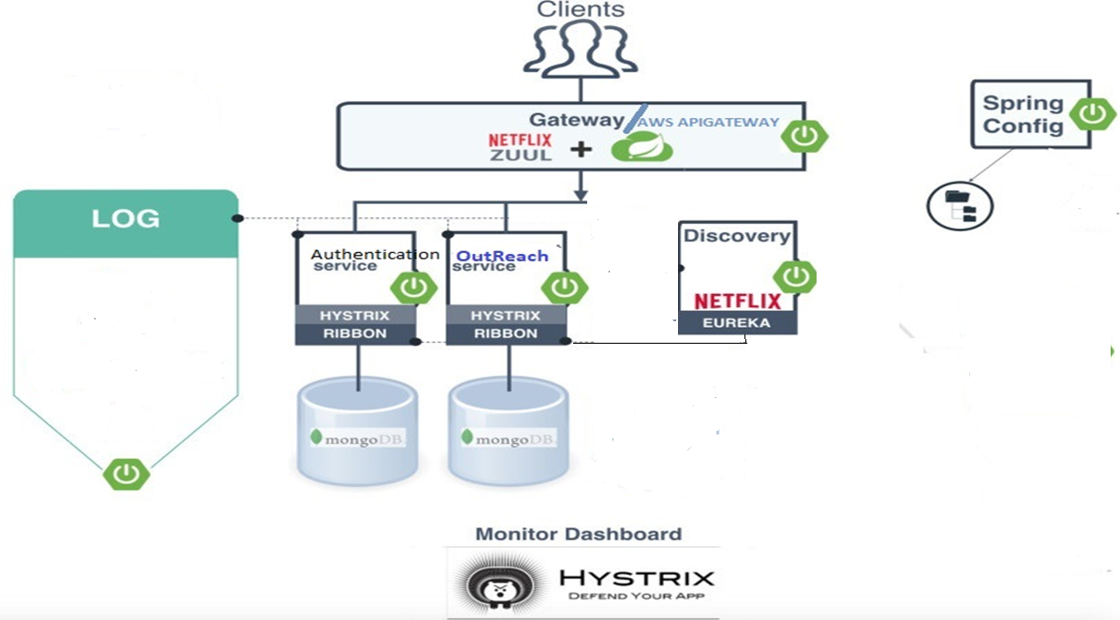

Slide 4
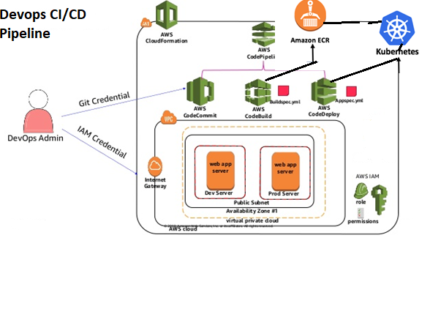
DevOps-2 - AWS DevOps
Jenkins

Slide 5
AWS -Services
AWS EC2
S3
AWS Code Pipeline(code commit/Code build/Code deploy)
AWS ECR(container registry
Route53
Load Balancer
Auto Scaling
API GATEWAY
VPC & Subnets
Security Group
IAM

