Slide 1
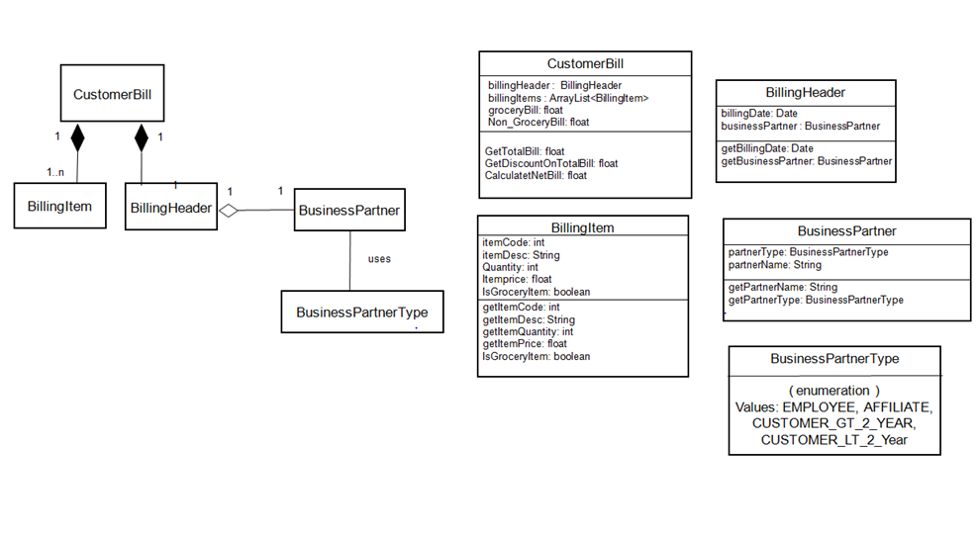
Mckinsey Coding Exercise Solution

