Slide 1

SUPERVISORS: Mr. Huynh Anh Dung
Mr. Nguyen Tat Trung
STUDENTS: Nguyen Thanh Long
Nguyen Ky Thanh
Duong Quynh
Hoang Thi Minh Sau

Slide 2





Role | Tasks in charge
Project Manager | ・Development team model and resource adjustment ・Development team contact point ・Coding FI Algorithm part, create design ・Playing main role with the project report writing and managing ・Project general management (project plan, task list, progress, issue, quality)
Project Technical Leader | ・Supporting techniques ・Coding the FI Application part ・Reviewing project source code, support fix bugs. ・Writing project reports ・Development (create design, implement, unit test, integration test)
Developer and researcher | ・Researching the algorithm of image processing ・Creating test case, test data and perform test ・Writing project report, printing and submitting a hard-copy to supervisors
Researcher and secretary (as a quality assurance) | ・Writing project report, reviewing document & project schedule ・Inspecting project processes and project deliverables ・Researching the algorithm of matching for identification ・Creating test case, test data and perform test ・Plays a role as a secretary of the project team
Nguyen Thanh Long
Nguyen Ky Thanh
Duong Quynh
Hoang Thi Minh Sau

Slide 3
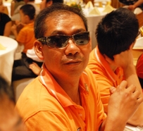
Mr. Huynh Anh Dung
Mr. Nguyen Tat Trung
Nguyen Thanh Long
Nguyen Ky Thanh
http://canhchimviet.info/fingerprint
Email: [URGENT], [@name], etc.
Offline at the library and home
Hoang Thi Minh Sau
Duong Quynh

Slide 4

Explosion of information technology
We want to create a product with the cheaper cost
Our passion about the biometrics

Slide 5







Slide 6



Fingerprint formed in the mother's uterus will exist forever through human life.
Each person owns a different fingerprint

Slide 7


Quality Induced Fingerprint Identification using Extended Feature Set introduced by Vatsa, M.; Singh, R.; Noore, A.; Singh, S.K. (2008)
Jin, A.L.H.; Chekima, A.; Dargham, J.A. and Liau Chung Fan introduce a paper named Fingerprint identification and recognition using back-propagation neural network (2002)
In “Image Processing, 2000. Proceedings. 2000 International Conference”, Huvanandana, S.; Changick Kim and Jenq-Neng Hwang introduces a paper named Reliable and fast fingerprint identification for security applications

Slide 8

Existing systems still remain many limitations
  1900 incorrect results in fingerprint identification procedures (According to statistics of the U.S. departments of biological identity)
  Error rate of fingerprint analysis is 0.8% (FBI)

Slide 9

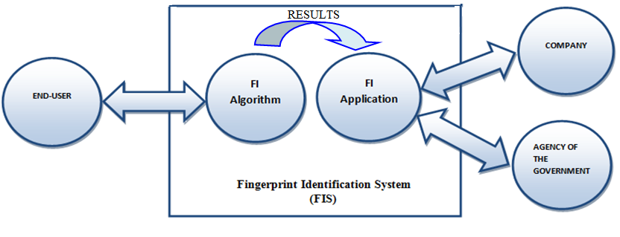


Slide 10
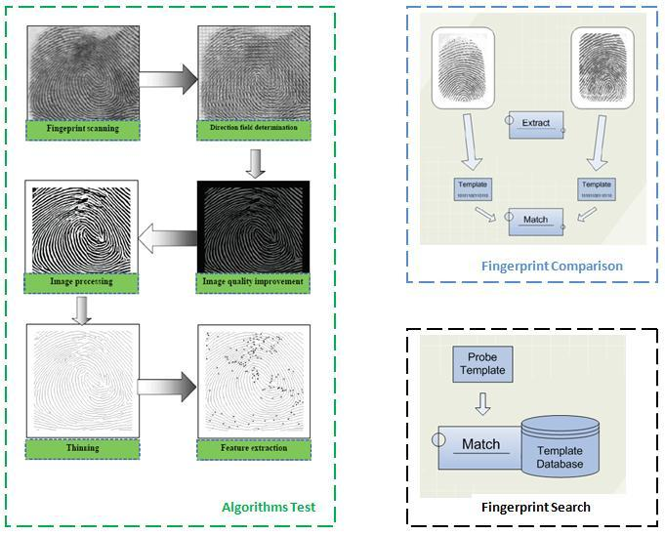

Slide 11
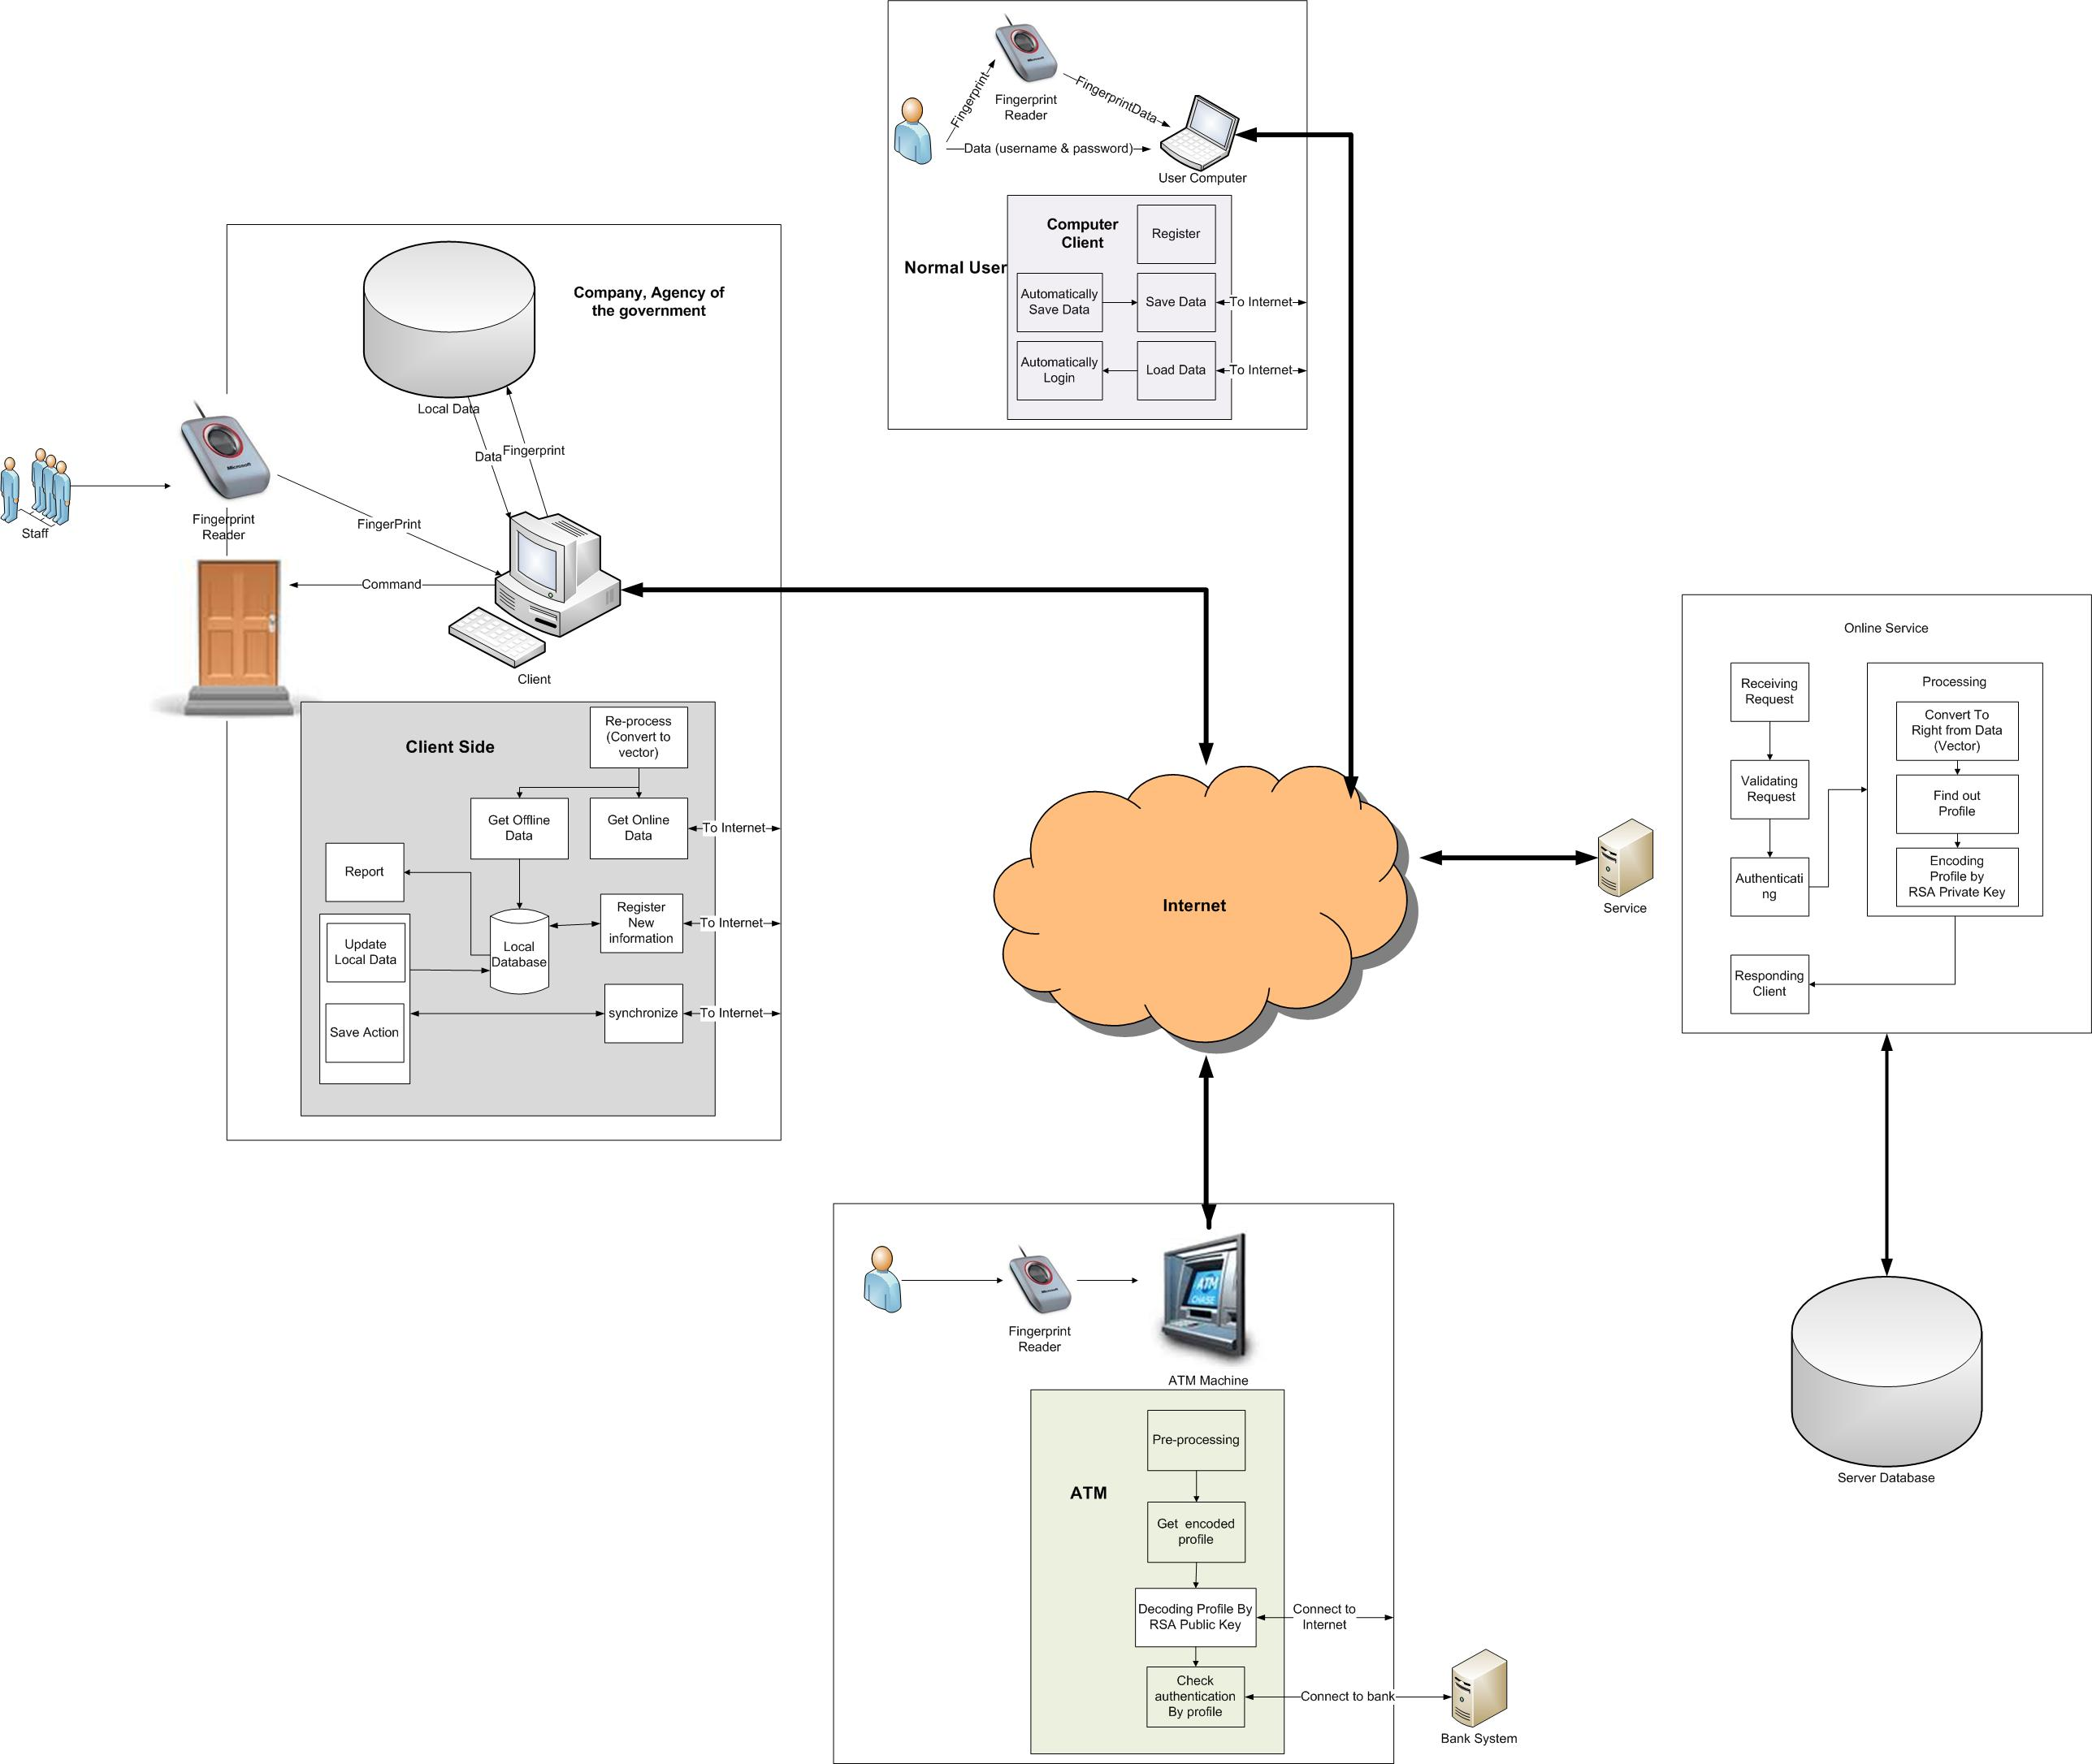

Slide 12



Scope
  Research and apply algorithms of image processing and matching for fingerprint identification
  Inputted image : 256x256 size in different formats as .png, .gif, .jpg and .bmp

Slide 13
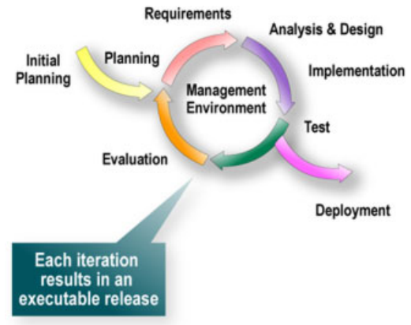


Slide 14
Development environment
FI Algorithm
- Windows XP, Vista, 7
- .Net Framework 4.0
FI Application
Microsoft SQL Server 2008

Slide 15

Tools and Techniques
    C# programming language / Microsoft Visual Studio 2010 on .NET framework 4.0
    ReSharper 5.0
    Jude community 5.4

Slide 16



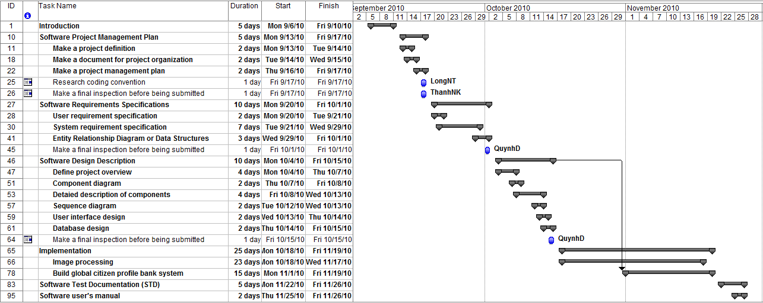

Slide 17


FI Algorithm:
  Allow users to input 256x256 size fingerprints image with different quality characteristics but only in format files: JPG, GIF, BMP, PNG
  The system also allows the user to test the algorithms of image processing that assures the sequence:
    Normalization → Enhancement → Representing in binary → Thinned Ridge → Show Details
    Enable / disable rule
  Allow the users to compare two fingerprint images.
  Allows the user to search the fingerprint inputted.

Slide 18
Additional requirements of FI Algorithm (Project success criteria):
  The processing time of each function of image processing should be about 2 seconds
  The result of comparing two images is processed less than 5 seconds
  Time processing of searching the input fingerprints in the fingerprint database is less than 10 seconds
  With 5 couples of fingerprint image pattern of same fingerprints, the system just returns to 1 error couple

Slide 19
FI Application
  Allows the staffs in companies to get their information from inputted fingerprint.
  Allows the administrator to make a report the working time, insert and update user information
  Allows the government agencies to search the fingerprint

Slide 20
Additional requirements of FI Application (Project success criteria)
  The search function should be processed less than 5 seconds.
  The getting, updating user information and report generating function should be less than 5 seconds.

Slide 21
Additionally common requirements
  User-friendly interface
  The system should guarantee completely all criterion and function about safety, reliability, usability, efficiency requirements, etc.

Slide 22


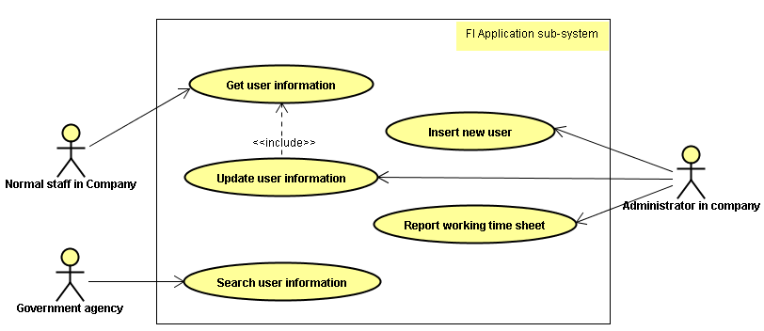

Slide 23



Slide 24
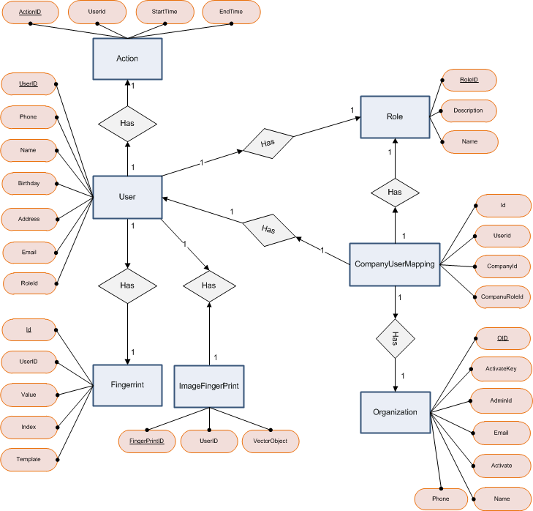

Slide 25

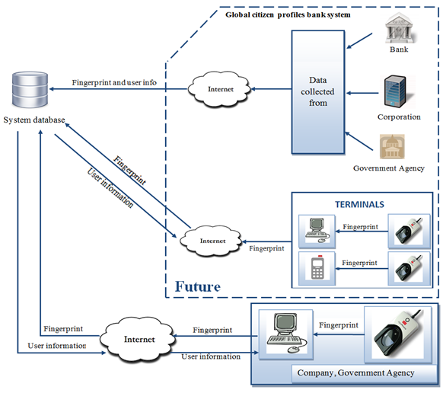
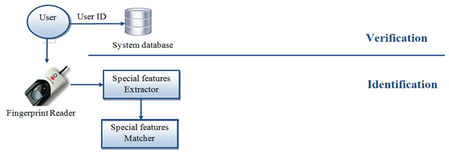

Slide 26
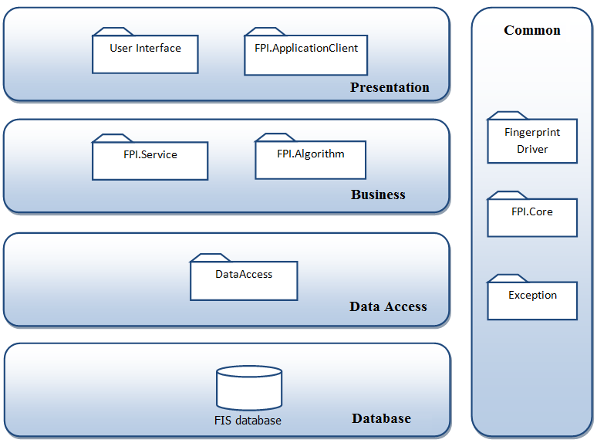

Slide 27

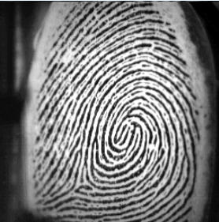
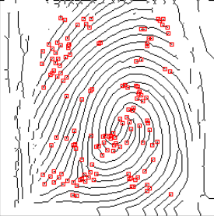
Image processing
Normalization
Enhancement
Representation in binary
Thinning ridges
Show details
Input image
Extracted features

Slide 28

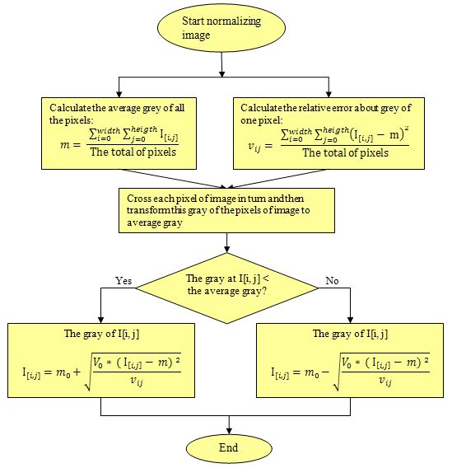

Slide 29
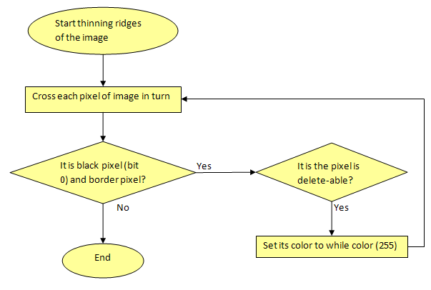

Slide 30
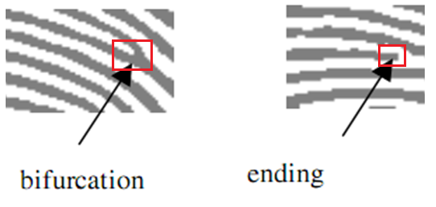
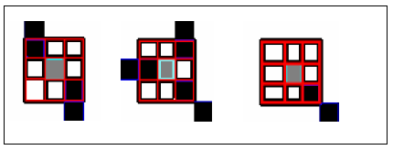

Slide 31
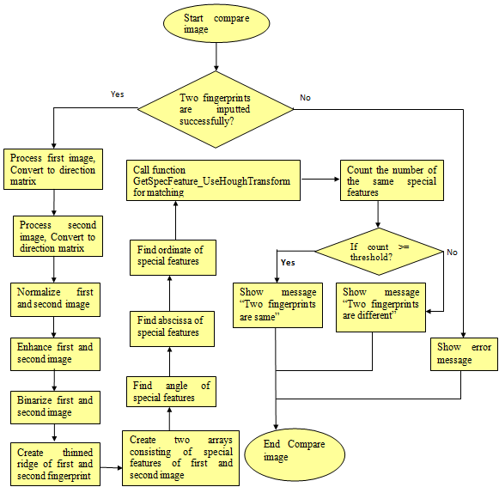

Slide 32
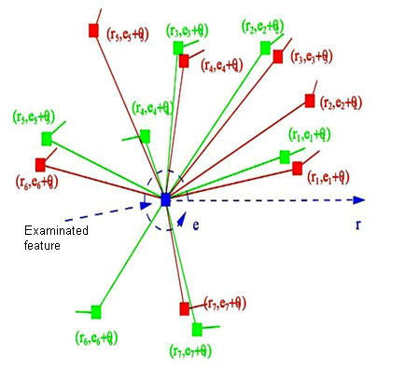

Slide 33

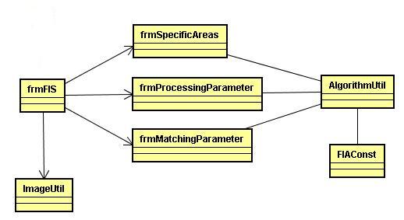
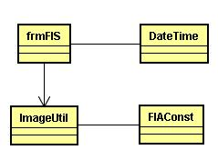
FI Algorithm
Class diagram for fingerprint comparison
Class diagram for image processing
Notes:
Show sequence by jude community
Search of FI Algorithm
Get user information of FI Application

Slide 34




FI Algorithm
  All functionalities related to image processing
  Comparing two fingerprint images
  Searching and identifying an input fingerprint image

Slide 35


FI Application
  Getting user information
  Searching user information
  Reporting working time
  Updating new user information

Slide 36



FI Algorithm
  Opening fingerprint image file
  Graphic user interface
FI Application
  Report format
  Sensor initialization and activation
  Graphic user interface

Slide 37


All things listed in 2. Features not to be tested.
Checklist with project success criteria

Slide 38
TEST REPORT
Project Name | Fingerprint Identification System |  | Creator |  |  | SauHTM
Project Code | FI |  | Reviewer/Approver |  |  | LongNT
Document Code | FI_Test Report_v1.0 |  | Issue Date |  |  | 26/11/2010
Notes | All of modules
No | Module code | Pass | Fail | Untested | N/A | Number of test cases
1 | Algorithms | 11 | 0 | 0 | 0 | 11
2 | FingerprintComparison | 8 | 0 | 0 | 0 | 8
3 | FingerprintSearch | 4 | 0 | 0 | 0 | 4
4 | Application | 14 | 0 | 0 | 0 | 14
Sub total |  | 37 | 0 | 0 | 0 | 37
 | Test coverage |  | 100.00 | %
 | Test successful coverage |  | 100.00 | %

Slide 39


Slide 40

Using algorithms associated with some other features to improve and increase quality of inputted images
Artificial neural network to increase the accuracy of identification
Global citizen profile bank

Slide 41


