Slide 1
Developing a Machine Learning Algorithm to Classify Neurodegenerative Diseases Based on Gait Parameters
Group 11: Julianna Gonzalez, Araana Mondal, Shravani Kulkarni, Shriya Jhaveri, and Mai-Ly Thompson

Slide 2
Project Overview
There is a need for accurate, non-invasive, and efficient methods to support potential diagnoses and monitoring of various neurodegenerative diseases.
The project aims to further improve the classification and differentiation between the NDDs using gait parameters.
A machine learning classification algorithm was developed using MLPClassifier and Cursor, an AI code generation program.

Slide 3
Problem
Dire need for efficient and non-invasive methods that can be used to diagnose and monitor neurodegenerative diseases like:
Amyotrophic Lateral Sclerosis (ALS)
Parkinson's Disease
Huntington's Disease
Our program will aim to distinguish between these neurodegenerative diseases using different gait parameters and a novel approach: Scikit-learn MLPClassifier Model

Slide 4
Significance
Neurogenerative diseases (NDDs) affect millions of people worldwide ^{[1]}.
ALS, Parkinson’s and Huntington’s disease are motor neuron diseases (MNDs) ^{[2]}.
Electromyography, nerve conduction studies, magnetic resonance imaging, blood and urine tests, and muscle biopsies are other clinical analyses and diagnostic tests to detect NDDs ^{[3]}
The ability to understand and diagnose NDDs in a non-invasive, quick, and easy way is critically important.
Upon training our machine learning model, it can be helpful in diagnosing NDDs by looking at gait dynamic metrics from patient data and automatically classifying which NDD the patient most likely has. This reduces the time to diagnosis and allows for earlier medical interventions to occur.
[1] "Neurodegenerative Diseases." National Institutes of Health.
[2] "Motor Neuron Diseases." National Institutes of Health.
[3] "Amyotrophic Lateral Sclerosis." National Institutes of Health
Notes:
MNDs are characterized by the destruction of neurons associated activity such as walking ^{[3]}.
Other clinical analyses and diagnostic tests are time-consuming and misunderstood
The ability to understand and diagnose NDDs in a non-invasive, quick, and easy way is critically important.

Slide 5
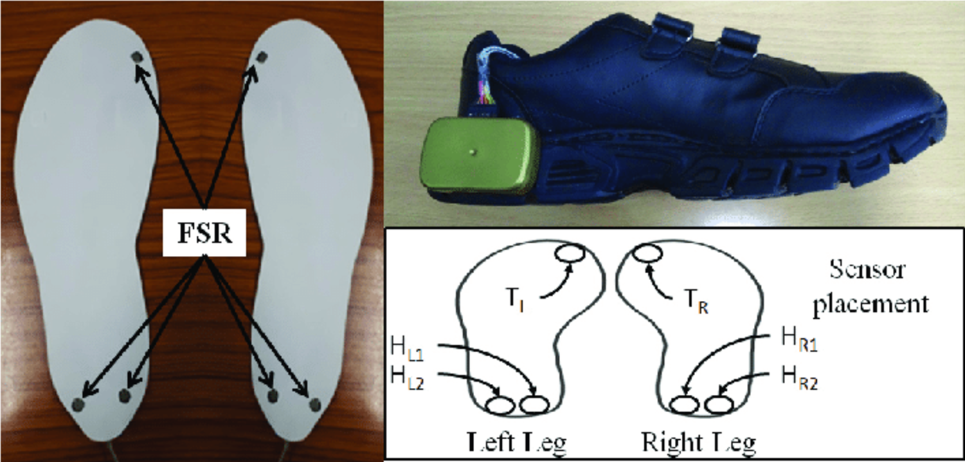
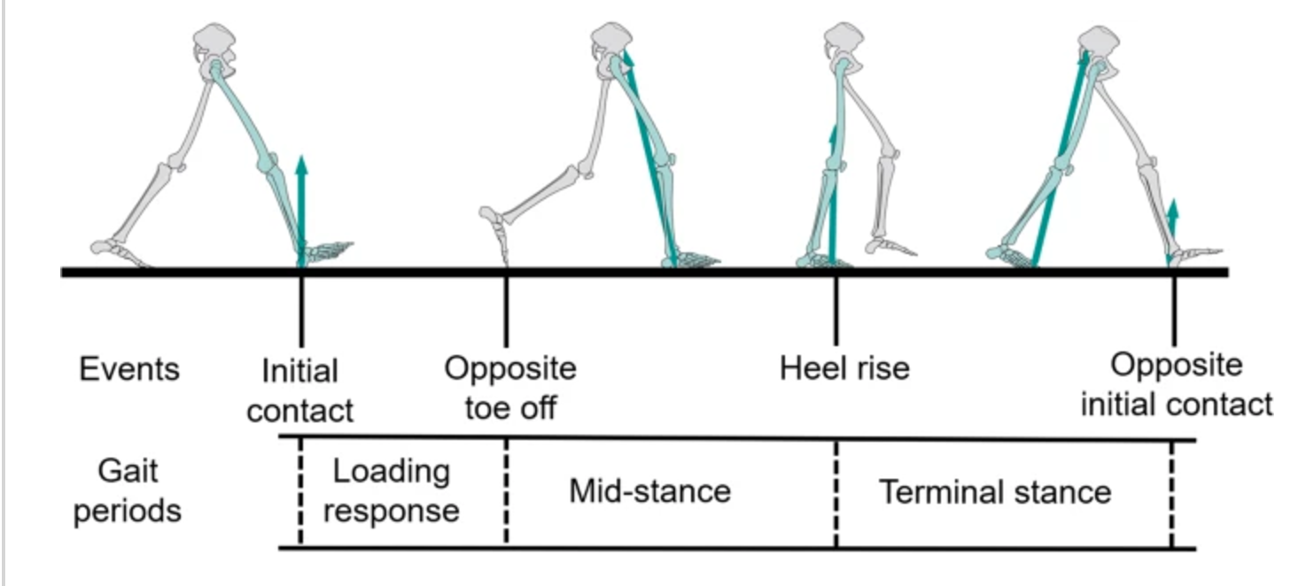
Data
Open Access database sourced from Hausdorff et al study, Physionet
Data consisted of control patients (n=16) and patients afflicted with ALS (n=13), Parkinson's (n=15), and Huntington's disease (n=20)
Raw data obtained using force-sensitive resistors
Stride-to-stride measures derived from this data
Goal is to analyze disease patterns on gait and force asymmetry and create an accurate predictive model

Slide 6
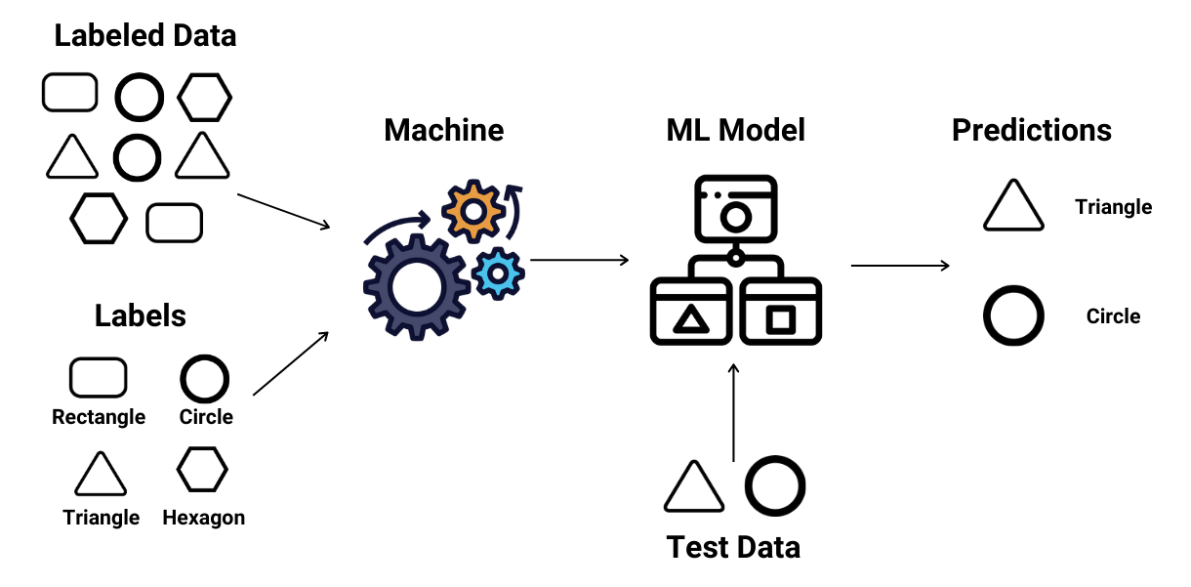
Methodology
The model is a classifier that uses supervised learning
We first split the data into training and testing datasets
We then used the MLPClassifier function to create and train a neural network model
We had the model make predictions and then tuned the parameters to increase the accuracy
We ran the model four times: All 4 labels, ALS vs Control, Huntington’s vs Control, and Parkinson’s vs Control
Huntington’s
Control
ALS
Control
Huntington’s
Parkinson’s

Slide 7
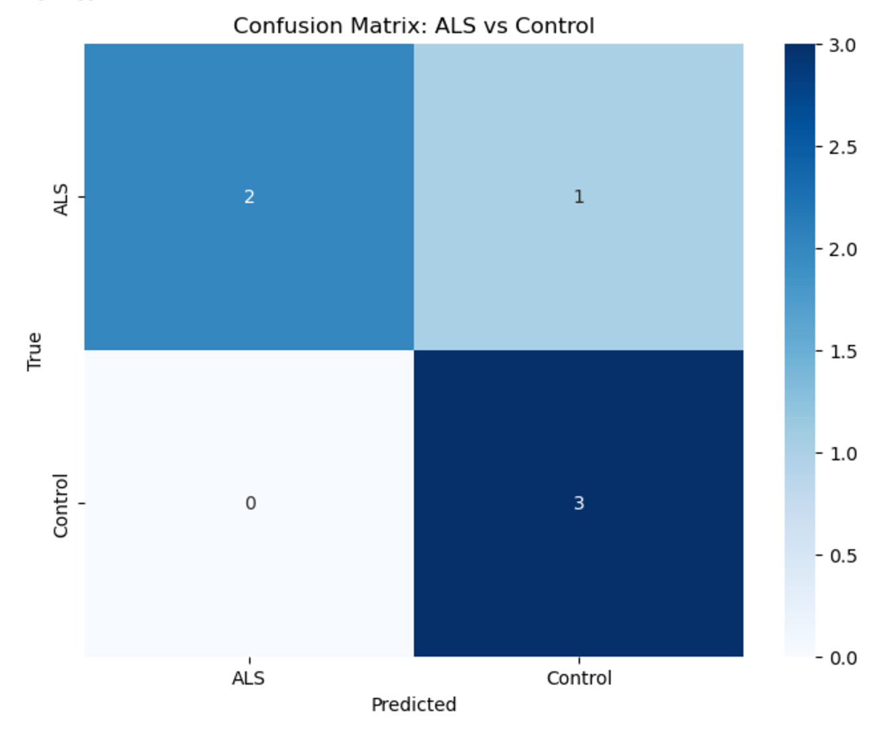
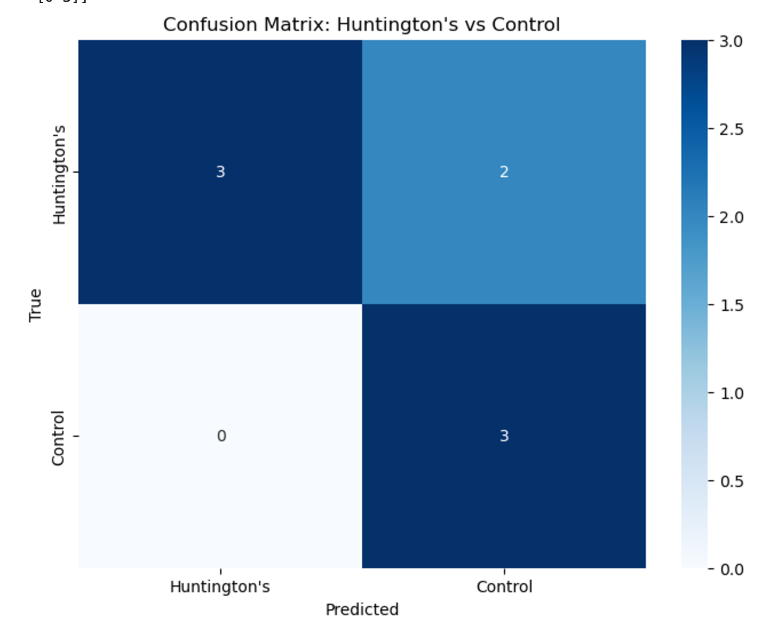
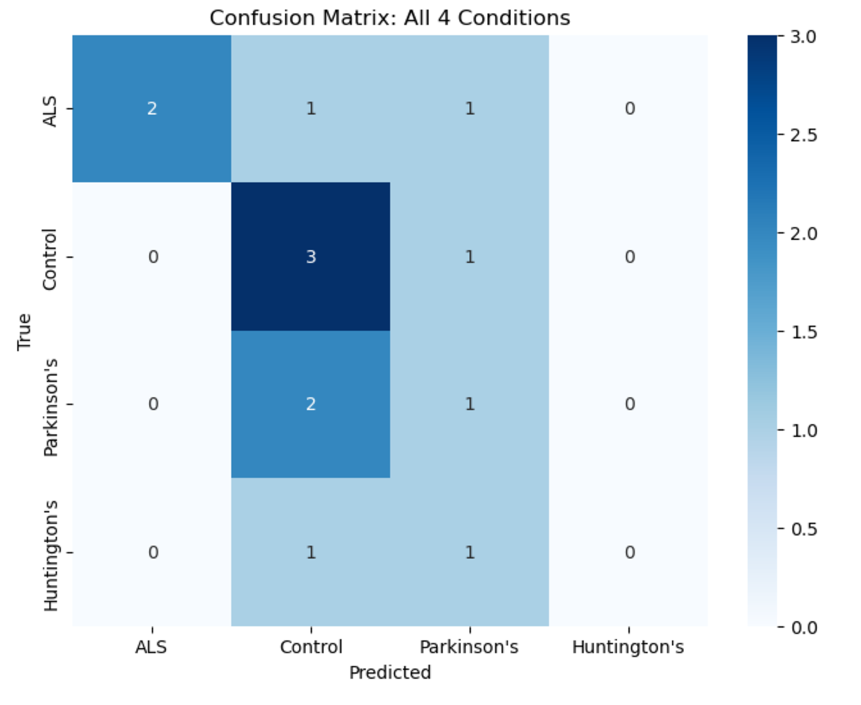
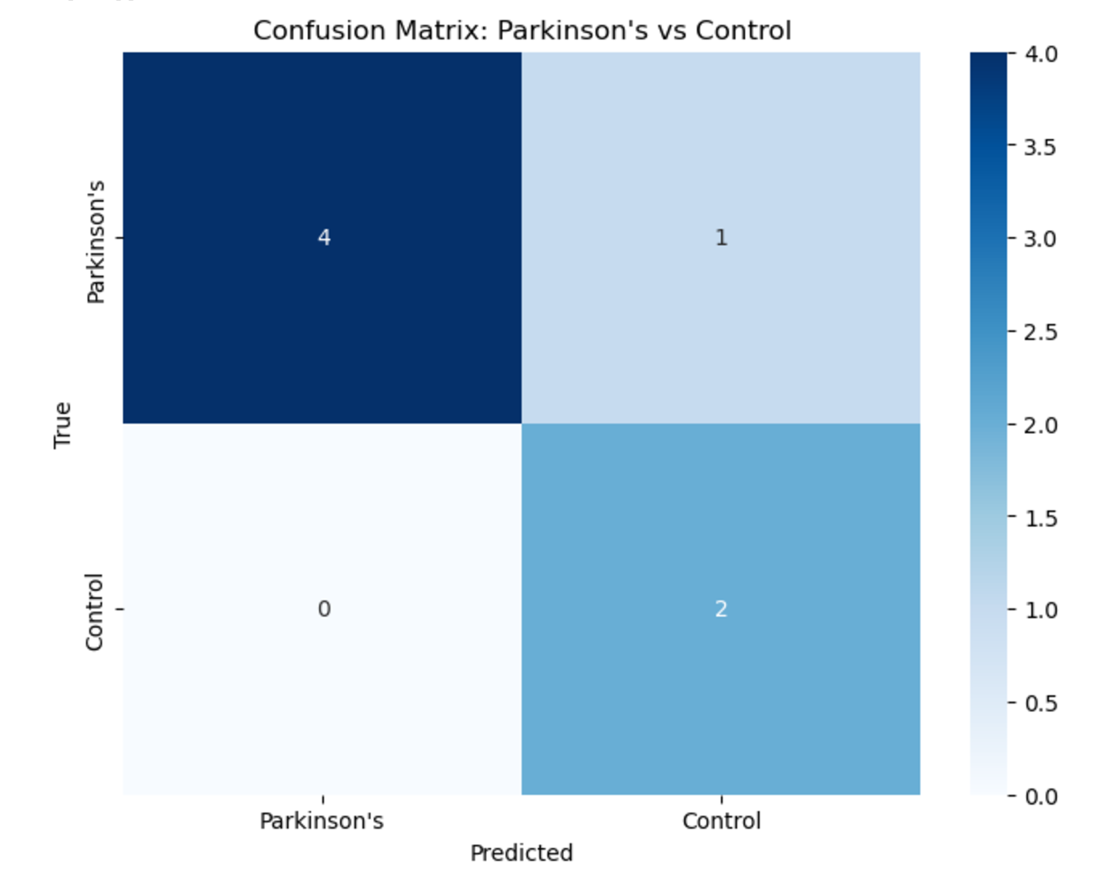
Results
Visualized Results using Confusion Matrix Plot
Individual Confusion Matrix: most accurate in distinguishing Parkinson's vs. Control (0.85 accuracy), least accurate in distinguishing Huntington's vs. Control (0.75 accuracy)
Model has low accuracy in distinguishing between all 4 conditions (0.46 accuracy)

