Slide 1
Japanese Restaurant
New York City

Slide 2
Introduction
Background
There are several factors that we need to considered to become successful in business. In this case is want to determine the best location (neighborhood) in New York City to start a restaurant
Problem
- What is best location in New York City for Japanese Restaurant ?
- Which areas have potential Japanese restaurant Market ?
- Which all areas lack Japanese restaurants ?
- Which is the best place to stay if I prefer Japanese Cuisine ?

Slide 3
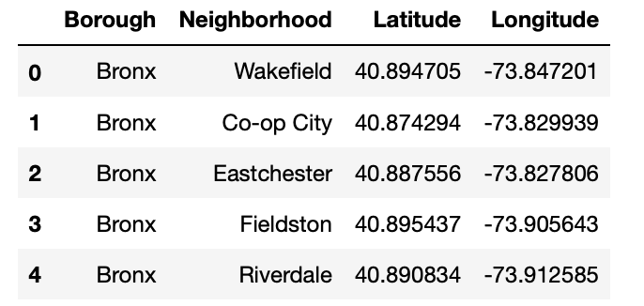
Data & Methodology
Example of New York neighborhood dataset
Method
Collect the NY city data
- Using FourSquare API we will find all venues for each neighborhood.
- Filter out all venues that are Japanese Resturants.
- Find rating , tips and like count for each Japanese Resturants using FourSquare API.
- Using rating for each restaurant , we will sort that data.
- Visualize the Ranking of neighborhoods using folium library(python)

Slide 4
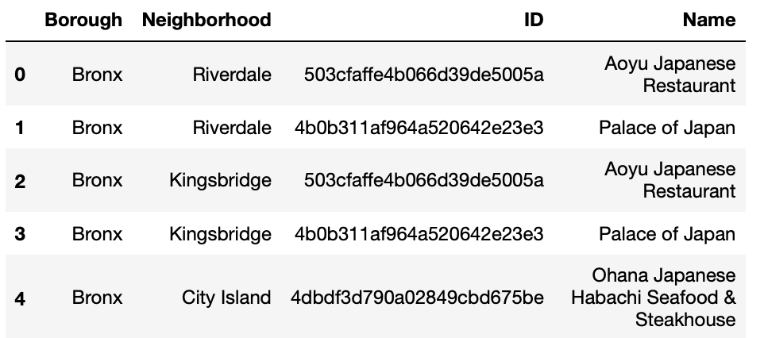
Results & Discussion
Conclusion
Japanese restaurant should be open in Bronx because there is few competitors in that area.

