Slide 1
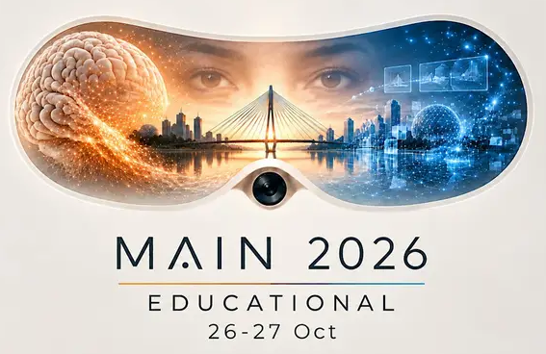
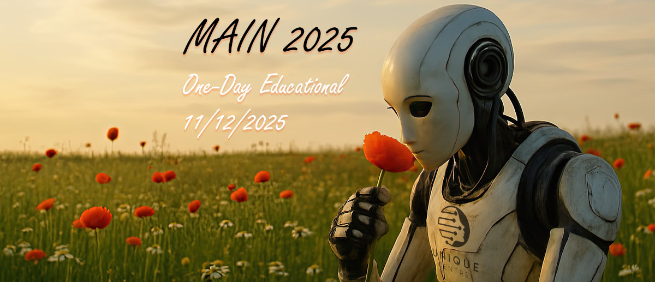

Slide 2

Sponsors

Slide 3

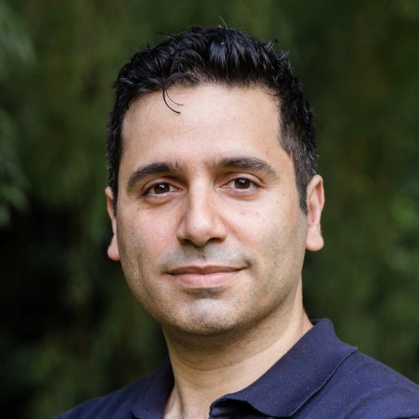
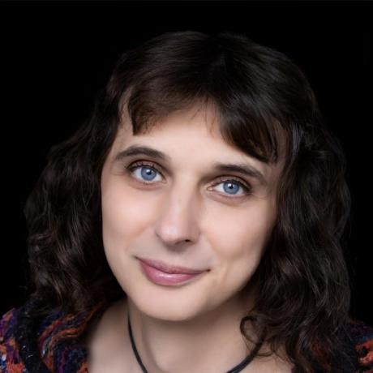
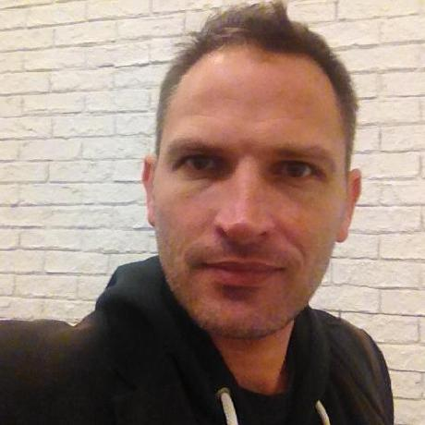
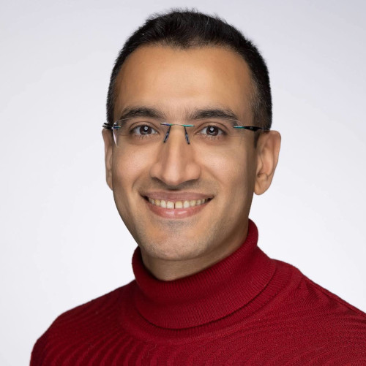
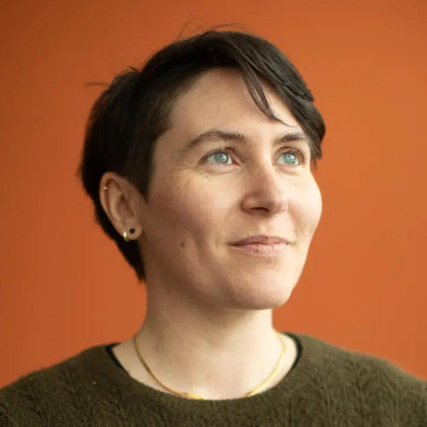
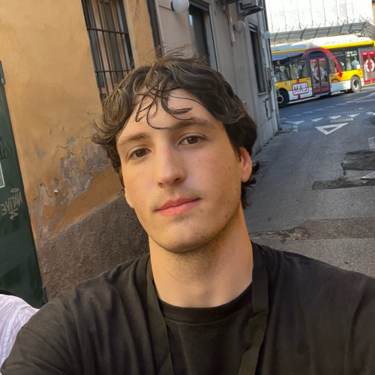
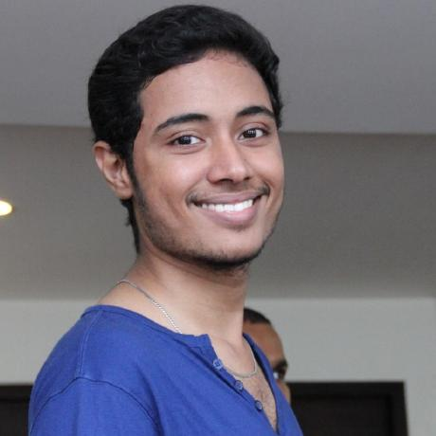
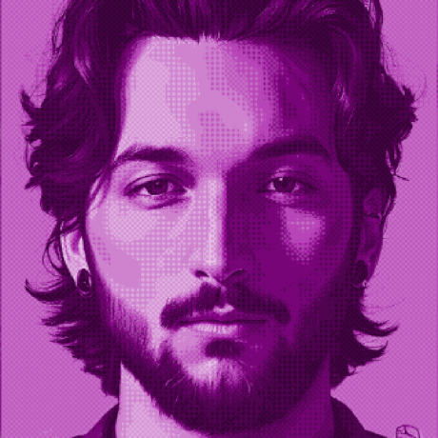
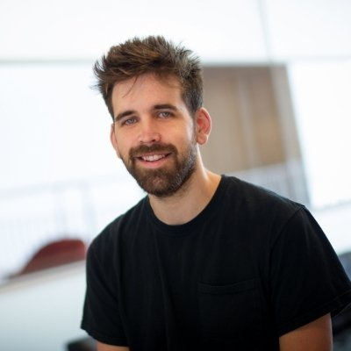

Organizers
Centre UNIQUE
Shahab Bakhtiari
Program committee
Lune Bellec
Executive committee
Karim Jerbi
Executive committee
Pouya Bashivan
Program committee
Audrey Durand
Program committee

Slide 4
Wifi Network: CRIUGM-Invite
Password: none
Room: Amphithéâtre
« Le Groupe Maurice »
Program and links to tutorial:
https://main-educational.github.io
Next: MAIN 2026 conference, October 29th-30th, HEC Montréal

Slide 5


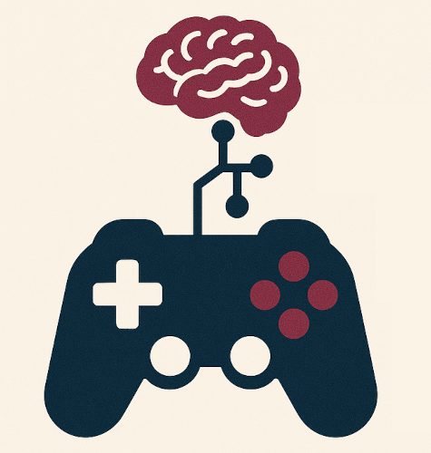

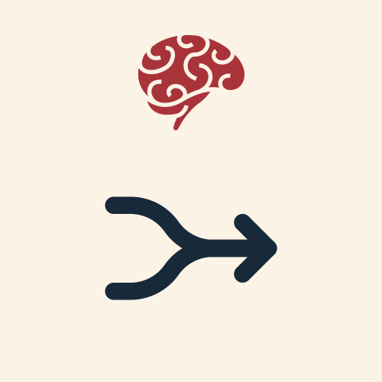



Sessions
Monday Oct. 26th: reasoning about the world
Tuesday Oct. 27th: benchmarking
World models and embodied agents
Active vision with deep neural networks
Reason to play
Cognitive benchmarking in large models
Alignment across modalities and brains

Slide 6
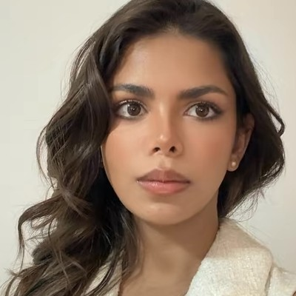
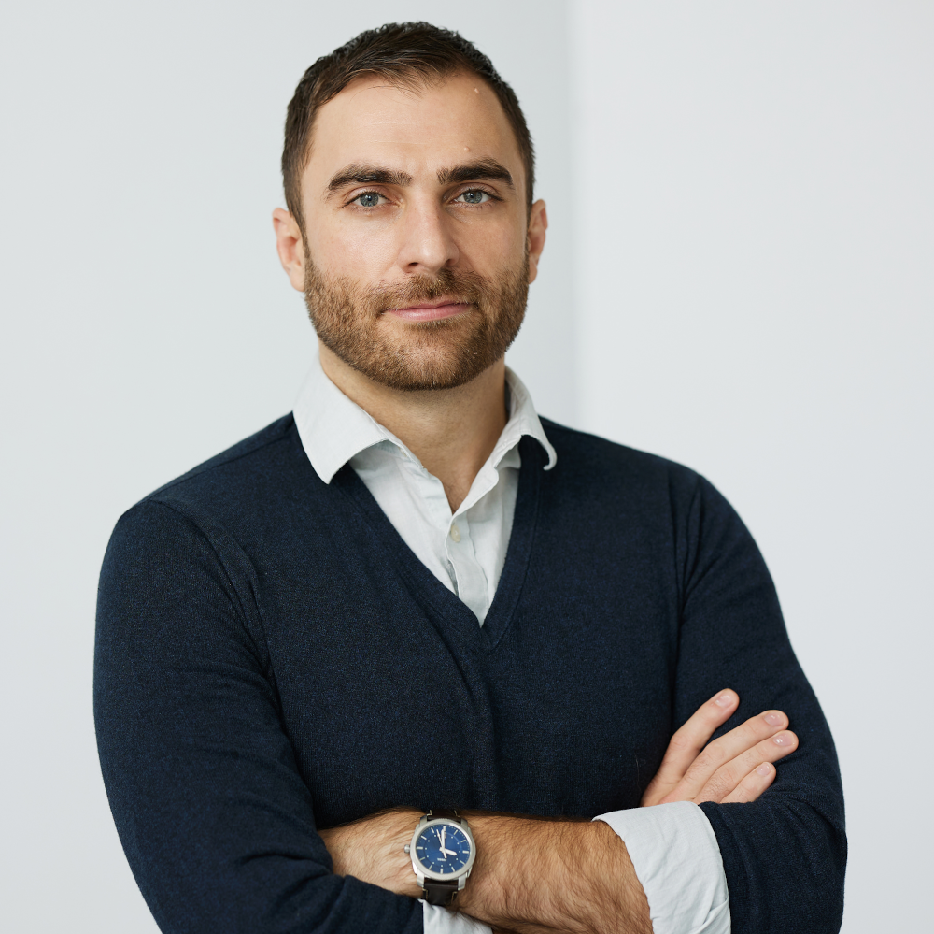
Session 1: World models and embodied agents
Monday October 26th
09:05-09:50 Lecture by Sonia Joseph, followed by questions
09:50-10:05 Break with coffee
10:05-12:05 Hands-on tutorial with Glen Berseth: Building World Models from the Ground Up
12:05-13:00 Lunch provided
Sonia Joseph
McGill University and Mila
Glen Berseth
Université de Montréal and Mila

Slide 7
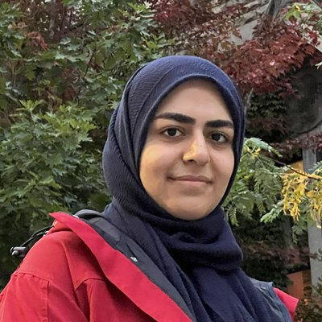
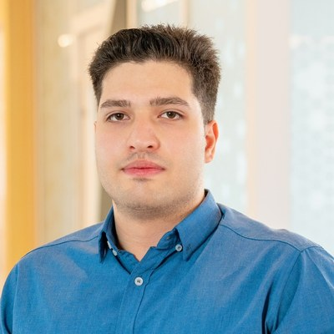
Session 2: Active vision with deep neural networks
Monday October 26th
13:00-14:45 Active vision with deep neural networks: from JEPA to seqJEPA and learned fixation policies
14:45-15:05 Break with coffee and snack
Motahareh Pourrahimi
Mila and McGill University
Hafez Ghaemi
Mila and Université de Montréal

Slide 8
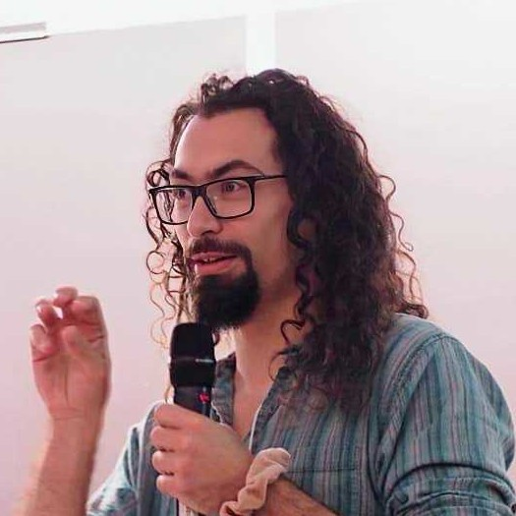
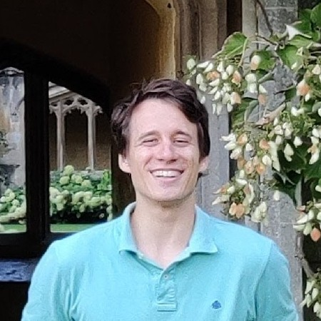
Session 3: Reason to play
Monday October 26th
15:05-16:50 Hands-on tutorial: human-AI alignment in learning to play new games, comparing large reasoning models with human players and their brain activity
Yann Harel
Boston College (in person)
Csaba Botos
Google DeepMind (online)

Slide 9

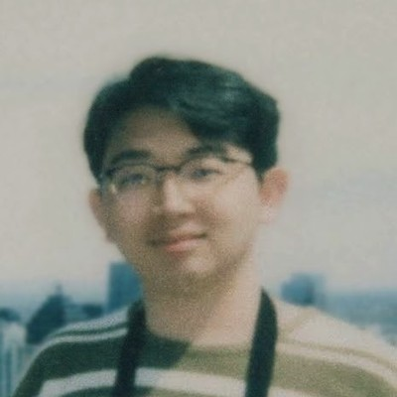
Session 4: Cognitive benchmarking in large models
Tuesday October 27th
08:30-09:00 Registration with coffee
09:00-12:00 Tutorial on LLMs, vision-language models and reasoning models (with a break)
12:00-13:00 Lunch provided
Lucas Gomez
McGill University
Zihan Weng
McGill University

Slide 10
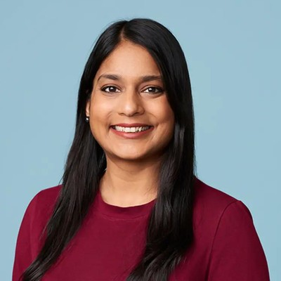
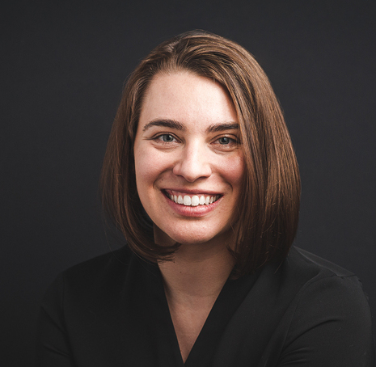
Session 5: Alignment across modalities and brains
Tuesday October 27th
13:00-13:50 Talk on vision-language alignment by Aishwarya Agrawal, followed by questions
13:50-14:00 Break with coffee
14:00-16:00 Hands-on tutorial with Elizabeth DuPre: functional alignment across participants with fmralign
Aishwarya Agrawal
Université de Montréal and Mila
Elizabeth DuPre
Université de Montréal

