Slide 1


Slide 2

Sponsors

Slide 3

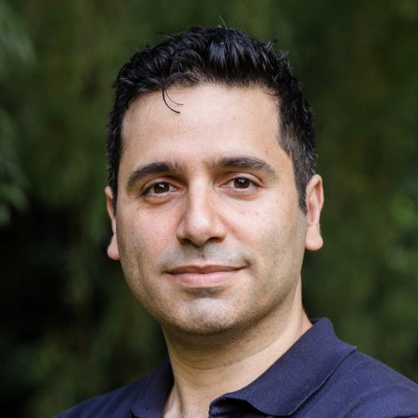
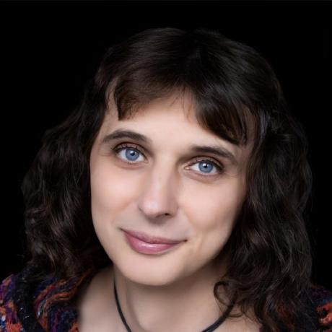
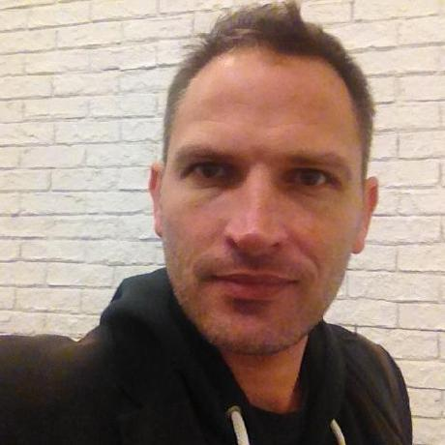


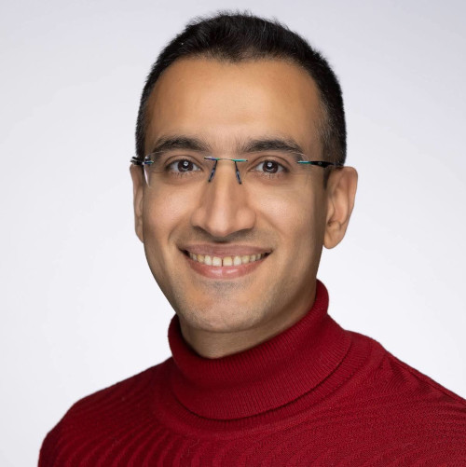
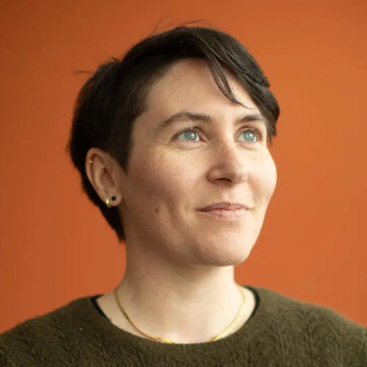
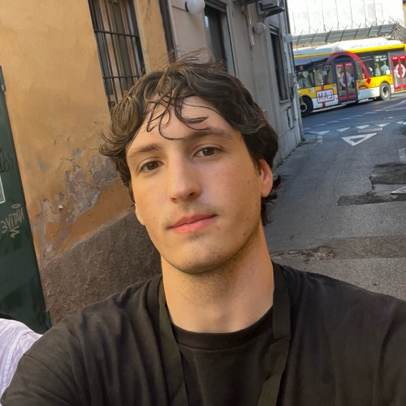
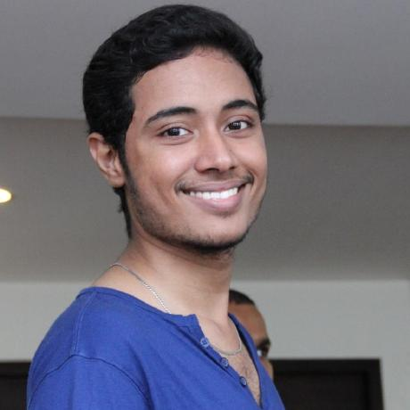

Organizers
Centre UNIQUE
Shahab Bakhtiari
Lune Bellec
Karim Jerbi
Shawn Manuel
Maelle Freteault
Pouya Bashivan
Audrey Durand
Luca Gomez
Pravish Sainath
Taylor Webb

Slide 4
Wifi Network: Événements-HEC
Password: Sept.HEC25!
Événements-HEC
Program and links to tutorial:
https://main-educational.github.io

Slide 5



Sessions
Cognitive benchmarks in large models
Videogames and RL for neuroAI
Dynamical systems for context integration

Slide 6
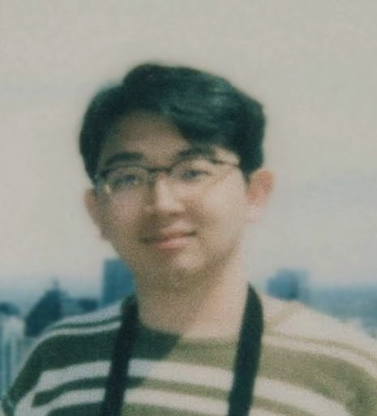
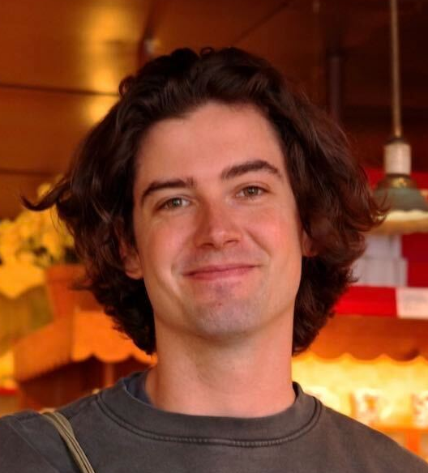
Session 1: cognitive benchmarks in large models
Lucas Gomez
Zihan Weng
Declan Campbell
09:00-12:00 Session in Room FPHEC
10:20-10:40 break with coffee and snack (room FPHEC)
12:00-12:45 Lunch provided (room FPHEC)

Slide 7
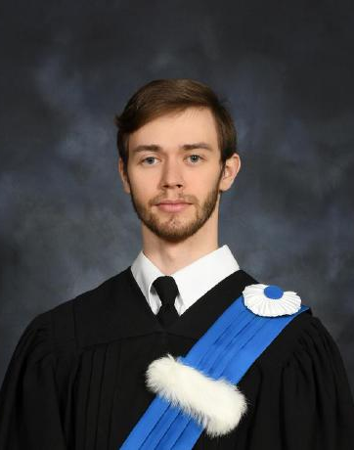
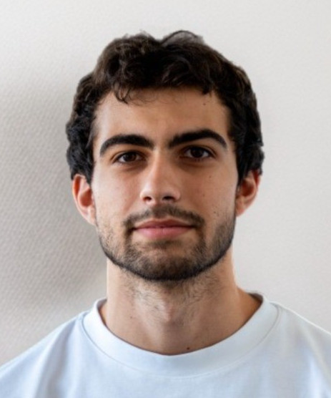
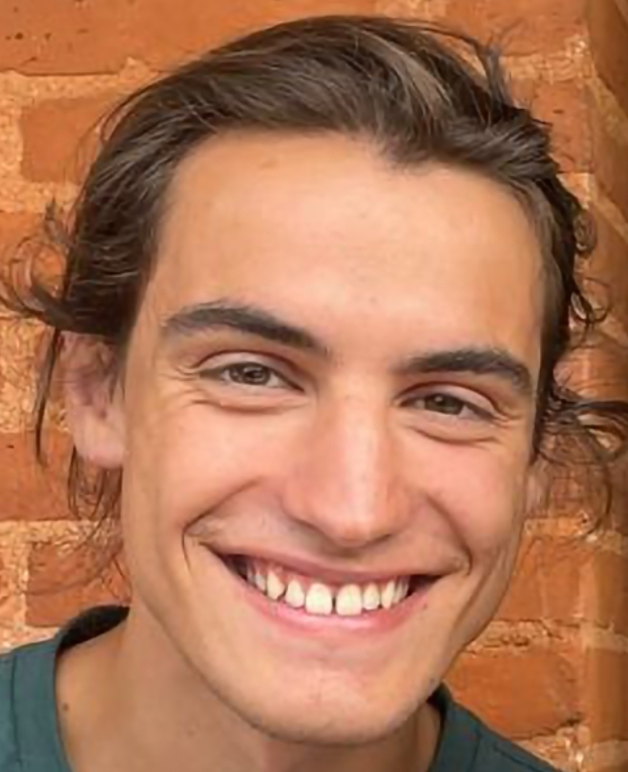
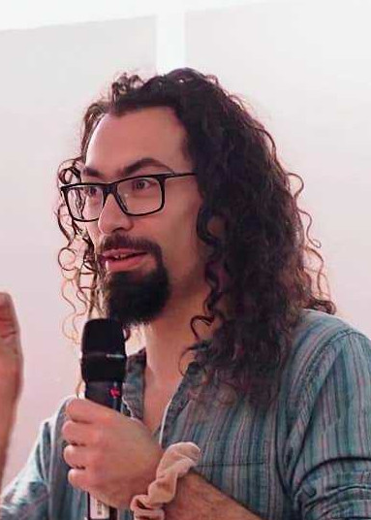
Session 2: videogames and RL for neuroAI
Julien Armand
Baptiste Bonin
Hugo Delhaye
Yann Harel
12:45-13:55 Videogames and RL for neuroAI part I (room FPHEC)
14:10-15:15 Videogames and RL for neuroAI part II (room Tkaronto)
15:15-15:35 Break with coffee and snack (room Tkaronto)

Slide 8
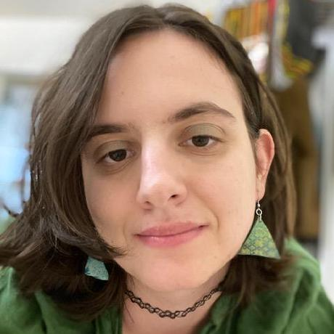
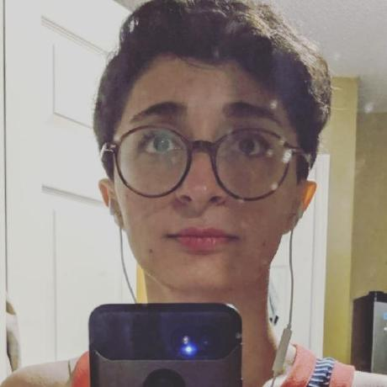
Session 3: Computation in NeuroAI: a dynamical systems perspective
Doris Voina
Ladan Shahshahani
15:35-17:30 room Tkaronto

