Slide 1
MAIN Training Days
Day 1: Machine Learning

Slide 2
Introduction to ML and Scikit-Learn

Slide 3
Contents
Set up Jupyter Notebook
Machine learning concepts
Scikit-learn examples
PCA & SVM
Nilearn tutorial (Part 1)
Nilearn tutorial (Part 2)

Slide 4
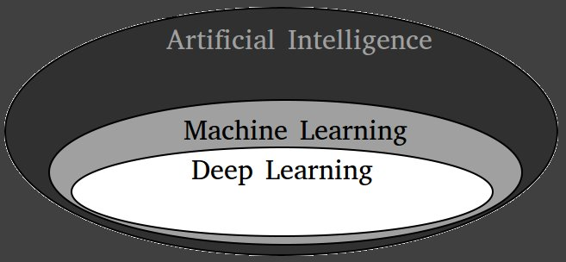
Machine Learning
Models with parameters which are optimized according to previously-seen data

Slide 5

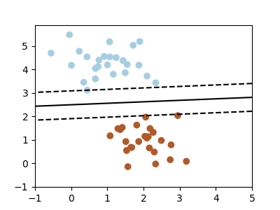

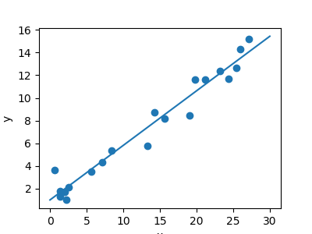
ML Tasks
Supervised Learning
  We have observations X we want to use to predict Y
  X: data, features, inputs
  Y: target, labels, outputs
  The goal is to find a model which best predicts Y based on X:
    Y = f(X)
  Models are further divided:
    Classification: Predicting ordinal numbers; determining classes for inputs
    Regression: Predicting continuous values
http://scipy-lectures.org/packages/scikit-learn/index.html

Slide 6


ML Tasks
Unsupervised Learning
  We have observations X
  The goal is to extract information about X
    E.g.: finding a representation, cluster the data

