Slide 1






⥫
SYRIATEL
Predicting Customer Churn
LEON MAINA

Slide 2






Introduction
Content: Brief overview of the project and its importance
Objective: Predict which customers are likely to leave (Churn).
Importance: Helps in taking proactive steps to retain customers.

Slide 3





Understanding Churn
Churn refers to the loss of customers or subscribers. It is a critical metric for businesses, especially in the telecommunications industry, impacting revenue and growth

Slide 4


Data Collection
We gathered data on customer demographics, usage patterns, and satisfaction metrics. This data will be analyzed to identify patterns and correlations.

Slide 5





Predictive Modeling
How we predict churn.
We use historical data to predict future behavior.
Models help us identify patterns & signals of potential churn.
Utilizing predictive modeling techniques can forecast potential churn with high accuracy.
This enables Syriatel to intervene and retain customers before they decide to leave.

Slide 6
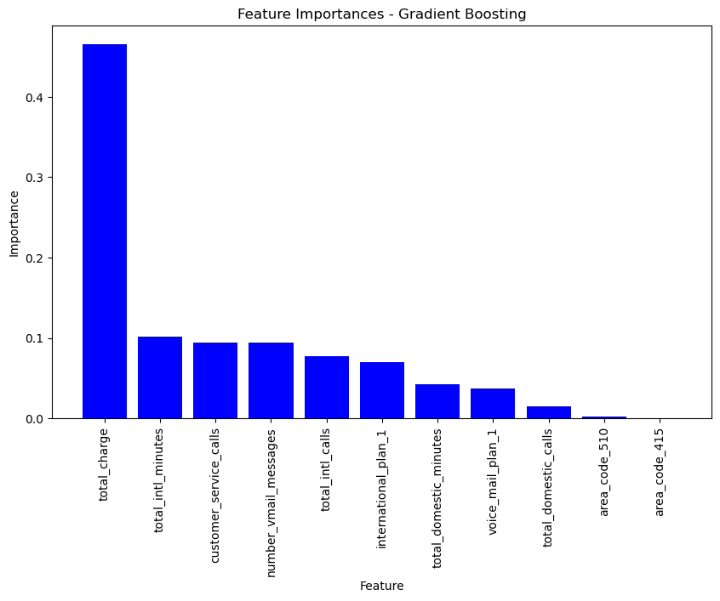
Key Metrics
Key metrics such as total charge, total minutes, and the use of voicemail and international plans will be of vital importance on predicting patterns of customer abandonment.

Slide 7
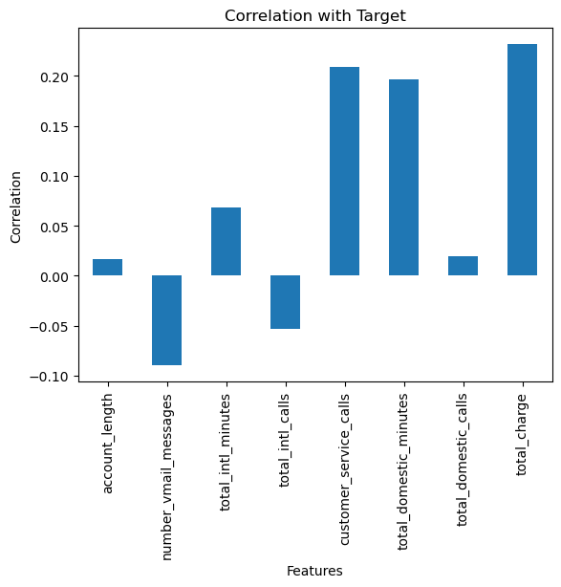
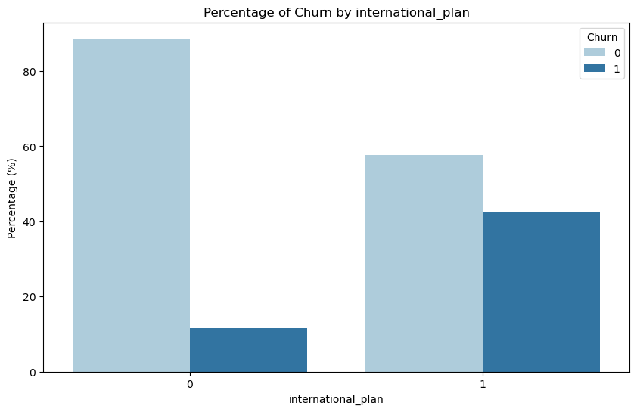
Factors Influencing Churn
Highlighting the most important factors that influence churn.
Total Charge: Higher charges are a strong indicator of churn.
Customer Service Calls: Frequent calls suggest potential issues.
International plan: Having an international plan plays a role

Slide 8

Model Performance.
Our models are measured in performance metrics accuracy, precision, recall.
Accuracy: How often we predict churn.(98%)
Precision & Recall: How weel we identify churners without too many false alarms.(87%)

Slide 9






Retention Strategies
Have a look at your international plan service delivery and charge and compare with competitors.
Promote Voicemails as customers enrolled are less likely to churn.
Look at the total charge and ways to reduce costs in the company and transfer that to the customer. Remove hidden charges if any.
Personalized Offers.
Focus on retaining high-risk customers with targeted interventions.
Improve customer service based on insights from frequent callers.
Tailor service plans to reduce churn rates.

Slide 10

Implementation Challenges.
Successful implementation of churn reduction strategies may face challenges such as data integration, resource allocation, and organizational alignment. Overcoming these hur is essential for long-term success.

Slide 11



Conclusion
Understanding and addressing customer churn patterns is critical for Syriatel's sustained growth and profitability. By leveraging insights from churn analysis, Syriatel can enhance customer retention and drive long-term business success.

Slide 12











Thanks!
Leon Ngari Maina.
ngarileon.com
+254 745 992 330
github.com/maina-leon

