Slide 1

SUSPICIOUS TRANSACTION DETECTION SYSTEM
Predicting Insights for Anti-Money Laundering (AML) Detection

Slide 2
TEAM MEMBERS
Mainak Chattopadhyay
Dinesh Saka
Neeha Shaik
Harika Ranipeta
Amrutha Srichandana Pallapothu

Slide 3
The existing methods for AML detection may not be sufficient to keep up with the evolving tactics of fraudsters, leading to potential vulnerabilities and increased risks for financial institutions and their customers. The challenge is to develop an innovative and efficient system that can detect suspicious transactions that can be potential money laundering activities, with the goal of preventing financial losses and protecting customers.
PROBLEM STATEMENT

Slide 4
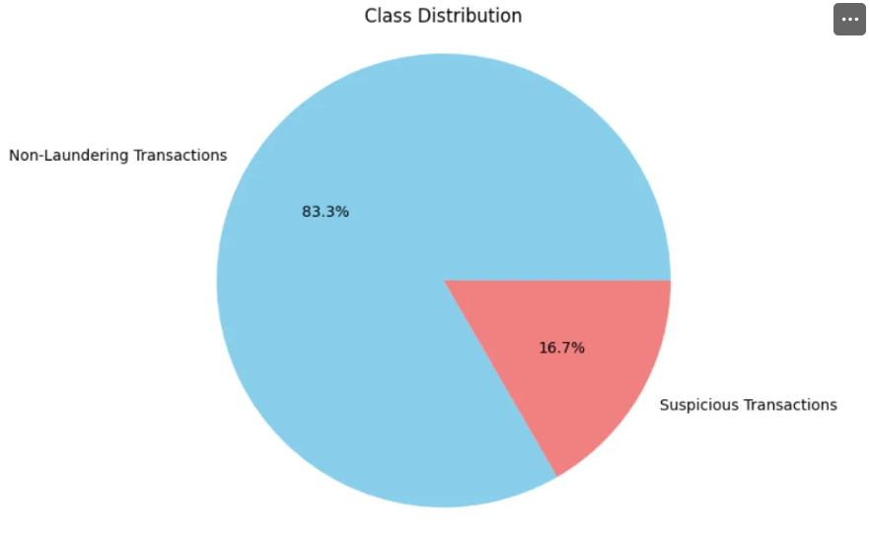
DATA VIZUALIZATION
Class Distribution :
Performance

Slide 5
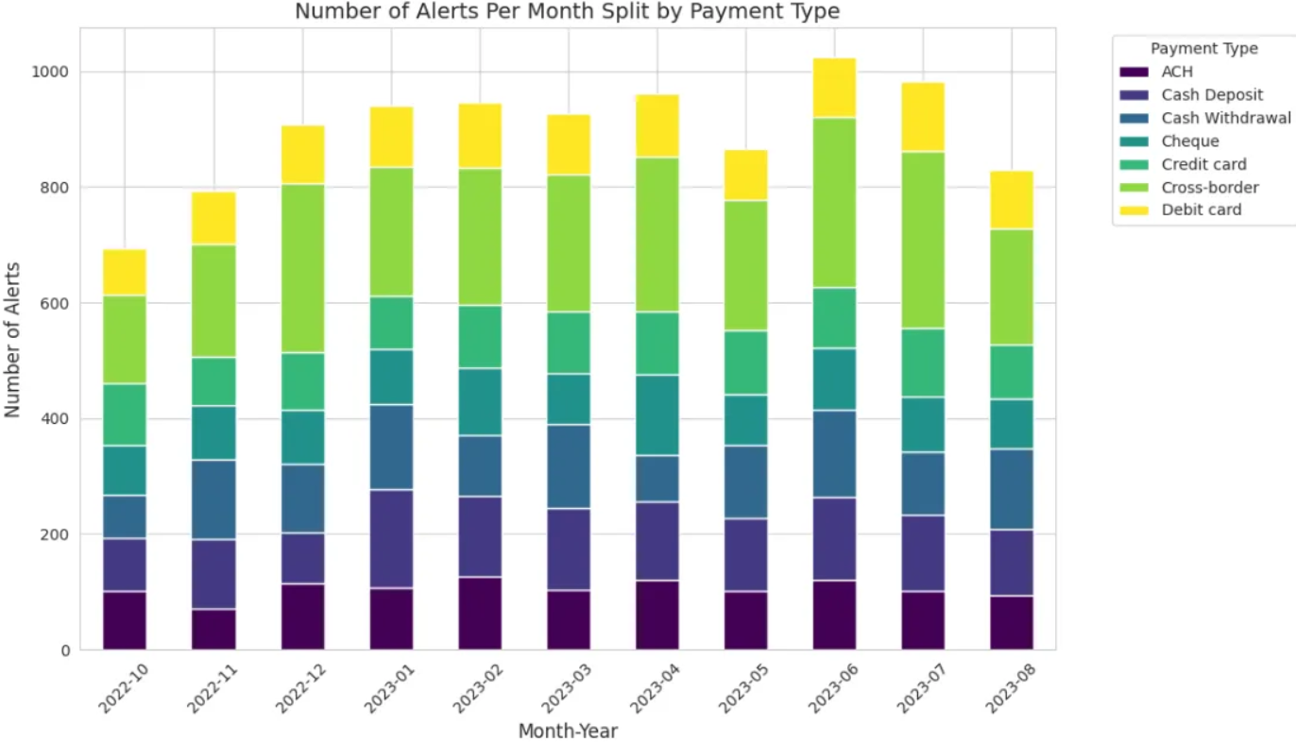
DATA VIZUALIZATION
No. of Alerts Per Month Split by Payment Type:
Performance

Slide 6
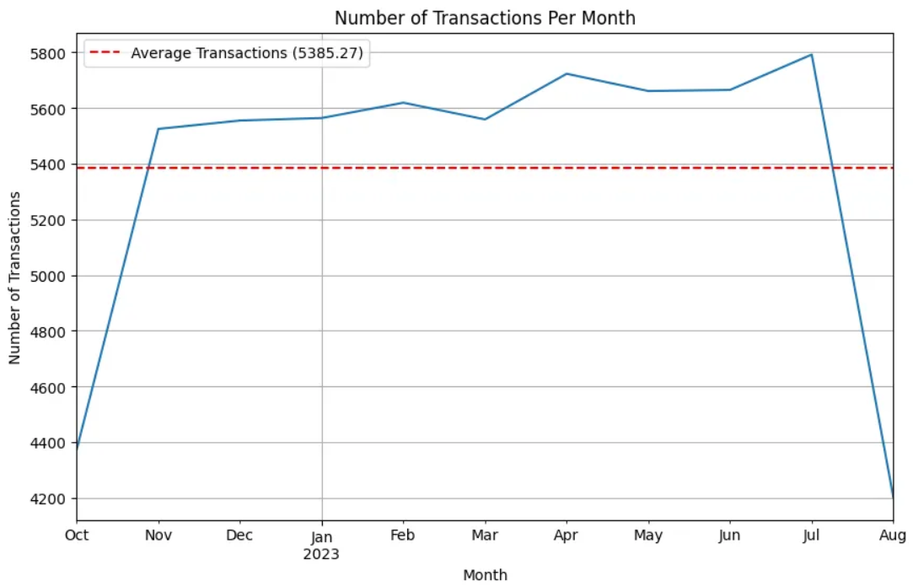
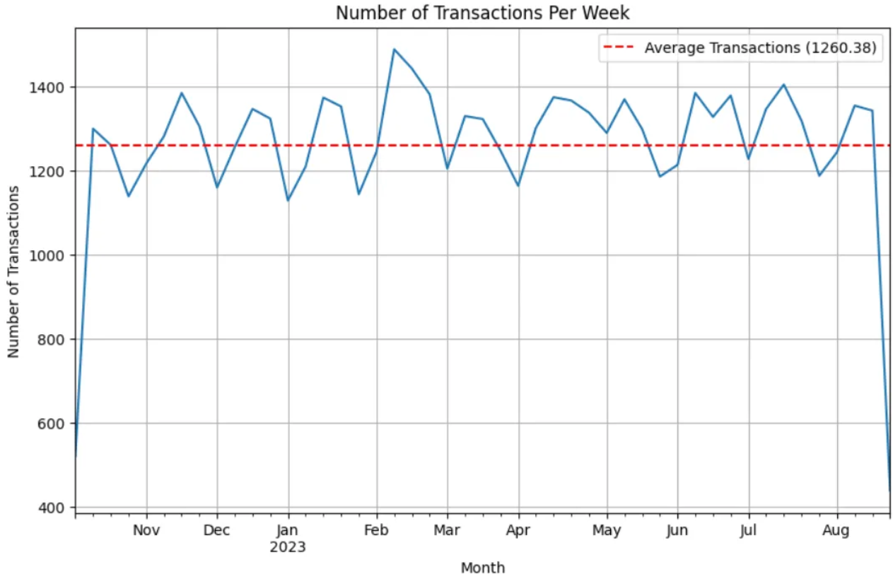
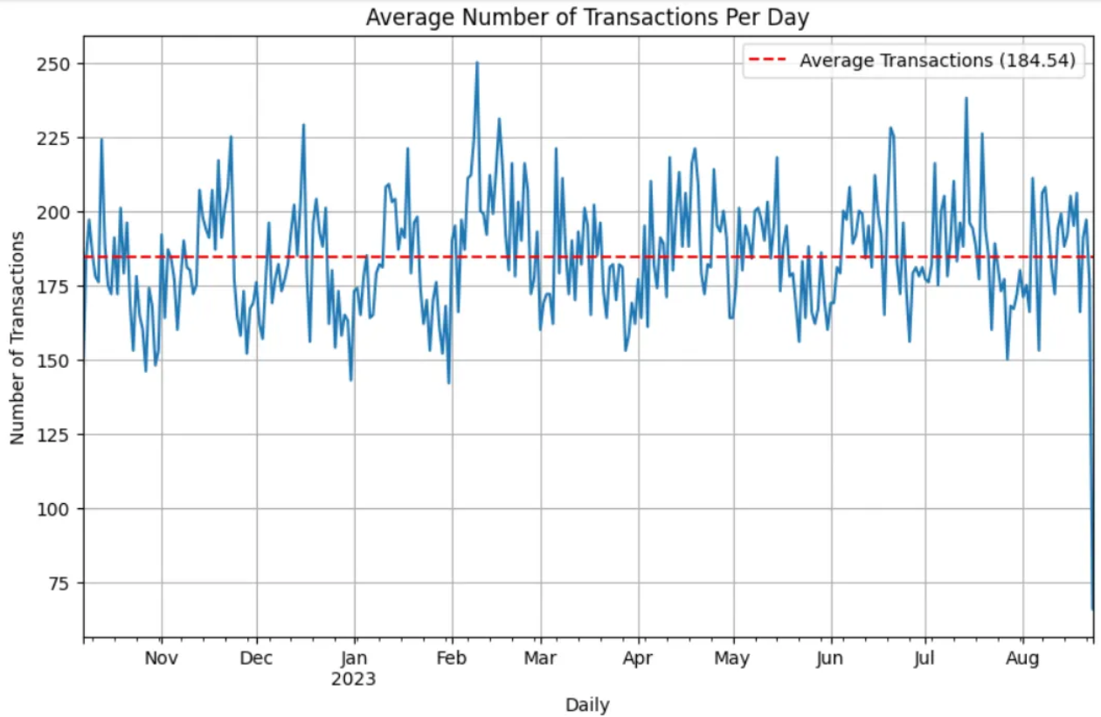
PER MONTH
PER WEEK
PER DAY
NUMBER OF TRANSACTIONS

Slide 7
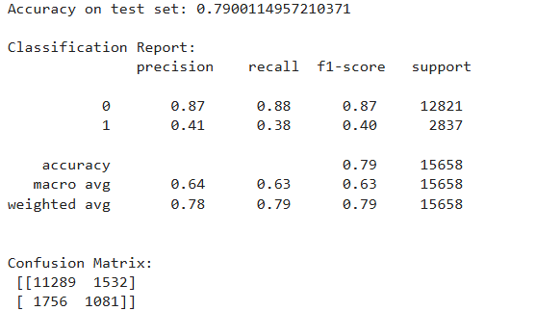
RESULT AND OUTCOMES

Slide 8
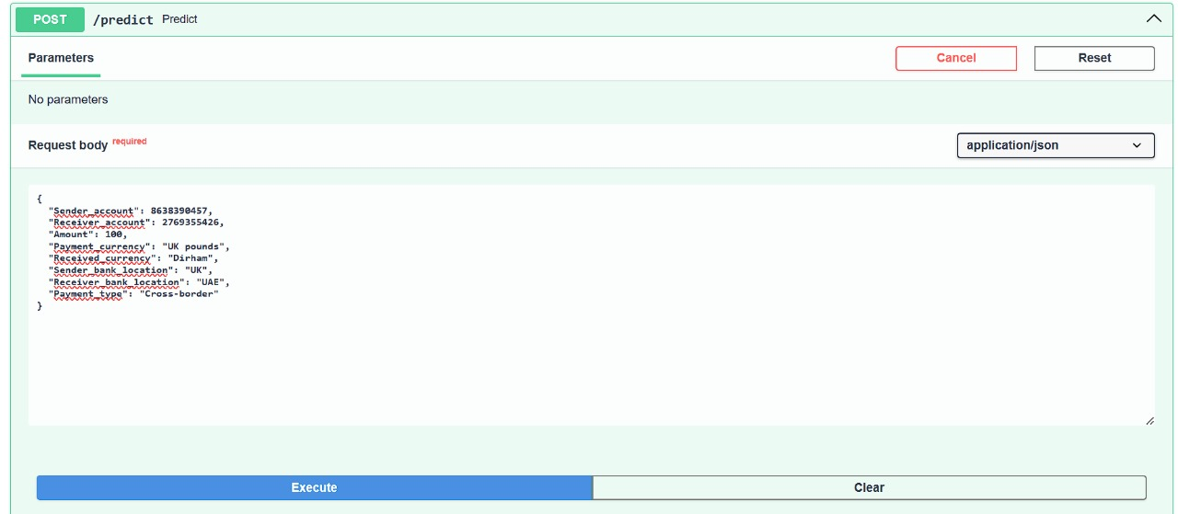

Slide 9
