Slide 1
OblivRec
CS670 · CRYPTOGRAPHIC TECHNIQUES FOR PRIVACY PRESERVATION · IIT KANPUR
Training
P₀ P₁ P₂
Serving
P₀ P₁ P₂
Private training and private delivery for recommendation
harvest
shared counts of
what was fetched
Nudge's three-server training composed with Pirsona's private retrieval, and measured: what the composition costs, and what it leaks.
Delivery
P₀ P₁
User
own device
Shravan Agrawal 230984
Shrasti Dwivedi 230982
Mainak Sarkar 230619
Final presentation · November 2026
Notes:
Shravan Agrawal · slide 1 of 26 · target 0:20
Hello. We are Shravan Agrawal, Shrasti Dwivedi and Mainak Sarkar, and this is OblivRec, our CS670 project on privacy-preserving recommendation. In the next thirty minutes we will show you what we built, what it costs, and where it breaks.

Slide 2
What a recommender learns about you
×
≈
B
item embeddings. Remember this one.
U
ratings, users × items
A
users, secret
Can a service recommend things to you, and deliver them, without learning what you rated, what it recommended, or what you opened?
Notes:
Shravan Agrawal · slide 2 of 26 · target 1:00
Every recommender works the same way. You tell it what you liked, and it learns what you will like next. Collaborative filtering does this by factorising a large matrix of ratings, one row per user and one column per item, into two small matrices. One describes users and one describes items. The item matrix is called B, and it will matter a great deal later. The catch is that the service has to see your ratings to do any of this. Your ratings are your preferences, and preferences reveal far more than people expect. So the question this project asks is simple to state. Can a service recommend things to you, and deliver them, without ever learning what you rated, what it recommended, or what you actually opened?

Slide 3
Two papers, two halves
Collection
ratings leave the user
Training
the model is fitted
Serving
scores are computed
Delivery
the item is fetched
NUDGE · USENIX SECURITY 2026
three servers, power iteration on secret shares
stops at the scores
PIRSONA · POPETS 2021
private retrieval for delivery, and the harvest that feeds training, with four-party Boolean training
“relies on other means (e.g., Apple’s private relay, Tor, or cryptographic private information retrieval) to let users fetch data items in a private way.”
Nudge, on what it does not do
Notes:
Shravan Agrawal · slide 3 of 26 · target 1:30
Our instructor pointed us at two papers, and each one solves half of this problem. The first is Nudge, from USENIX Security 2026. It trains the recommender on secret-shared ratings across three servers, at the scale of the Netflix dataset. But Nudge stops at the scores. In its own words, it relies on other means to let users fetch data items in a private way. So once you know which film to watch, fetching it tells the server exactly which film that was. The second paper is Pirsona, from PoPETs 2021. It does the fetching privately, using private information retrieval, and it has a lovely trick where the servers collect the next round of training data straight out of those private fetches. But its training runs a four-party protocol, and Nudge's training needs one fewer server that has to be trusted not to collude. So neither paper does both halves well. Nudge has the training we want and Pirsona has the private delivery, and nobody had put them together, because nobody had built both.

Slide 4
What we built
Nudge’s private training, composed with Pirsona’s private delivery, and measured.
WRITTEN
Every protocol in C++17, from the papers. No cryptographic library.
CHECKED
18 test binaries, also run in a hardened build with undefined-behaviour traps and bounds checks.
REPRODUCIBLE
One command, mingw32-make reproduce, rebuilds every figure from committed data.
Notes:
Shravan Agrawal · slide 4 of 26 · target 0:45
That is what we did. OblivRec composes Nudge's private training with Pirsona's private delivery into one system, and then measures the composition, because a composition is only interesting if you know what it costs. Everything we show you today runs. We wrote the cryptographic core ourselves, from the original papers rather than from a library. And every figure on these slides is regenerated from committed data by a single command.

Slide 5
Private training
x = x₀ + x₁ + x₂
for each of 16 components
v ← random start
repeat 10 times
w ← U · v | 1 round
v ← transpose(U) · w | 1 round
v ← Trunc(v) | 3 rounds
v ← SetOrthogonal(v, B) | local, then Trunc
v ← Normalize(v) | Trunc inside
open v as the next row of B | public by design
P₀
holds x₀, x₁
P₁
holds x₁, x₂
P₂
holds x₂, x₀
One server sees two uniformly random pieces. Any two can reconstruct, so we assume at most one is compromised.
Matrix-vector products cost one round each, whatever the size of U. Truncation and normalisation take most of the rounds.
Notes:
Shravan Agrawal · slide 5 of 26 · target 1:30
Here is how the training half works. Each user's ratings are split into three random-looking pieces, one per server, so that any two servers together could recover them but any single server sees only noise. This is two-out-of-three replicated secret sharing. Now, factorising a matrix under secret sharing is normally expensive, because multiplying two secret values forces the servers to talk to each other. Nudge's insight is to factorise with power iteration, which is mostly matrix-times-vector work. Under this kind of sharing, a matrix-vector product is cheap. Each server multiplies its own pieces locally, and only the result is exchanged, in a single round, however large the matrix is. Most of the rounds go to two other operations: truncation, which keeps fixed-point numbers from overflowing, and normalisation. There is one design choice to hold onto. As each part of the item matrix B converges, it is opened in the clear. B is public, by design. That is what makes training affordable, and it is also the reason delivery has to be private, as Shrasti will show you.

Slide 6
Private delivery
01
02
03
04
Servers
score shares ⟦a⟧ · B, computed locally, no rounds
User
adds the shares and picks the top 10 on the device
User to P₀, P₁
one short key per server, per fetch
P₀ and P₁
each expands its key over all 2,048 records
227 B
16,384 B
Each key on its own is pseudorandom. The difference of the two answers is the record, and neither server learns which one it was.
the key each server receives, for a 2,048-record catalogue
the naive one-hot query it replaces
Notes:
Shravan Agrawal · slide 6 of 26 · target 1:30
Now the delivery half. Once B is public, scoring is almost free. Your score for every item is your own secret vector times the public matrix B, and multiplying a secret-shared vector by a public matrix needs no communication at all. Each server computes its share of your scores alone. The servers never assemble a ranking. They hand you your score shares, you add them up on your own device, and you pick your top ten locally. Then you have to fetch those ten items, and this is where Pirsona's half comes in. We use two-server private information retrieval, built on a distributed point function. You send each server a short key, 227 bytes for our catalogue. Each key on its own looks random. The server runs it across every item in the catalogue and returns a combination, and when you put the two answers together you get exactly the record you asked for. Neither server learns which one. We wrote this distributed point function ourselves, and Mainak will show you how we checked it.

Slide 7
Closing the loop
Training
P₀ P₁ P₂
B public, ⟦A⟧ shared
Serving
P₀ P₁ P₂
WHAT RUNS TODAY
The harvest, its conversion and the weight check are built and tested. A test drives real private fetches through them into the training code.
The running servers do not yet retrain from harvested counts. Every model in this talk was trained on ratings read from disk.
Cost: one round per training refresh to convert, one round per query to check the weight.
harvest
shared counts of
what was fetched
score shares
Delivery
P₀ P₁
User
own device
one key pair per fetch
Notes:
Shravan Agrawal · slide 7 of 26 · target 1:20
There is one more piece, and it is what makes this a system rather than two halves bolted together. When a server answers a private fetch, it has already computed a secret share of a vector with a one at the item you fetched. Pirsona's trick is to keep that share instead of throwing it away. Summed over all your fetches, those shares become a secret-shared record of what you consumed, which is exactly the input the next round of training needs. So the servers collect the next round's training data straight out of this round's private fetches, with no separate upload. Turning those shares into training input costs one round per training refresh. Delivery feeds training, and training feeds delivery. To be precise about how far this goes: the harvest is built and tested, and a test drives real private fetches through it into the training code. Our running servers do not yet retrain from it, and every model we show was trained on ratings read from disk.

Slide 8
It runs end to end
$ demo --user 42 --k 10 \
--a A_private_fss_b128_ell10.bin --b B_private_fss_b128_ell10.bin
rank item score (2t-scaled) title (fetched privately)
0 0 3985510293721 Toy Story (1995)
1 94 3253835172460 Aladdin (1992)
2 172 3003783912317 Princess Bride, The (1987)
3 285 2832029832122 English Patient, The (1996)
4 236 2784941524260 Jerry Maguire (1996)
5 70 2682062760624 Lion King, The (1994)
6 203 2626050118158 Back to the Future (1985)
7 14 2564579331556 Mr. Holland's Opus (1995)
8 317 2432749438261 Schindler's List (1993)
9 116 2292504447885 Rock, The (1996)
ranking agrees with model/out/top10_u42_private_fss_b128_ell10.txt on all 10
positions, in order.
All 10 records fetched privately and verified byte-exact
against a cleartext lookup. Each fetch cost one 227-byte DPF key
per server against a 2048-entry domain.
10 of 10
ranking positions match an independent reference
byte-exact
every fetched record, against a cleartext lookup
no leak
the model was trained with the normaliser that reveals nothing
Real output of the demo, captured from the program, not retyped. Model: spec-faithful training, 128-bit ring, 10 iterations.
Notes:
Shravan Agrawal · slide 8 of 26 · target 0:45
And it does run, end to end. This is our demo serving a model that was trained privately, using the version of training that reveals nothing at all. It returns ten real film titles for user forty-two, Toy Story first, and every one of them was fetched by private information retrieval and checked byte for byte against the catalogue. The ranking also matches an independently computed reference on all ten positions. Nothing on this screen was ever visible to a server. But there is a question we have not answered yet. Does delivery really need to be private at all?
[Hand over to Shrasti]

Slide 9
A fetch is a projection
01
B is public, so every item has a position everyone can see.
your vector, secret
the observer’s estimate, their mean
an item you fetched
any other item, at its public position
02
Your recommendations are the items pointing most nearly the way your secret vector points.
03
So each fetch an observer sees is a direction near yours, not one bit.
Schematic. The real item space has 16 dimensions.
Notes:
Shrasti Dwivedi · slide 9 of 26 · target 1:00
Thank you, Shravan. Let me start with the design choice he asked you to hold onto. B is public. Every item has a public position in a sixteen-dimensional space, and your recommendations are simply the items that point most nearly in the same direction as your own secret vector. So think about what an observer learns if they see which items you fetch, and nothing else. Each fetch is not one bit of information. It is a direction in a space everyone can see, and it tells the observer that your vector points somewhere near it. Collect a few of those, and the observer can start to triangulate your vector. That is the attack, and we measured it.

Slide 10
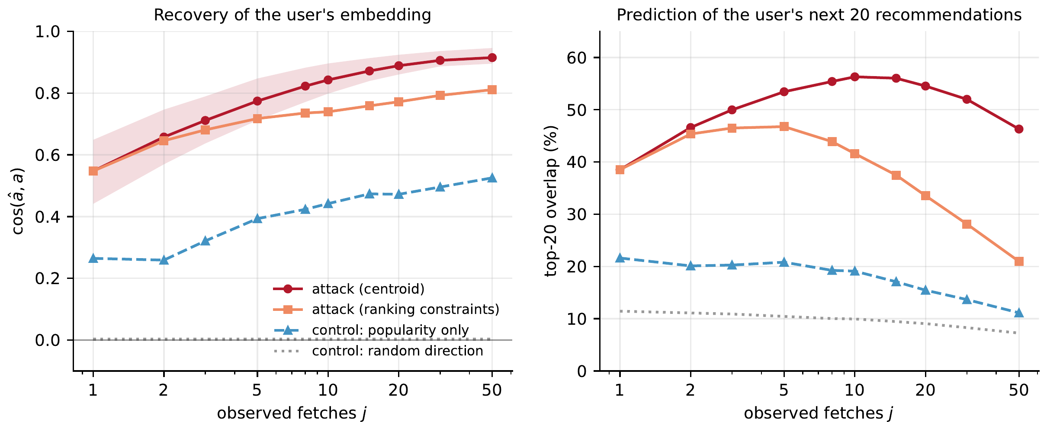
The attack
0.55
cosine with your true vector after one fetch
0.84
after ten fetches
56%
of your next twenty recommendations, predicted from those ten
Data bench/results/leakage_attack.jsonl · all 943 users · F1
The observer sees only which items you fetched. No ratings, no scores.
Notes:
Shrasti Dwivedi · slide 10 of 26 · target 1:30
Here is the result, across all 943 users of MovieLens. The attack is deliberately simple. The observer averages the public vectors of the items you fetched and uses that as a guess of your secret vector. After a single fetch, the guess already has a cosine similarity of 0.55 with your true vector. After ten fetches it reaches 0.84. And the number that matters most to a non-specialist is on the right. From your first ten fetches alone, the observer predicts 56 percent of your next twenty recommendations, things you have not fetched yet. So without private delivery, a server that never sees a single rating still learns your taste well enough to predict what you will watch next. Neither of the papers we started from measures this, because neither one implements both halves.

Slide 11
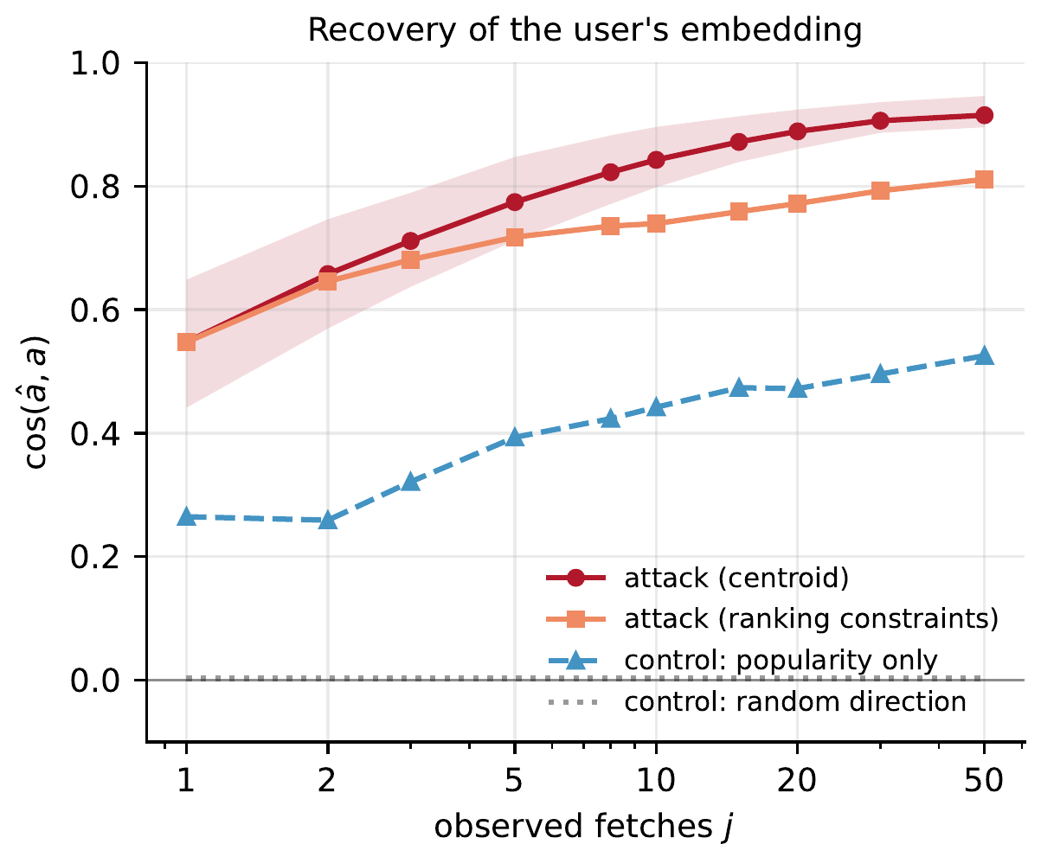
The control
0.84
0.44
the attack, ten fetches
the same method on the ten most popular items, ignoring the user
0.40
the margin: what is learned about you, not about what is popular
The margin is 0.28 after one fetch and 0.38 to 0.42 from two to fifty. A random direction scores 0.003.
Data leakage_attack.jsonl · F1, left panel
Notes:
Shrasti Dwivedi · slide 11 of 26 · target 1:15
The part of this experiment we care about most is the control. Popular films sit near the top of almost everyone's list. So a guessing method can look impressive while having learned nothing about you personally, only what is popular, which is public anyway. So we ran the identical method on the ten most popular films in the catalogue, ignoring the user completely. It reaches a cosine of 0.44. The attack reaches 0.84. The gap between them, about 0.40, is the part that is genuinely about you, and it stays at roughly that size for every number of fetches from two to fifty. We also report a random guess, which sits at zero, as it should. We would rather show you the control than let a large number speak for itself.

Slide 12
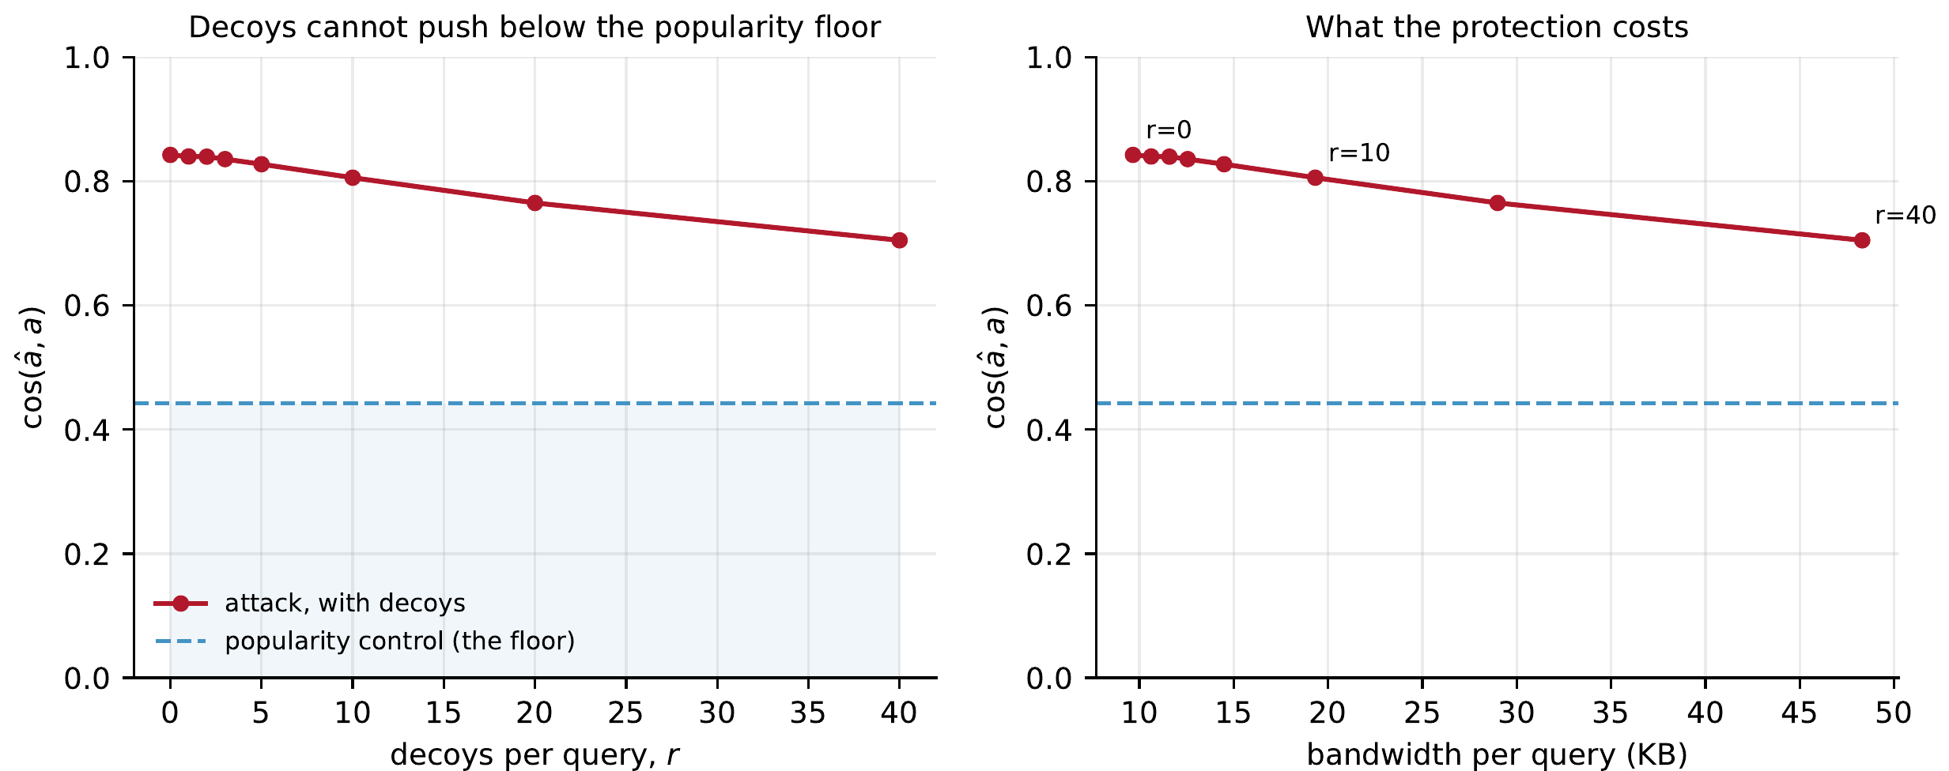
Defence one: decoys
40 decoys
five times the real traffic
0.71
the attack after them, from 0.84
0.44
the floor a working defence must reach
Data leakage_attack.jsonl · popularity-weighted decoys, k = 10 · F6
Popular decoys pull the estimate toward what is popular, which the control already knew.
Notes:
Shrasti Dwivedi · slide 12 of 26 · target 1:15
So can we avoid private retrieval with something cheaper? The obvious idea is decoys. Fetch your ten real items plus some extras to confuse the observer, drawn from popular items so that they look plausible. We measured it. Even with forty decoys, five times the real traffic, the attack only falls from 0.84 to 0.71. The popularity line sits at 0.44, and that line is where a defence has to land to have actually worked, because below it the observer has learned nothing about you that is not already public. Decoys do not get there. The reason is that averaging is robust. Adding popular items pulls the guess toward what is popular, which the control already knew.

Slide 13
Defence two: differential privacy
v ← (U^{T}U + E) v
σ = √(2 ln(1.25 / δ)) / ε
δ = 2⁻⁴⁰ as in Nudge. The paper does not state the scale, so it comes from Analyze Gauss, the result it cites (Dwork, Talwar, Thakurta, Zhang, STOC 2014).
Nudge, section 9: power iteration on the Gram matrix plus symmetric Gaussian noise E, shared once through PRF keys, so it costs no communication.
ONE DELIBERATE CHANGE
Nudge divides each user’s row by the number of ratings. That bounds a row’s norm by 5 / √c, which is above one for anyone with fewer than 25 ratings. We normalise rows to unit length instead, which makes the bound exact, and report both versions.
200 of 943
users in our training split have fewer than 25 ratings
Notes:
Shrasti Dwivedi · slide 13 of 26 · target 1:30
The second, more principled idea comes from Nudge itself. Its section nine adds differential privacy. We read that section before writing any code, and it was not what we expected. Nudge does not add noise to B. It adds Gaussian noise to the Gram matrix, U transpose U, through a noise term inside every step of power iteration. That costs no communication, which is elegant. The paper does not state the noise scale, so we took it from the result by Dwork and colleagues that it cites, known as Analyze Gauss. We also changed one detail on purpose. Nudge normalises each user's ratings by how many they gave, but that does not keep every user's contribution bounded. Two hundred of our 943 users have fewer than twenty-five ratings, which is exactly where the bound fails. So we normalised by length instead, which makes the guarantee exact, and we report both versions.

Slide 14
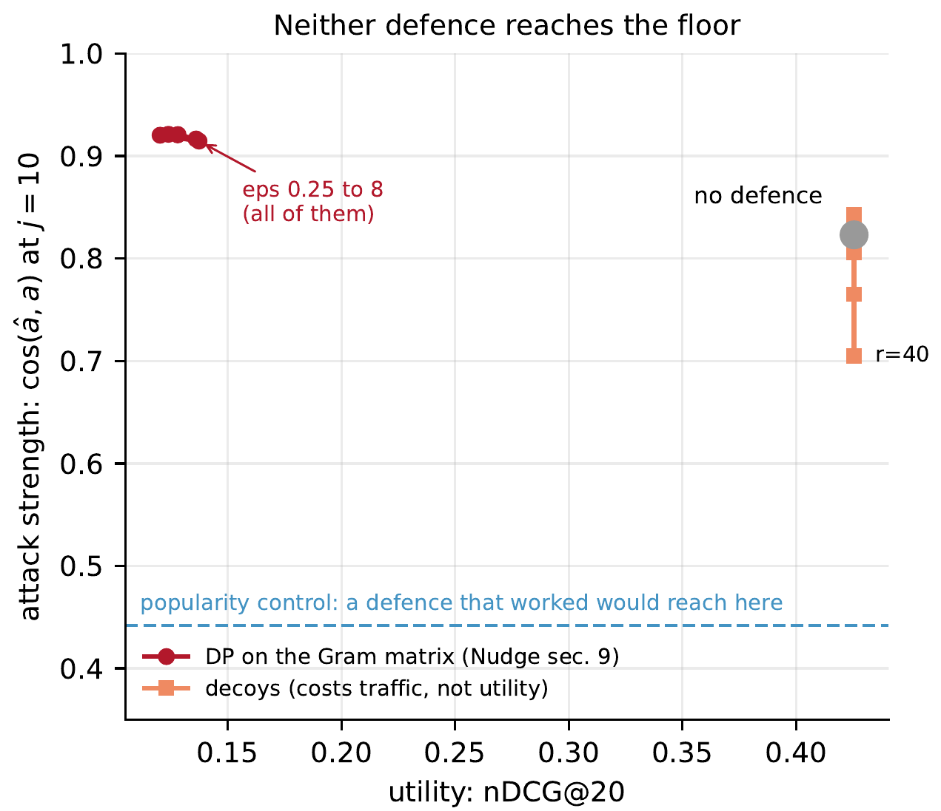
Why it fails
−71%
recommendation quality at ε = 1: nDCG@20 from 0.4255 to 0.1239
0.82 → 0.92
the attack gets stronger, not weaker
Differential privacy bounds what B reveals about other people’s ratings. The attack uses B as a known map, and you and the observer share the same noisy B.
Data dp_study.jsonl · ε = 1, δ = 2^-40 · F10, left
Notes:
Shrasti Dwivedi · slide 14 of 26 · target 1:00
Both results go the wrong way. At epsilon equal to one, recommendation quality falls by 71 percent. And the attack does not get weaker. It gets stronger, from 0.82 to 0.92. That sounds like a paradox, but it is not. Differential privacy here protects the training data, meaning what B reveals about other people's ratings. Our attack asks a different question. It recovers your own vector, using B as a known map. You and the observer both use the same published, noisy B, so the geometry of the attack is untouched. What the noise does destroy is the shared popularity structure, and that structure was helping the control, not the attack.

Slide 15
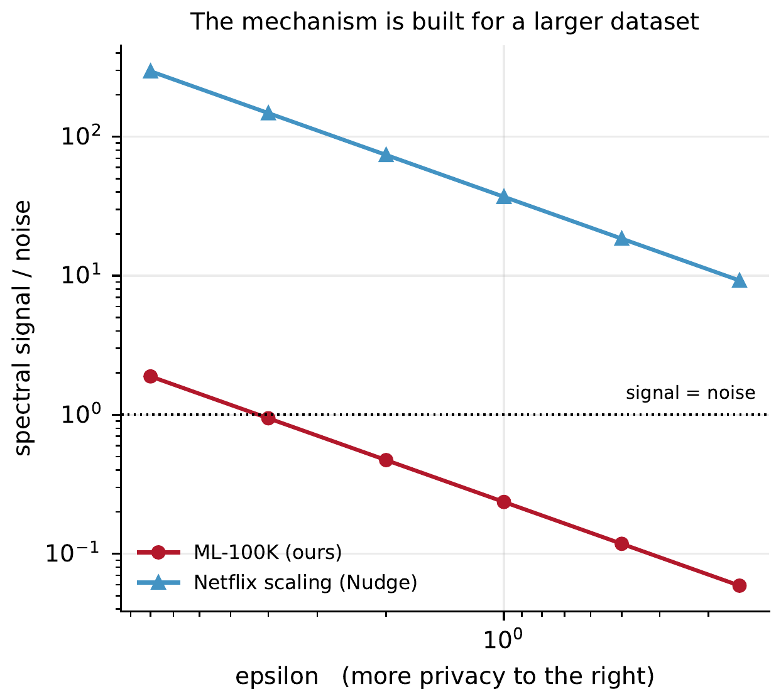
Why we lose 71% and Nudge loses 17%
signal grows with m, the number of users
noise grows with σ√n, n the number of items
157×
larger m / √n for Netflix (480,189 users, 17,770 items) than for MovieLens-100K (943, 1,682)
4.2×
0.29 → 0.24
noise over signal on our data at ε = 1
Nudge on Netflix, the same mechanism
Data dp_study.jsonl · F10, right
Notes:
Shrasti Dwivedi · slide 15 of 26 · target 1:00
There is one more thing worth explaining. Nudge reports that the same mechanism costs them only 17 percent on Netflix, while it costs us 71. Both numbers are right. The noise this mechanism adds grows with the square root of the number of items, while the useful signal grows with the number of users. Netflix has about half a million users and our dataset has under a thousand, which puts Netflix 157 times further into the safe region. We measured the ratio directly, and on our data the noise is about four times larger than the signal. So this mechanism is built for a much larger dataset than ours. That is a statement about scale, and not a disagreement with the paper.

Slide 16
So the fetch must be private
0.44 popularity floor
where a defence that worked would land
decoys, 40 per query: 0.84 → 0.71
differential privacy, ε = 1: 0.82 → 0.92
0.4
0.5
0.6
0.7
0.8
0.9
1.0
attack strength: cosine between the observer’s estimate and your vector
Neither defence comes near the floor. A private read leaves the observer no index to average, which is what OblivRec does.
Notes:
Shrasti Dwivedi · slide 16 of 26 · target 0:30
So we measured two cheaper defences, and neither one reaches the line that would mean the observer learned nothing. That is the case for making the fetch itself private, which is what our system does. What does that cost?
[Hand over to Mainak]

Slide 17
A DPF we can trust
7.16 × 10⁹
ASSERTED AT EVERY NODE OF THE TREE
On the path to α | seeds differ, control bits differ
Off the path | seeds equal, control bits equal
comparisons of the DPF’s output against the true point function. Every one correct.
Every secret index against every input, for every domain up to 16 bits on the 64-bit ring and 15 bits on the 128-bit ring. Written from the Boyle, Gilboa and Ishai papers, not taken from a library.
A wrong control-bit update shows here at the exact level where it happens, long before any output goes wrong.
Notes:
Mainak Sarkar · slide 17 of 26 · target 0:45
Thank you, Shrasti. Everything Shravan and Shrasti described rests on one primitive, the distributed point function, and we wrote it ourselves from the papers by Boyle, Gilboa and Ishai rather than using a library. So before any result, here is why you can trust it. We tested it exhaustively. For every possible secret index and every possible input, up to sixteen bits of domain, we compared its output against the true point function. That is 7.16 billion checks, and every one of them passed.

Slide 18
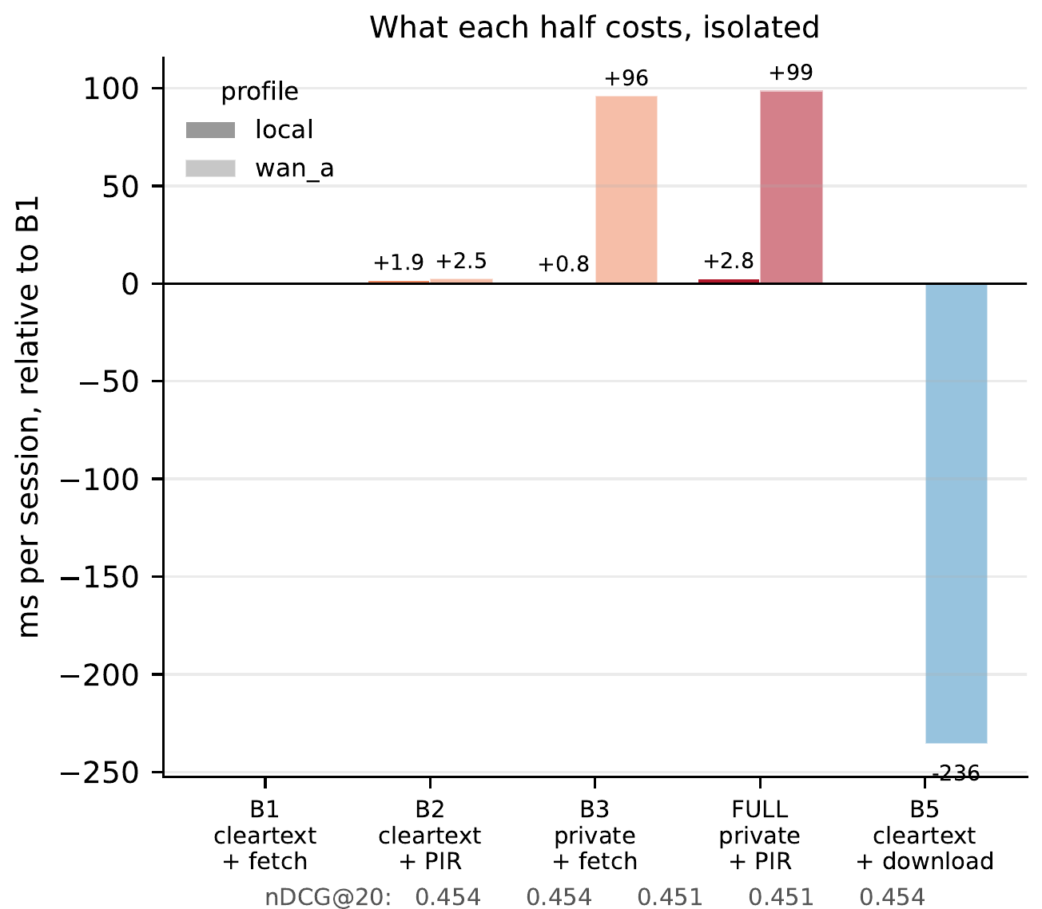
The cost of each half
FULL = B2 + B3 − B1
to the byte: 64,760,124 bytes, asserted before any row is written
+2.5 ms
+96 ms
private delivery, per session
private training, per session, one run shared by 943 users
0.454 → 0.451
wan_a: 30 ms round trip, 100 Mbit/s, channel-level emulation
nDCG@20
Data bench_compose.jsonl · F8, left
Notes:
Mainak Sarkar · slide 18 of 26 · target 1:30
Now, what does privacy cost? This figure isolates each half. First everything in the clear, then private delivery alone, then private training alone, then the full system with both. The first result is a clean one. The cost of the full system is exactly the cost of private delivery plus the cost of private training, to the byte. Composing the two halves adds nothing, because training traffic flows between the servers while delivery traffic flows between you and the servers, and the two never interact. We check that equality inside the benchmark before any number is written down. On a simulated wide-area link with thirty milliseconds of round-trip time, private delivery adds about two and a half milliseconds per session. Private training adds about ninety-six, once one training run is spread across the 943 users it serves. And recommendation quality barely moves, from 0.454 to 0.451.

Slide 19
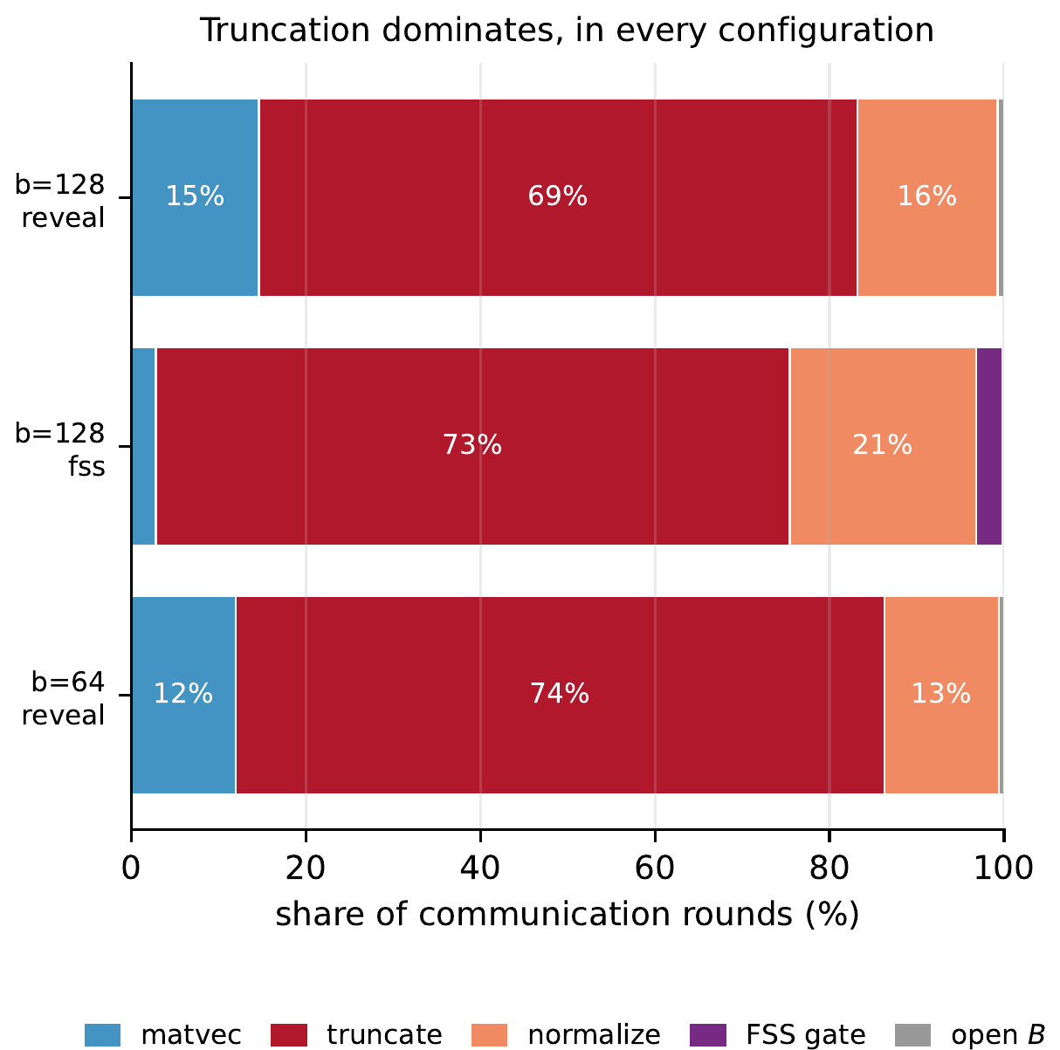
Where the rounds go
69 to 74%
of all rounds are truncation, in every configuration
3.1%
0 and 0
the FSS comparison gate, in the one configuration that has it
rounds and bytes left unexplained by the breakdown
To make training faster, make truncation cheaper. The sophisticated part is not the bottleneck.
Data bench_stages.jsonl · F9, left
Notes:
Mainak Sarkar · slide 19 of 26 · target 1:15
Where does the time go? We attributed every communication round in training to the operation that caused it, and the attribution adds up with nothing left over: zero rounds and zero bytes unexplained, in every configuration we ran. The answer is not what we expected. Truncation, the operation that keeps fixed-point numbers in range, takes between 69 and 74 percent of all rounds. The comparison gate, the most sophisticated cryptography in the whole system, takes about 3 percent in the one configuration that uses it. So if you want this system to be faster, you make truncation cheaper. The sophisticated part is not the bottleneck.

Slide 20
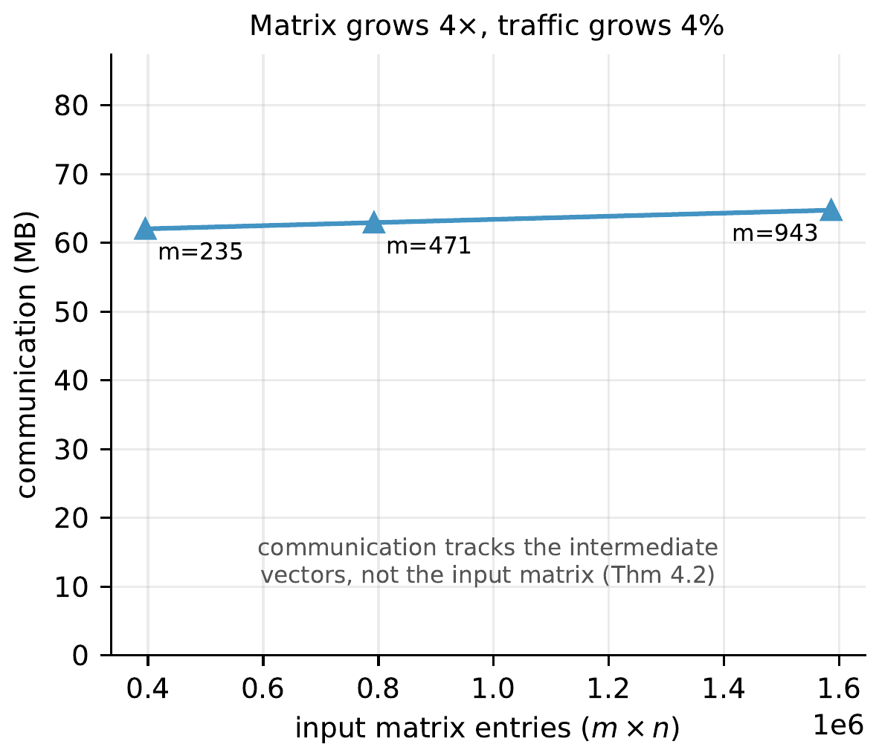
The theorem, measured
4×
+4.4%
larger input matrix, from 235 to 943 users
traffic, from 62.03 to 64.75 MB
2,686
rounds, at every matrix size
Communication follows the vectors in the computation, not the rating matrix. That is Nudge’s Theorem 4.2, and the reason we built on it.
Data bench_sweep.jsonl · F7, right
Notes:
Mainak Sarkar · slide 20 of 26 · target 0:45
This one is short, and it is the reason we built on Nudge in the first place. Nudge proves that communication depends on the size of the vectors in the computation, and not on the size of the rating matrix. We measured it. We made the input matrix four times larger, and traffic grew by only 4.4 percent, while the number of rounds did not change at all.

Slide 21
What measuring quality found
identical
rounds and bytes under both ranges: 11,519 rounds, 143,941,376 bytes. A cost-only benchmark could not see the bug.
0.0020
the real cost of revealing nothing, after the fix
The first run’s values are recorded in commit d2138ad and at the gate’s call site, not in the committed data.
Notes:
Mainak Sarkar · slide 21 of 26 · target 1:00
Now a story about why we measure quality and not just cost. The first time we measured the version of training that reveals nothing, it looked as if privacy cost us almost eleven points of recommendation quality. That would have been a striking headline, and it was wrong. A comparison gate had been given a range too narrow for the values it actually sees, and values outside that range were silently clamped. The number of rounds and bytes was identical either way, so a benchmark that measures only cost could never have caught it. Once fixed, the real cost is a few thousandths. We then confirmed it against a control run that changed one thing at a time.

Slide 22
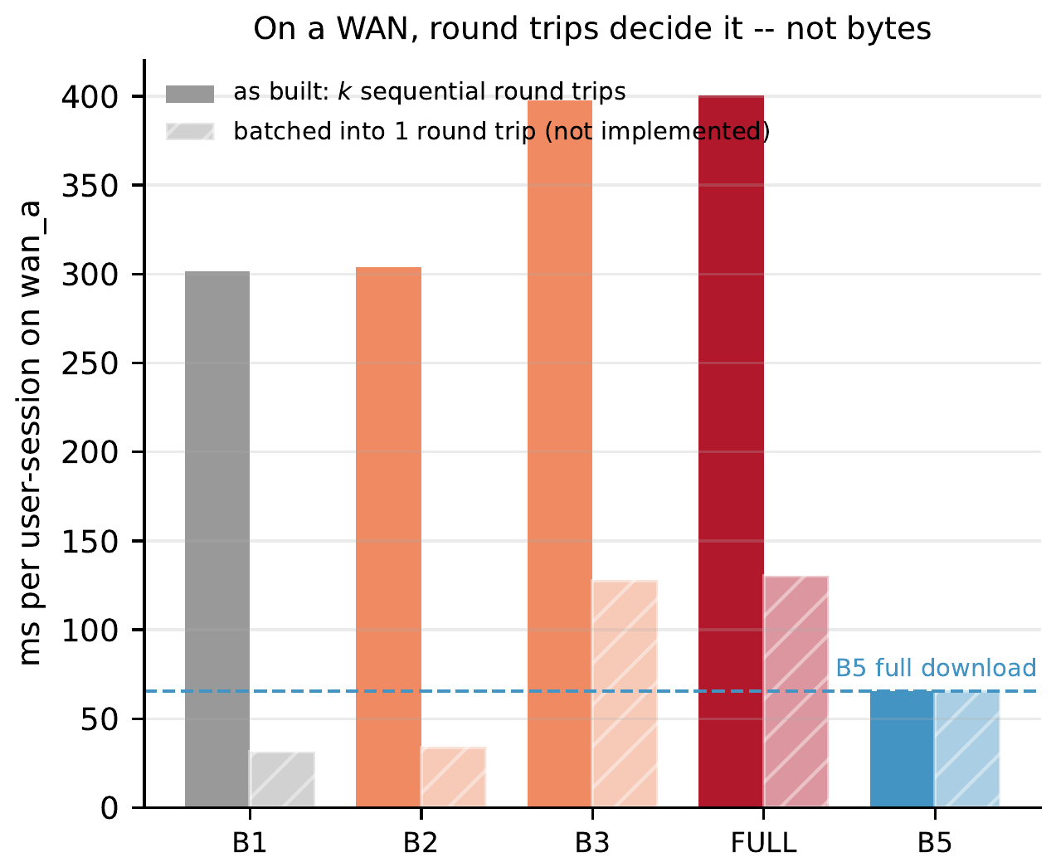
The result that goes against us
4.6×
faster to download the whole catalogue on wan_a: 65.6 ms against 303.9 ms for our private retrieval
45×
33.9 ms
more bytes for the download
batched private retrieval, one round trip. Not built.
We fetch ten items one after another, so we pay ten round trips. The download pays one.
Data bench_compose.jsonl · wan_a · F8, right
Notes:
Mainak Sarkar · slide 22 of 26 · target 1:00
Here is a result that goes against us, and we think you should hear it from us. On a wide-area link, simply downloading the entire catalogue is about four and a half times faster than our private retrieval, even though it sends about forty-five times more data. The reason is round trips. We fetch ten items one after another, so we pay ten round trips, and the full download pays one. On a slow network, round trips dominate. The fix is straightforward. You know all ten items at once, so you could ask for them in a single round trip, which would make us about twice as fast as the download. We have not built that, and our figures say so.

Slide 23
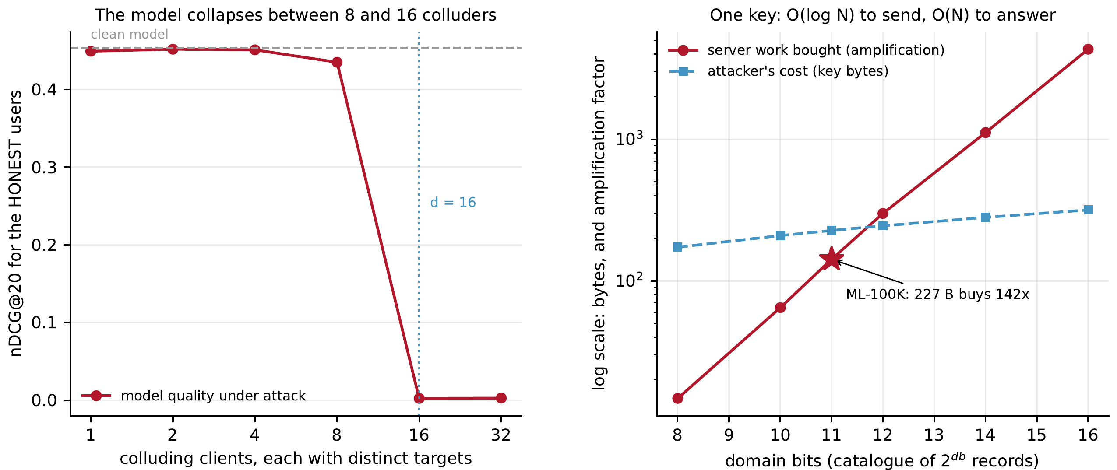
The malicious client
Data poison_study.jsonl, bench_dos.jsonl · F11
Sixteen colluders take nDCG@20 from 0.4536 to 0.0021. Only powers of two were run, so the collapse lies between 8 and 16. The fix costs one round per query.
One 227-byte key buys 142× its own cost in server work in this run, over 100× in every run. Measured, not mitigated.
Notes:
Mainak Sarkar · slide 23 of 26 · target 2:05
Now, what if a user is malicious? We found a real hole in our own design here. Remember the loop that collects training data from fetches. An honest client always asks for exactly one copy of an item, but nothing enforced that. A malicious client could ask for an item with a weight of one million, still get its film back, and cast a million-strong vote in the next round of training, with every check we had passing. So we measured what that buys. One attacker, even at a million, moves quality by only about one percent, because power iteration renormalises at every step, so extra weight only changes a direction. Eight attackers working together, each pushing different items, still cost only four percent. Sixteen destroy the model, and quality falls to almost zero. We tested powers of two, so the collapse happens somewhere between eight and sixteen. Our model has sixteen directions, which fits the idea that each attacker captures one, but we have not tested the numbers in between. The fix costs one round per query. The two servers add up their shares of the key's output and compare the totals, which reveals only the weight and never the item. It closes weight inflation. It does not stop a forged key that spreads the weight across items, and closing that needs an audit we have not built. The right panel shows a second exposure. One 227-byte key buys 142 times its own cost in server work in the run on screen, and more than a hundred times in every run we made, because the server has to touch every item to stay private. That one we measured but have not mitigated.

Slide 24
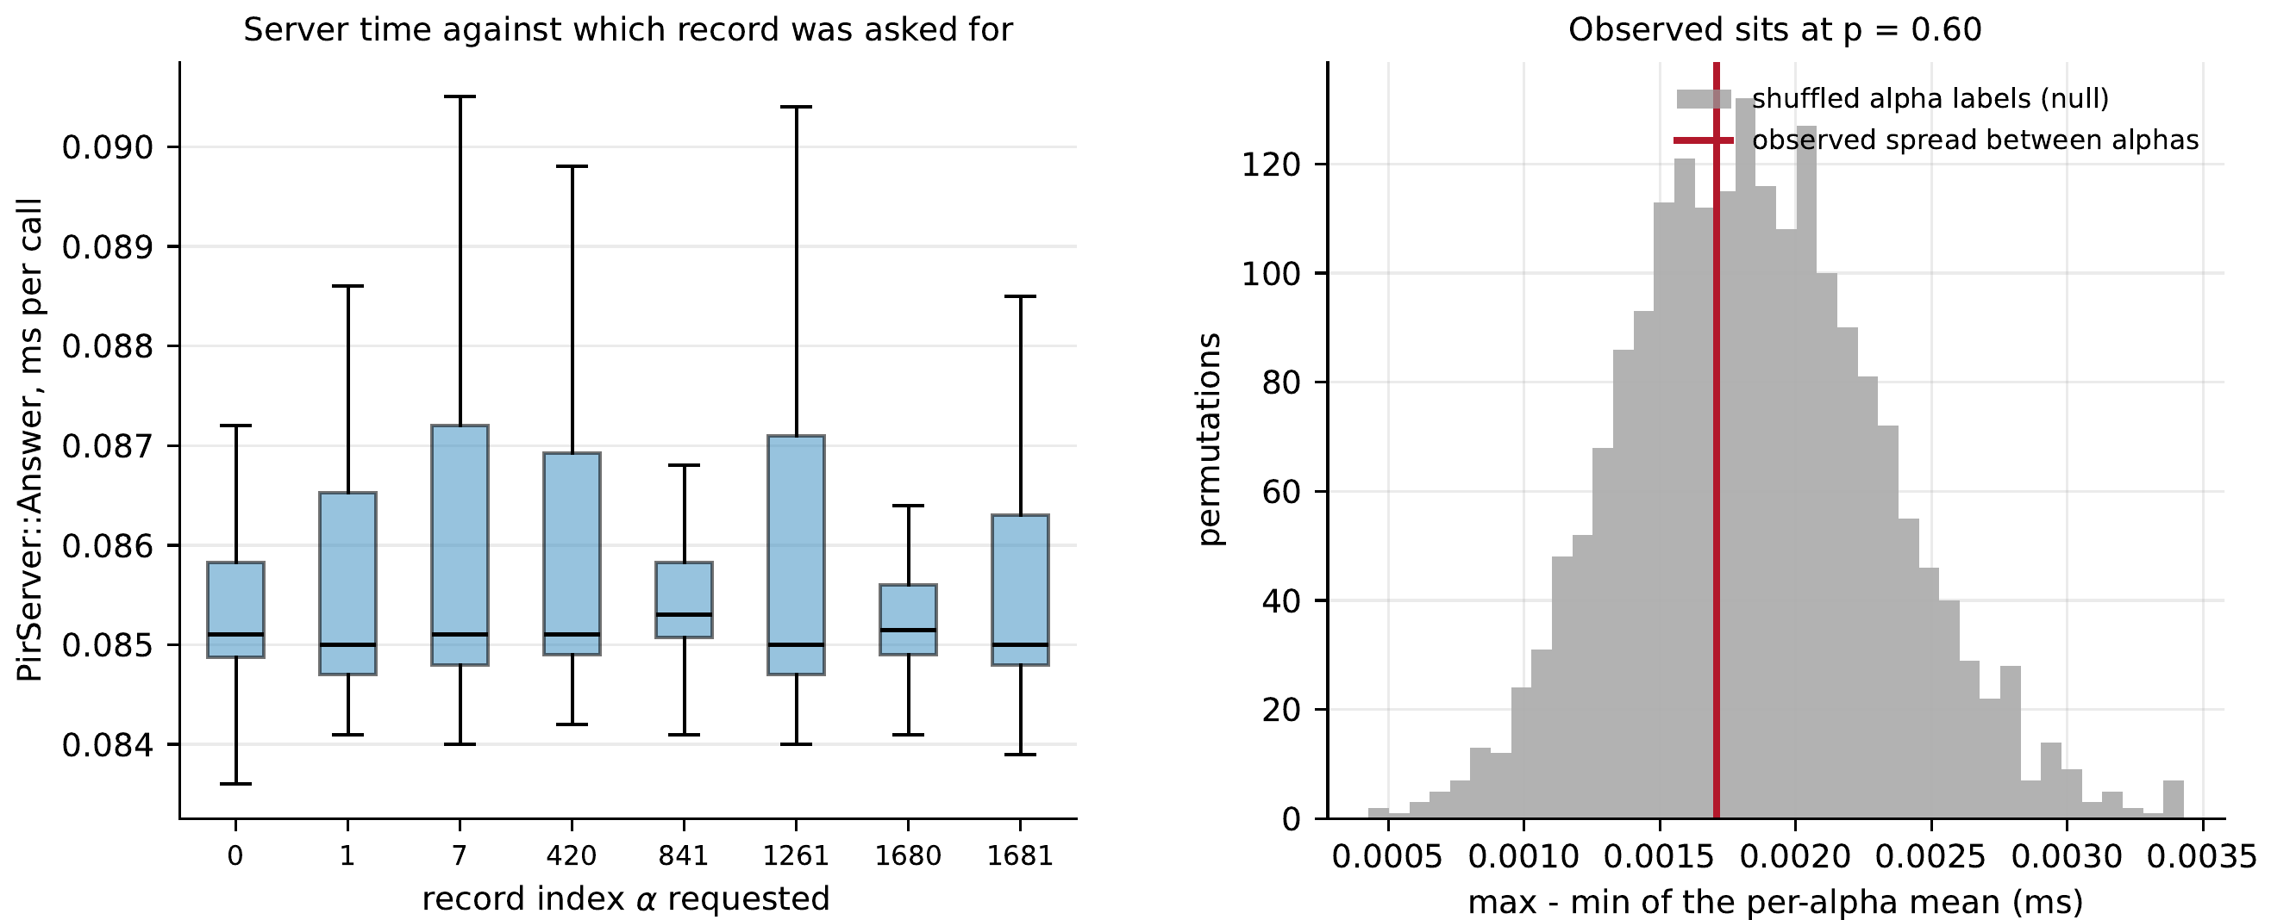
Timing
≤ 2%
of an 87 µs call: the bound on any record-dependent timing
p = 0.60
permutation test on shuffled labels
Data bench_timing.jsonl · 8 records, 200 interleaved calls each · F12
The spread between records, 1.7 µs, is smaller than the noise within one record, 6.0 µs. A bound, not a proof of constant time.
Notes:
Mainak Sarkar · slide 24 of 26 · target 0:30
Finally, timing. Could an observer tell which item you fetched from how long the server takes? We timed the server's answer for eight items spread across the whole catalogue. The differences between items are smaller than the noise within a single item, so any leak is below 2 percent of a call. That is a bound, and not a proof of constant time.

Slide 25
What we do not claim
TWO SERVERS
If two of the three servers collude, they learn everything. The whole system rests on this assumption.
DEVIATION
A server that deviates from the protocol is out of scope.
SCALE
MovieLens-100K only. Three parties in one process did not fit MovieLens-1M in memory.
NETWORK
Wide-area times come from a cost model on measured traffic, not from real networks.
PROOF
The security argument is a simulation sketch, not a formal proof.
TIMING
Absolute times drift with the laptop’s thermal state, so we report ratios.
Notes:
Mainak Sarkar · slide 25 of 26 · target 1:00
Let us be plain about what we do not claim. Our system is secure against one server that follows the protocol and tries to learn from what it sees. If two of the three servers collude, the shares reconstruct and there is no protection at all, and that is the assumption everything rests on. A server that deviates from the protocol is out of scope. We ran on MovieLens-100K and not the million-rating version, because simulating all three parties in one process did not fit comfortably in our machine's memory. Our wide-area numbers come from a cost model applied to measured traffic, not from real network emulation. Our security argument is a sketch and not a formal proof. And our timings vary between runs, so we report ratios rather than absolute times.

Slide 26
Conclusion
01
Composing private training and private delivery costs exactly the sum of the halves.
02
Private delivery is not optional. Ten fetches reveal most of your taste, and both cheaper defences fail.
03
About seventy percent of the cost is truncation. That is where to optimise.
Thank you
Shravan Agrawal · Shrasti Dwivedi · Mainak Sarkar
Source, report and the data behind every figure are in the submission, tag v1.0-final.
Notes:
Mainak Sarkar · slide 26 of 26 · target 0:45
To sum up. We built both halves of a private recommender and composed them, which neither paper had done. Composing them costs exactly the sum of the halves and nothing more. Private delivery is not optional, because ten observed fetches reveal most of your taste and both cheaper defences fail. And about seventy percent of the cost lies in one operation, truncation, which is where future work should go. Every figure you have seen is regenerated from committed data by one command. Thank you.

Slide 27
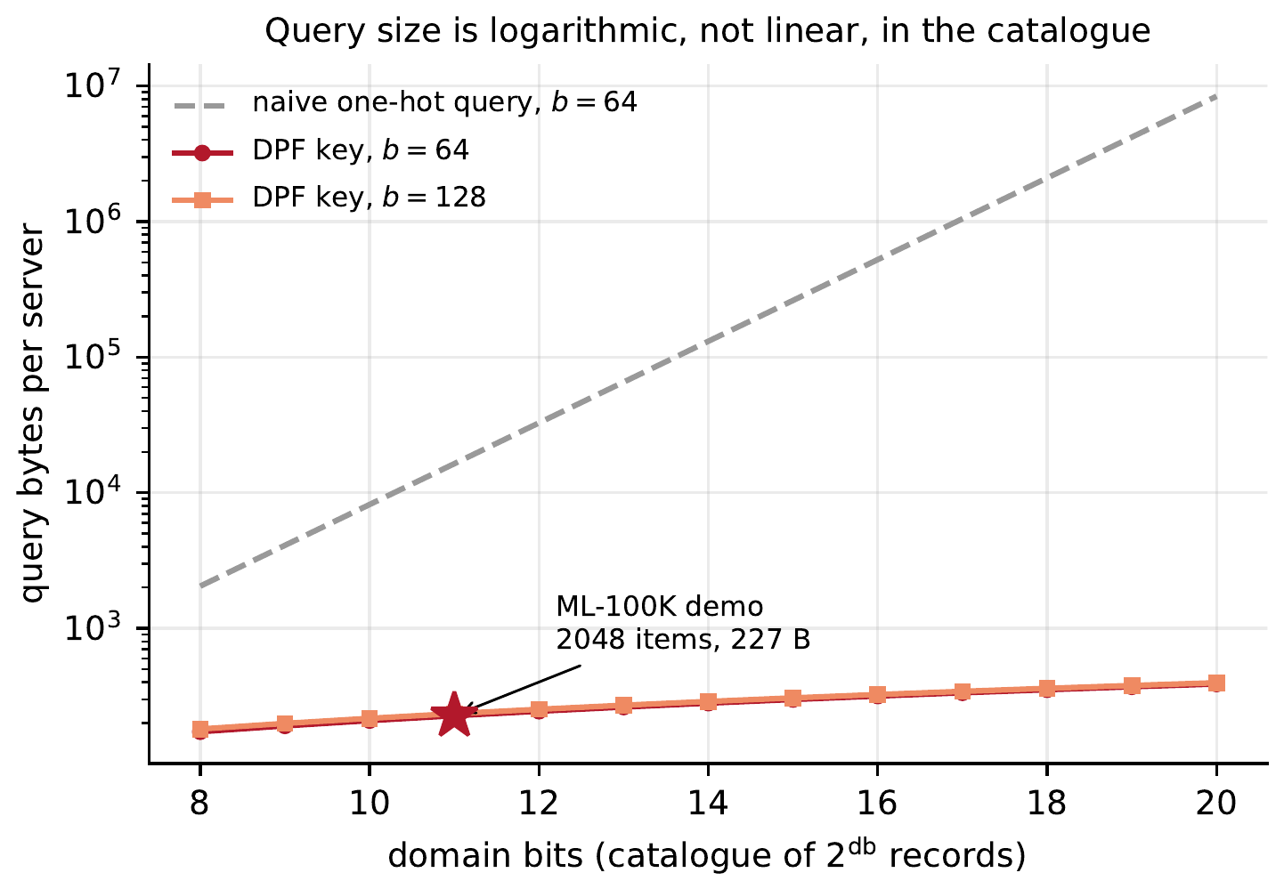
Query size is logarithmic in the catalogue
227 B
per key at 2,048 records, 64-bit ring
16,384 B
the naive one-hot query
1 + 4 + 16 + 18 · D + b / 8 bytes, for a domain of D bits
Closed form asserted by tests/test_dpf_serialize.cpp · F2
Notes:
Backup slide for questions. Not presented in the recording.
Key size is 1 + 4 + 16 + 18 bytes per domain bit + the ring's byte width. The serialiser's reported size is asserted equal to the bytes it writes, by tests/test_dpf_serialize.cpp. At 11 domain bits a key is 227 bytes against 16,384 for a naive one-hot query.

Slide 28
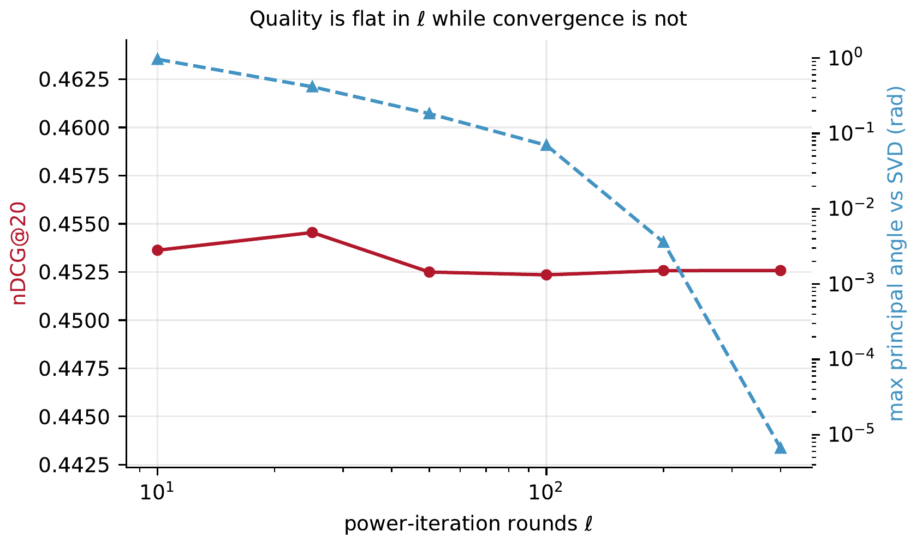
Quality is flat in the number of iterations
0.4523 to 0.4545
nDCG@20 from 10 to 400 iterations
0.97 → 6.7 × 10⁻⁶
radians to the true subspace
Data oracle_ell_sweep.jsonl · F4
Notes:
Backup slide for questions. Not presented in the recording.
Across a fortyfold increase in iterations the subspace angle to the true singular vectors falls by five orders of magnitude, while nDCG@20 stays between 0.4523 and 0.4545. Ranking needs a stable subspace, not the exact singular vectors, so ten iterations is the operating point. model/ell_sweep.py recomputes every committed row.

Slide 29
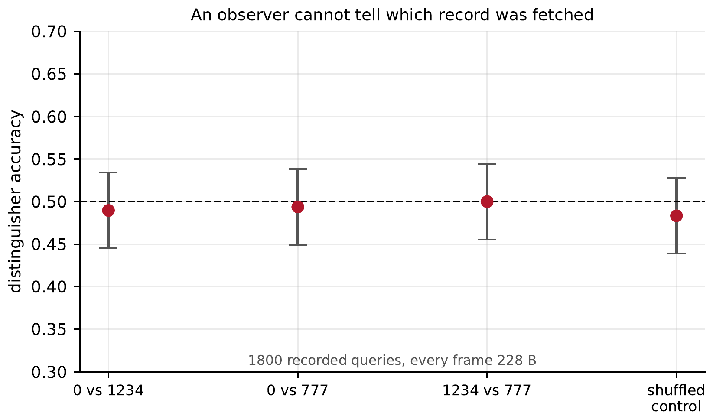
A classifier on the wire bytes sits at chance
228 B / 265 B
every query frame and every reply, whatever the index, over 1,800 queries
0.490 to 0.500
classifier accuracy, with 0.5 inside every 95% interval
0.483
the same pipeline on shuffled labels
Data distinguisher_result.jsonl · F5
Notes:
Backup slide for questions. Not presented in the recording.
Over 1,800 recorded queries every query frame is 228 bytes and every reply is 265 bytes, whatever the index. A logistic-regression classifier trained on the raw bytes scores 0.490 to 0.500 on held-out pairs, with chance inside every 95% interval. The shuffled-label control scores 0.483. A null result, not a proof: it rules out length or byte patterns that correlate with the query.

Slide 30
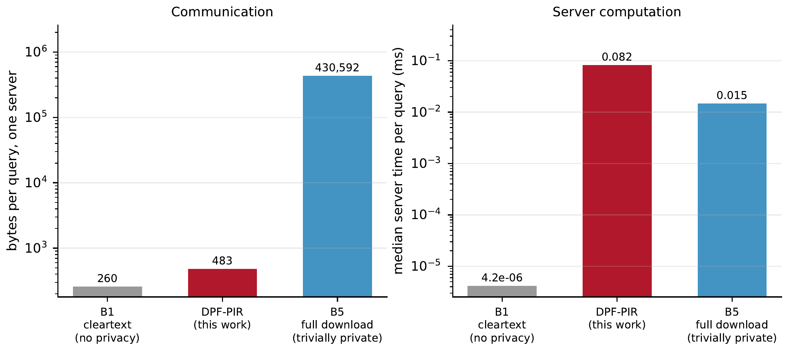
The private read against its alternatives
446×
fewer bytes than the full download, both servers
about 5×
more server CPU than the download
8.0 to 22.9
Gbit/s: the link speed below which the private read wins, across runs
Data bench_baseline.jsonl · F3
Notes:
Backup slide for questions. Not presented in the recording.
DPF-PIR sends 483 bytes to each server, 446 times fewer bytes than downloading the catalogue, counting both servers. It costs about five times the server CPU of the download (5.3 and 5.6 in two committed runs). The link speed below which the private read wins is derived from absolute times, so it moved between runs: 8.0 and 22.9 Gbit/s. Either way it is far above any wide-area link.

Slide 31
Threat model at a glance
CLASS | ADVERSARY | WHAT WE CLAIM
A1 | one semi-honest server | learns nothing beyond the leakage profile, argued by a simulation sketch
A2 | one server and colluding users | honest users’ ratings stay hidden, model quality does not
A3 | two colluding servers | no guarantee: the shares reconstruct
A4 | a deviating server | out of scope
A5 | a malicious user | weight inflation closed, redistribution and the DoS open
A6 | a network observer | sizes fixed and measured, server timing bounded, wire timing not analysed
Notes:
Backup slide for questions. Not presented in the recording.
The headline guarantee is against A1, one semi-honest server, exactly Nudge's model. If two servers collude, the shares reconstruct and there is no protection, which is the assumption the system rests on. The security argument is a real/ideal simulation sketch, and the revealing normaliser is only secure against a weaker functionality that also outputs the norms.

