Slide 1
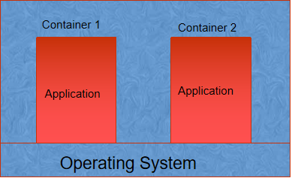
Kubernetes Cluster
Containers are isolated runtime within an operating system and our application is running within this isolated containers.
Kubernetes cluster is a set of hosts for runnign our containers.
These hosts are called nodes of Kubernetes cluster.
HOST
HOST
HOST

Slide 2
Kubernetes Cluster
Every Kubernetes cluster must have one master node and many worker node. Master node is responsible for maintaining the cluster and the worker nodes are responsible for running the application.
Worker Node
Worker Node
Master Node
HOST
HOST

Slide 3

Advantages Kubernetes Cluster
In microservice architecture we can decide how many containers we want to run in a node and how many nodes will be there.
If any contaner or entire node is down then master node will create this automatically. This way the statue of kubernetes cluster is maintained.

Slide 4
Creating Kubernetes Cluster in Google Cloud
There are mainly two types of Kubernetes cluster available in Google cloud
Standard Cluster
Autopilot Cluster
Nodes are automatically managed for Autopilot Cluster. For Standard Cluster we need to manually provision new nodes.

Slide 5
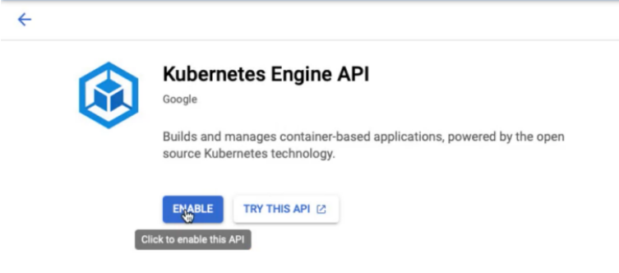
Creating Kubernetes Cluster in Google Cloud : Demo
Go to Console and search for Kubernetes Engine. If you are doing for the first time you need to Enable Kubernetes Engine API. (For Any service as they use API, so we need to enable the API before using the service.)
2. Click on Clusters. Click create and Select Standard. Specify Name and click create.

Slide 6
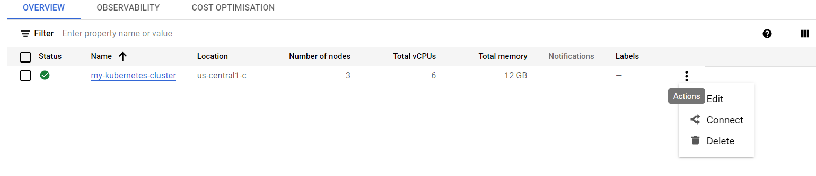
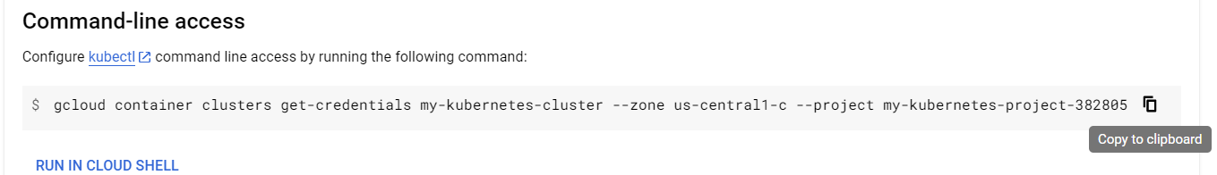
Creating Kubernetes Cluster in Google Cloud : Demo
Activateing cloud Shell and connecting kubernetes cluster.

Slide 7
Creating Kubernetes Cluster in Google Cloud : Demo
Commands to deploy your application.
kubectl create deployment my-first-app --image=dasmainak/boot-gcp-repo:1.0
kubectl get deployment -o wide
2. In order to use the service from outside we need to expose this deployment by using below command. --type=LoadBalancer means whenever we create a service, in the background GKE will create a Load Balanecr for us.
1. kubectl expose deployment my-first-app --type=LoadBalancer --port=4000
2. kubectl get service
3. If we face any issue and we need to delete any service or deployment. We can use below commands.
1. kubectl delete deployment <deployment-name>
2. kubectl delete service <service-name>

Slide 8
Creating Kubernetes Cluster in Google Cloud : Demo
If we want to see what is happening inside my cluster then we can use below command.
1. kubectl get events.
2. If we want to increase the number of running instances.
1. kubectl scale deployment my-first-app --replicas=3
2. kubectl get pod/pods
Now if you delete any pod then a new pod will be created automatically.
1. kubectl delete pod <instance-name>
3. Now if we want to keep 100 instances so, to support this we need to increase the number of nodes.
1. gcloud container clusters resize my-kubernetes-cluster --node-pool default-pool --num-nodes=2 --zone us-central1-c

Slide 9
Creating Kubernetes Cluster in Google Cloud : Demo
If we want to update a new version then use below command.
1. kubectl set image deployment my-first-app boot-gcp-repo=dasmainak/boot-gcp-repo:2.0
highlighted is the container name.

