Slide 1
PRABUDDHA TECHATHON 2026
PRABUDDHA
TECHATHON 2026
NexaCity: Real-Time Smart Urban Monitoring System
Problem Statement– SmartScape 5G: Powering Intelligent Cities
Theme – Smart Governance & Urban Technology
PS Category – Software + IoT
Team ID – [YOUR TEAM ID]
Team Name – Glitch Gods
1

Slide 2
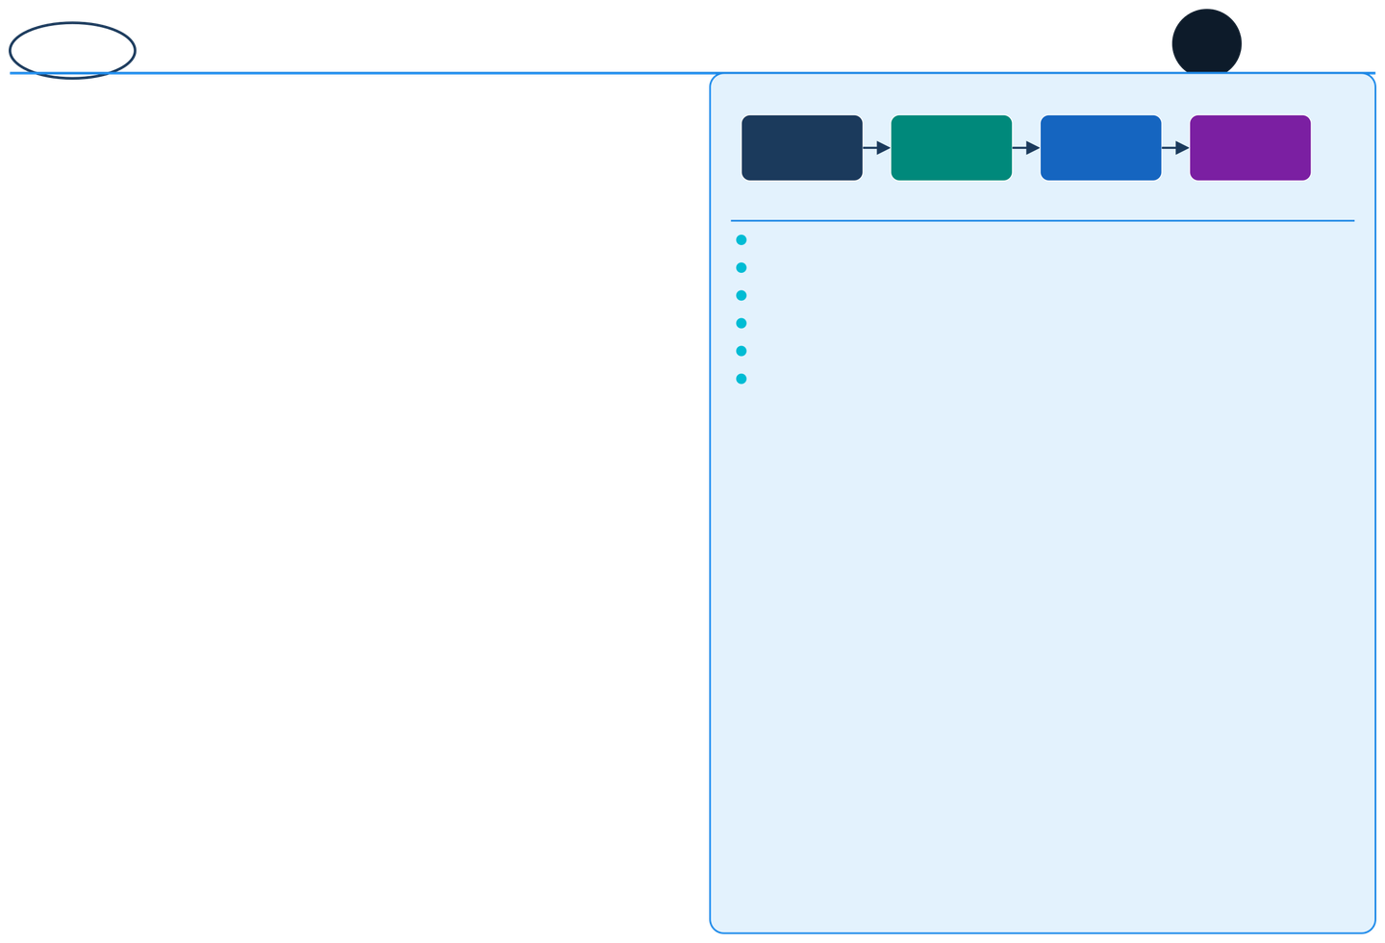
NexaCity5G – Smart City Platform Overview
NEXACITY
5G
PRABUDDHA
TECHATHON2026
GLITCH
GODS
01.
IoT Onboarding
02.
Edge Processing
03.
04.
City Dashboard
AI/ML Analysis
Unique Value Proposition (UVP):
Traffic Intelligence
Emergency Response
AI-driven signal control via 5G edge nodes. Real-time rerouting
& congestion alerts.
Panic SOS routing, auto-dispatch to nearest unit, incident command dashboard.
Real-Time Intelligence: 5G + edge computing for sub-10ms city decisions.
Modular Architecture: Plug-and-play subsystems per city's needs.
AI Predictive Analytics: Proactive alerts — not just reactive dashboards.
Scalable Deployment: Microservices design supports multi-city rollout.
Hybrid Connectivity: 4G/5G fallback ensures 24x7 uptime reliability.
Citizen-First Interface: Multilingual React Native app with voice support.
Waste Management
Energy & Grid
Smart bin sensors,
IoT fill-level alerts, AI-optimised collection route planning.
Smart meter analytics, demand forecasting, renewable integration, grid anomaly alerts.
2

Slide 3
GLITCH
GODS
Technical Approach
NEXACITY
5G
PRABUDDHA
TECHATHON2026
React Native (Frontend):
IoT Device Onboarding
Cross-platformmobileapp with real-time city dashboards, alerts,SOS,andmultilingualvoice interface.
Simulated Sensor
MQTT Broker
Edge Node
Node.js + FastAPI (Backend):
Edge Processing Layer
MicroservicesAPIshandlingIoT data ingestion, city modulecoordination, and RESTful communication.
Raw Data
Preprocess
Feature Extract
AI / ML Engine:
AI Analytics Engine
Traffic prediction (LSTM), anomaly detection (Isolation Forest), demand forecasting (ARIMA + XGBoost).
Traffic LSTM
Anomaly Detect
Demand ARIMA
MQTT / WebSockets:
City Command Dashboard
Real-time bidirectional communication between IoT edge beforedata reaches cloud — sub-10ms response.
Alert Engine
Heatmaps
Auto-Dispatch
5G Edge Computing (MEC):
Authority & Citizen App
On-premise edgenodeshandle latency-critical decisions beforedata reaches cloud — sub-10ms response.
Push Alert
SOS Route
Incident Log
Database Stack:
PostgreSQL(structured), InfluxDB (time-series IoT data), MongoDB(logs),Firebase (auth & push notifications).
Cloud (AWS + CDN):
S3 formodelstorage, Lambda for serverless processing, CloudFront CDN for dashboard asset delivery.
Product Status:
Coremodules —IoT simulator, AI engine, React Native app, and admin dashboard — built. Integration into unified platform in progress.
3

Slide 4
METHODOLOGY
PRABUDDHA
TECHATHON2026
GLITCH GODS
NEXACITY
5G
A: IoT ONBOARDING & SETUP
City Admin
Registers
Configure
MQTT Broker
Setup
Edge Node
Pairing
Live Data
Streaming
SensorGrid
B: EDGE PROCESSING
Raw Sensor
Preprocess
Feature
Extraction
Anomaly Detect?
Forward to
Data In
&Filter
AI Engine
YES→Alert
C: AI ANALYTICS
Traffic
Waste Fill
Predictor
Emergency
ARIMA
AI Fusion
Layer
Predictive
LSTM Model
Insight Out
D: GEO-ALERT ENGINE
GPS Location
Check
Zone Classify?
Safe
Safe Zone
Risk Zone
Notify App
→
No Action
→
Geo-Alert
& Authorities
Risk
E: DASHBOARD & RESPONSE
Admin
Login
Live
Heatmap
Incident
Auto
Dispatch
City
Resolved
Alert Log
4

Slide 5
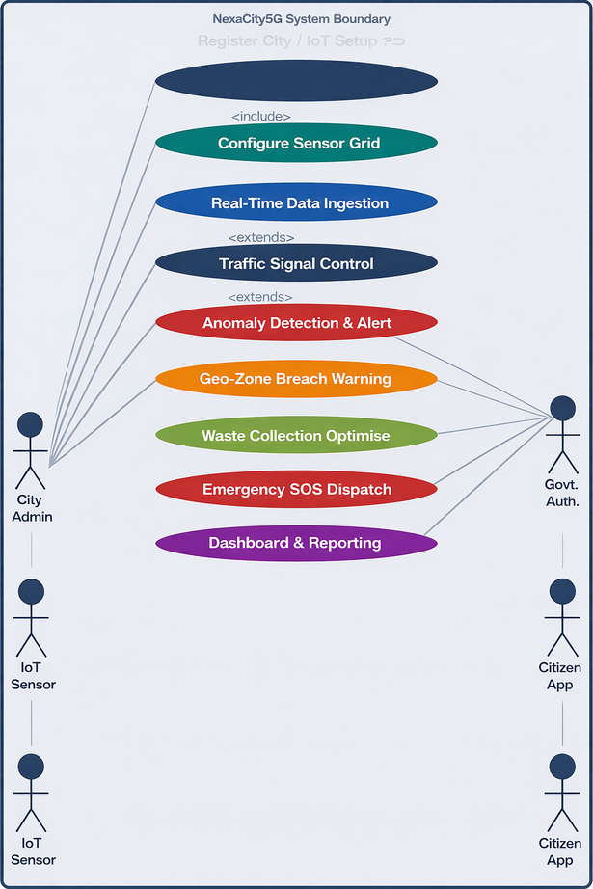
GLITCH GODS
CASE DIAGRAM
NEXACITY
5G
PRABUDDHA
TECHATHON2026
Actors:
City Admin:
Registers city, configures IoT sensors, and manages the platform.
IoT Sensors:
Simulated 5G-connected devices sending real-time urban data streams.
Govt. Authority:
Monitors dashboards, verifies incidents, and triggers emergency dispatch.
Citizens / App:
Receives real-time alerts, SOS routing, and city service updates.
System Functions:
IoT Grid Setup & Live Data Streaming (device management)
AI Anomaly Detection (traffic, waste, emergency)
Geo-Zone Breach Alerts (real-time boundary enforcement)
Emergency SOS Auto-Dispatch (multi-level escalation)
City Dashboard Heatmaps & Incident Reports
5

Slide 6
FEASIBILITY AND VIABILITY
NEXACITY
5G
PRABUDDHA
TECHATHON 2026
GLITCH GODS
Feasibility Analysis
Viability Analysis
Technical Feasibility
Economic Viability
Builton AWS free tier + open-source frameworks,
low-cost pilot-first rollout with strong
ROI via reduced urban incident costs and fuel savings.
React Native, FastAPI,Node.js, Python
ML, MQTT, AWS, InfluxDB — all production-ready frameworks.
Operational Feasibility
Microservicesdesign allows independent deployment
Of traffic, waste, and emergency modules per city.
Government & Policy Viability
Aligned with SmartCities Mission(MoHUA) and
Digital India frameworks. DPDP Act 2023 compliant.
Social Feasibility
Market & Scale Viability
Multilingual citizen app, voice SOS, and inclusive
UI support diverse urban populations across India.
Modular design lets anycity adopt one or all modules.
Proven demand from 100+ Smart City Mission projects.
6

Slide 7
IMPACT AND BENEFITS
PRABUDDHA
TECHATHON 2026
GLITCH GODS
NEXACITY
5G
1. Urban Mobility & Safety
Impact:
2.EmergencyResponse Efficiency
Impact:
AI-driven traffic management cuts average commute time by 25-30%. Real-time geo-alerts prevent accidents in high-risk intersections.
Sub-10ms SOS routing to nearest emergency unit via 5G edge. Auto-incident logging eliminates manual report delays.
Benefit:
Benefit:
Citizens experience faster, safer daily travel.
Reduced fuel consumption and carbon emissions city-wide.
Response times reduced from minutes to seconds.
Better coordination between police, fire, and medical services.
3. Environmental Sustainability
Impact:
4. Data-Driven Governance
Impact:
Smart waste sensors prevent overflow; AI optimises pickup routes. Energy grid analytics cut wastage and detect distribution faults.
Live dashboards give authorities real-time city intelligence. Historical analytics support evidence-based urban planning.
Benefit:
Benefit:
Cleaner cities with 30% reduction in unnecessary waste trips. Lower city energy bills through predictive grid management.
Faster, smarter policy decisions backed by verifiable data. Scalable platform grows with the city's population and needs.
7

Slide 8
RESEARCH AND REFERENCES
PRABUDDHA
TECHATHON2026
GLITCH GODS
NEXACITY
5G
RESEARCH :
Key Technology Pillars
IEEE Xplore (2023):
Smart City IoTarchitectures using 5G MEC for real-time
5G + Edge Computing
— Sub-10ms city intelligence via MEC nodes
urban traffic and emergency management.
Cisco Smart City Report (2022):
AI/ML Engine
— LSTM + ARIMA + Isolation Forest models
Edge computingdeploymentstrategies for low-latency
civic IoT applications — a practical framework.
Microservices
— Independent traffic/waste/emergency modules
NITI Aayog Smart Cities (2023):
India'sSmart CitiesMission: outcomes, tech stack
MQTT/WebSockets
— Real-time bidirectional IoT communication
adoption, and lessons from 100 city deployments.
REFERENCES :
Hybrid Connectivity
— Seamless 4G/5G failover ensures 99.9% uptime
ITU Smart City KPIs Report, 2022 MoHUA Smart Cities Mission Reports
– smartcities.gov.in
Multi-City Scalability
— Kubernetes + AWS Lambda auto-scaling design
MQTT Protocol Specification v5.0
–mqtt.org
5G MEC Architecture
– ETSI EN 302 217
TensorFlow Lite for Edge AI InfluxDB Time-Series for IoT
–tensorflow.org/lite
– influxdata.com/docs
9

