Slide 1






Unknown Prompt, the only Lacuna: Unveiling CLIP’s Potential for Open Domain Generalization
Mainak Singha¹, Ankit Jha², Shirsha Bose³, Ashwin Nair⁴, Moloud Abdar⁵, Biplab Banerjee²
¹Aisin Corporation, Japan, ²IIT Bombay, ³TU Munich, Germany, ⁴IISER Thiruvananthapuram, India, ⁵Deakin University, Australia

Slide 2
Prompt Learning for Open Domain Generalization
Motivation:
CNN based generalized models can effectively learn distribution shifts, but often misclassify novel classes during inference, especially when these classes were absent during training.
Even zero-shot transfer in CLIP and generalized transfer in existing vision language models (VLMs) encounter challenges in detecting completely unlabeled outlier or unknown classes, as they rely on class names in the textual input prompt.

Slide 3
Prompt Learning for Open Domain Generalization
Our Proposal:
Leveraging the pre-trained stable diffusion model for the generation of the pseudo-open training samples (unknown) using positive and negative prompts.
Introducing a novel domain-agnostic prompt learning strategy to generalize the domain-specific style information in the text space.
Enhance visual semantics in a learnable latent space by maximizing the similarities between the CLIP’s textual and visual features.

Slide 4



Step 1: Pseudo-Open Sample Generation
Positive Prompts
Stable Diffusion
Negative Prompts
Positive Prompts = [“a [source domain] of an unknown class”]
Negative Prompts = [“car, dog, elephant, ….. , house”]

Slide 5
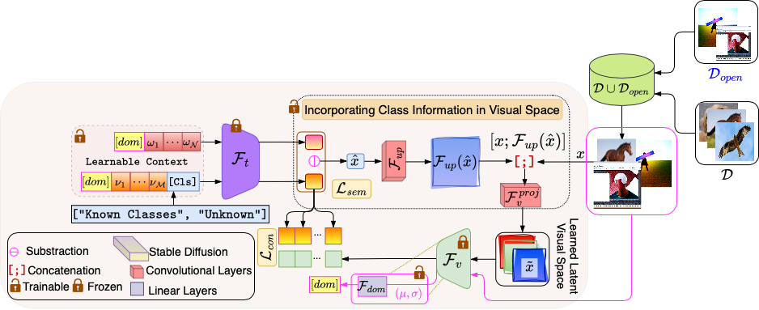
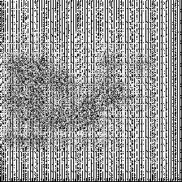

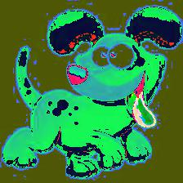
Step 2: Prompt Learning for Open Domain Generalization

Slide 6
Prompt Learning for Open Domain Generalization
Proposed Methodology:
Leveraging the pretrained Stable Diffusion v1-5 model for pseudo-open samples generation, unknown or unseen categories as positive prompts, while known classes serve as negative prompts (indicating what we do not want to generate).
Classification strategy encompasses C+1 classes, (C+1)-th as novel unknown-class.
Adaptive prompt learning across all classes, enabling the capture of domain-specific distributions and overarching semantic contents through distinct token sets.
Establishing a latent visual space, guided by the prompts.
Propose a cross-domain semantic consistency loss to cultivate a robust class-wise correlation in the derived latent visual representations.

Slide 7
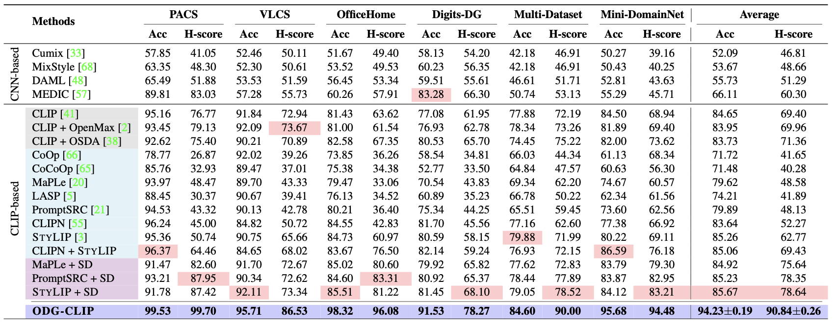
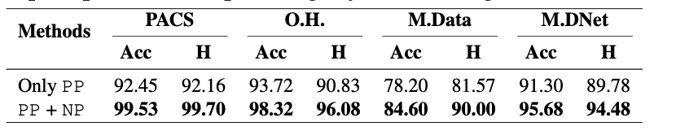
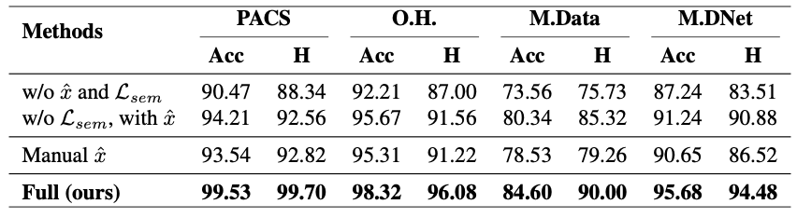
Prompt Learning for Open Domain Generalization
Experiments and Results:

Slide 8
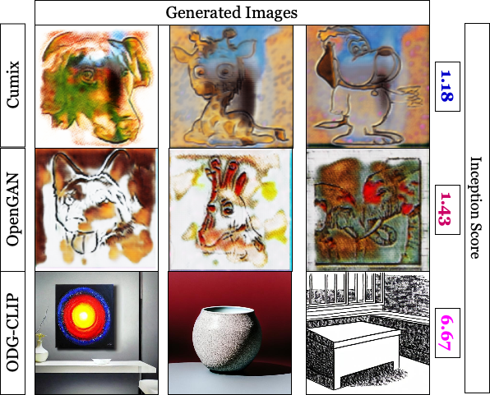
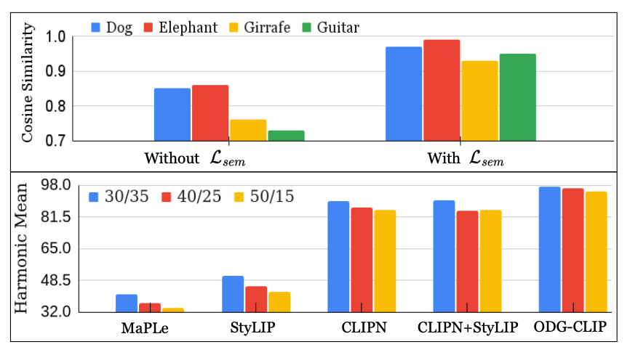
Prompt Learning for Open Domain Generalization
Experiments and Results:

Slide 9
Prompt Learning for Open Domain Generalization
Summary:
Open Domain Generalization (ODG) addresses both known and novel classes across out-of-distribution domains. During inference, the target domain may include completely unlabeled familiar categories and entirely new categories, resembling real-world recognition scenarios.
Our ODG-CLIP harness the semantic capabilities of the vision-language pretrained model CLIP, to solve the ODG task, just using a text prompt of unknown class.

Slide 10

Prompt Learning for Open Domain Generalization
Thank You!!

