Slide 1
Paperwork in. Clean records out.
AI FOR ACCOUNTS PAYABLE
Template sample for Lathmere, a concept brand
Notes:
Template sample. Lathmere is a fictional concept brand made by Sabin Mainali; it is not a real company. Layout 1 Cover: eyebrow, title (2 lines max), subtitle. The lime square is part of the layout, so it cannot be moved by accident.

Slide 2
Agenda
Why invoice matching stalls the close
How Lathmere reads and matches
What your team still controls
Pilot plan and next step
Notes:
Template sample. Lathmere is a fictional concept brand made by Sabin Mainali; it is not a real company. Layout 3 Agenda: numbering is automatic. Add or remove lines and the numbers follow.

Slide 3
Why matching stalls the close
01
Three documents, three formats, one ledger entry
Notes:
Template sample. Lathmere is a fictional concept brand made by Sabin Mainali; it is not a real company. Layout 2 Section: two-digit number sits inside the brand square.

Slide 4
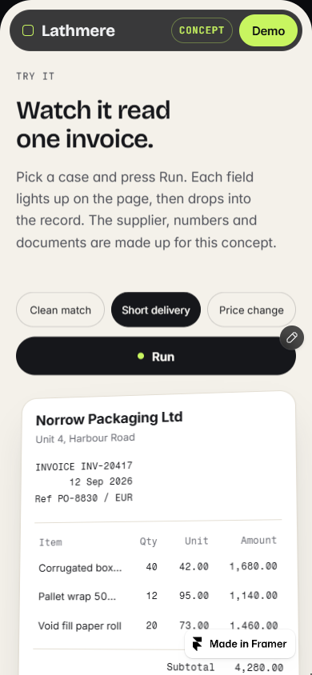
Your team reviews exceptions, not every invoice
Lathmere reads invoices, purchase orders and delivery notes
It checks that all three agree before anything posts
Only mismatches reach a person, with the reason attached
Notes:
Template sample. Lathmere is a fictional concept brand made by Sabin Mainali; it is not a real company. Layout 4 Content and image: right side is a picture placeholder. Insert a picture and it crops to the frame.

Slide 5
One invoice, four steps
1
2
3
4
Receive
Read
Match
Write
PDF, scan, photo or spreadsheet arrives
Fields pulled from the page
Checked against PO and delivery note
Posted to the ledger with GL codes
Lime marks the step where a person may need to act.
Notes:
Template sample. Lathmere is a fictional concept brand made by Sabin Mainali; it is not a real company. Layout 7 Title only, used for a workflow. Markers, numbers and labels are native shapes and text, so they stay editable.

Slide 6
Before and after Lathmere
Today
With Lathmere
Fields keyed by hand from PDFs
Missing delivery notes chased by email
Mismatches found after posting
Fields read and checked on arrival
Missing documents flagged per invoice
Mismatches held before they post
Notes:
Template sample. Lathmere is a fictional concept brand made by Sabin Mainali; it is not a real company. Layout 5 Comparison: light card for the current state, dark card for the proposed state.

Slide 7
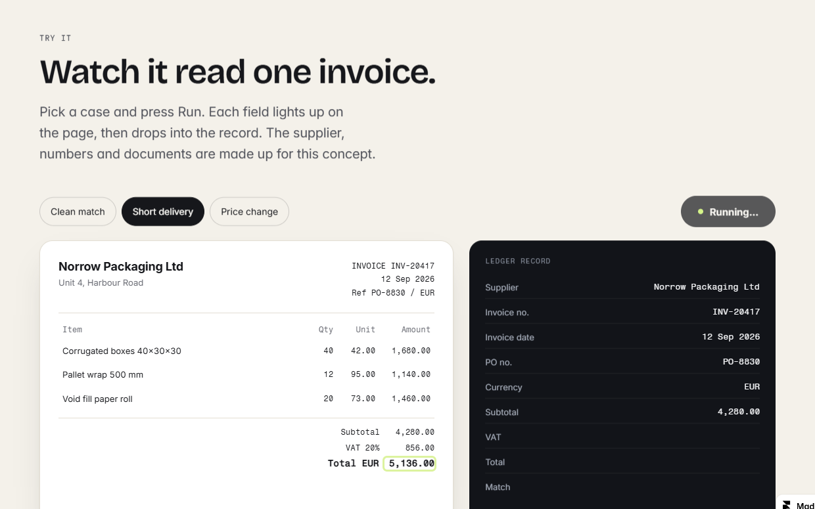
See the reason behind every flag
Each field lights up on the invoice, then drops into the ledger record.
Screenshot from the Lathmere concept site. Supplier and numbers are made up.
Notes:
Template sample. Lathmere is a fictional concept brand made by Sabin Mainali; it is not a real company. Layout 6 Product screenshot: 16:10 picture frame on the left, caption on the right.

Slide 8
Exceptions fall as vendor rules mature
Sample data for layout demo only.
The chart is native PowerPoint. Right click, Edit Data, and the bars, labels and colours update from the theme.
Notes:
Template sample. Lathmere is a fictional concept brand made by Sabin Mainali; it is not a real company. Layout 8 Chart: chart placeholder plus a commentary card. Numbers on this slide are invented for the demo.

Slide 9
Four-week pilot plan
Week | Focus | Owner | Output
1 | Connect inbox and ERP | Finance ops | Live document feed
2 | Set vendor matching rules | AP lead | Rule list signed off
3 | Run alongside the current process | AP team | Side-by-side report
4 | Go live on two entities | Controller | Go or no-go decision
Example plan for the template. Rows and columns stay fully editable.
Notes:
Template sample. Lathmere is a fictional concept brand made by Sabin Mainali; it is not a real company. Layout 9 Table: header row in ink, thin warm-grey rules, note line under the table.

Slide 10
Start with one vendor, one month
Questions and next step
Template concept by Sabin Mainali
Notes:
Template sample. Lathmere is a fictional concept brand made by Sabin Mainali; it is not a real company. Layout 10 Closing: solid lime square echoes the cover outline, so the deck opens and closes on the same shape.

