Slide 1


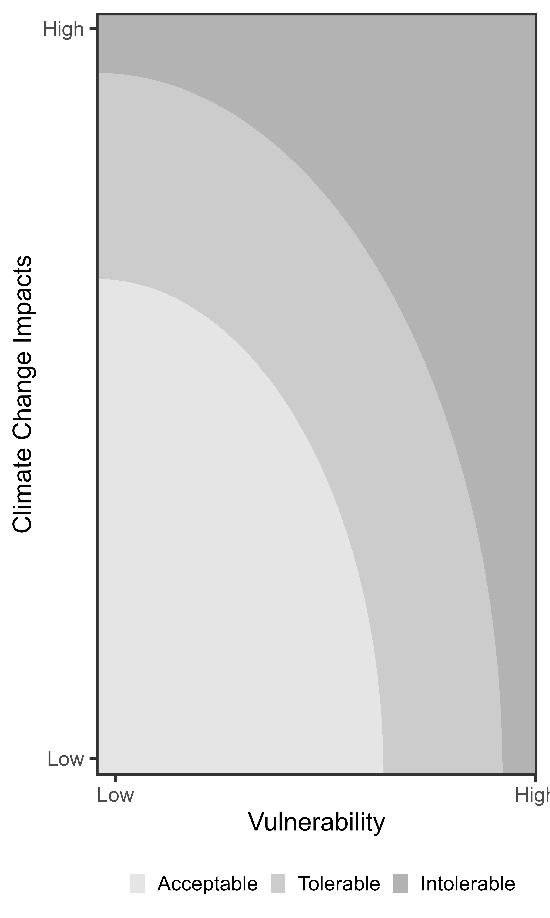


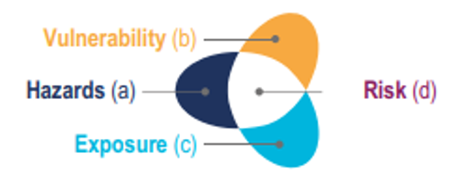
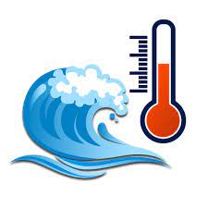





CLIMATE HAZARD
SYSTEMS AT RISK
SOCIAL VULNERABILITY
RISK ESTIMATE
OPTIONS SPACE
High
Investment in effective
vulnerability reduction
Warming trend
Crop
Adaptative capacity (AC)
Extreme temperature
Coral reef
Livelihood
Demography
Health
Cultural
Medium
Investment in effective adaptation
Sea surface temperature
Seagrass
Sensitivity (SS)
Low
Ocean acidification
Mangrove
SSP2-4.5
Organisation
Flexibility
Agency
Learning
Assets
SSP3-7.0
Functional diversity
Potential residual risk
Drying extremes
Risk with high potential adaptation
Risk with current
level of adaption
(A)
Generic AR6
IPCC framework
(B)
Agroecological risk framework
(C)
Results & Policy Space

