Slide 1
GROUP 14 · DS 423 SA · MACHINE LEARNING WITH LARGE DATASETS
Anime Recommendation
System
A reproducible biased-SVD baseline for explicit ratings and personalized Top-10 unseen-anime recommendations.
Duy Tan University, Da Nang
Trương Nhật Trường — 29211164915
Mai Nam Quốc — 29211145181
01
Notes:
Introduce the project, team, course, and central claim. Emphasize that this is a reproducible baseline rather than a production recommender.

Slide 2
PROBLEM STATEMENT
The project ranks unseen anime from explicit user preferences
Input
Model task
Output
Historical explicit user–anime ratings on the original 1–10 scale. Missing pairs are unknown.
Estimate personal scores by learning shared patterns among observed user and anime ratings.
A personalized Top-10 list containing anime the selected user has not already rated.
Objective 01
Objective 02
Objective 03
Prepare an auditable explicit-rating dataset.
Predict held-out ratings using RMSE and MAE.
Retrieve highly rated held-out items using Precision@10 and Recall@10.
GROUP 14 · DUY TAN UNIVERSITY, DA NANG
02
Notes:
Explain why recommendation is needed for a large catalogue. Clarify that missing interactions are unknown preferences, not zeros or dislikes.

Slide 3
DATASET
Personal ratings train SVD; metadata labels its output
Source: CooperUnion’s Anime Recommendations Database (Kaggle, 2016).
FILE
ROWS
FIELDS
ROLE
rating.csv
7,813,737
user_id · anime_id · rating
Learning signal after semantic cleaning
anime.csv
12,294
title · genre · type · episodes · average · members
Joined after ranking for readable Top-10 output
Personal target
Display-only statistic
rating.csv.rating is the user’s explicit score and becomes the SVD target.
anime_average_rating is a public catalogue average—not a feature or predicted personal rating.
Meaning comes before modeling: similarly named rating fields answer different questions.
GROUP 14 · DUY TAN UNIVERSITY, DA NANG
03
Notes:
Describe both files and exact sizes. Stress that personal ratings train SVD while public average ratings are display-only.

Slide 4
CLEANING AUDIT
Cleaning preserves the meaning of an explicit preference signal
STAGE
COUNT
MEANING
Raw interactions
7,813,737
All source user–anime rows
Remove rating = −1
−1,476,496
18.90% watched but not explicitly scored; not a dislike
Invalid / missing ratings
−0
Required rating values are complete and parseable
Merge duplicate keys
−7
Mean retains one target per matrix cell
Clean explicit interactions
6,337,234
69,600 users · 9,927 anime · 0.9172% density
Why not map −1 to 0 or 1?
Why can ratings be fractional?
It would teach that “watched but unrated” is negative preference, changing the signal’s meaning.
Duplicate averaging creates valid 6.5 and 8.5 targets while remaining inside [1, 10].
GROUP 14 · DUY TAN UNIVERSITY, DA NANG
04
Notes:
Walk down the funnel. Spend time on the −1 semantic decision, then explain duplicate averaging and final coverage.

Slide 5
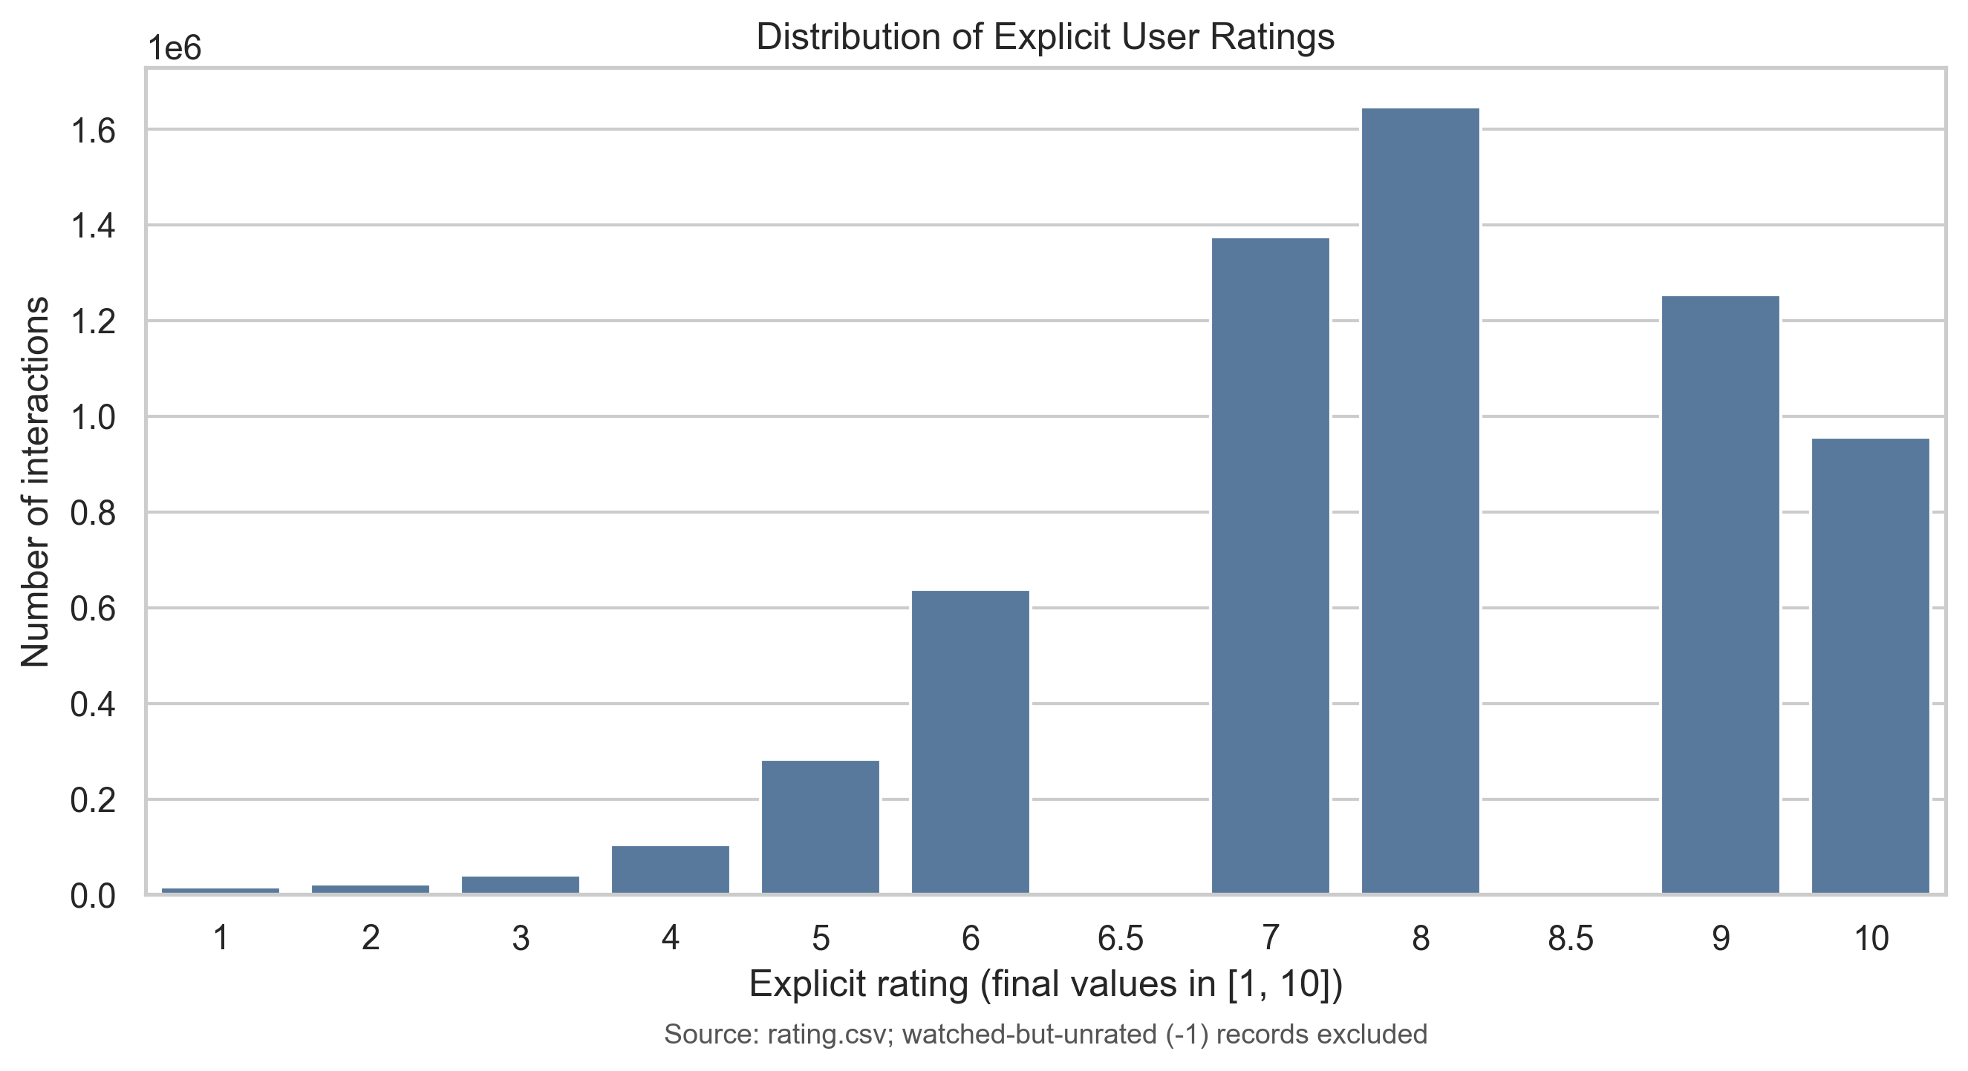
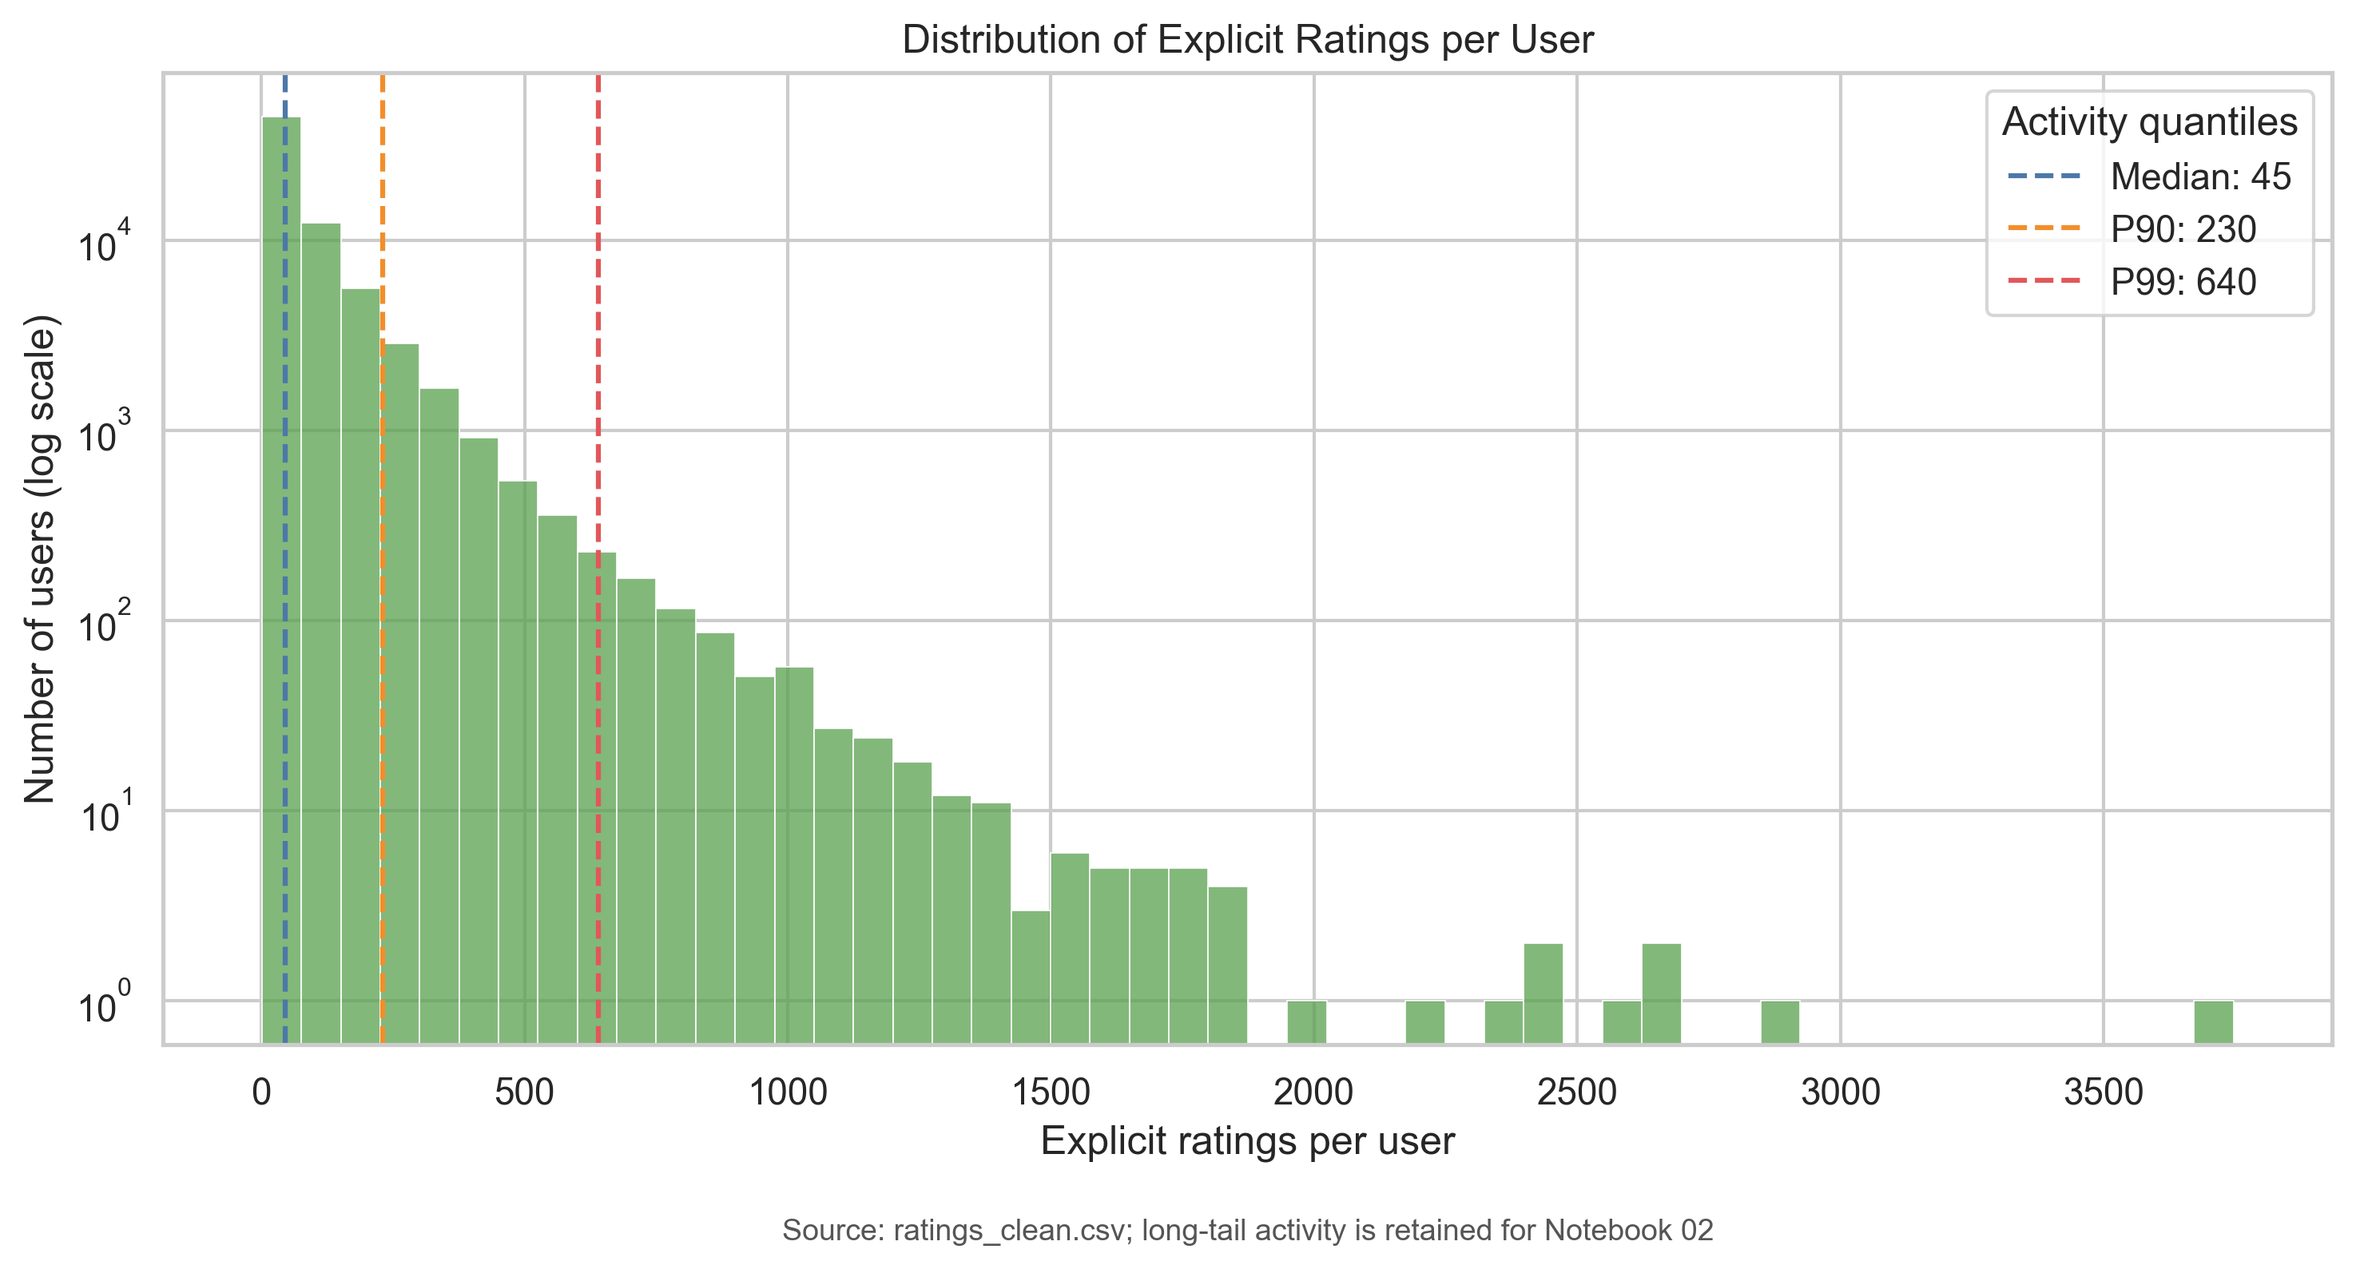
EXPLORATORY DATA ANALYSIS
EDA exposes sparsity, positive skew, and unequal evidence
Mean 7.81 · mode 8 · 82.55% of ratings ≥7
Median 45 · P90 230 · P99 640 ratings per user
0.9172% density
34,226 ratings
Implication
Extreme missingness supports collaborative filtering.
Death Note shows concentrated popularity.
Cold start, unequal evidence, popularity bias.
GROUP 14 · DUY TAN UNIVERSITY, DA NANG
05
Notes:
Interpret both charts. Rating count measures popularity rather than objective quality; EDA motivates but does not evaluate the model.

Slide 6
IMPLEMENTATION
Two notebooks create an auditable path from raw CSVs to Top-10 output
Load & validate
Clean & export
Define scope
Tune & evaluate
Refit & rank
Schemas, types, missing values, duplicates, sentinel
Remove −1, merge keys, save clean CSVs and EDA
Seeded 1M sample, min-5 k-core, outer split
Select factors inside train; test untouched holdout
Fit all model data; score unseen candidates
ratings = ratings[ratings.rating != -1]
train, test = train_test_split(data, test_size=.20, random_state=42)
candidates = all_model_anime - set(user_rated_anime)
Artifacts: ratings_clean.csv · anime_clean.csv · model_evaluation_metrics.csv · figures/*.png · top_10_recommendations.csv
GROUP 14 · DUY TAN UNIVERSITY, DA NANG
06
Notes:
Explain the Notebook 01/02 boundary. Point to sentinel removal, seeded splitting, and excluding already-rated anime.

Slide 7
METHODOLOGY
Biased SVD estimates ratings from shared user–anime patterns
r̂ᵤᵢ = μ + bᵤ + bᵢ + qᵢᵀpᵤ
Baseline level
Personal interaction
Training
μ is the global mean; bᵤ and bᵢ adjust for user and anime rating tendencies.
pᵤ and qᵢ are learned latent vectors; their dot product captures alignment.
SGD minimizes regularized squared error over observed ratings, without zero-filling missing pairs.
Latent factors are inferred patterns—not automatic genre labels. SVD also cannot solve pure cold start.
GROUP 14 · DUY TAN UNIVERSITY, DA NANG
07
Notes:
Read the equation term by term. Explain biases, latent alignment, regularization, and cold-start limits.

Slide 8
HOW SVD LEARNS
Each observed rating nudges the model toward a better prediction
predict → compare → update
1 · Initialize
2 · Predict & compare
3 · Update & repeat
Create one 30-number vector per retained user and anime, plus user and item biases. Values start near random.
Real CSV example: user 3 rated anime 20 as 8. Compute r̂₃,₂₀, then error e₃,₂₀ = 8 − r̂₃,₂₀.
SGD updates bᵤ, bᵢ, pᵤ, and qᵢ for that pair. Regularization limits overfitting; repeat for 20 epochs.
Only observed rows create errors and updates. Missing user–anime cells remain unknown; they are never filled with zero.
GROUP 14 · DUY TAN UNIVERSITY, DA NANG
08
Notes:
Use the real cleaned row (user 3, anime 20, rating 8). Explain initialization, prediction, error, and the SGD update. Only the parameters for the current user and anime are changed in that step. Repeat across shuffled observed rows for 20 epochs. Regularization prevents large parameters from simply memorizing noise.

Slide 9
DATASET EXAMPLE
Shared rating patterns support an estimate for an unseen pair
r̂(Lan, Anime C) = 7.8 + 0.3 + 0.2 + 0.9 = 9.2
Observed evidence
Bias contribution
Latent compatibility
Teaching matrix: Lan rates Anime A = 9 and B = 4; Minh rates A = 8 and C = 9; Lan–C is unknown.
7.8 is the global level; +0.3 is Lan’s rating tendency; +0.2 is Anime C’s learned item tendency.
+0.9 represents user–anime vector alignment learned across many overlapping histories; a negative dot product would lower the score.
The 9.2 decomposition is illustrative, not an exported parameter set. Real cleaned examples: user 3 rated anime IDs 20 = 8, 154 = 6, 170 = 9, and 199 = 10.
GROUP 14 · DUY TAN UNIVERSITY, DA NANG
09
Notes:
Read the teaching matrix first: observed numbers are evidence and Lan–Anime C is the unknown pair. Then decompose 9.2 into the global mean, user bias, item bias, and latent interaction. State that all four decomposition values and the Lan/Minh matrix are illustrative, while the user-3 rows are real cleaned dataset examples. Latent dimensions are inferred and should not be named as genres.

Slide 10
EXPERIMENTAL DESIGN
The experiment makes resource limits and leakage protection visible
SCOPE
INTERACTIONS
USERS
ANIME
Leakage-safe order
Cleaned baseline
6,337,234
69,600
9,927
1. Create outer 80/20 holdout first.
2. Inside outer train only, compare 30, 50, 100 factors.
3. Validation RMSE: 1.2649, 1.2723, 1.2817.
4. Select 30; evaluate once on untouched outer test.
Fixed-seed sample
1,000,000
60,743
8,218
After min-5 k-core
952,497
41,370
5,985
Outer train
761,997
—
—
Outer test
190,500
—
—
Final configuration: 30 factors · 20 epochs · learning rate 0.005 · regularization 0.02 · seed 42
Sampling and k-core define model scope, not extra cleaning. The random split is not temporal forecasting.
GROUP 14 · DUY TAN UNIVERSITY, DA NANG
10
Notes:
Distinguish cleaned data from model-scope data. Explain outer holdout and inner validation, then state the selected configuration.

Slide 11
EVALUATION PROTOCOL
Four metrics answer two questions under a stated candidate set
Rating prediction
Ranking at K = 10
RMSE = √[(1/n)Σ(rᵤᵢ−r̂ᵤᵢ)²]
MAE = (1/n)Σ|rᵤᵢ−r̂ᵤᵢ|
Both compare predicted and true held-out 1–10 ratings; lower is better.
Relevance: true held-out rating ≥8.
Precision@10: relevant among 10 highest-predicted held-out items.
Recall@10: share of relevant held-out items recovered.
4,802
32,911
35
eligible users
fewer than 10 test items
no relevant test item
Scope boundary: held-out observed-item ranking—not every unseen anime in the full catalogue.
GROUP 14 · DUY TAN UNIVERSITY, DA NANG
11
Notes:
Define prediction and ranking metrics separately. Explain relevance, eligibility, and candidate-set scope.

Slide 12
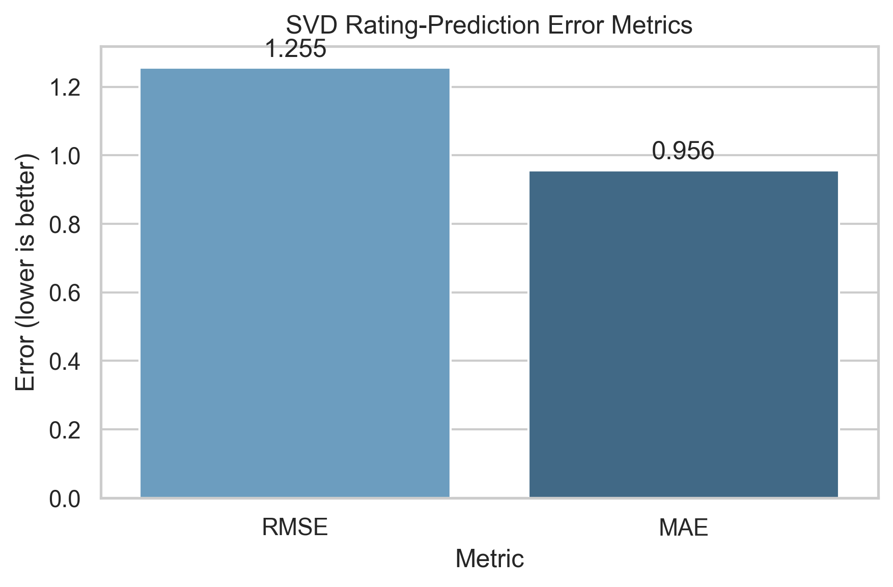
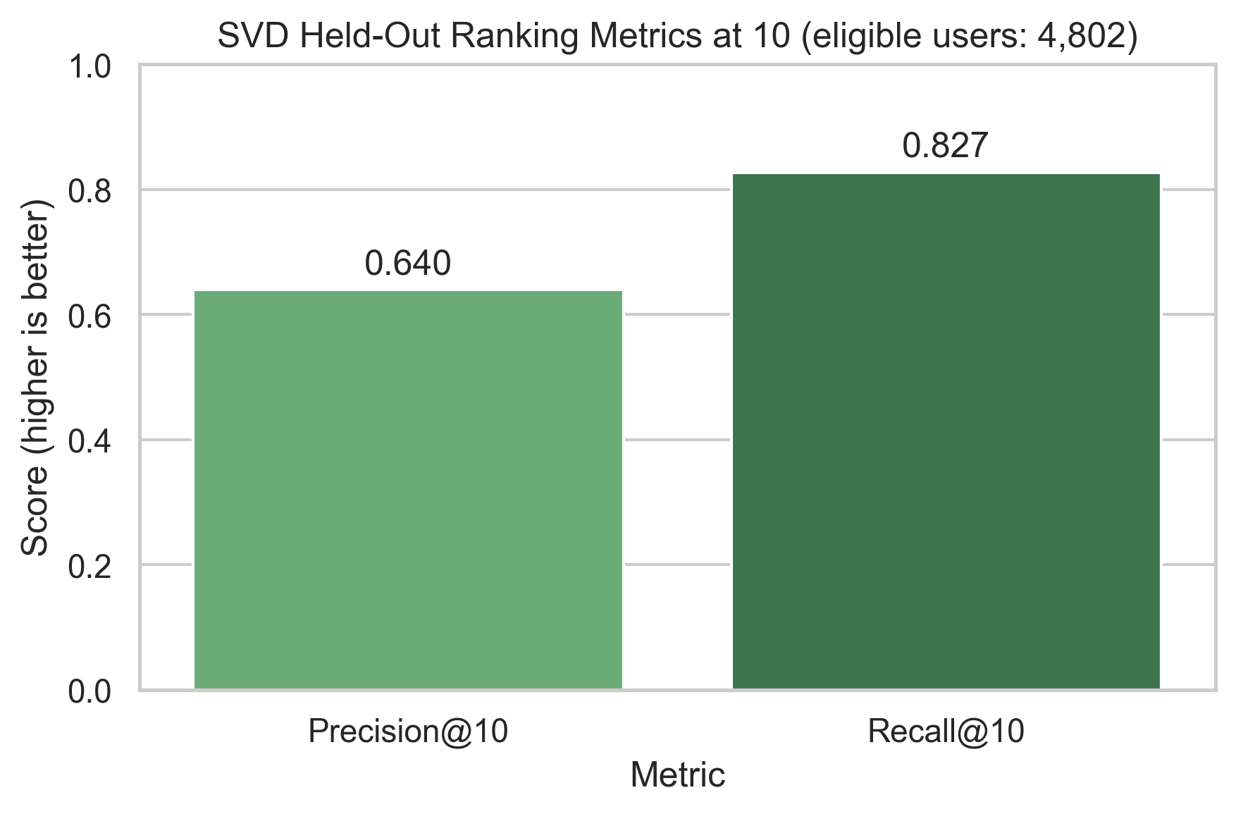
VERIFIED EVALUATION
SVD adds ranking evidence but only marginal rating-error gains
METRIC
BIAS-ONLY
30-FACTOR SVD
INTERPRETATION
RMSE
1.2552
1.2551
Improvement is negligible
MAE
0.9604
0.9560
Average error is just under one point
Precision@10
—
0.6397
Scoped held-out ranking evidence
Recall@10
—
0.8273
Same users and candidate set
GROUP 14 · DUY TAN UNIVERSITY, DA NANG
12
Notes:
Use exported values, not stale notebook cells. Emphasize marginal RMSE gain and scoped ranking evidence.

Slide 13
RECOMMENDATION SERVING
Serving refits after evaluation and returns only unseen anime
Serving protocol
TYPICAL HISTORY · USER 25321
33 retained ratings · mean observed rating 7.79
1. Freeze outer-test metrics.
2. Refit 30-factor SVD on all 952,497 model interactions.
3. Remove anime already rated by the user.
4. Sort predicted scores; break ties by anime ID.
5. Return 10; join metadata after ranking.
Seven profiles are demonstrations, not extra test folds.
RANK
ANIME
PREDICTED
1
Ginga Eiyuu Densetsu
9.6250
2
Gintama°
9.4408
3
Neon Genesis Evangelion
9.4265
4
Fullmetal Alchemist: Brotherhood
9.3124
5
Byousoku 5 Centimeter
9.2897
A prediction is an estimate—not a verified future rating, public average, or objective-quality claim.
GROUP 14 · DUY TAN UNIVERSITY, DA NANG
13
Notes:
Explain evaluation versus serving fits, unseen filtering, tie-breaking, and the Top-5 example. Clarify what predicted ratings do not mean.

Slide 14
CONCLUSION, NEXT STEPS & REFERENCES
The baseline is reproducible—and its boundaries are explicit
The project turns explicit ratings into unseen-anime Top-10 recommendations while keeping data semantics, evaluation scope, and serving logic auditable.
LIMITATION
LINKED NEXT STEP
APA REFERENCES
Cold start
Genre/content fallback or hybrid
CooperUnion. (2016). Anime recommendations database [Data set]. Kaggle.
Hug, N. (n.d.). Matrix factorization-based algorithms. Surprise.
Koren, Y., Bell, R., & Volinsky, C. (2009). Matrix factorization techniques for recommender systems. Computer, 42(8), 30–37. https://doi.org/10.1109/MC.2009.263
Shared: integration, testing, and cross-checking of code, figures, metrics, and report claims.
Sampling & k-core bias
Coverage/diversity on broader data
Observed-item ranking
Full-catalogue evaluation
Random split
Temporal validation when possible
Marginal bias-only gain
Stronger baselines and broader tuning
Mai Nam Quốc · 50%
Trương Nhật Trường · 50%
Data loading, cleaning, EDA, preparation, APA references, report review.
SVD, evaluation, Top-10 export, presentation, report integration, conclusion.
GROUP 14 · DUY TAN UNIVERSITY, DA NANG
14
Notes:
Restate the contribution and evidence boundary. Pair limitations with next steps. Confirm the 50/50 contribution wording before submission.

