Slide 1
Restaurant’s Analysis using Zomato API Project Report Amit Maindola

Slide 2
Acknowledgements
I would take this opportunity to thank CourseEra Team to give us opportunity to work on this Project of my choice and providing all the required knowledge, skills and Training for the Project.

Slide 3
Abstract
Restaurant business has seen a great surge after the booming of online services such as recommendation system, Online Order, Home Delivery etc. It’s Sophistication is increasing everyday, exploring new dimensions.
Due to increased business it is paramount to know the existing market for Restaurants in a city. Recommendation to business owners about places perfect for opening a new Restaurant with a particular Cuisine where the owner would get best traffic for the Restaurant.
I build an Analysis system using Zomato Data for the business owners to analyze the market based on Cuisines, Nightlife, Popularity and Restaurants types. The Insights derived from the analysis is helpful in understanding the existing business and how or which area lacks the service.

Slide 4
Introduction
We provide a broad description of the Analysis performed on the Restaurants in Chandigarh City. Data Science changed the way people find the products, information, solutions and even other people. The goal is to generate meaningful insights and make a recommendation system to the business owners for the new Restaurants.
Rather than providing a static experience in which user search for and potentially buy a products, recommendation system increase interaction to provide a richer experience.
With burgeoning consumerism buoyed by emergence of web, buyers are presented with increasing range of choices while sellers are being faced with the challenge of personalizing their advertising efforts.
Suggest best suited place to new entrants in the restaurant business for setting up new business to fill the Cuisine void and garner high traffic.

Slide 5
Business Problem
Due to Increased connectivity and availability of Data it is now possible to extract and derive the useful Insights from the available data and study the existing Market of the Hypothesis/Model/Product you want to make.
Our requirement is to build a model which can analyze the existing Restaurants in a city and can suggest where a new Restaurant can be opened depending on the type of Cuisine or the Customer category or the Initial Budget we have for the Business.
To fulfill the Business Requirement we have to study the existing data about the market, finding out the various parameters associated with the Business which are to be considered.
Establishing the relationship between the parameters and how and what kind of Cuisines can affect the Traffic in the new Restaurant.

Slide 6
Data Requirement and Collection
The Analytic approach need certain data to be in a format which can be used to perform representation and visualization guided by domain Knowledge.
The data is collected for the City from websites through webscrapping.
FourSquare API has limited information for the Restaurants in India thus better approach will be to use Zomato.
Restaurant data is collected for areas from Zomato API.
The collected data is in form of json and csv format which are to be manipulated and formatted.

Slide 7
Data Preparation and Modeling
The collected data is then prepared by performing the cleaning and formatting to bring in the better shape.
Data are collect in the form of JSON format, which are cleaned and then saved in the CSV format to be consumed by DataFrame.
Collected Data is then further cleaned and formatted using the Pandas Library
Once data is prepared and well formatted we can perform the various visualization on the data.
Various charts and bar graphs are created on the data to
We have to perform One Hot Encodings to bring the data into the shape which is suitable for the application of Machine learning Algorithm.
We would be using Pandas.get_dummies() Method to convert categorical variables into the numerical values.
Once the data is ready we would be using Kmeans Clustering Algorithm.

Slide 8
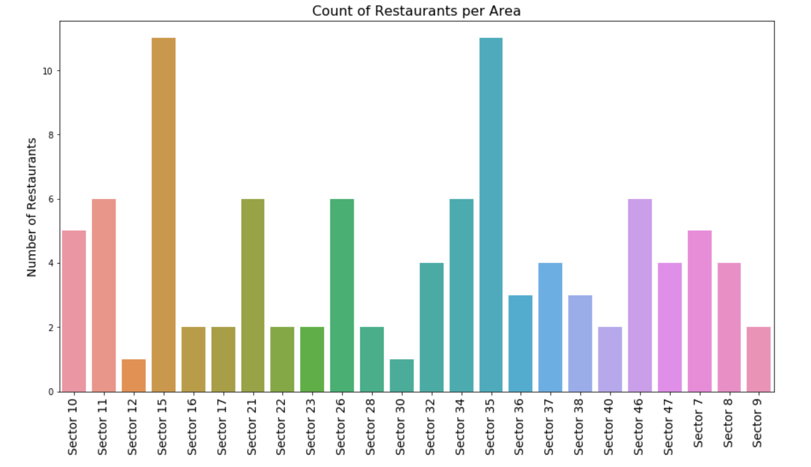

Slide 9
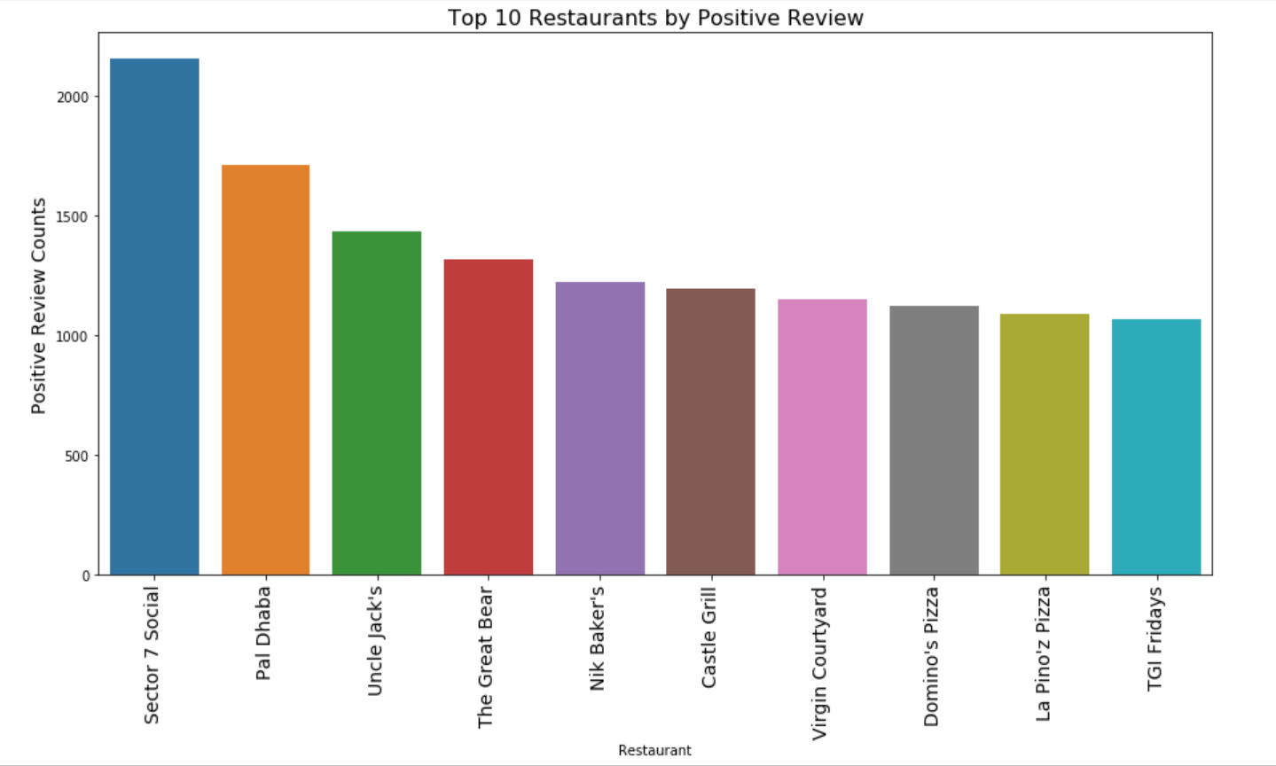

Slide 10
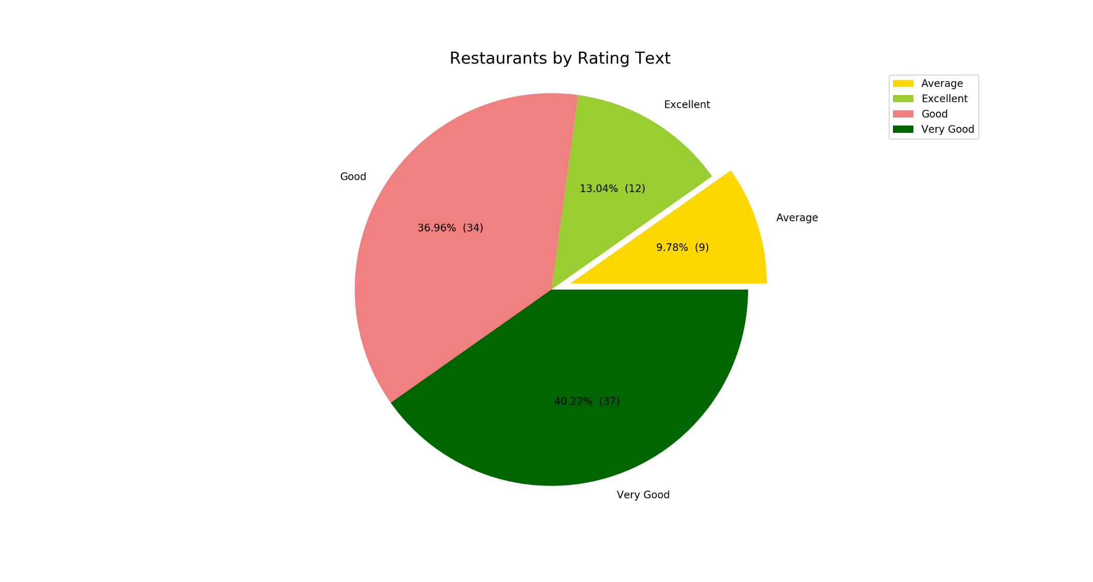

Slide 11
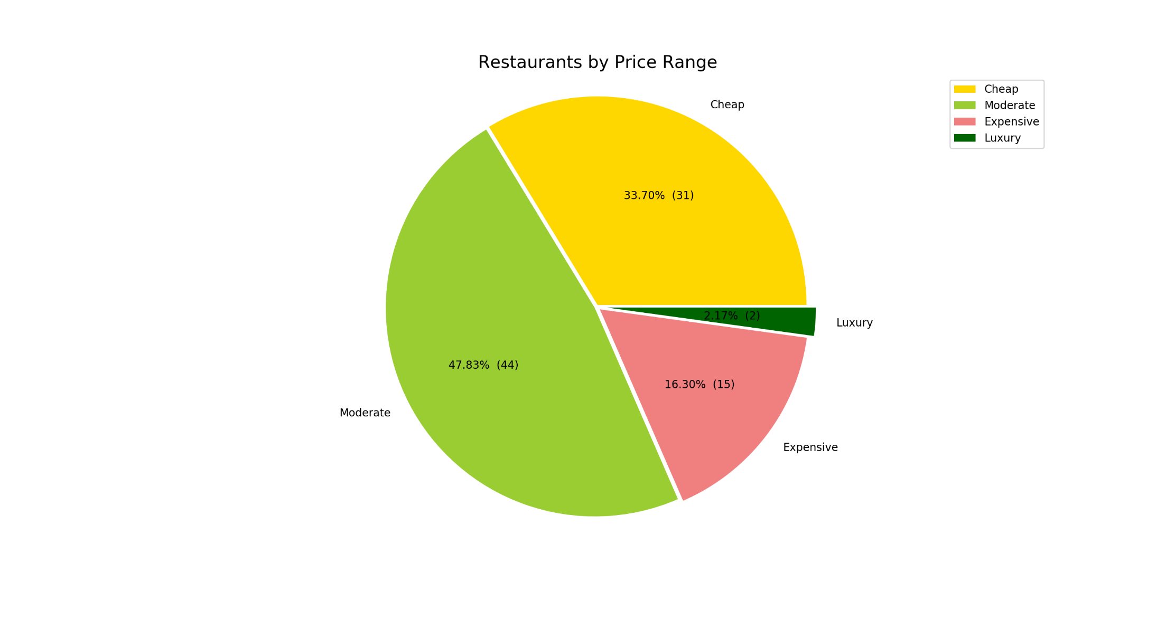

Slide 12
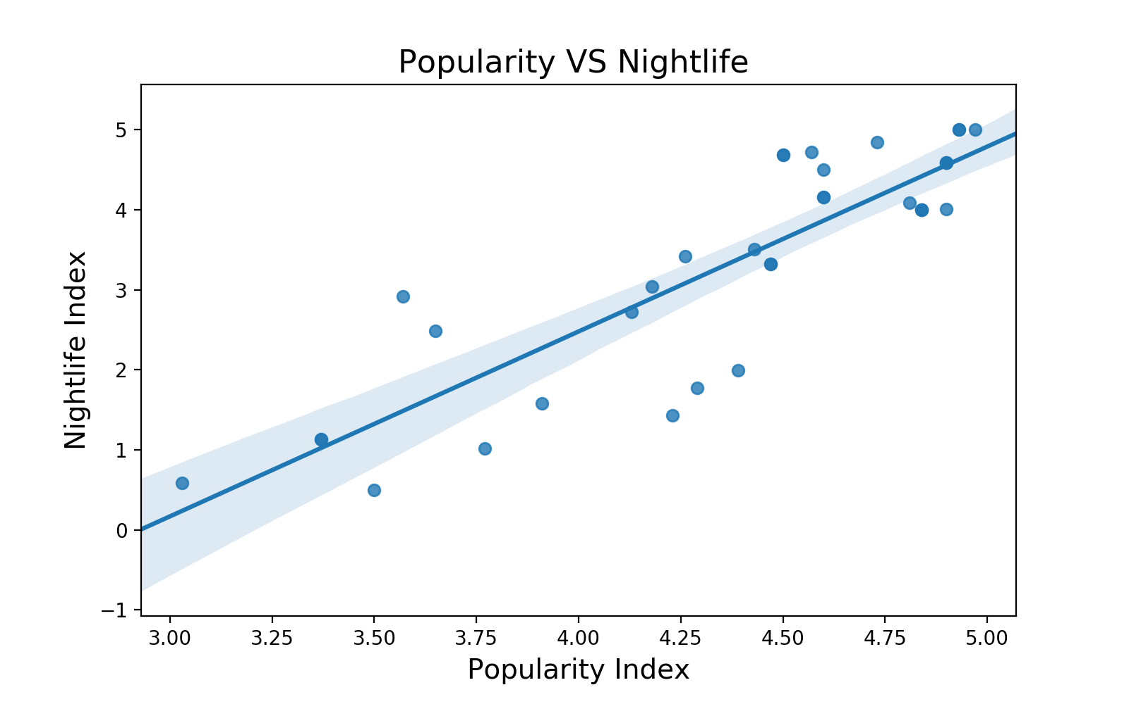

Slide 13
Conclusion
After analyzing all the available data and charts we can determine the below points.
If we are planning to open an Expensive Restaurant serving North Indian, Fast food and other Cuisines then Sector 15 and Sector 35 are our best options.
If we are planning to open a mid-Range Restaurant serving Beverages, Fast food, Chinese or Street Food then Sector 36, 23 and 40 are best options due to vicinity with other sectors.
If we are planning to open a low cost, mid-range Restaurant serving North India, Continental, Chinese, Cafe we can choose Sector 12,17,22 and nearby vicinity.
If we are planning to open a new bakery then possible choices are Sector 10,26,32,37,46

