Slide 1
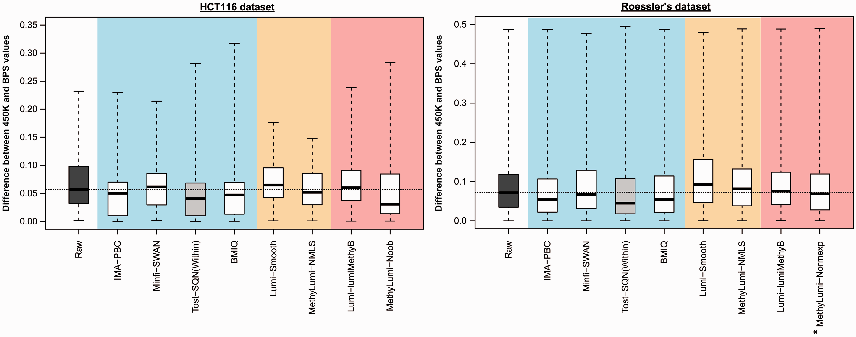

Figure 3: Comparison of the different within-array normalization methods using BPS data as referential data. Boxplots ...
Notes:
Figure 3: Comparison of the different within-array normalization methods using BPS data as referential data. Boxplots show the distribution of the absolute difference between DNA methylation measurements obtained from Infinium HumanMethylation450 and BPS, when Infinium data are subjected (white) or not (dark gray) to within-array normalization, for HCT116 and Roessler’s data sets. Blue, orange and red indicate Infinium typeI/II bias correction methods, color bias adjustment and background correction methods, respectively. Raw: Infinium raw data; IMA-PBC: PBC from the IMA package; Minfi-SWAN: Subset quantile Within-Array Normalization from the minfi package; Tost-SQN(within): categorical SQN from Touleimat and Tost pipeline (this boxplot is highlighted in light gray to indicate that each sample has been normalized individually to apply only the within-array normalization component of this method); BMIQ: Beta-Mixture Quantile Normalization; Lumi-Smooth: color bias adjustment from the lumi package (smooth quantile normalization); MethyLumi-NMLS: dye bias equalization (normalizeMethyLumiSet) of the methylumi package (method originally proposed in the Genome Studio software); Lumi-lumiMethyB: background correction from the lumi package; MethyLumi-Noob: background correction based on normal exponential convolution model using out-of-band intensities as controls from the methylumi package; MethyLumi-Normexp: same as MethyLumi-Noob but controls used are negative probes present on the array (*On the Roessler’s data set, this method was applied instead of the ‘Noob’ method because we do not have access to the IDAT files of these samples). A colour version of this figure is available at BIB online: http://bib.oxfordjournals.org.
Unless provided in the caption above, the following copyright applies to the content of this slide: © The Author 2013. Published by Oxford University Press.This is an Open Access article distributed under the terms of the Creative Commons Attribution Non-Commercial License (http://creativecommons.org/licenses/by-nc/3.0/), which permits non-commercial re-use, distribution, and reproduction in any medium, provided the original work is properly cited. For commercial re-use, please contact journals.permissions@oup.com

