Slide 1

Numerical Method Sessional
CSE - 4746
Prof. Mohammed Shamsul Alam
Professor
Dept. of CSE, IIUC

Slide 2
Project Name: Numerical Integration
Team Name: Team_Integration
Team Members
Md Jubair Hossain
C193051
Mainuddin Hasan
C193070 (Leader)
Mohammad Sakib Chowdhury
C193055(Co-Leader)
Jahirul Islam
C193083
Mohammad Mezbah Uddin
C193082

Slide 3
Intro
º
º
Features
º
Implementation
Result Analysis
º
Future Plans
º

Slide 4
Intro
We are considering an object that is being moved along a straight line by a force that varies with position. The force applied to the object is given by the function F(x) = 3x^2 - 2x + 1, where x represents the position of the object in meters and the force is measured in Newtons.

Slide 5
Features
- Position-Dependent Force
- Numerical Integration

Slide 6
Types of Numerical Integration
Trapezoidal Rule
Simpson's 1/3 Rule
Simpson's 3/8 Rule

Slide 7
Trapezoidal Rule
I = h/2 [y₀ + 2 (y₁ + y₂ + ………. + y_{n-1}) + y_{n}]
The above formula is known as the trapezoidal rule for numerical integration.
The geometrical significance of this rule is that the curve y = f(x) is replaced by n straight line joining the points (x₀, y₀) and (x₁, y₁), (x₁, y₁) and (x₂, y₂), …. , (x_{n-1}, y_{n-1}) and (x_{n}, y_{n}).
The area bounded by the curve y = f(x), the ordinates x = x₀ and x = x_{n} and the x axis is then approximately equivalent to the sum of the areas of the n trapezium obtained.

Slide 8
Simpson's 1/3 Rule
I = h/3 [y₀ + 4 (y₁ + y₃ + y₅ +....+ y_{n-1}) + 2 ( y₂ + y₄ +.…+ y_{n-2}) + y_{n}]
The above formula is known as Simpson’s one-third rule on simply Simpson’s rule.
It should be noted that this rule requires the division the whole range into an even number of subintervals of width h.

Slide 9
Simpson's 3/8 Rule
I = 3h/8 [(y₀ + y_{n}) + 3 (y₁ + y₂ + y₄ + y₅ + …+ y_{n-2} + y_{n-1}) + 2 (y₃ + y₆ + … + y_{n-3})]
The above formula is known as Simpson’s one-third rule on simply Simpson’s rule.
Simpson’s 3/8 rule can be applied when the range [a, b] is divided into a number of subintervals, which must be a multiple of 3.

Slide 10
Implementation
- Define the Force Function
- Choose Integration Method
- Discretize the Interval
- Evaluate the Force at Each Subinterval
- Perform Numerical Integrationl
- Obtain the Work Done

Slide 11
Force Function
f(x) = 3x^2 - 2x + 1

Slide 12
Result Analysis
Initial, End position (Meter) | Work Done - Real integration (Joule) | Work Done - Trapezoidal rule (Joule) | Work Done - Simpson’s ⅓ rule (Joule) | Work Done - Simpson’s ⅜ rule (Joule)
1 - 5 | 104J | 104.222J | 104.00012J | 104.000J
5 - 15 | 3060J | 3060.81J | 3060.00032J | 3060J
10 - 50 | 121640J | 122140.3241J | 121640.00034J | 121640.00J

Slide 13
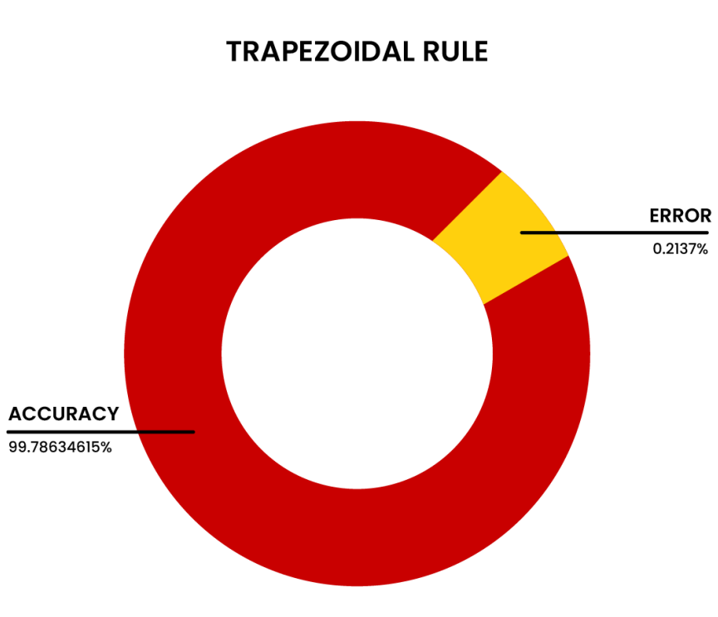
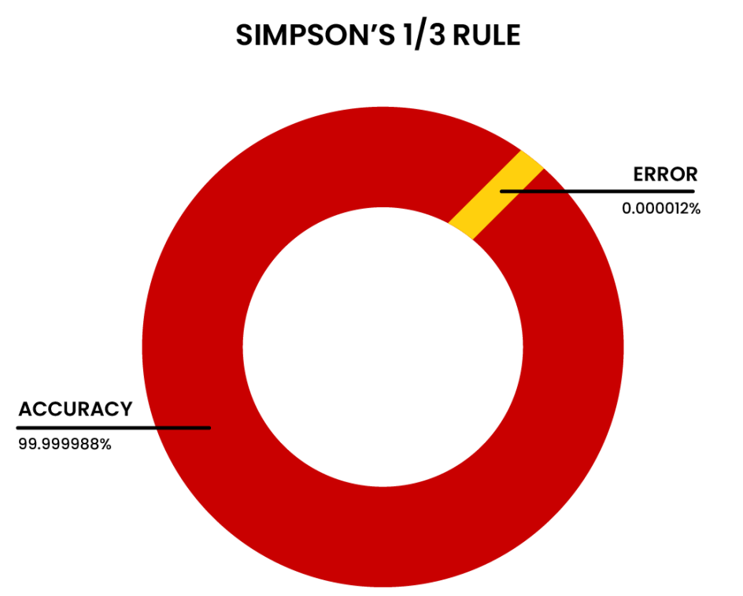
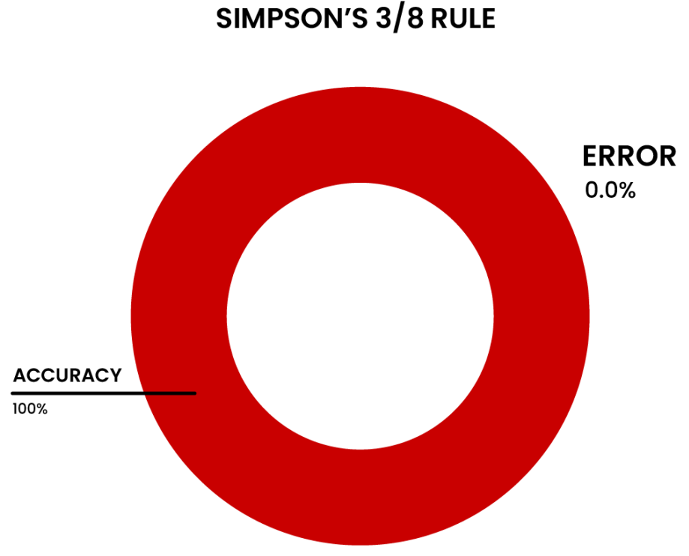
Pie Chart of Accuracy

Slide 14
Future Plans & Possible Extensions
- Analysis of Energy
- Optimization of Integration Methods

Slide 15
THE END

