Slide 1
Micro-Frontend (MFE) Architecture
Complete Visual Representation of Angular-in-AngularJS Migration Architecture

Slide 2
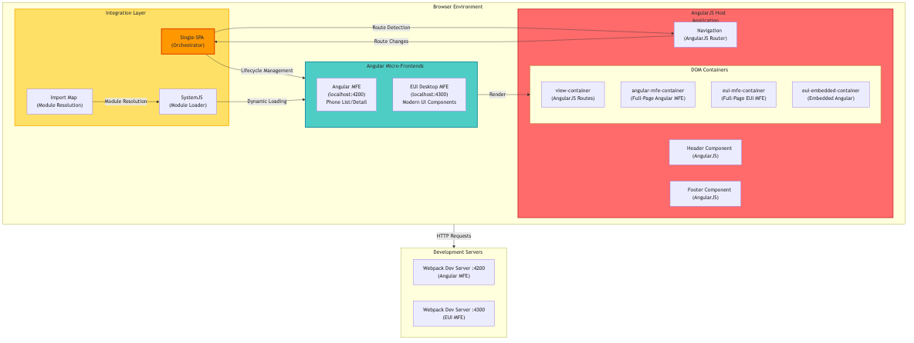
🏗️ High-Level Architecture Overview

Slide 3
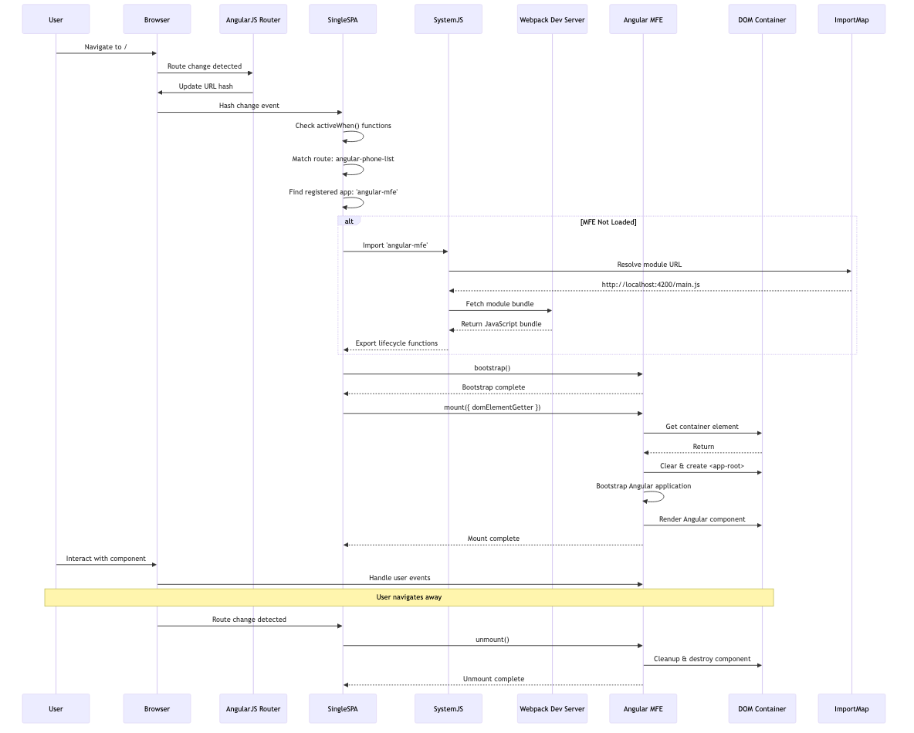
🌊 Runtime Flow: Request to Render

Slide 4
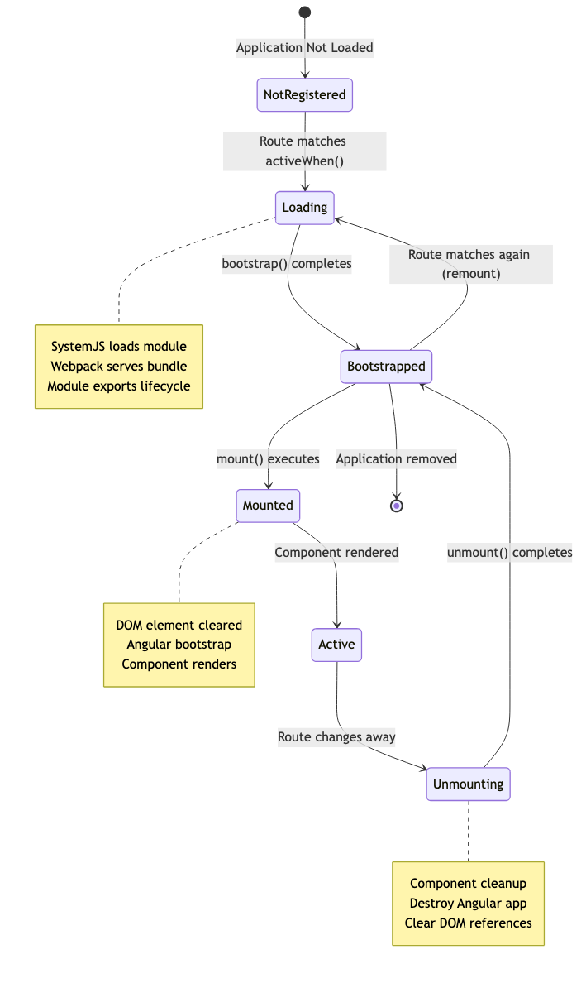
🔄 Component Lifecycle Management

Slide 5
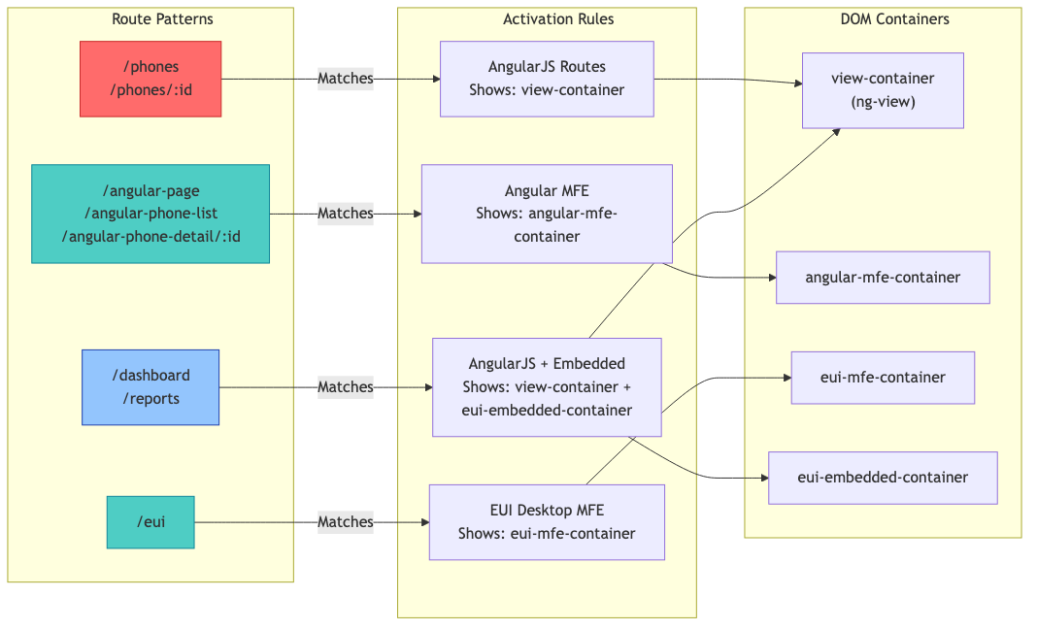
🗺️ Route-Based Activation Matrix

Slide 6
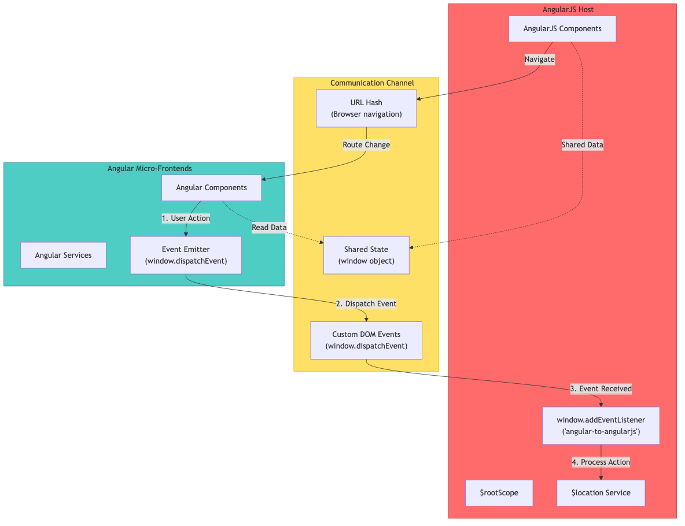
📡 Cross-Framework Communication

Slide 7
🔌 Single-SPA Application Registration
M
e
r
m
a
i
d
D
i
a
g
r
a
m
:
g
r
a
p
h
T
D
S
t
a
r
t
[
B
r
o
w
s
e
r
L
o
a
d
s
i
n
d
e
x
.
h
t
m
l

Slide 8
📦 Module Loading & Bundle Structure
M
e
r
m
a
i
d
D
i
a
g
r
a
m
:
g
r
a
p
h
T
B
s
u
b
g
r
a
p
h
H
o
s
t
A
p
p
[
"
🏠
A
n
g
u
l
a
r
J
S
H

Slide 9
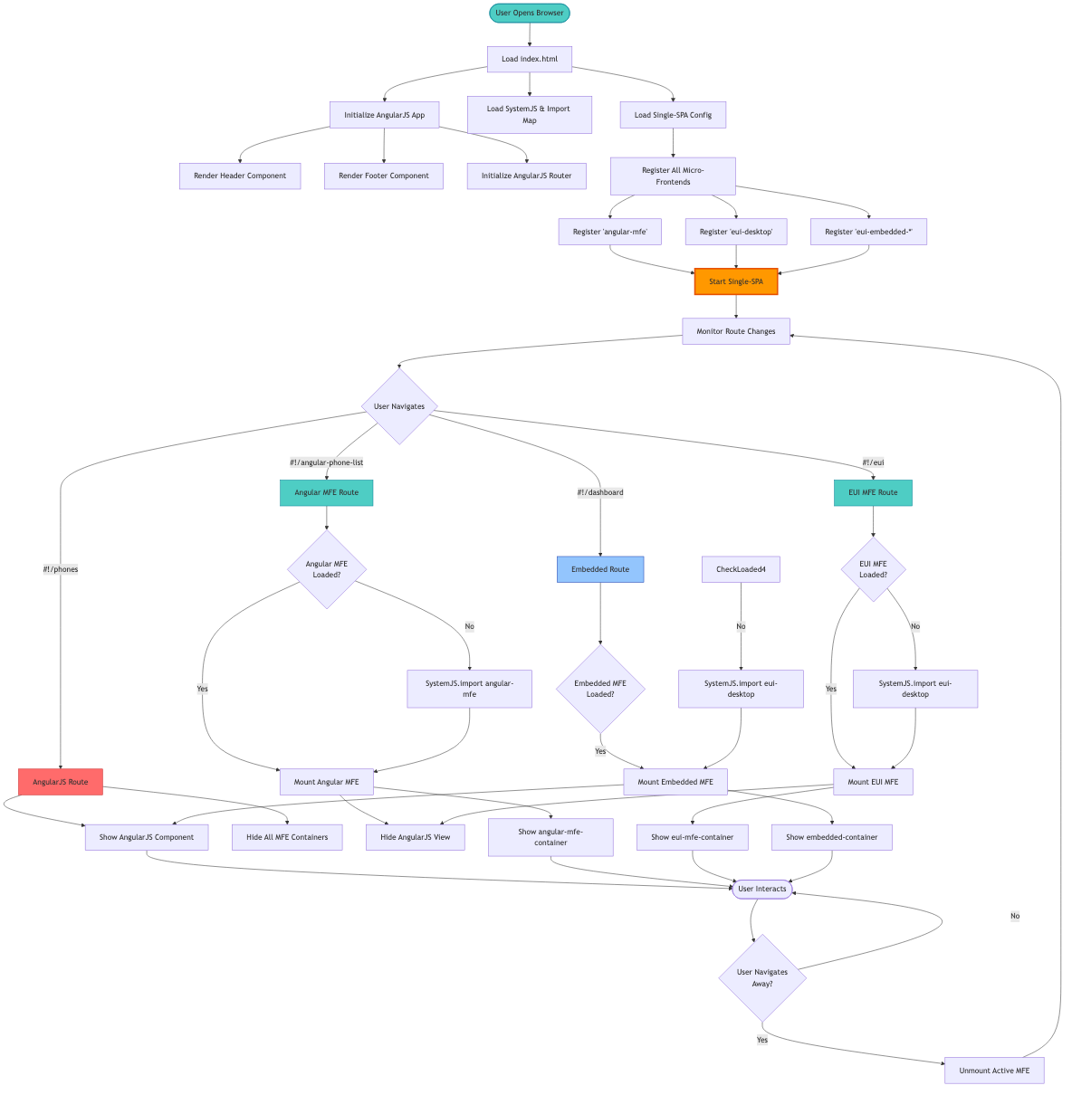
🎯 Complete Integration Flow

Slide 10
🏛️ Project Structure with MFE Integration
a
n
g
u
l
a
r
-
p
h
o
n
e
c
a
t
/
│
├
─
─
📱
A
n
g
u
l
a
r
J
S
H
o
s
t
A
p
p
l
i
c
a
t
i
o
n
│
├
─
─

Slide 11
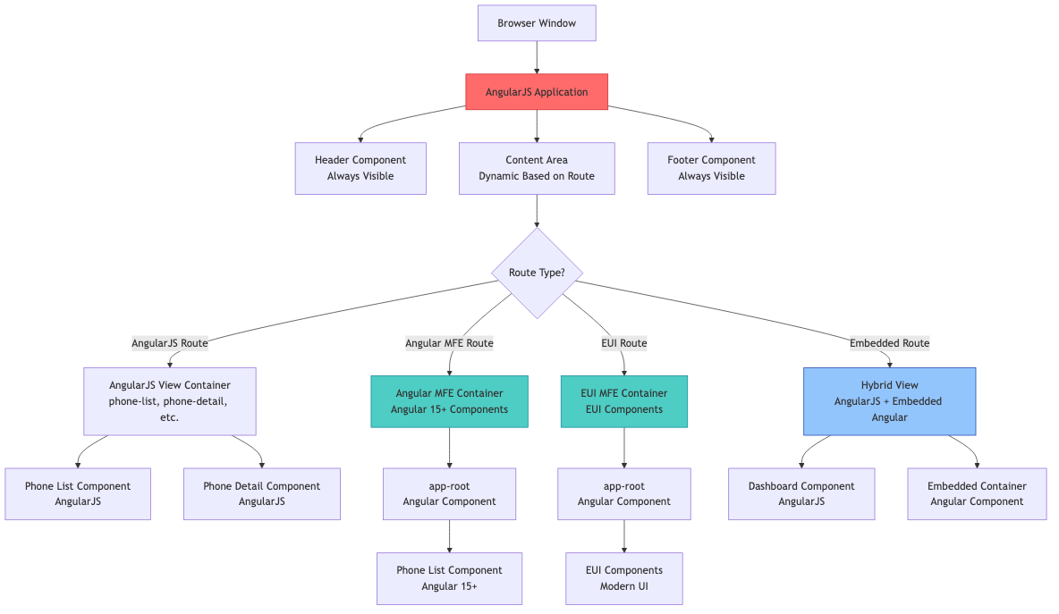
🎨 Visual Component Hierarchy

Slide 12
📊 Migration Strategy Visualization
M
e
r
m
a
i
d
D
i
a
g
r
a
m
:
g
a
n
t
t
t
i
t
l
e
M
i
c
r
o
-
F
r
o
n
t
e
n
d
M
i
g
r
a
t
i
o
n
T
i

Slide 13
🔍 Key Integration Points
|
I
n
t
e
g
r
a
t
i
o
n
P
o
i
n
t
|
T
e
c
h
n
o
l
o
g
y
|
P
u
r
p
o
s
e
|
|
-
-
-
-
-
-
-
-
-
-
-
-

Slide 14
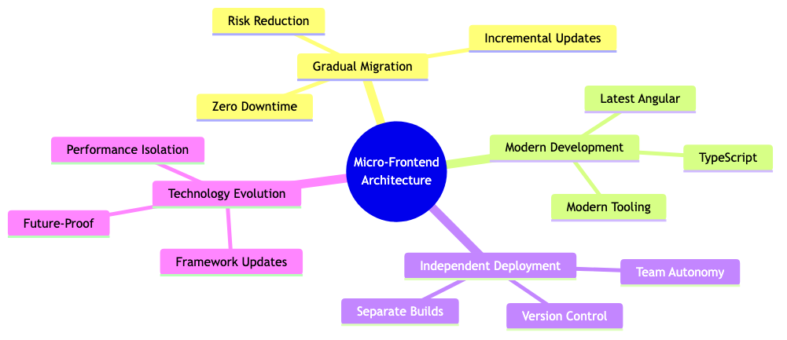
✅ Benefits Visualization

