Slide 1


DSFT-07 PHASE 3 PROJECT PRESENTATION PROJECT TITLE:Detecting customers who are likely to churn By Mainye Gesanda Peter

Slide 2

PROJECT OVERVIEW This Dataset contains information about customers of a Telecom company and whether they churned or not. Churn refers to the phenomenon of customers leaving a service or product. The dataset includes various features that can be used to predict churn behavior

Slide 3
Problem statement The problem we aim to address in this project is predicting customer churn in a telecom dataset. By analyzing customer data such as usage patterns, demographics, and customer service interactions, we aim to develop a predictive model that can accurately identify customers who are likely to churn. This model will enable telecom companies to proactively intervene and implement retention strategies to reduce churn rates

Slide 4
DATA • Data Source: https://www.kaggle.com • Target variable: Churn Target audience: Telecom company

Slide 5
PROCEDURES • Importing all necessary packages • Loading the dataset • Cleaning the data • Exploratory Data Analysis • Modelling approach

Slide 6
Main Objective
Build a classifier to predict whether a customer will ("soon") stop doing business with SyriaTel, a telecommunications company

Slide 7
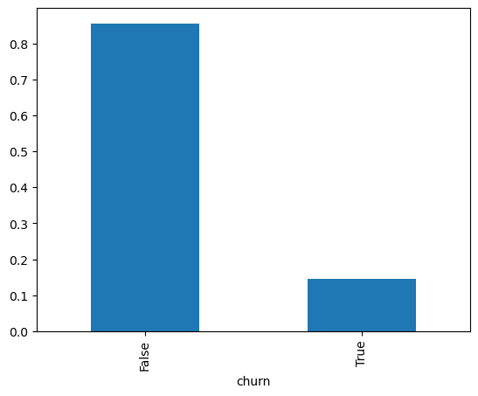
VISUALIZATIONS OF THE FINDINGS
Percentage of loyal customers

Slide 8
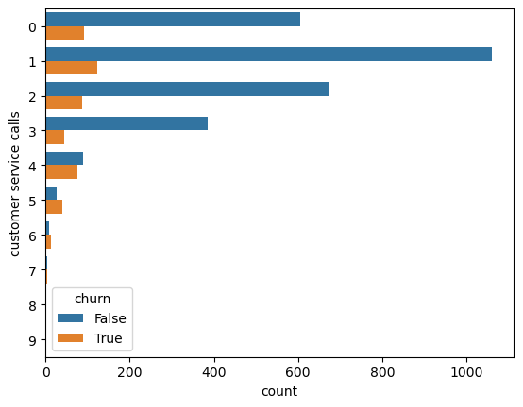
Call center and churn
Relationship between the number of calls to the call center and Churn

Slide 9
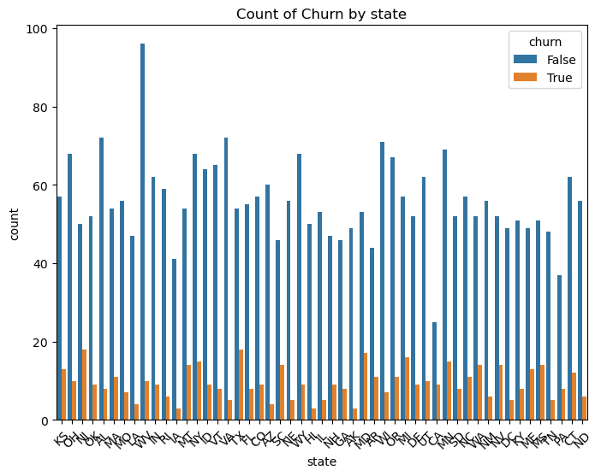
CHURN AND STATE
Counts of churn by state

Slide 10
CONCLUSION Precision: For the class labeled as False, the precision remains the same as before hyperparameter tuning, indicating that 91% of the customers predicted to not churn actually did not churn. For the class labeled as True, the precision remains perfect at 100%, meaning that all customers predicted to churn actually did churn. Recall: After hyperparameter tuning, the recall for the class labeled as False remains perfect at 100%, indicating that all actual instances of not churning were correctly identified by the model. However, the recall for the class labeled as True has improved to 46%, compared to the previous recall of 39%. This suggests that the model is now better at identifying actual instances of churn. F1-score: The F1-score for both classes has improved slightly, with the F1-score for the class labeled as True increasing from 0.56 to 0.63. Accuracy: The overall accuracy of the model has also improved slightly from 91% to 92%

Slide 11
RECOMENDATION
As a recommendation, it's advisable to deploy the refined model into a production environment for real-world usage.

Slide 12


