Slide 1
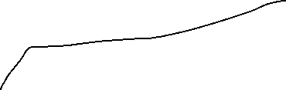




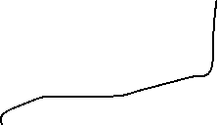
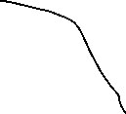


Yes
Video upload
Blur faces
Source of data
No
None
1080
Force plate
?
File upload
Process

Slide 2

df_landmarks_raw, fps_video, capturing_length_video, total_frames_video, video_path= process_video_blured(video_path, show_pose=1, blur_faces=blur_facesuser)
Pose estimation and video meta data
# fill nans in the landmarks
# filter the landmarks
# calculate the joint angles
# calculate the center of mass
# calculate the velocity
# calculate the acceleration
Warn user if video sampling freq is to low
Process
1080
Process
Force
Process
None
&
&
&
Blur face (0/1) and overlay filtered landmarks in the video
Blur face (0/1)
Downsample force data to video fs
Calculate com position from force plate
Scale the com position from video from pixel to m using peaks from both sources
Use com position from video and force data to sync
Create overlay video force
Video download

