Slide 1
Generating Breast Cancer IHC Images with Deep Learning
May 14, 2024
Yuchen Li
Xichu Yu
Maiqi Zhou

Slide 2
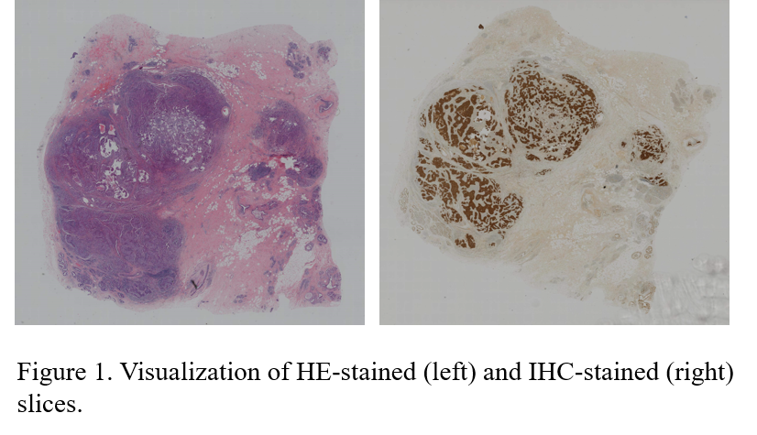
Background
Breast Cancer: A Global Challenge
Breast cancer remains a leading cause of mortality among women worldwide.
Effective treatment and accurate diagnosis rely heavily on detailed analysis of histopathological images.
Histopathological Images
Hematoxylin and Eosin (HE) and Immunohistochemistry (IHC) stained slices are critical in evaluating breast cancer.
Figure 1: An example of HE and IHC stained images.
Source: "Breast Cancer Immunohistochemical Image Generation Challenge." grand-challenge.org. https://bci.grand-challenge.org/ (accessed May. 1, 2024)

Slide 3
Objectives
Challenges with IHC Staining:
The preparation of IHC-stained sections is time-consuming and expensive.
IHC staining is typically performed on a single pathological slice, which may not fully represent the status of tumors.
To improve breast cancer diagnosis, we propose training a deep-learning model.
This model will perform image-to-image translation from the HE domain to the IHC domain, reducing costs and enhancing diagnostic efficiency.
The model will be integrated into existing diagnostic software, enabling adoption in clinical settings.

Slide 4
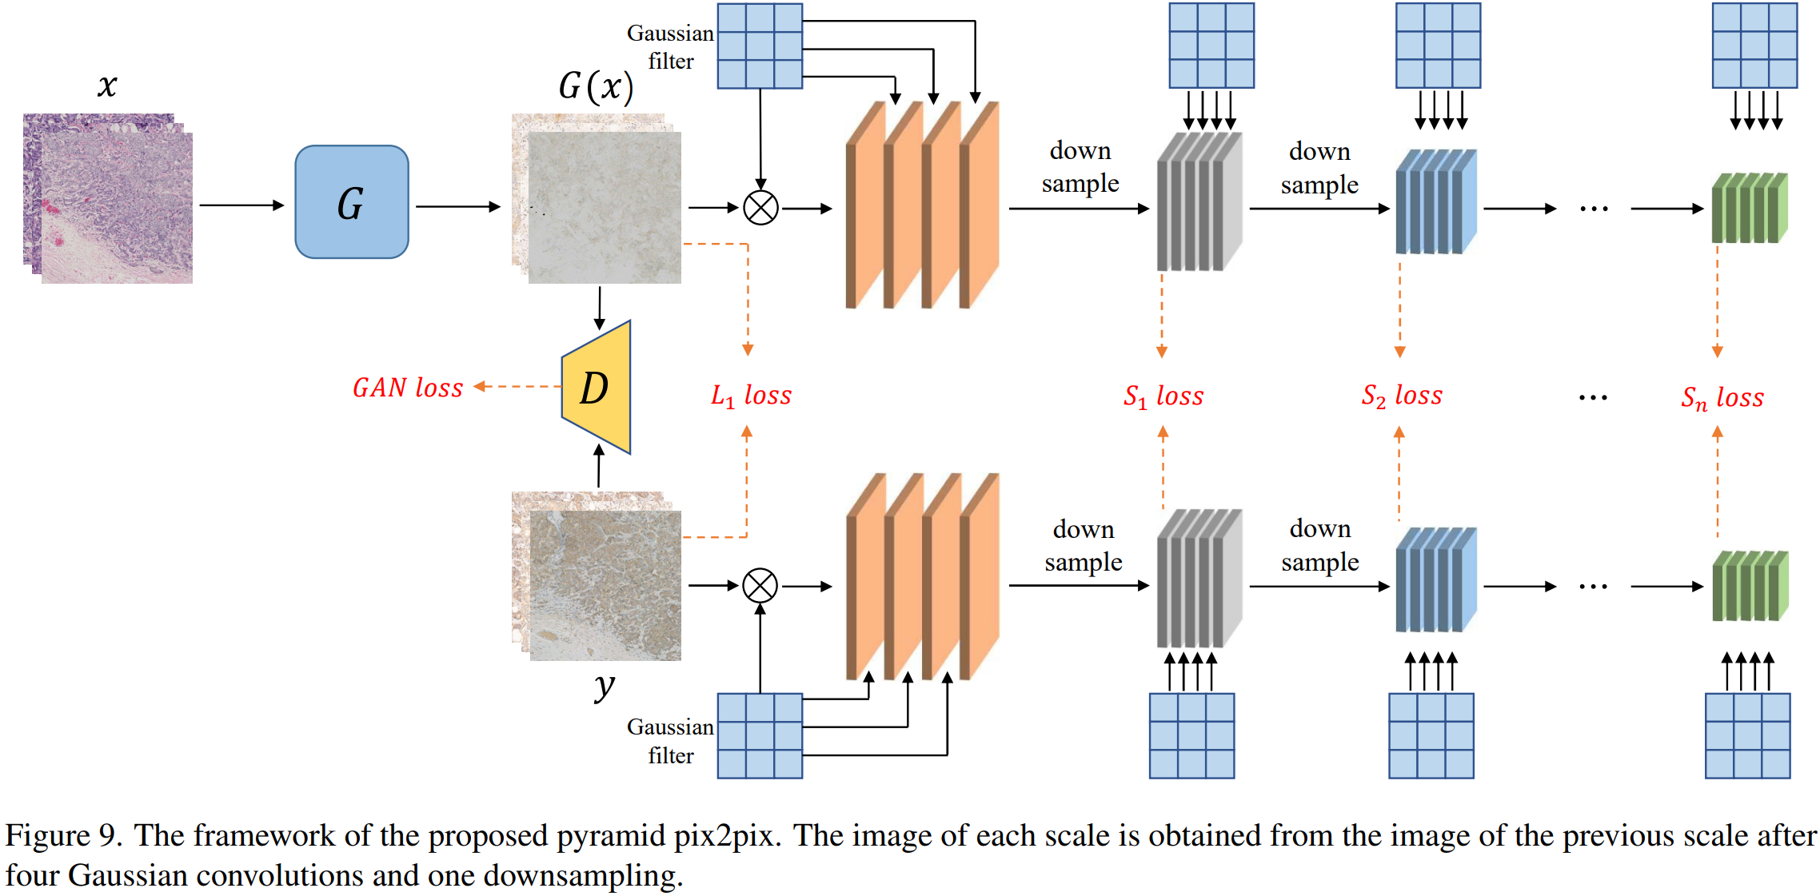
Model Design
Figure 2: Pyramid Pix2Pix architecture proposed by the challenge organizer.
We propose to leverage and improve the Pyramid Pix2Pix architecture.
Utilize improvements presented by the challenge participants to refine our model.
Source: Liu et al. "Bci: Breast cancer immunohistochemical image generation through pyramid pix2pix." In *Proceedings of the IEEE/CVF conference on computer vision and pattern recognition*, pp. 1815-1824. 2022.

Slide 5
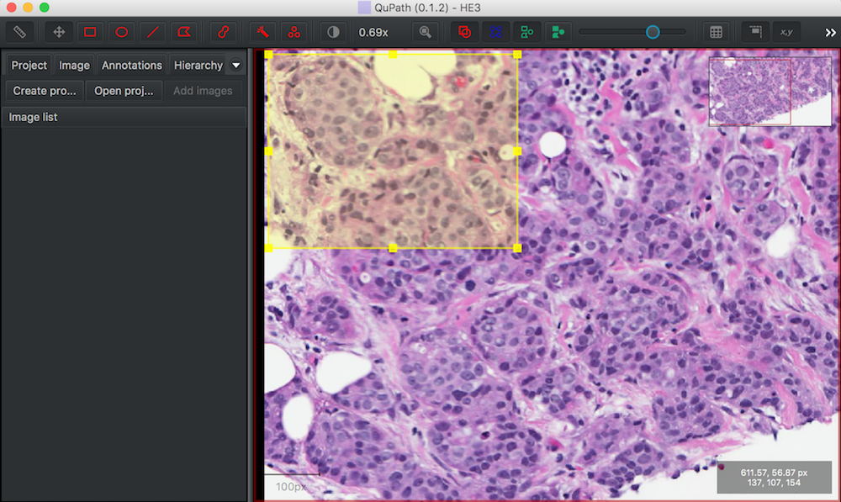
Software Design
QuPath
Open-source pathology image analysis software.
Support customizable extensions.
We plan to develop a python extension that will integrate our model to QuPath with user-friendly functions.
Source: D. Breen, "H&E Histology Color Normalization - QuPath," Drexel University, 2018. [Online]. Available: https://www.cs.drexel.edu/~deb39/ZarellaLab/h-e-histology-color-normalization_qupath.html. [Accessed: 12-May-2024]

Slide 6
Task distribution
Task | Member
Literature study & Method design | collaboratively
Implementation of model | Yuchen Li, Maiqi Zhou
Development of software system | Xichu Yu
Training and evaluation of model | Yuchen Li
Testing and documentation of software system | Maiqi Zhou, Xichu Yu
Writing and organization of project report | collaboratively

Slide 7
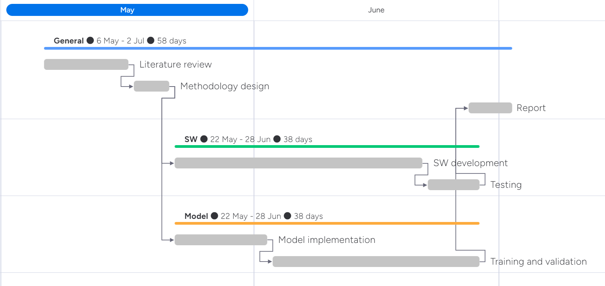
Time schedule
Task | Timeline
Literature review | 6-16 May
Methodology design | 17-21 May
Model implementation | 22 May-2 Jun
Training and validation | 3-28 Jun
Software development | 22 May-21 Jun
Testing | 22-28 Jun
Report | 27 Jun-2 Jul

