Slide 1
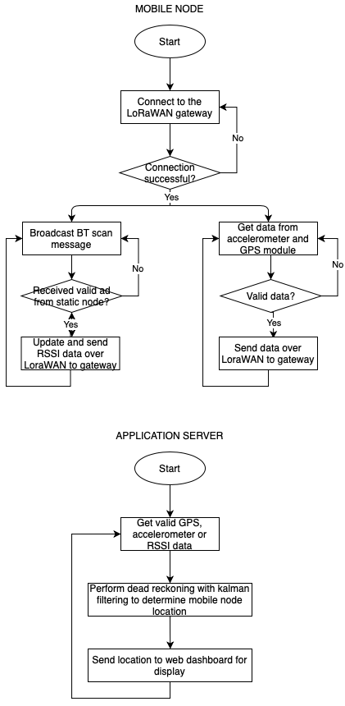
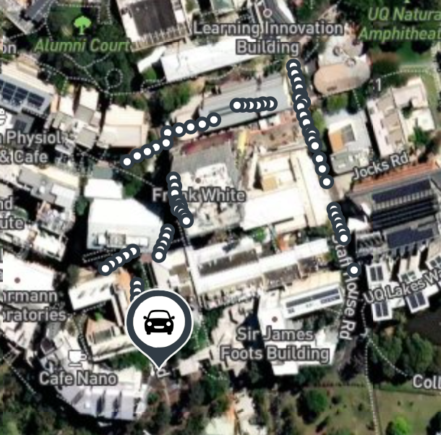
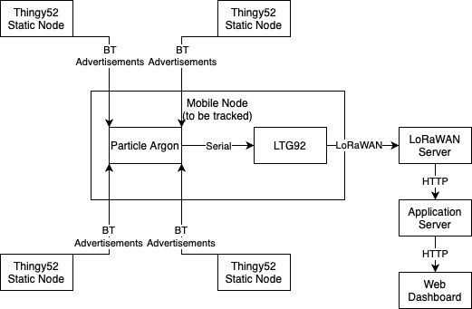
Outdoor GPS Dead-Reckoning with Lorawan
Artemis-Blue (Rhys Sneddon and Mairah Zulkepli)
AIMS (KPI)
The key performance indicators of the project would be:
Particle argon able to determine RSSI values for the static nodes and send them to the LTG92
Able to send data GPS and RSSI data from the LTG92 LoRaWAN GPS tracker to the LoRaWAN gateway
Data is processed using a dead-reckoning model with kalman filtering to determine the estimated location of the mobile node
Having a web dashboard viewer that shows the estimated location of the mobile node
Be able to usefully track the mobile node in at least a 10 x 10 m outdoor area
SYSTEM OVERVIEW
System Block Diagram
Software Flowchart
RESULTS
CONCLUSIONS
We were able to achieve the following KPIs:
Process the data using a dead-reckoning model to determine an estimated location
Have a web dashboard viewer that shows an estimated location

