Slide 1
Introduction to Playwright

Slide 2
Playwright
Playwright by Microsoft is an open-source web test automation library on Node.js, which makes test automation easier for browsers based on Chromium, Firefox, and Webkit through a single API
Playwright Architecture:
While Selenium works on HTTP Protocol.
The Playwright works on WebSocket Protocol.
WebSocket is a computer communication protocol, that provides a full-duplex communication channel single TCP connection.

Slide 3
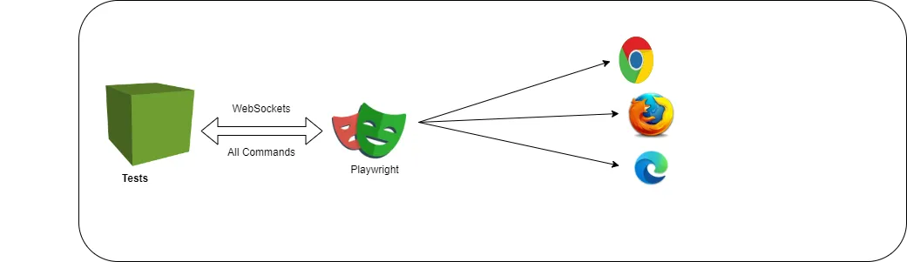
Playwright

Slide 4
Playwright
Key differences between HTTP and WebSockets
Communication Model:
HTTP:
Relies on a request-response model.
The client sends a request to the server, the server processes it, and then sends a response back to the client.
WebSocket:
Enables full-duplex communication.
Both the client and server can send and receive messages at any time, allowing for a real-time, two-way conversation.
Connection:
HTTP:
Creates a new connection for each request-response cycle.
This can be inefficient for applications that require frequent data exchange. (STOCK EXCHANGE)
WebSocket:
Establishes a single, persistent connection between the client and server.
This reduces overhead and improves performance for real-time applications. (STOCK EXCHANGE)
HTTP like a mail system where you send a letter (request) and wait for a reply (response).
WebSockets are more like a live chat where you can send and receive messages instantly.

Slide 5
Playwright
Playwright heavily relies on asynchronous operations in C# due to the nature of web automation.
Waiting for actions:
Many Playwright methods involve waiting for the browser to perform actions like loading a page or clicking a button. async Task allows code to continue without blocking while these actions happen in the background.
Improved responsiveness:
Code with async Task ensures your automation script remains responsive while waiting for browser actions. This prevents the entire script from freezing.
Overall, async Task in C# with Playwright enables smooth and efficient automation by handling the asynchronous nature of web interactions.

Slide 6
Playwright
Playwright heavily relies on asynchronous operations in C# due to the nature of web automation.
Waiting for actions:
Many Playwright methods involve waiting for the browser to perform actions like loading a page or clicking a button. async Task allows code to continue without blocking while these actions happen in the background.

Slide 7
Playwright
Installation & Configurations
Install Node.js
Open a CMD or PowerShell window and enter node -v to check if node.js is installed. If it is installed, it will display the version installed.
If node.js is not installed, download it and install it from the following link. https://nodejs.org/en/download
Install Playwright
Let us install the Playwright browsers on our machine. By default, Playwright installs the following 3 browsers: Chromium, Firefox, and Webkit.
Open a CMD or PowerShell window from a working directory.
Execute the following command, which installs Playwright browsers and their dependencies.
npx playwright install

Slide 8
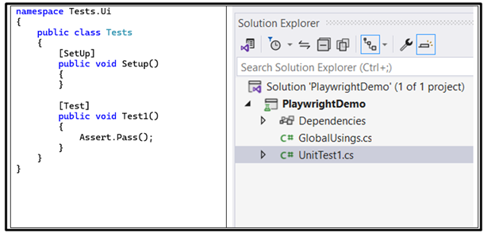
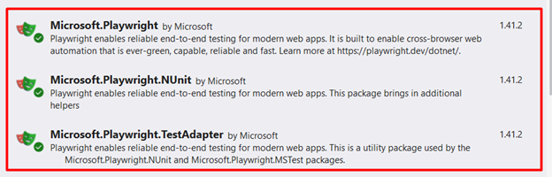
Playwright
Installation & Configurations
Open Visual Studio and create a new NUnit project
To create the test project, start Visual Studio and create a new project using the NUnit template. The basic structure of the generated project should include a single test case called 'UnitTest1.cs’
Install NuGet packages for Playwright
Next, install the NuGet packages for Playwright. To do so, right-click on the test project and select “Manage NuGet Packages…”. Once the NuGet Package Manager window opens, search for the following packages, shown in Figure 2, and install them.
Microsoft.Playwright
Microsoft.Playwright.NUnit
Microsoft.Playwright.TestAdapter

Slide 9
Any Question?
End!

