Slide 1

Project Presentation
Entitled
“A Blockchain enabled IoT Infrastructure for Power Redistribution”
:Presented By: G24
Aashish Chachan
(U19EC112)
Vivek Damani
(U19EC127)
Vinit Mairal
(U19EC134)
:Guided By:
Dr. Shilpi Gupta
Associate Professor,DECE
DEPARTMENT OF ELECTRONICS ENGINEERING
Sardar Vallabhbhai National Institute of Technology Surat-395007, Gujarat, INDIA.

Slide 2
PRESENTATION OUTLINES
Introduction
Motivation
Literature survey
Research Gap
Objectives
Methodology
Working
Conclusion and Future Scope
References

Slide 3
INTRODUCTION
What happens in case of a power failure in a society/campus?
What about the street lights, elevators, water pumps and other important services?
Should individuals be allowed to ask for power in an instant prepaid way?
Can this distribution be thought of on a large scale?
Can IoT be of help? If customers are able to communicate with the grid?

Slide 4
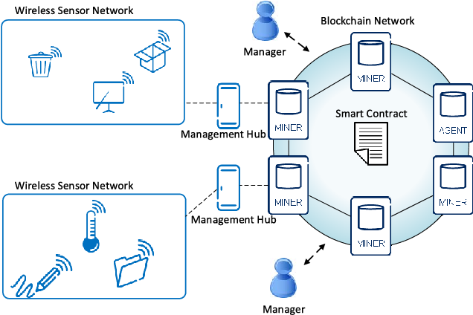
BLockchain + IoT System
Algorithm for distribution to be written in the smart contract.
Transactive energy – real time power requests and payments, eliminate the need of two –way meter reading and human involvement
Residents can request more power in case of emergency.
[1] ”Distributed Energy Resources and the Application of AI, IoT, and Blockchain in Smart Grids”, 2020, [Online] Available: A https://www.mdpi.com/1996-1073/13/21/5739
Notes:
The IoT network sending requests/data/ receiving commands

Slide 5
Motivation
IoT is an evolving domain, that helps machines speak and communicate smartly. It offers a wide area of future opportunities and possibilities to develop some really smart systems.
Blockchain is another evolving and trending field, whose most attractive offering is cryptocurrency or ‘coded money’, eliminating the need of manual billing and money management.
There was an urge to develop some complex systems from these simple technologies to solve real life problems, as the possibilities are endless.
Tumbled upon the concept of Smart Grids, which can serve as one of the biggest application of a Blockchain + IoT System.

Slide 6
Literature Survey
Distributed Energy Resources and the Application of AI, IoT, and Blockchain in Smart Grid.
Blockchain Based Metering and Billing System Proposal with Privacy Protection for the Electric Network.
Integration of IoT With Smart Grid.

Slide 7
Smart Grid
Smart Grid incorporates technology, structures, and protocols to make the electricity system networks more intelligent and efficient. It is merely a radical modification of the existing electricity system networks. In general, the smart grid is intended to substitute the fossil fuel-rich conventional electricity grid. With the smart grid will be able to “detect, react, and pro-act” to disparities in usage and manifold issues and enhances the reliability, availability, resilience, stability, security, and, at the same time, ensures grid operations sustainably and affordably[2].
[2] Atalay, M.; Angin, P. A Digital Twins Approach to Smart Grid Security Testing and Standardization. In Proceedings of the 2020 IEEE International Workshop on Metrology for Industry 4.0 & IoT (MetroInd4.0&IoT), Roma, Italy, 3–5 June 2020.

Slide 8
IoT Components in the Context of Smart Grids
The communication and transmission of data from the smart grids are divided into information and operation data. The information comprises meter readings, utility bills, power rates, marking and patterns, and customers’ geographic position in smart grids. The operational data includes a network’s real-time current and voltage levels, condenser banks, fault positions, and energy storage values[3]. The central and peripheral technologies make SGs consist of different intelligent devices as specified :
[3] Atalay, M.; Angin, P. A Digital Twins Approach to Smart Grid Security Testing and Standardization. In Proceedings of the 2020 IEEE International Workshop on Metrology for Industry 4.0 & IoT (MetroInd4.0&IoT), Roma, Italy, 3–5 June 2020.

Slide 9
IoT Components in the Context of Smart Grids
Advanced Sensing and Measurement : Smart Grid incorporates smart metering, which gathers data on electricity prices and usage for customers and utilities, including the time and amount of electricity consumed[1].
Automatic Monitoring and Control : SG provides real-time tracking and display of energy system device conditions and efficiency through linkages and over large geographic areas, helping device operators and users recognize and optimize power system modules, actions, and output[1] .
[1] ”Distributed Energy Resources and the Application of AI, IoT, and Blockchain in Smart Grids”, 2020, [Online] Available: A https://www.mdpi.com/1996-1073/13/21/5739

Slide 10
IoT Components in the Context of Smart Grids
Information & Communication Technology : Communication is extended throughout distribution networks and offers high-speed two-ways communication flows that make the smart grid dynamic interactive for real-time information exchange.[1]
Distribution Automation : It is a technique for automated control that maximizes electricity distribution networks’ performance to make the grid more reliable and efficient. It helps to readjust the distribution topology and bi-directional power flows [1].
[1] ”Distributed Energy Resources and the Application of AI, IoT, and Blockchain in Smart Grids”, 2020, [Online] Available: A https://www.mdpi.com/1996-1073/13/21/5739

Slide 11
Blockchain In Distribution of Energy
Smart Contract : BC-based on the smart contract allows a peer in the smart grid to perform an energy trading transaction (e.g., electricity sale) directly with another peer (peer-to-peer) and invoice it. This peer-to-peer concept needs transactions to be stored on a platform that is part of the ESN. The peers are the participants involved in the electricity trades (typically, the consumer, prosumer, regulatory authority, etc.) [4,5]. It is a virtual protocol that automatically performs the default transaction processes without needing a third-party intervention. An example of this in smart energy systems would include developing fully self-governing smart contracts between an energy supplier and a customer who controls both the sale and the payment separately and safely [4,5]. If the client does not make the price, the smart contract system would immediately terminate the supply until the transaction is completed, provided the partners have already agreed to use this provision in their contract[4,5].
[4] Ahl, A.; Yarime, M.; Goto, M.; Chopra, S.S.; Kumar, N.M.; Tanaka, K.; Sagawa, D. Exploring blockchain for the energy transition: Opportunities and challenges based on a case study in Japan. Renew. Sustain. Energy Rev. 2020, 117, 109488.

Slide 12
Blockchain In Distribution of Energy
Decentralization : For several years, the centralized model has performed well, but with the rise in the volume of data shared during the trading process, there is a possibility that the servers encounter bottlenecks and a single point of failure, making them vulnerable to attack [4].
[4] Ahl, A.; Yarime, M.; Goto, M.; Chopra, S.S.; Kumar, N.M.; Tanaka, K.; Sagawa, D. Exploring blockchain for the energy transition: Opportunities and challenges based on a case study in Japan. Renew. Sustain. Energy Rev. 2020, 117, 109488.

Slide 13
Research Gap
Transactive Energy is being discussed, but no much discussion is being done on its effective distribution and prioritisation.
There is no practical implementation of IoT and Blockchain for smart grid enhancement.
Smart Grid can manage power distribution based on priority orders, but what about difficulties in billing? Can blockchain be of help?

Slide 14
Objectives
To explore the potential of using blockchain, IoT, and Arduino technology in developing a smart grid system by taking the best of all worlds.
Focus on the benefits such as increased security, transparency, and the availability of transactive energy via power coins, that are gained by using blockchain in our model.
Smart distribution of power when there is a shortage of it, on the basis of defined priority.
Give power to a customer when asked for in exchange of ether coins (Power Coins in real life implementation).

Slide 15
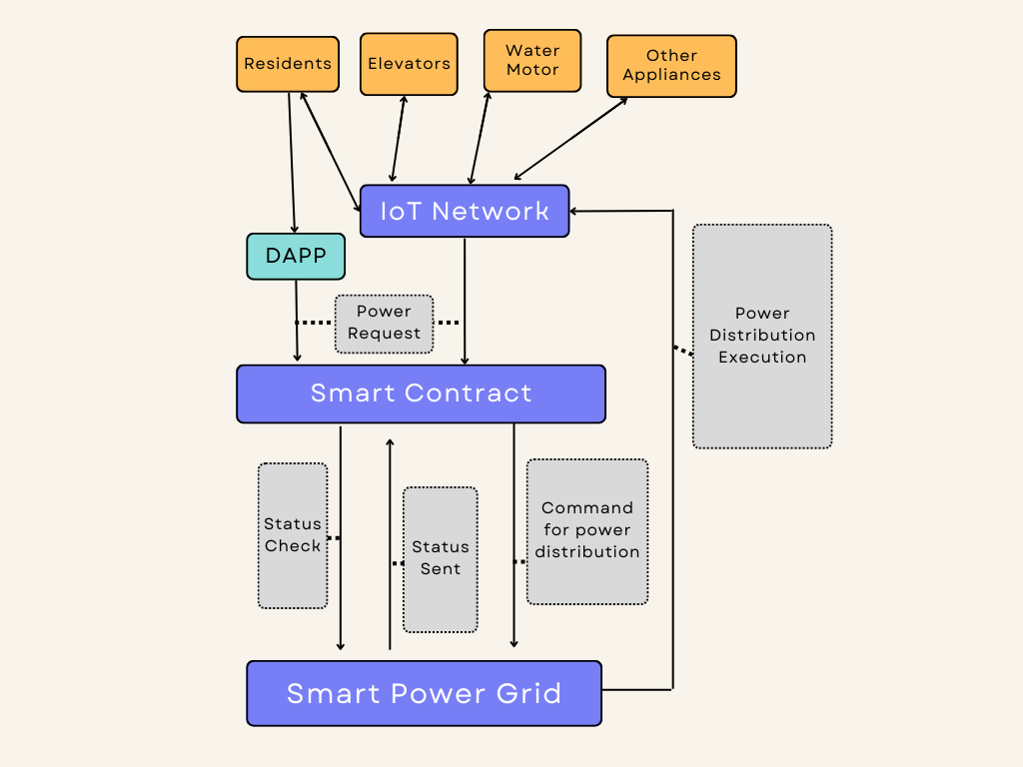
Methodology

Slide 16
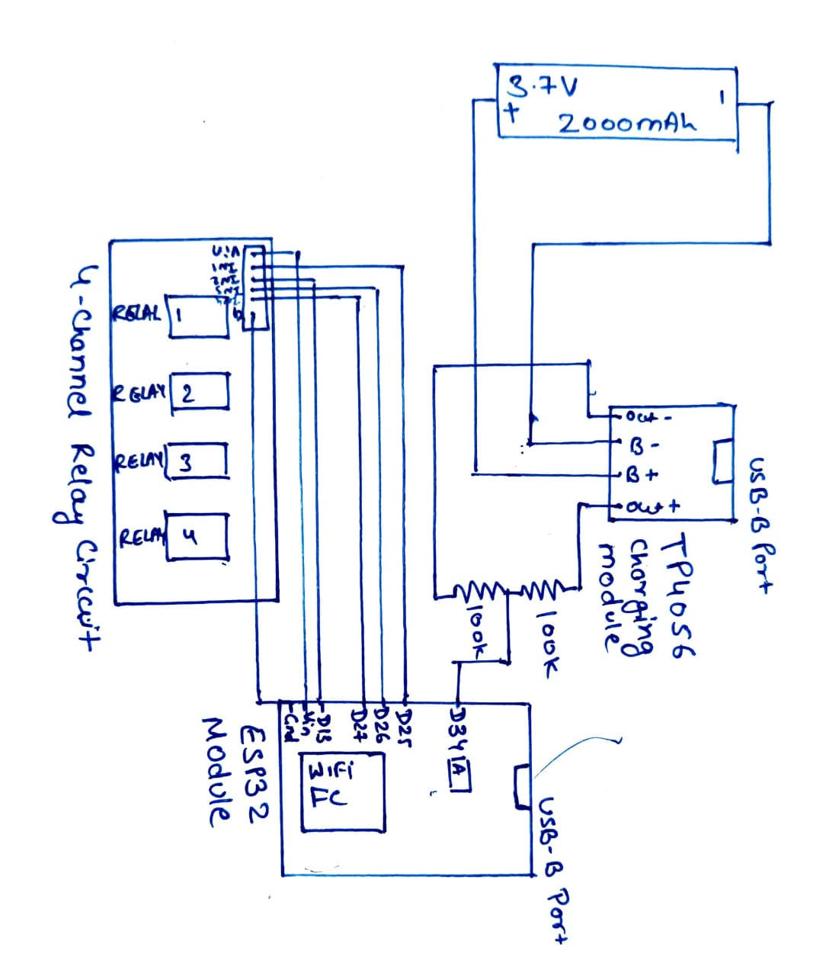
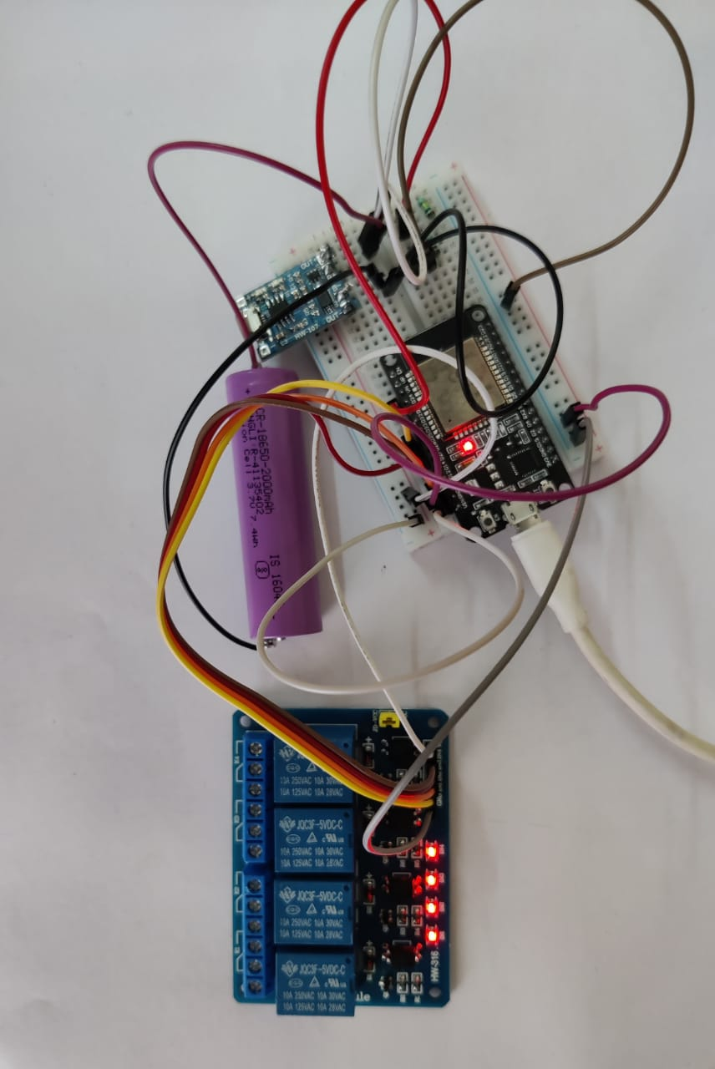
Circuit Diagram

Slide 17
Circuit Diagram Implementation

Slide 18
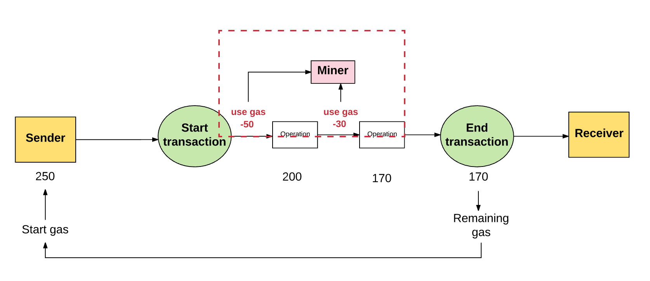
Ethereum Transactions
[6] P. Kasireddy, “How does ethereum work anyway?” 2017. [Online]. Available:
https://www.preethikasireddy.com/post/how-does-ethereum-work-anyway

Slide 19
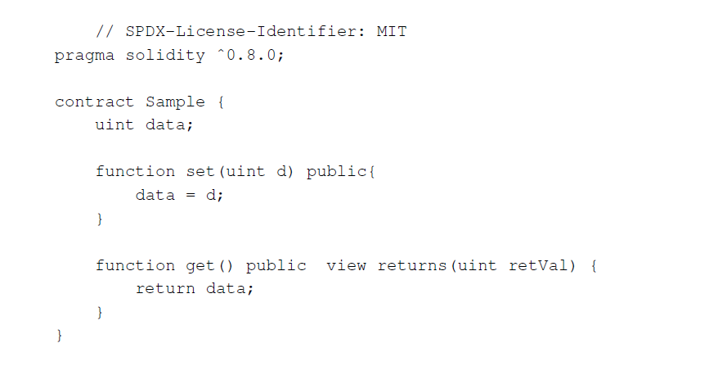
Smart Contracts

Slide 20
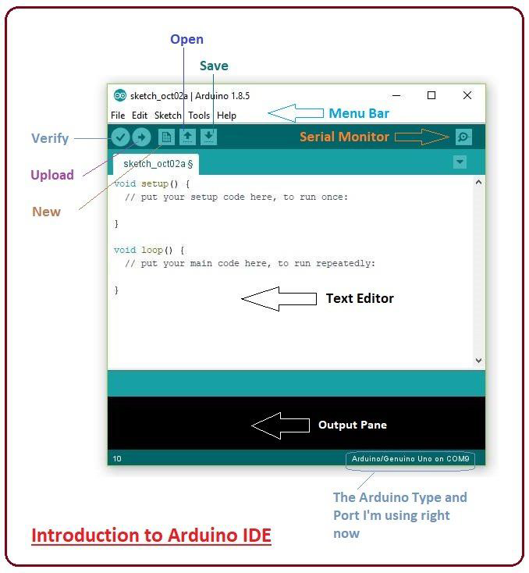

Slide 21
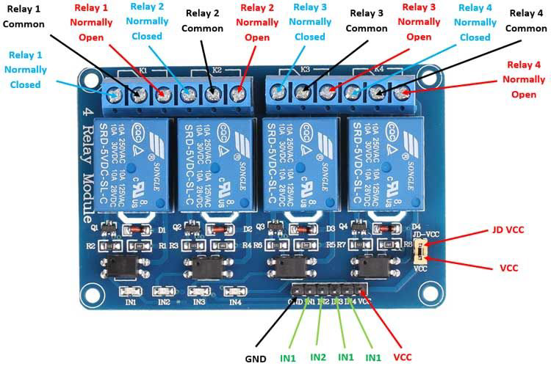
Relay
[7] 2023. [Online]. Available: https://ieeexplore.ieee.org/abstract/document/8728311

Slide 22
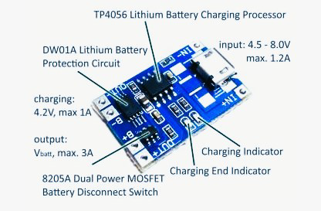
Tp4056
The TP4056 is a complete constant-current/constant-voltage linear charger for single cell lithium-ion batteries. Its SOP package and low external component count make the TP4056 ideally suited for portable applications. Furthermore, the TP4056 can work within USB and wall adapter.
[7] 2023. [Online]. Available: https://ieeexplore.ieee.org/abstract/document/8728311

Slide 23
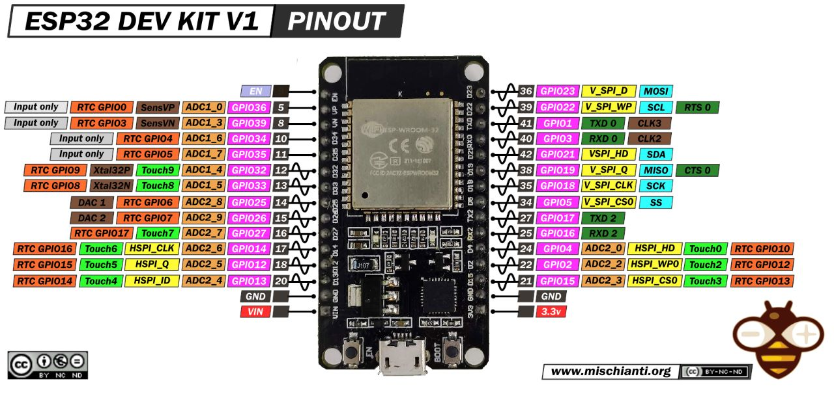
ESP32
The ESP32 system on a chip (SoC) series was developed by Espressif Systems and features dual-mode Bluetooth and Wi-Fi functionality.
https://www.google.com/url?sa=i&url=https%3A%2F%2Fwww.mischianti.org%2F2021%2F02%2F17%2Fdoit-esp32-dev-kit-v1-high-resolution-pinout-and-specs%2F&psig=AOvVaw0kgOxE_ok1JnqDfWyI6itI&ust=1683783898834000&source=images&cd=vfe&ved=0CBEQjRxqFwoTCNi4zPqF6v4CFQAAAAAdAAAAABAH[10].

Slide 24
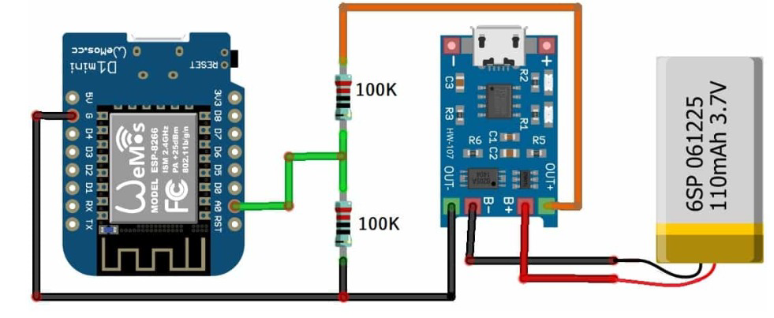
Circuit design for battery monitoring
[8] “Battery monitoring system.” [Online]. Available: https://how2electronics.com/
iot-based-battery-status-monitoring-system-using-esp8266/

Slide 25
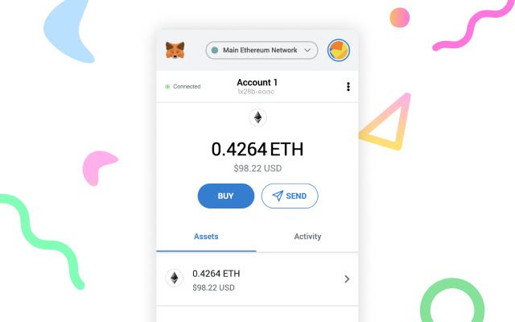
Metamask
Users can use MetaMask to store and manage account keys, broadcast transactions, send and receive Ethereum-based coins and tokens, and securely connect to decentralised applications using a suitable web browser or the built-in browser of the mobile app. Websites or other decentralized applications can connect, authenticate, and/or integrate other smart contract functionality with a user’s MetaMask wallet.

Slide 26
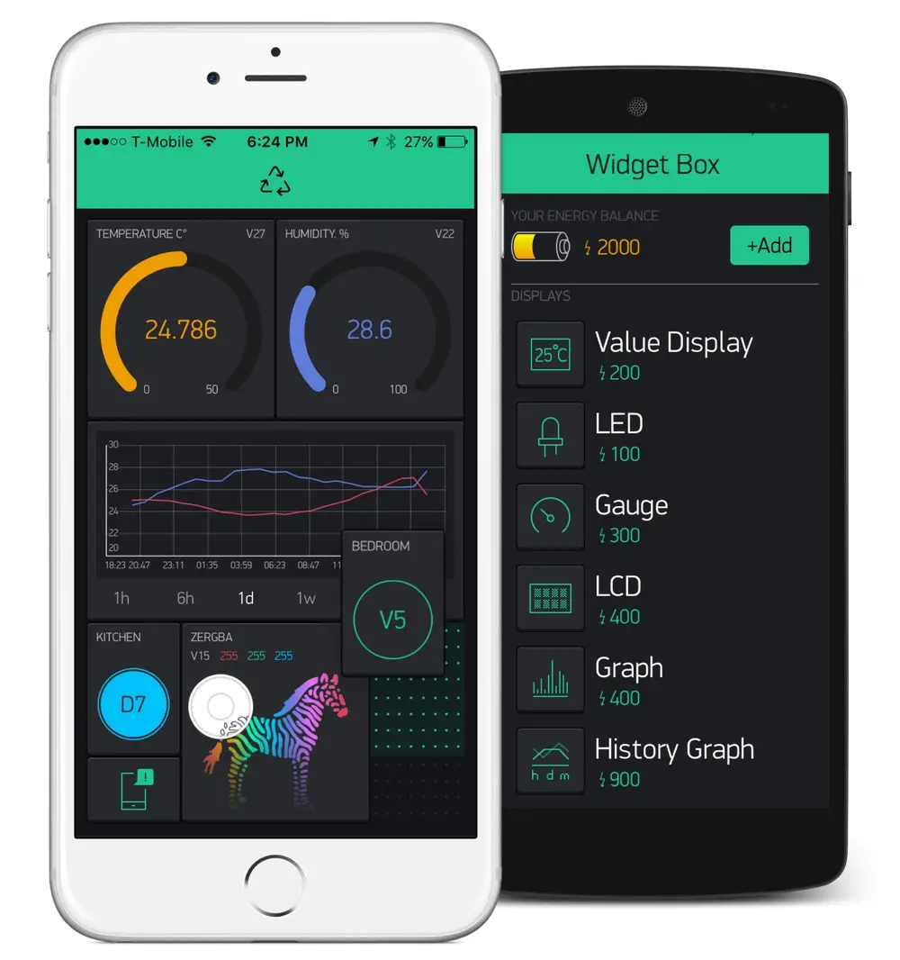
Blynk Iot Platform
Blynk is a low-code IoT software platform for managing thousands of users and deployed products, connecting devices to the cloud, and creating mobile apps to remotely control and monitor them.

Slide 27
WORKING

Slide 28
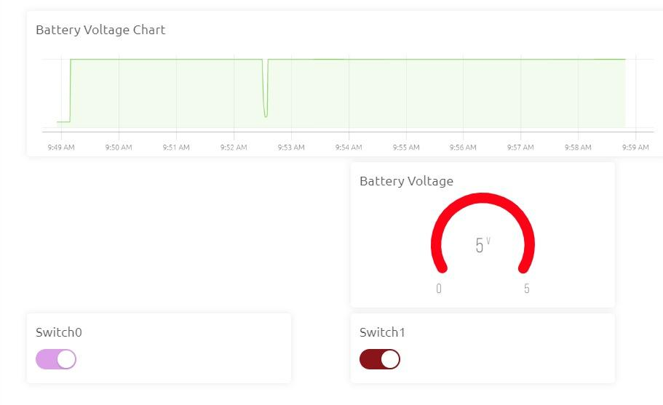

Slide 29
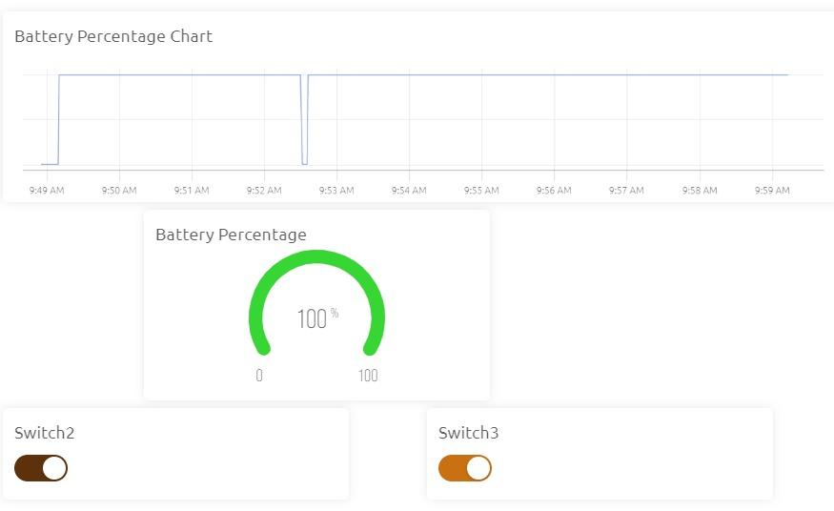

Slide 30
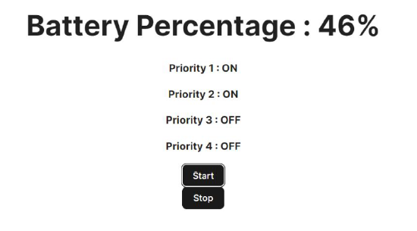
Part(i): priority based model

Slide 31
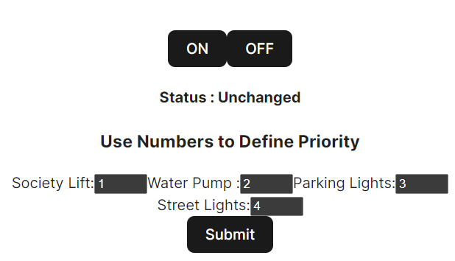
To update the priority order:
Transaction needs to be done via Metamask, that will be recorded on ethereum blockchain.
Improved security.
Improved authenticity.

Slide 32
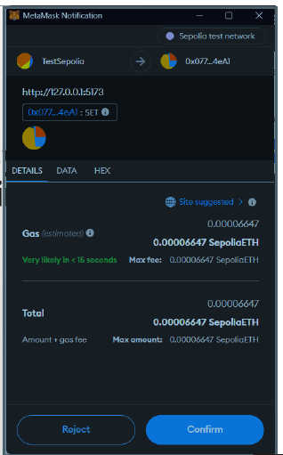
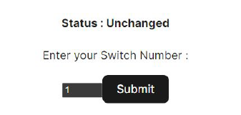
Part (II): user based model

Slide 33
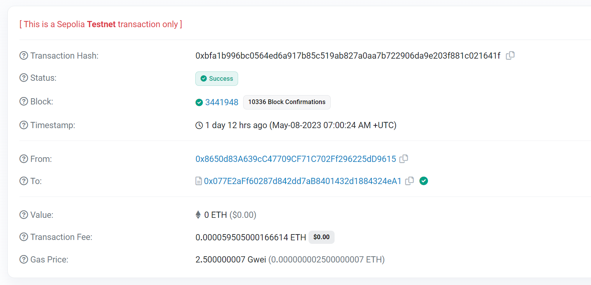
A Transaction Block

Slide 34
Conclusion
The research provided us with a very excellent grasp of both the Internet of Things (IoT) and Blockchain, as well as how we may proceed to create a model that is based on these technologies to make a solution for smart power distribution.
We implemented power distribution system by two methods
One through power distribution based on prioritizing the defined appliances and distributing according to the power remaining in the battery, and keeping a track on how battery level is gradually decreasing.
The second model focused more on a commercial level, when a user or industry can ask for power in exchange of power coins.

Slide 35
Future Scope
We can automate the prioritisation of devices as well as the battery power check.
For power loss, we can also include the actual exponential function.
It maybe hard to accurately measure the battery power levels in case of large societies having multiple set of inverter batteries thus this can also be a task for improvement in future.
These simplifications allowed us to show a working model for our objectives, however, there are many unrecognised issues that may arise while scaling this project.

Slide 36
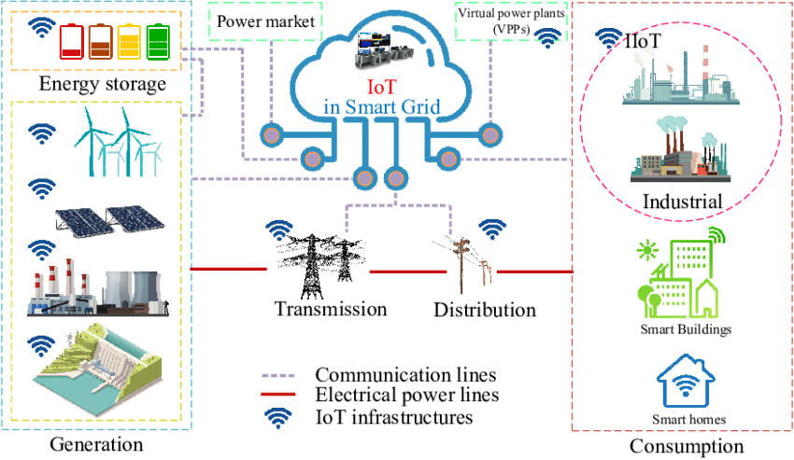
Grid smart enough to provide only what’s essential
Priority based: street lights, hospitals etc.
Smart appliances, able to ask for power in case of outage
Controlling supply based on demand
[9] “Smart grid services conceptual representation highlights,” 2023. [Online]. Available:
https://www.researchgate.net/figure/Digital-Business-Ecosystem-Example_fig3 339552585

Slide 37
References
[1] https://www.mdpi.com/1996-1073/13/21/5739
[2] Atalay, M.; Angin, P. A Digital Twins Approach to Smart Grid Security Testing and Standardization. In Proceedings of the 2020 IEEE International Workshop on Metrology for Industry 4.0 & IoT (MetroInd4.0&IoT), Roma, Italy, 3–5 June 2020.
[3] Atalay, M.; Angin, P. A Digital Twins Approach to Smart Grid Security Testing and Standardization. In Proceedings of the 2020 IEEE International Workshop on Metrology for Industry 4.0 & IoT (MetroInd4.0&IoT), Roma, Italy, 3–5 June 2020.
[4] Ahl, A.; Yarime, M.; Goto, M.; Chopra, S.S.; Kumar, N.M.; Tanaka, K.; Sagawa, D. Exploring blockchain for the energy transition: Opportunities and challenges based on a case study in Japan. Renew. Sustain. Energy Rev. 2020, 117, 109488.
[5] Ahl, A.; Yarime, M.; Tanaka, K.; Sagawa, D. Review of blockchain-based distributed energy: Implications for institutional development. Renew. Sustain. Energy Rev. 2019, 107, 200–211.
[6] P. Kasireddy, “How does ethereum work anyway?” 2017. [Online]. Available:
https://www.preethikasireddy.com/post/how-does-ethereum-work-anyway
[7] 2023. [Online]. Available: https://ieeexplore.ieee.org/abstract/document/8728311
[8] “Battery monitoring system.” [Online]. Available: https://how2electronics.com/
iot-based-battery-status-monitoring-system-using-esp8266/
[9] “Smart grid services conceptual representation highlights,” 2023. [Online]. Available:
https://www.researchgate.net/figure/Digital-Business-Ecosystem-Example_fig3 339552585
[10]https://www.google.com/url?sa=i&url=https%3A%2F%2Fwww.mischianti.org%2F2021%2F02%2F17%2Fdoit-esp32-dev-kit-v1-high-resolution-pinout-and-specs%2F&psig=AOvVaw0kgOxE_ok1JnqDfWyI6itI&ust=1683783898834000&source=images&cd=vfe&ved=0CBEQjRxqFwoTCNi4zPqF6v4CFQAAAAAdAAAAABAH

