Slide 1

Air Receiver
V-001
MLK PMT 10101
FLUID | COMPONENT | DESIGN CODE | MATERIAL |  |  | INSULATED (Y/N) | OP. PARAMETER |  | CURRENT RISK RATING | Corrosion Group : Damage Mechanism Susceptible: Internal Shell General Corrosion External ATMOSPHERIC CORROSION
 |  |  | TYPE | SPEC | GR |  | T (֯C) | P (Mpa)
Air | Top Head | ASME VII DIV 1 | CS | SA-516 | 70L | N | 50 | 3.6 | LOW
Air | Shell | ASME VIII DIV 1 | CS | SA-516 | 70L | N | 50 | 3.6
Air | Bottom Head | ASME VIII DIV 1 | CS | SA-516 | 70L | N | 50 | 3.6
INSPECTION METHOD | INSPECTION COVERAGE | DAMAGE MECHANISM
UTTM (Correction Factor) | 100% of TML Location – Refer TML as per Attachment | General Corrosion
VISUAL INSPECTION | External Visual Inspection (100% Coverage) With follow up by UT, RT, or pit gauge as required. | Atmospheric Corrosion

Slide 2
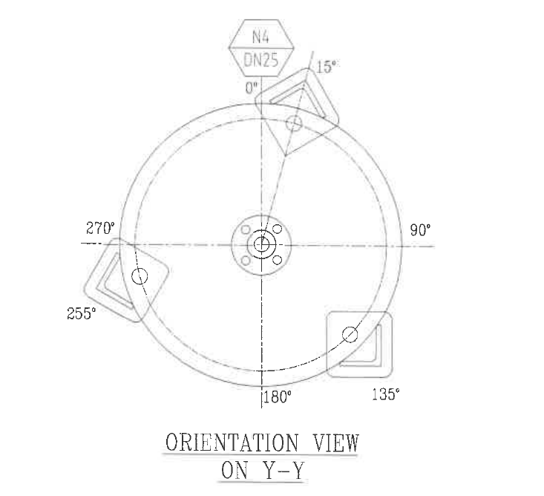

Expansion Tank
V-002
MLK PMT 10102
FLUID | COMPONENT | DESIGN CODE | MATERIAL |  |  | INSULATED (Y/N) | OP. PARAMETER |  | CURRENT RISK RATING | Corrosion Group : Damage Mechanism Susceptible: Internal Cooling Water Corrosion External General Corrosion
 |  |  | TYPE | SPEC | GR |  | T (֯C) | P (Mpa)
CHILLED WATER | Top Head | ASME VII DIV 1 | SS | SA 240 M | 316L | N | 100 | 1 | LOW
CHILLED WATER | Shell | ASME VIII DIV 1 | SS | SA 240 | 316 | N | 100 | 1
CHILLED WATER | Bottom Head | ASME VIII DIV 1 | SS | SA 240 M | 316L | N | 100 | 1
INSPECTION METHOD | INSPECTION COVERAGE | DAMAGE MECHANISM
UTTM | 100% of TML Location – Refer TML as per Attachment | Cooling Water Corrosion
VISUAL INSPECTION | External Visual Inspection (100% Coverage) With follow up by UT, RT, or pit gauge as required. | General Corrosion

Slide 3

FLUID | COMPONENT | DESIGN CODE | MATERIAL |  |  | INSULATED (Y/N) | OP. PARAMETER |  | CURRENT RISK RATING | Corrosion Group : Damage Mechanism Susceptible: Internal Steam Condensate Corrosion External Corrosion Under Insulation(CUI)
 |  |  | TYPE | SPEC | GR |  | T (֯C) | P (Mpa)
 | Top Head | ASME VII DIV 1 | CS |  |  |  |  |  | LOW
 | Shell | ASME VIII DIV 1 | CS
 | Bottom Head | ASME VIII DIV 1 | CS
INSPECTION METHOD | INSPECTION COVERAGE | DAMAGE MECHANISM
EMAT | 100% of TML Location – Refer TML as per Attachment 1 | General Corrosion
VISUAL INSPECTION | External Visual Inspection (100% Coverage) And Remove >5% of suspected area (as per Attachment 2). And Follow up by UT, RT or pit gauges as required if visual inspection reveal CUI as necessary | CUI

Slide 4

FLUID | COMPONENT | DESIGN CODE | MATERIAL |  |  | INSULATED (Y/N) | OP. PARAMETER |  | CURRENT RISK RATING | Corrosion Group : Damage Mechanism Susceptible: Internal Shell General Corrosion External CUI-CLSCC
 |  |  | TYPE | SPEC | GR |  | T (֯C) | P (Mpa)
 | Head | ASME VII DIV 1 | SS |  |  |  |  |  | LOW
 | Shell | ASME VIII DIV 1 | SS
INSPECTION METHOD | INSPECTION COVERAGE | DAMAGE MECHANISM
UTTM (Correction Factor) | 100% of TML Location – Refer TML as per Attachment 1 | General Corrosion
VISUAL INSPECTION | 100% external visual inspection prior to insulation removal Ref: 1. General VI. Ext Inspection Checklist 2. CUI-CLSCC inspection checklist. And For suspected area where accessible: > 5% DPT or Eddy Current Testing with UT follow up of all relevant indication. | CUI-CLSCC
DPI (High Temp) | For suspected area where accessible: > 5% DPT or Eddy Current Testing with UT follow up of all relevant indication as per Attachment 2 | CUI-CLSCC

Slide 5

FLUID | COMPONENT | DESIGN CODE | MATERIAL |  |  | INSULATED (Y/N) | OP. PARAMETER |  | CURRENT RISK RATING | Corrosion Group : Damage Mechanism Susceptible: Internal Shell Side Cooling Water Corrosion Internal Tube Side Sulfuric Acid Corrosion External Shell Side General Corrosion External Tube Side CUI-CLSCC
 |  |  | TYPE | SPEC | GR |  | T (֯C) | P (Mpa)
 | Top Channel (Tube Side) | ASME VII DIV 1 | SS |  |  |  |  |  | LOW
 | Shell | ASME VIII DIV 1 | SS
 | Bottom Channel (Tube Side) | ASME VIII DIV 1 | SS
INSPECTION METHOD | INSPECTION COVERAGE | DAMAGE MECHANISM
UTTM | 100% of TML Location – Refer TML as per Attachment 1 | General Corrosion Sulfuric Acid Corrosion
VISUAL INSPECTION | 100% external visual inspection prior to insulation removal Ref: 1. General VI. Ext Inspection Checklist 2. CUI-CLSCC inspection checklist. And For suspected area where accessible: > 5% DPT or Eddy Current Testing with UT follow up of all relevant indication. | General Corrosion CUI-CLSCC
DPI (High Temp) | For suspected area where accessible: > 5% DPT or Eddy Current Testing with UT follow up of all relevant indication as per Attachment 2 | CUI-CLSCC

Slide 6

FLUID | COMPONENT | DESIGN CODE | MATERIAL |  |  | INSULATED (Y/N) | OP. PARAMETER |  | CURRENT RISK RATING | Corrosion Group : Damage Mechanism Susceptible: Internal Steam Condensate Corrosion External Corrosion Under Insulation(CUI)
 |  |  | TYPE | SPEC | GR |  | T (֯C) | P (Mpa)
 | Head | ASME VII DIV 1 | CS |  |  |  |  |  | LOW
 | Shell | ASME VIII DIV 1 | CS
INSPECTION METHOD | INSPECTION COVERAGE | DAMAGE MECHANISM
UTTM (Correction Factor) | 100% of TML Location – Refer TML as per Attachment 1 | General Corrosion
VISUAL INSPECTION | External Visual Inspection (100% Coverage) And Remove >5% of suspected area (as per Attachment 2). And Follow up by UT, RT or pit gauges as required if visual inspection reveal CUI as necessary | CUI

Slide 7

FLUID | COMPONENT | DESIGN CODE | MATERIAL |  |  | INSULATED (Y/N) | OP. PARAMETER |  | CURRENT RISK RATING | Corrosion Group : Damage Mechanism Susceptible: Internal Shell Side General Corrosion Internal Tube Side General Corrosion External General Corrosion
 |  |  | TYPE | SPEC | GR |  | T (֯C) | P (Mpa)
 | Channel (Tube Side) | ASME VII DIV 1 | SS |  |  |  |  |  | LOW
 | Shell | ASME VIII DIV 1 | SS
INSPECTION METHOD | INSPECTION COVERAGE | DAMAGE MECHANISM
EMAT | 100% of TML Location – Refer TML as per Attachment 1 | General Corrosion
VISUAL INSPECTION | 100% external visual inspection Ref: 1. General VI. Ext Inspection Checklist | General Corrosion

Slide 8

FLUID | COMPONENT | DESIGN CODE | MATERIAL |  |  | INSULATED (Y/N) | OP. PARAMETER |  | CURRENT RISK RATING | Corrosion Group : Damage Mechanism Susceptible: Internal Shell Side Sulfuric Acid Corrosion Internal Tube Side Cooling Water Corrosion External General Corrosion
 |  |  | TYPE | SPEC | GR |  | T (֯C) | P (Mpa)
 | Channel | ASME VII DIV 1 | SS |  |  |  |  |  | LOW
 | Shell | ASME VIII DIV 1 | SS
INSPECTION METHOD | INSPECTION COVERAGE | DAMAGE MECHANISM
UTTM | 100% of TML Location – Refer TML as per Attachment 1 | Sulfuric Acid Corrosion Cooling Water Corrosion
VISUAL INSPECTION | 100% external visual inspection Ref: 1. General VI. Ext Inspection Checklist | General Corrosion

Slide 9

FLUID | COMPONENT | DESIGN CODE | MATERIAL |  |  | INSULATED (Y/N) | OP. PARAMETER |  | CURRENT RISK RATING | Corrosion Group : Damage Mechanism Susceptible: Internal Shell Side General Corrosion Internal Tube Side Cooling Water Corrosion External General Corrosion
 |  |  | TYPE | SPEC | GR |  | T (֯C) | P (Mpa)
 | Channel | ASME VII DIV 1 | SS |  |  |  |  |  | LOW
 | Shell | ASME VIII DIV 1 | SS
INSPECTION METHOD | INSPECTION COVERAGE | DAMAGE MECHANISM
UTTM | 100% of TML Location – Refer TML as per Attachment 1 | General Corrosion Cooling Water Corrosion
VISUAL INSPECTION | 100% external visual inspection Ref: 1. General VI. Ext Inspection Checklist | General Corrosion

Slide 10

FLUID | COMPONENT | DESIGN CODE | MATERIAL |  |  | INSULATED (Y/N) | OP. PARAMETER |  | CURRENT RISK RATING | Corrosion Group : Damage Mechanism Susceptible: Internal Shell (Tube Side) General Corrosion Internal Channel Head (Tube Side) Cooling Water Corrosion External General Corrosion
 |  |  | TYPE | SPEC | GR |  | T (֯C) | P (Mpa)
 | Channel (Tube Side) | ASME VII DIV 1 | SS |  |  |  |  |  | LOW
 | Shell | ASME VIII DIV 1 | SS
INSPECTION METHOD | INSPECTION COVERAGE | DAMAGE MECHANISM
UTTM | 100% of TML Location – Refer TML as per Attachment 1 | General Corrosion Cooling Water Corrosion
VISUAL INSPECTION | 100% external visual inspection Ref: 1. General VI. Ext Inspection Checklist | General Corrosion

