Slide 1

ICT Skills for Scientists
Lecturer:
Mairead Meagher

Slide 2




Mairead Meagher
mairead.meagher@setu.ie
Office 316, top floor, Science building
Contact Details
3 hours labs per week, Friday 2:15 – 5:15, ITG17
Attendance is taken every week

Slide 3
Aim of Module
The aim of this module is to prepare you for the ICT part of your course.
This specifically includes the Microsoft Office programs:
Word
Excel
Powerpoint
We will also look at general ICT issues

Slide 4

Module Content
Introduction to ICT
Moodle, OneDrive, Teams
Basic IT Skills
MS Windows Operating System
Backup, Passwords, Virus Scanning Software
Email Etiquette, Online identity
Organising your college data
Organising your Web Brower (Bookmarks)
Microsoft Word
Word Processing Skills
Writing, formatting reports
Microsoft Excel
Spreadsheets (analytical skills)
Formulas and graphs
Microsoft PowerPoint
Presentation Skills
Group presentation

Slide 5
Weekly schedule
Week 2: General Introduction / basic Excel
Week 3 : Word Basics
Week 4 : Word Advanced
Week 7 : Excel Advanced
Week 8 : Excel Graphs
Week 9: Excel Revision
Week 10: Excel Test
Schedule subject to change
Reading Week
Week 5 : Word Assignment
Week 12: PowerPoint Group Presentations
Week 6 : Excel Basics
Week 11:PowerPoint

Slide 6

Assessment
100% Continuous Assessment
Weekly engagement(10%)
Word Assignment (in class) (20%)
Excel Test (in-class) (50%)
Group PowerPoint presentations(20%)

Slide 7
Introduction to ICT in SETU, Waterford Campus
University Computers Logging In, self service password reset
Moodle, Logging In, Uploading Assignments, School Information Area on Moodle
Student email, OneDrive, Student Microsoft Office
Basic IT Skills, Folders, Files, Windows Explorer, Suggested filing system
Backups, Passwords, Virus Scanning Software
Email Etiquette, Attaching Files and Downloading Attachments
Bookmarks on browser

Slide 8

Moodle is a virtual learning environment (VLE) that you can access from any location. It is used to distribute notes, accept assignments, and contact students.
You can access Moodle by opening a web browser and typing in the following address: moodle.setu.ie
Log in using the same details that you used for your university login.
Once you have logged in successfully you should see all the modules you are timetabled for.
Click on Introduction to ICT for Scientists to see the material required for this module.
We will use Moodle to connect to tutors and to act as a weekly list of work.

Slide 9

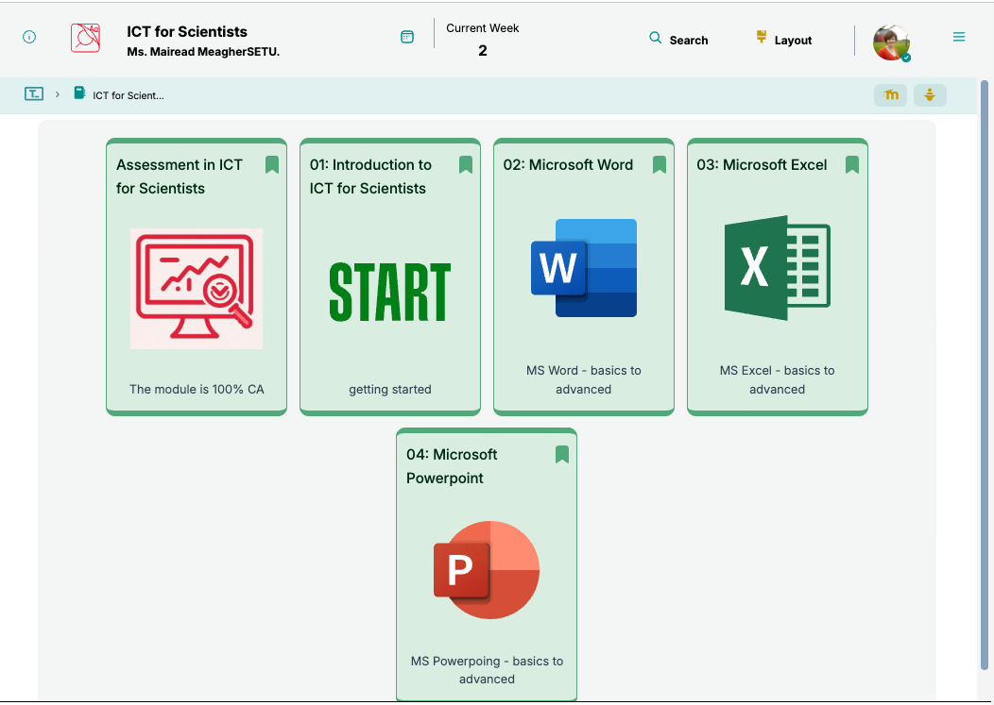
https://tutors.dev/course/ict-sci-25
We will use a static website (called tutors) to curate the resources :
Lectures
Exercises
Videos
The topics will be released as the weeks go by
The url for the website is:
https://tutors.dev/course/ict-sci-25

Slide 10
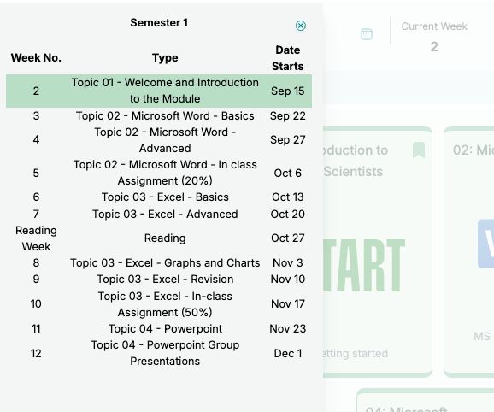
The calendar icon will give you a overview of the weekly todo list.

Slide 11
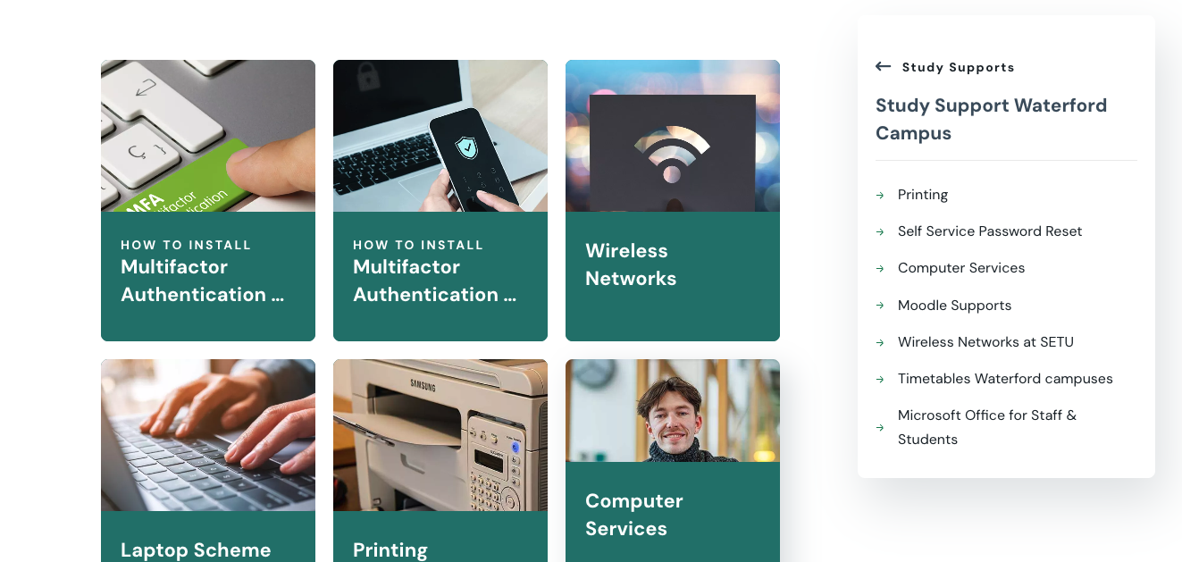
Student Credentials
Use StudentNumber@setu.ie to access the following:
University Computers
Moodle
Student email
Student Registration & Fees
Library Systems
Eduroam Wifi
MS Outlook
MS Teams
OneDrive
The SETU website has lots of help for access here:
https://www.setu.ie/current-students/study-supports/study-support-waterford

Slide 12

University Computers
Log in
Log in to university computers
Your username is your StudentNumber@setu.ie
Your password is provided to with your registration information.
Help
If you have trouble logging in you can
Call into Computer Services. Computer Services is located in the corner of the ground floor of the IT Building.
You can email them computerservices@setu.ie

Slide 13
Changing Passwords
You can change your password from home if you register for this service using this link: https://www.setu.ie/current-students/study-supports/study-support-waterford/self-service-password-reset
When used, this program will change your password for all the following systems at the one time:
Computer Login
Moodle
Online Student Services
Timetables
Library Systems
Eduroam WIFI
OneDrive
Office 365
Software Download site
Microsoft Teams

Slide 14
Student Email
Undergraduate SETU students are issued with a @setu.ie email address.
Your student email address is your studentnumber@setu.ie ( e.g. 20001234@setu.ie).
You can access this account through Outlook, included in the Microsoft Office suite. As a registered student, you are entitled to download and use Office 365 on your devices.
Please use your new @setu.ie email address as your primary account for all university communications.
https://www.setu.ie/current-students/study-supports/study-support-waterford/new-email-for-waterford-students

Slide 15
Accessing Cloud from home
One Drive
You will be able to access your OneDrive from outside SETU through a web link which will be on the SETU site or directly by
https://wit-my.sharepoint.com/
You will need to use your full student login, for example 12345678@setu.ie and password to gain access.
Google Drive
You can access the Google Drive associated with your email address.
This can be accessed once you sign on to Google Chrome (you can also access your bookmarks once you’ve signed in)

Slide 16
OneDrive Things to know!
When you leave SETU and your SETU account is deleted then ALL the Files on your OneDrive are DELETED. If you want to keep your files after you leave SETU then before you leave please copy/move your files to another personal storage area.
If you use the webpage to access any files, and it's not a Microsoft office application like Word, Excel, etc. it will ask you to download the file to the local PC. If you make changes to the downloaded files then you must make sure that you have uploaded/copied the updated version back to your OneDrive.
As it's network storage it should be expected to be a bit slower than on-site/local storage.
Microsoft have certain restrictions in place to stop very large amounts of files being uploaded at once, thus OneDrive cannot be used to back up a full PC. It's designed to be used for day to day access of files.
After a file is copied/deleted on this drive you may need to refresh (F5 key) the list before the changes are evident.

Slide 17

Free MSOffice for Students
Students have access to download and run Microsoft Office products.
This is a free service provided by Microsoft for the duration of study at SETU.
This allows for the installation of Office on up to 5 devices including PC, Mac, and Mobile Devices.
Full versions of:
To download Click Here

Slide 18

Microsoft Windows
MS Windows is an Operating System
Windows Explorer
Files, Folders
Read, Create, Move, Edit and Delete
Copy/Paste, Rename
Working with Files and Folders
https://edu.gcfglobal.org/en/windowsbasics/working-with-files/1/

Slide 19
Protection
Backups
Virus Scanning Software
Secure Passwords
Length >8
Different passwords
Mary had a little lamb his fleece was white as snow
Mhallhfwwas10!!

Slide 20
Email
Etiquette
Spelling/Grammar
Response time
Attachments
Reply/Reply All

Slide 21
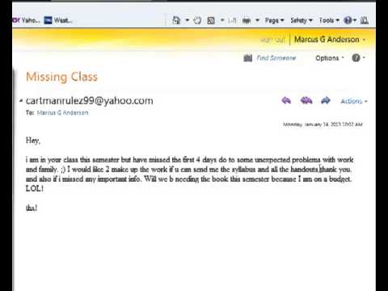
Poor email etiquette

Slide 22
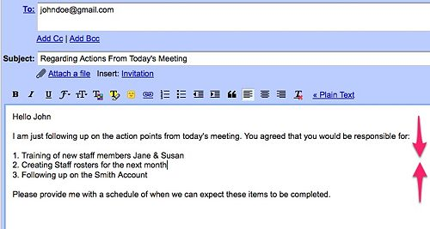
Professional email etiquette

Slide 23
Filing system
It is really important to organise where you store all your college files/ software.
If you don’t do this early, chaos will ensue! The best way is to organise your files from the start.
You can use this file structure on Cloud (One-Drive/Google Drive) and mirror it on your labtop so you can 'backup' easily by dragging the full folder from one to the other.
If you are using a labtop, then you can use your local drive but be sure to back it up regularly.

Slide 24
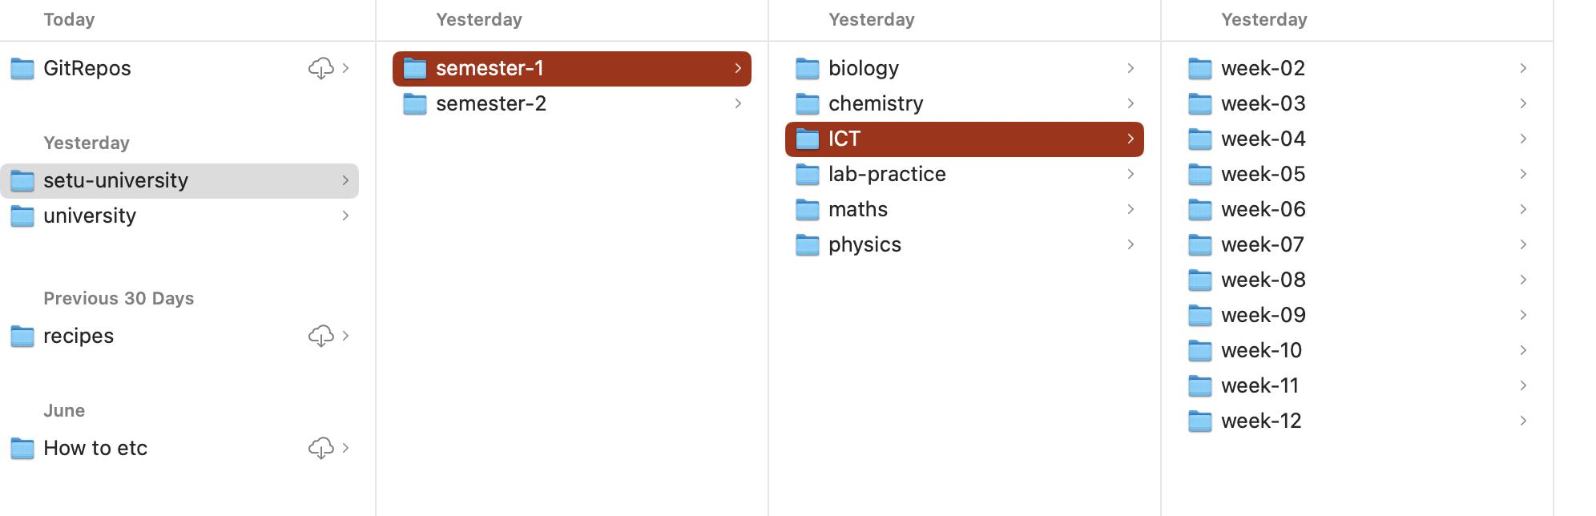
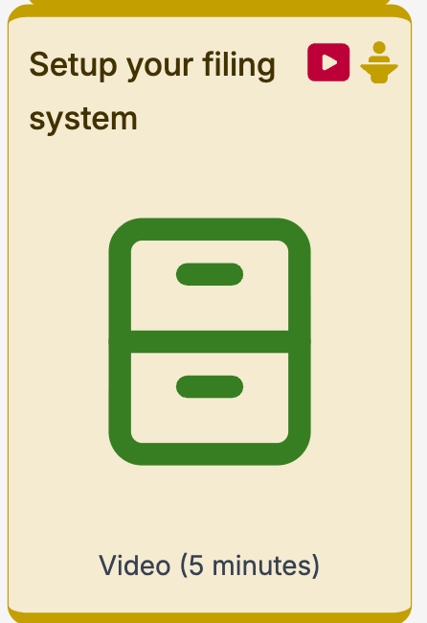
Suggested Filing system
A suggested filing system is given.
Note you could have subfolders named Topic 01 etc. whichever is most appropriate.
Video is available here on tutors

Slide 25
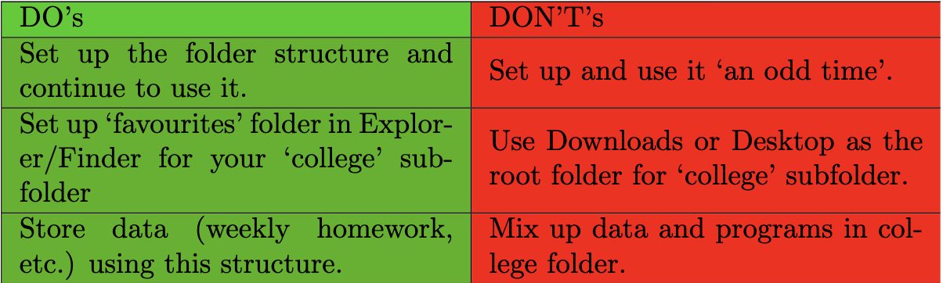
Do’s and Don’ts of Filing Systems

Slide 26

Managing Bookmarks on your browser
You will be using a lot of online resources during your time in university.
It is a good idea to set up a bookmarks or bookmark folders in your browser.
This will save you a lot of time in the long run.
Video is available here on tutors

Slide 27

Questions? (always ask!)

