Slide 1

Functional Programming
Introduction to module
Produced
by:
Ms. Mairead Meagher
Department of Computing and Mathematics
http://www.wit.ie/

Slide 2
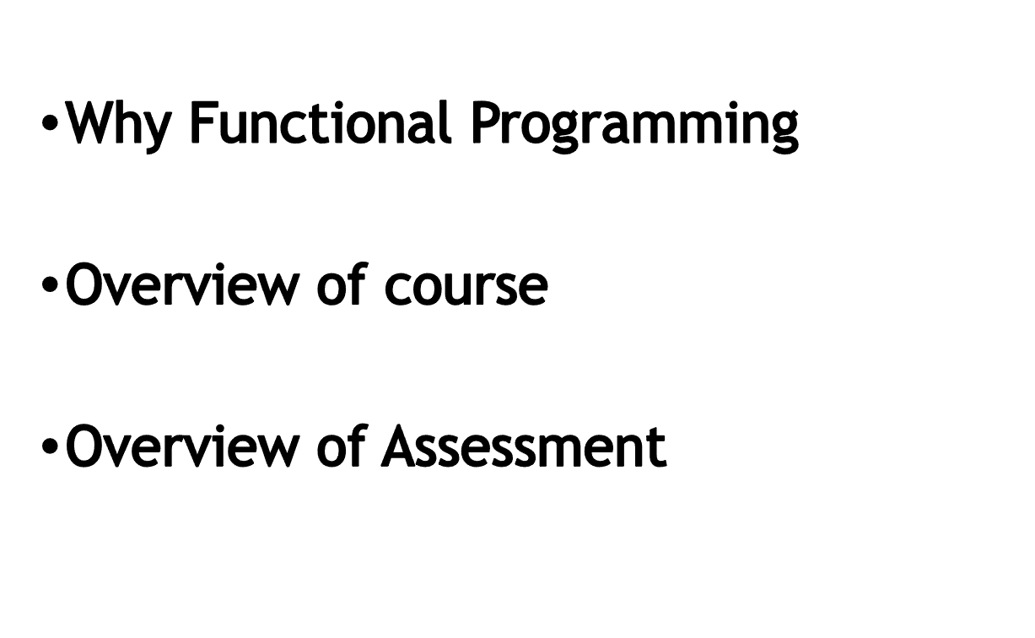
Agenda

Slide 3

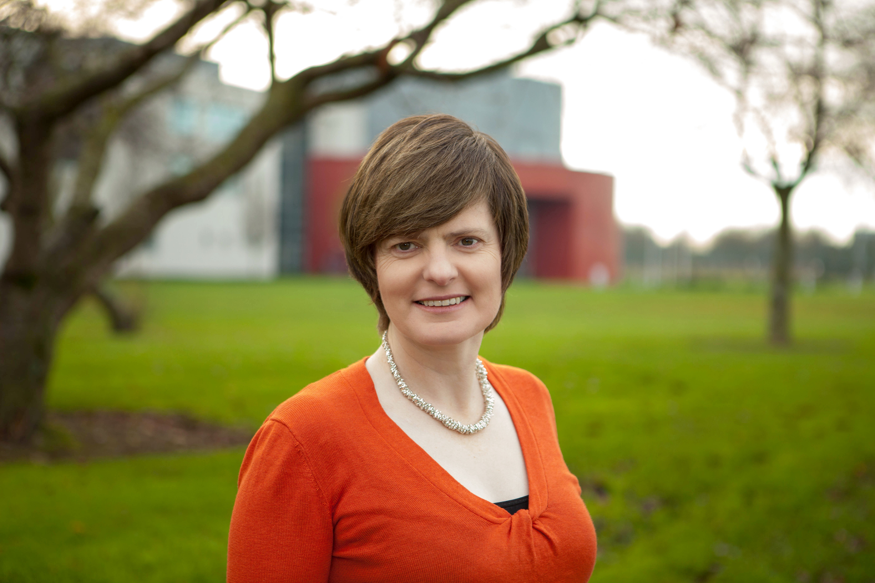
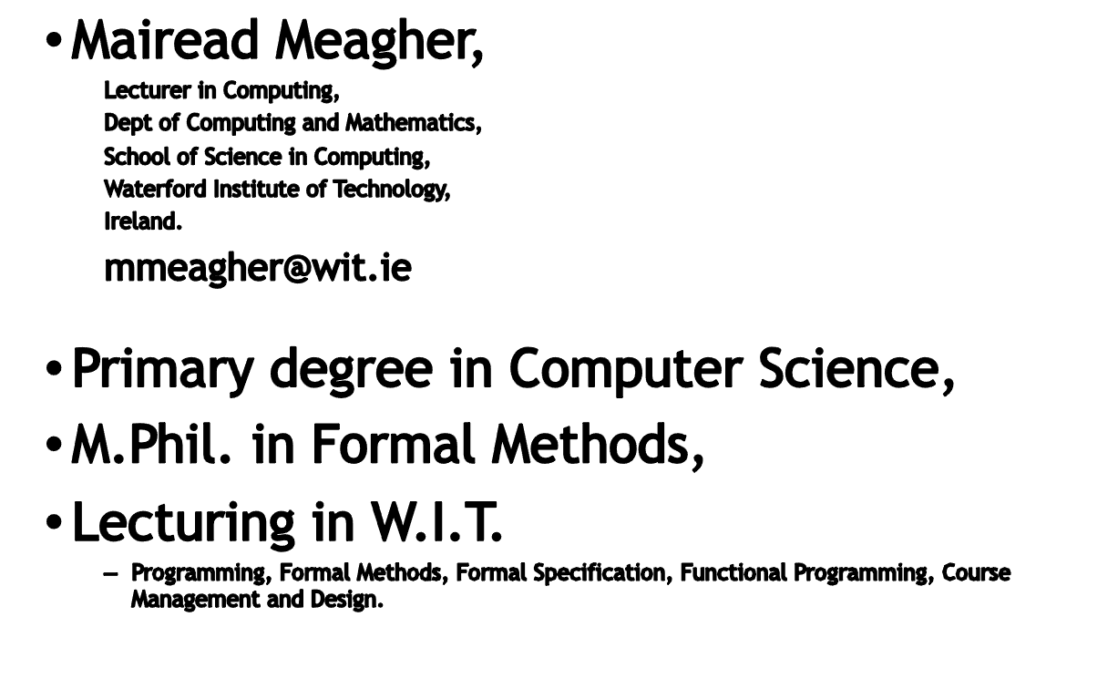
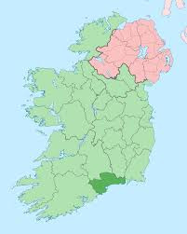
Department of Computing and Mathematics
http://www.wit.ie/

Slide 4

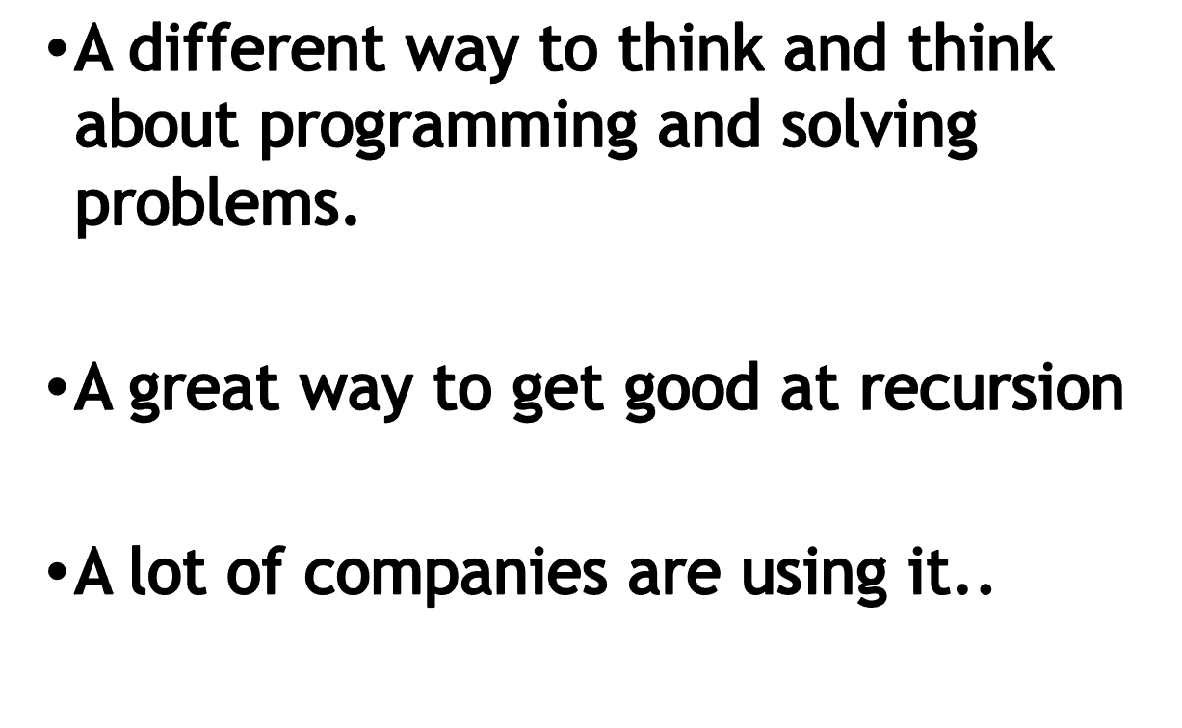

Slide 5
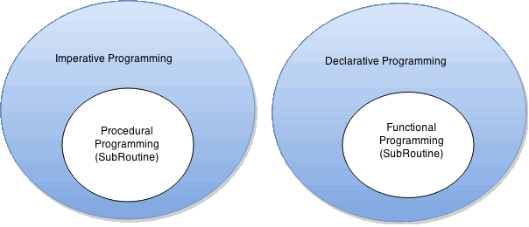
What’s different from what you’ve seen
How to do it, not what to do
What to do, not how to do it.

Slide 6
What’s different from what you’ve seen
Explain to your friend : What is an orange peanut?
(He only knows brown peanuts)
Imperative
Functional
How to do it, not what to do
What to do, not how to do it.
That brown peanut you have : Paint it orange.
That’s what an orange peanut is.
That brown peanut that you have:
If you had another peanut that’s just like it in every way except that it’s orange.
That’s what an orange peanut is.

Slide 7
Differences
Imperative
Functional
Loops
No loops !!!
Variables – use them for e.g. accumulating values
Variables cannot be changed
(immutability)
If [condition]
then [command]
else [command]
If [condition]
then [value]
else [value]
More later ….

Slide 8


So how will we approach this module?
14 weeks
4 hours per week
Each topic will have associated with it:
  Lecture/s (pre-recorded)
  Online contact where we have either
    Summary of main points of lectures OR
    Labs practising :
      Techniques we have seen in lectures
      Going through pre-defined sets of exercises online.

Slide 9



Ethos of Module
Practice, practice, practice,
Engagement – ask questions,
Work submitted must be your own,
Help me to help you.

Slide 10
Brief Overview of Course
We will use
Moodle – used for announcements, linking to tutors
Tutors (where course material is curated)
Slack for communication within the group and to me.

Slide 11
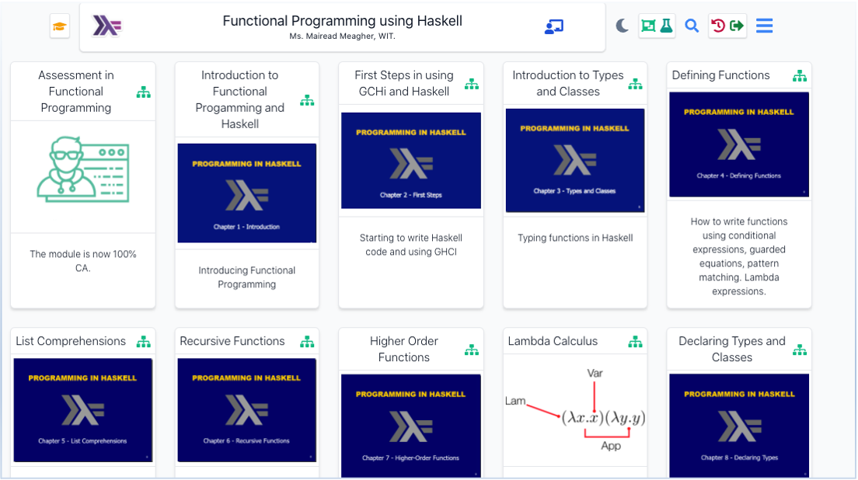
Brief Overview of Course - tutors
https://tutors-svelte.netlify.app/#/course/funct-prog-reg-21.netlify.app

Slide 12


Any questions?
using mmeagher@wit.ie
Please put ‘OTH-Regensburg query’ in the subject line of your email.

Slide 13

Looking forward to seeing you soon.

