Slide 1

PROGRAMMING IN HASKELL
Chapter 8.3
Function Composition

Slide 2
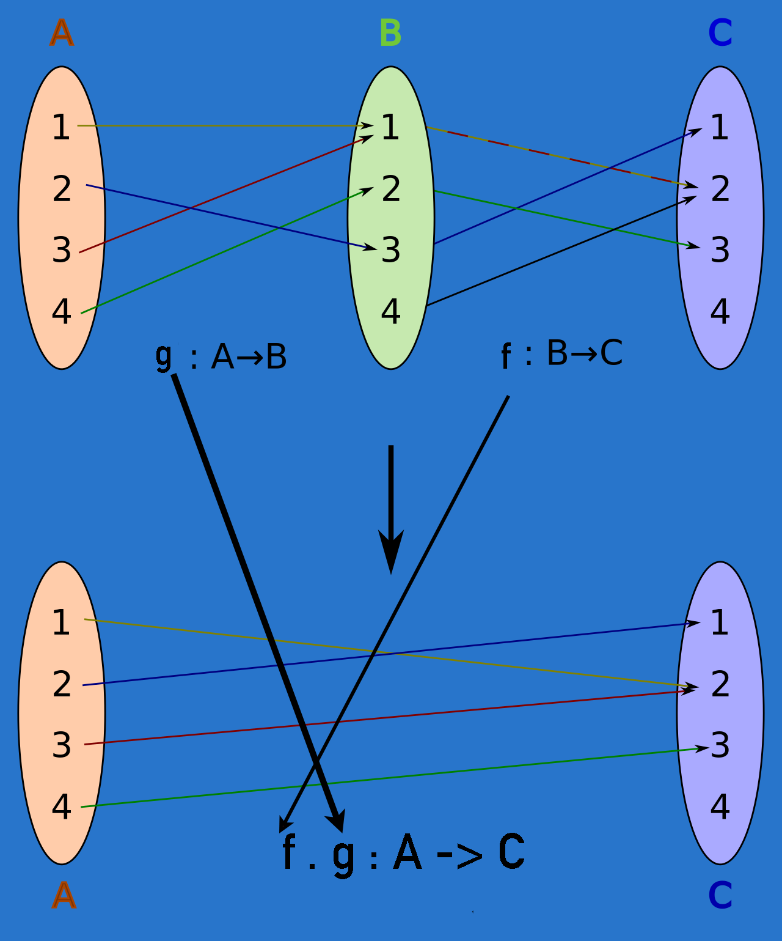
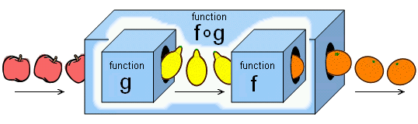
Function Composition
We sometimes use one function after another and we can see these functions as one, composed together:
(f . g) (x) = f (g (x) )

Slide 3
Function Composition
Call g with some value, call f with the result
(.) :: (b -> c) -> (a -> b) -> a -> c
f . g = \x -> f (g x)
Input parameter of f must be the same as the return type of g

Slide 4
Function Composition – why
Often convenient to create functions on the fly
Could use lambda, but composition may be more concise
[-5,-3,-2,-7]
[-5,-3,-2,-7]
*Main> map (\x -> negate (abs x)) [5,-3, -2, 7]
*Main> map (negate . abs) [5, -3, -2, 7]

Slide 5
Function Composition – why
[[1..5],[3..6],[1..7]]
[-14,-15,-27]
[[1..5],[3..6],[1..7]]
[-14,-15,-27]
*Main> map (\xs -> negate (sum (tail xs)))
*Main> map (negate . sum . tail)

Slide 6
Function Composition with multiple parameters
If a function takes multiple parameters, we must partially apply
45
45
45
*Main> sum (replicate 5 (max 6 9))
*Main> (sum . replicate 5) (max 6 9)
*Main> sum . replicate 5 $ max 6 9

Slide 7
The process
To rewrite a function with lots of parentheses using function composition
first write out the innermost function and its parameters
then put a $ before it
compose all prior functions by omitting their last parameter (but not other parameters) and putting . between them

Slide 8
The process
*Main> replicate 2 (product (map(*3) (zipWith max [1,2] [4,5])))
[180,180]
[180,180]
*Main> replicate 2 . product . map (*3) $ zipWith max [1,2] [4,5]

Slide 9
Aside on zipWith
zipWith takes a function and two lists as parameters and then joins the two lists by applying the function between corresponding elements. Here's how we'll implement it*:
*Note we use zipWith’ so that you can check this and not cause a conflict with Prelude’s version
zipWith' :: (a -> b -> c) -> [a] -> [b] -> [c]
zipWith' _ [] _ = []
zipWith' _ _ [] = []
zipWith' f (x:xs) (y:ys) = f x y : zipWith' f xs ys

Slide 10
Aside on zipWith
ghci> zipWith (+) [4,2,5,6] [2,6,2,3]
= [6,8,7,9]
ghci> zipWith max [6,3,2,1] [7,3,1,5]
= [7,3,2,5]
ghci> zipWith (++) ["foo ", "bar ", "buzz "]
["fighters", "hoppers", "aldrin"]
= ["foo fighters", "bar hoppers"," buzz aldrin"]

Slide 11
Aside on zipWith
ghci> zipWith (*) (replicate 5 2) [1..]
[2,4,6,8,10]
ghci> zipWith (zipWith (*))
[[1,2,3],[3,5,6],[2,3,4]]
[[3,2,2],[3,4,5],[5,4,3]]
[[3,4,6],[9,20,30],[10,12,12]]

Slide 12
Aside on zipWith
Note that you can use function application as the
function
zipWith ($) funcList valueList
zipWith ($) [(+ 5),(* 3)] [1,5]
= [6,15]

Slide 13
Eta conversion with Funtion Composition
f ( g ( h (i (j (k x) ) ) ) )
can be rewritten as
(f . g . h . i . j . k ) x
myfunc :: a -> b
myfunc x = (f . g . h . i . j . k ) x
can be rewritten as
myfunc :: a -> b
myfunc = (f . g . h . i . j . k )

Slide 14
Eta Conversion
answer :: [Int] -> Int
answer xs = sum (map cube (filter by7 xs))
cube :: Int -> Int
cube x = x * x * x
by7 :: Int -> Bool
by7 x = x `mod` 7 == 0
can be rewritten using the eta reduction

Slide 15
More on Composition Operator
Object-level definition
answer :: [Int] -> Int
answer xs = sum . map cube . filter by7 xs
can be rewritten , by removing xs when it is the rightmost term on each side of =
Function-level definition
answer :: [Int] -> Int
answer = sum . map cube . filter by7

Slide 16
More on Composition Operator
fun xs = (filter odd . map square) xs
similarly can be rewritten
fun = filter odd . map square
Eta reduction
Eta abstraction

Slide 17


