Slide 1

PROGRAMMING IN HASKELL
Chapter 1 - Introduction

Slide 2
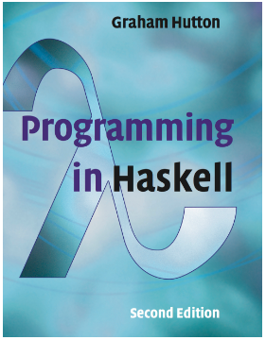
Book Title
This course(including slides) is largely based on the book:
Programming in Haskell,
Graham Hutton, 2nd Ed,
Cambridge University Press,
ISBN 978-1-316-62622-1.

Slide 3
What is a Functional Language?
Opinions differ, and it is difficult to give a precise definition, but generally speaking:
Functional programming is style of programming in which the basic method of computation is the application of functions to arguments;
A functional language is one that supports and encourages the functional style.

Slide 4
Example
Summing the integers 1 to 10 in Java:
int total = 0;
for (int i = 1; i ≤ 10; i++)
total = total + i;
The computation method is variable assignment.
3

Slide 5
Example
Summing the integers 1 to 10 in Haskell:
sum [1..10]
The computation method is function application.
4

Slide 6
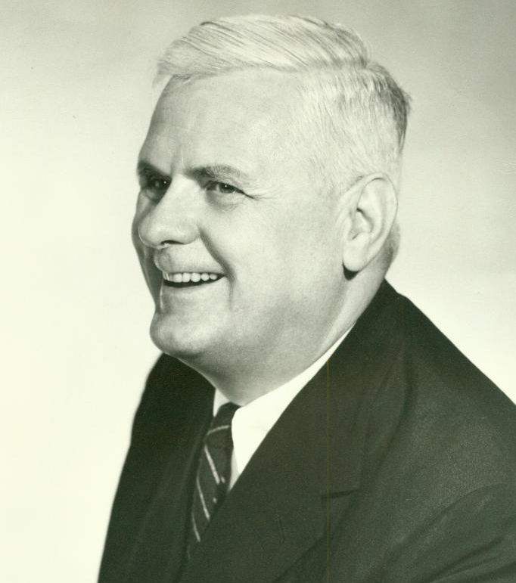
Historical Background
1930s:
Alonzo Church develops the lambda calculus, a simple but powerful theory of functions.
5

Slide 7
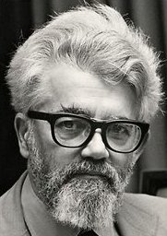
Historical Background
1950s:
John McCarthy develops Lisp, the first functional language, with some influences from the lambda calculus, but retaining variable assignments.
6

Slide 8
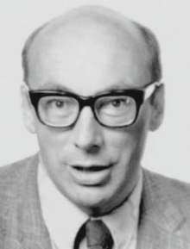
Historical Background
1960s:
Peter Landin develops ISWIM, the first pure functional language, based strongly on the lambda calculus, with no assignments.
7

Slide 9

Historical Background
1970s:
John Backus develops FP, a functional language that emphasizes higher-order functions and reasoning about programs.
8

Slide 10
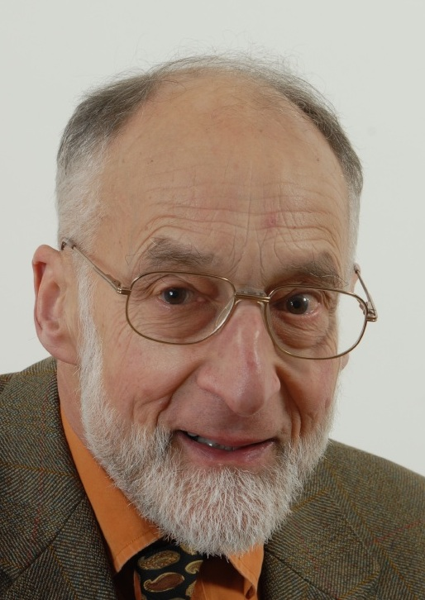
Historical Background
1970s:
Robin Milner and others develop ML, the first modern functional language, which introduced type inference and polymorphic types.
9

Slide 11

Historical Background
1970s - 1980s:
David Turner develops a number of lazy functional languages, culminating in the Miranda system.
10

Slide 12

Historical Background
1987:
An international committee starts the development of Haskell, a standard lazy functional language.
11

Slide 13
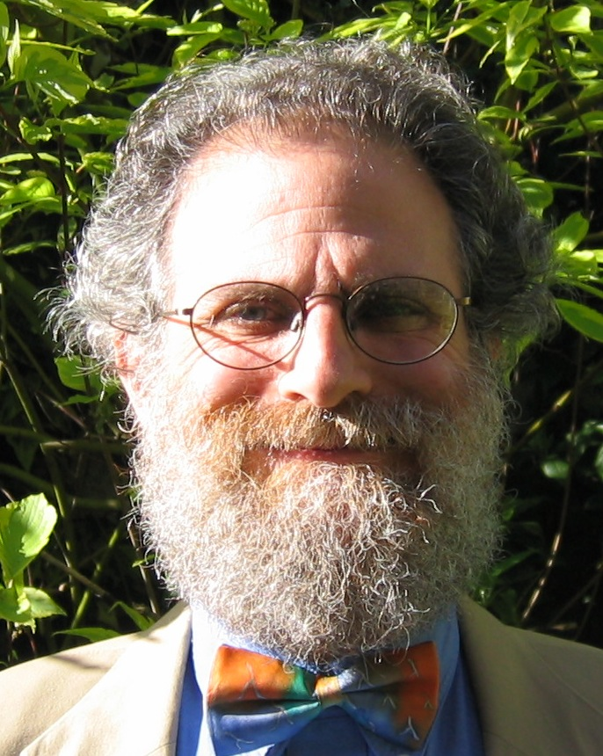
Historical Background
1990s:
Phil Wadler and others develop type classes and monads, two of the main innovations of Haskell.
12

Slide 14
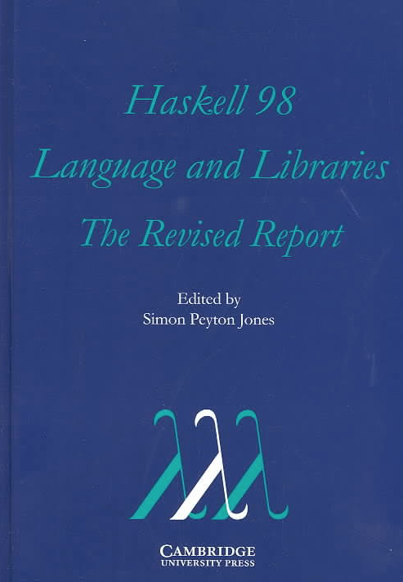
Historical Background
2003:
The committee publishes the Haskell Report, defining a stable version of the language; an updated version was published in 2010.
13

Slide 15

Historical Background
2010-date:
Standard distribution, library support, new language features, development tools, use in industry, influence on other languages, etc.
14

Slide 16
A Taste of Haskell
f [] = []
f (x:xs) = f ys ++ [x] ++ f zs
where
ys = [a | a ← xs, a ≤ x]
zs = [b | b ← xs, b > x]
?
15

