Slide 1

PROGRAMMING IN HASKELL
Chapter 4.3 – First Class Functions

Slide 2
Lambdas, let and where
We wish to write a function that takes two numbers, and returns the greater of the sum of the squares of the numbers (x² + y²) or the square of the sums of the numbers (x+y)²
We will call it sumSquareOrSquareSum we will write this using :
where
lambda functions, and finally
let

Slide 3
Starting point
Repetition of terms
sumSquareOrSquareSum :: Int -> Int -> Int
sumSquareOrSquareSum x y =
if x^2 + y^2 > (x + y)^2
then x^2 + y^2
else (x + y)^2
We can do better….

Slide 4
Using where
sumSquareOrSquareSum’ :: Int -> Int -> Int
sumSquareOrSquareSum’ x y =
if sumSquare > squareSum
then sumSquare
else squareSum
where sumSquare = x^2 + y^2
squareSum = (x + y)^2
Cleaner
Easier to read

Slide 5
Towards lambda functions
body :: Int -> Int -> Int
body sumSquare squareSum =
if sumSquare > squareSum
then sumSquare
else squareSum
sumSquareOrSquareSum'' :: Int -> Int -> Int
sumSquareOrSquareSum'' x y =
body (x^2 + y^2) ((x + y)^2)
Next, we will rewrite body as a lambda function.

Slide 6
Using lambda functions
Rewrite ‘body as lambda
sumSquareOrSquareSum''' :: Int -> Int -> Int
sumSquareOrSquareSum''' x y =
(\sumSquare squareSum ->
if sumSquare > squareSum
then sumSquare
else squareSum )
(x^2 + y^2) ((x + y)^2)

Slide 7
Using let
Readability of the where clause
sumSquareOrSquareSum'''' :: Int -> Int -> Int
sumSquareOrSquareSum'''' x y =
let sumSquare = (x^2 + y^2)
squareSum = (x + y)^2
in
if sumSquare > squareSum
then sumSquare
else squareSum
With the power of the lambda function

Slide 8
First Class Functions
First class functions are functions that can be passed around like any other values, including as arguments to functions.

Slide 9
First Class Functions. example
ifEvenInc :: Int -> Int
ifEvenInc n =
if even n
then n + 1
else n
ifEvenDouble :: Int -> Int
ifEvenDouble n =
if even n
then n*2
else n
ifEvenSquare :: Int -> Int
ifEvenSquare n =
if even n
then n^2
else n
Only differences

Slide 10
First Class Functions. Introduce a function as an argument
inc :: Num a => a -> a
inc n = n + 1
double :: Num a => a -> a
double n = n * 2
square :: Num a => a -> a
square n = n ^ 2
ifEven :: Integral a => (a->a) -> a -> a
ifEven f n =
if even n
then f n
else n
even only works on integers

Slide 11
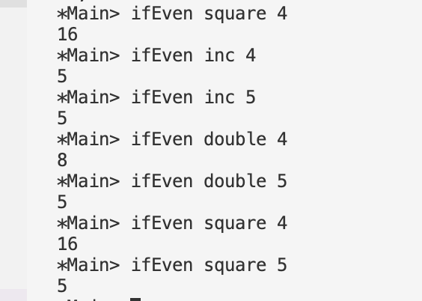
First Class Functions
We can call these functions thus:

Slide 12
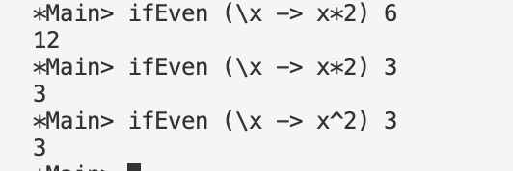
Using lambdas
etc.

Slide 13
Example – sorting 1/3
Sorting is an example where we use:
built in functions and also
pass functions into other (sortBy) functions
We use:
Pairs/Tuples (fst and snd return the first and second element of the tuples respectively)
Form (“firstname”, “lastname”)

Slide 14
Example – sorting 2/3
import Data.List ( sort )
names :: [(String, String)]
names = [("Angela", "Merkel"), ("Joe", "Biden"), ("Michael D", "Higgins"), ("Boris", "Johnson")]
Default sort is on first element
Called as

Slide 15
Example – sorting 3/3
import Data.List ( sort, sortBy )
names :: [(String, String)]
names = [("Angela", "Merkel"), ("Joe", "Biden"), ("Michael D", "Higgins"), ("Boris", "Johnson")]
compareLastNames :: Ord a => (a, a) -> (a, a) -> Ordering compareLastNames name1 name2
| lastName1 > lastName2 = GT
| lastName1 < lastName2 = LT
| otherwise = EQ
where lastName1 = snd name1
lastName2 = snd name2
Called as

Slide 16
Example – structuring a solution
Problem: We want to write an address generating function.
This function is to take names and addresses from the three different SETU campuses:
Waterford Campus ,
Carlow Campus ,
Wexford Campus
with slightly different rules for different colleges.
We wish to structure a solution that generalises as much as possible, but also allows for differences.
We will pass functions into other functions to help!

Slide 17
Example – structuring a solution
SETU (Waterford Campus):
Staff are allocated offices based (only) on their last
name, i.e.
< “L” – they are in the “Lower Floor, Main Building”,
otherwise, they are in the “Middle Floor, Science Building”.
The remaining part of the address is
”SETU, Cork Road, Waterford, Ireland, X91 K0EK."
e.g. “Adam Able” from SETU (Waterford) would be given the address :
“Adam Able , Lower Floor, Main Building, SETU, Cork Road, Waterford, Ireland, X91 K0EK."
e.g. “Sean Stack” from SETU (Waterford) would be given the address :
“Sean Stack , Middle Floor, Science Building, SETU, Cork Road, Waterford, Ireland, X91 K0EK."

Slide 18
Example – structuring a solution
SETU (Carlow Campus):
All staff SETU (Carlow Campus) have the
same address:
"SETU (Carlow Campus), Dublin Road, Carlow,
Ireland, R93 V960."
e.g. “Adam Able” from SETU (Carlow) would be given the address :
“Adam Able , SETU, Dublin Road, Carlow, Ireland, R93 V960."

Slide 19
Example – structuring a solution
SETU (Wexford Campus):
All staff in the Wexford Campus have the same address:
"SETU (Wexford Campus), Summerhill Rd, Townparks, Wexford, Y35 KA07."
In the address, however, the last name is before the first name.
e.g. “Adam Able” from SETU (Wexford Campus) would be given the address :
“Able, Adam, SETU (Wexford Campus), Summerhill Rd, Townparks, Wexford, Y35 KA07.”

Slide 20
Example – structuring a solution
A few notes:
We use the (“Tom”, “Hanks”) structure to model a name and use a type synonym Name to encapsulate this structure.
type Name = (String, String)
When we write a function, we write the arguments in the order (left to right) from most general to least general. This allows maximum reuse of these functions.

Slide 21
Example – structuring a solution
Each location needs a different address structure. To calculate the full (String) address we need
location
name (not so obvious but in case of SETU ( Waterford Campus) , the address depends also on name)
We will use the folloing ‘key’s to indicate the locations. ”
WatSETU”,
“CarSETU” and
“WexSETU”
(depending on the key, we will call a different function)

Slide 22
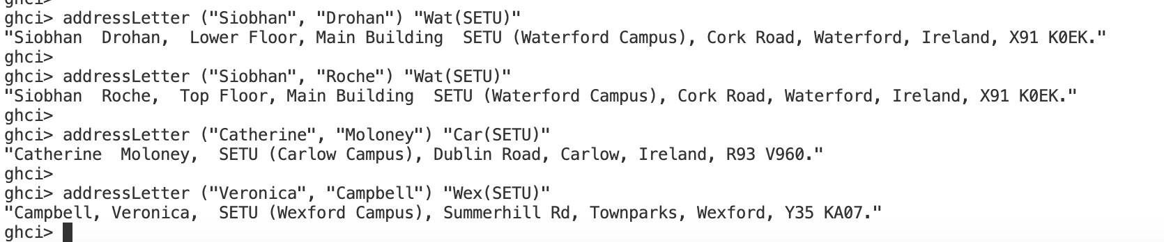
Example – structuring a solution
Top-down approach:
addressLetter :: Name -> String -> String
addressLetter name location = getLocation location name
e.g. of running addressLetter:

Slide 23
Example – structuring a solution
Returns the appropriate String producing function
getLocation :: String -> (Name -> String)
getLocation location = case location of
"Wat(SETU)" -> watOffice
"Car(SETU)" -> carOffice
"Wex(SETU)" -> wexOffice
_ -> (\name -> fst name ++ " " ++ snd name ++ ": Address unknown" )
Uses lambda function, expecting another argument

Slide 24
Example – structuring a solution
watOffice :: Name -> String
watOffice name =
if lastName < "L"
then nametext ++ ", Lower Floor, Main Building " ++ office WatSETU
else nametext ++ ", Top Floor, Main Building " ++ office WatSETU
where
nametext = fst name ++ " " ++ snd name
lastName = snd name

Slide 25
Example – structuring a solution
carOffice :: Name -> String
carOffice name = nametext ++ ", " ++ office CarSETU
where
nametext = fst name ++ " " ++ snd name
wexOffice :: Name -> String
wexOffice name = nametext ++ ", " ++ office WexSETU
where
nametext = snd name ++ ", " ++ fst name

Slide 26
Example – structuring a solution
data Location = WatSETU | CarSETU| WexSETU
:
:
office :: Location -> String
office WatSETU = "SETU (Waterford Campus), Cork Road, Waterford, Ireland, X91 K0EK."
office CarSETU= "SETU (Carlow Campus), Dublin Road, Carlow, Ireland, R93 V960."
office WexSETU = "SETU (Wexford Campus), Summerhill Rd, Townparks, Wexford, Y35 KA07."

Slide 27
Example – Overall solution
The full text of the solution is available in the associated lab

Slide 28


