Slide 1

PROGRAMMING IN HASKELL
Chapter 4.4 – Closures and Partial Functions

Slide 2
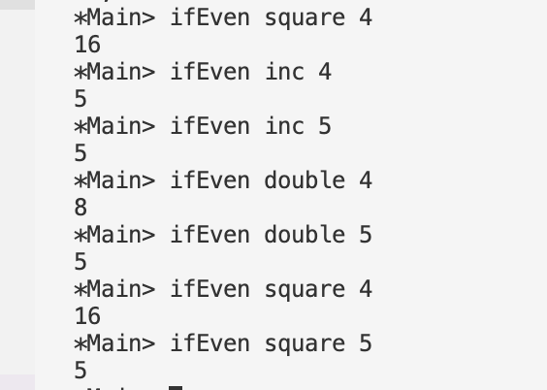
First Class Functions.. recall
inc :: Num a => a -> a
inc n = n + 1
double :: Num a => a -> a
double n = n * 2
square :: Num a => a -> a
square n = n ^ 2
ifEven :: Integral a => (a->a) -> a -> a
ifEven f n =
if even n
then f n
else n
However, we are still repeating code

Slide 3
Use of lambdas leading to closures
We would like to write a function that will return ifEvenX (where x is double etc.).
We introduce genIfEven:
genIfEven :: Integral a => (a -> a) -> a -> a
genIfEven f = (\x -> ifEven f x)

Slide 4
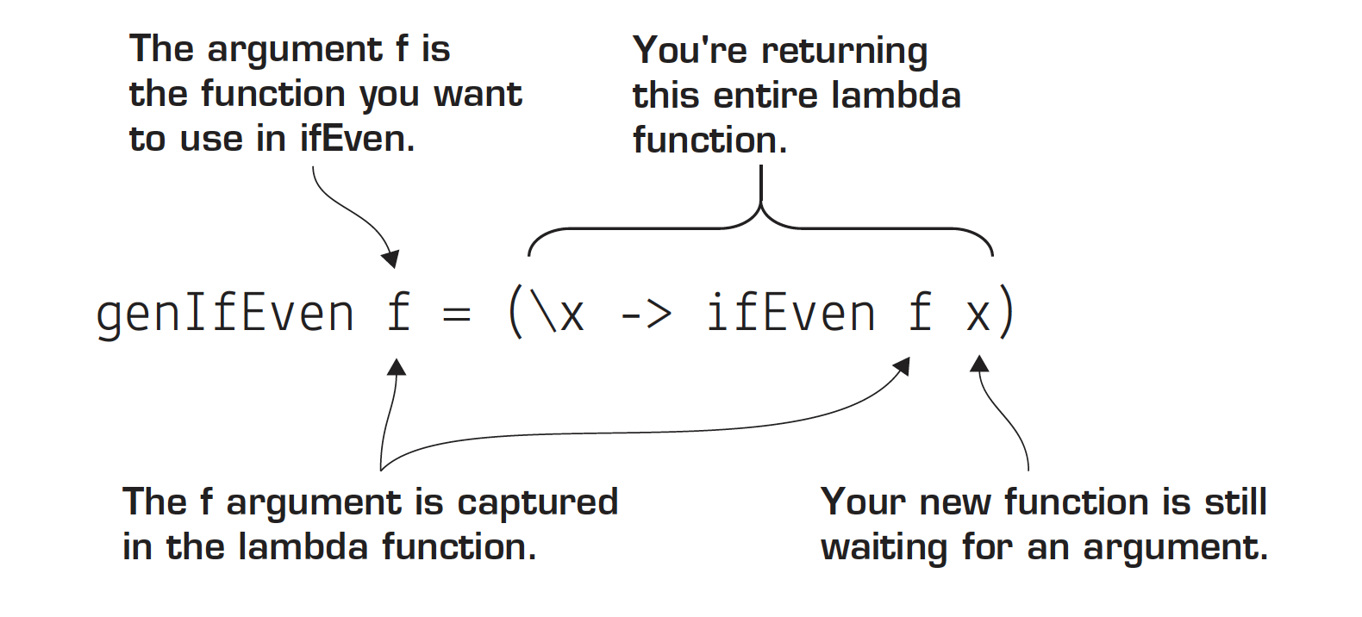
Closures
How this works:
You pass in a function and return a lambda function. The function f is captured inside the lambda function. When you capture a value inside a lambda function, this is referred to as a closure.

Slide 5
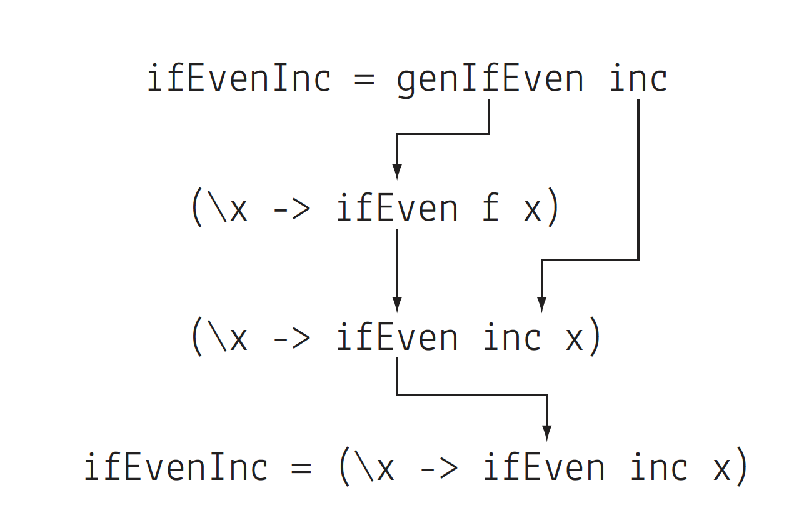
Example – genIfEven inc

Slide 6
Closures and Partial Application
Closures are powerful and useful. But the use of lambda function
to create the closure can make it less clear.
We can use Partial Application which is cleaner and easier to read
add4 :: Num n => n -> n -> n -> n -> n
add4 a b c d = a + b + c + d
addXto3 :: Num n => n -> n -> n -> n -> n
addXto3 x = (\b c d -> add4 x b c d)
addXYto2 :: Num n => n -> n -> n -> n -> n
addXYto2 x y = (\c d -> add4 x y c d)

Slide 7
Closures and Partial Application
mystery = add4 5
This returns a function that expects the remaining 3 arguments.
anotherMystery = add4 5 4
This returns a function that expects two arguments.
This is called Partial Application and is clearer to the reader.

Slide 8


Slide 9
Reference
Based on material from ‘Get Programming in Haskell’, Will Kurt.

