Slide 1

PROGRAMMING IN HASKELL
Chapter 7.3 – The Stack Tool

Slide 2
What is Stack?
Its main feature is that it 'sandboxes' the full
installation of ghc, dependencies and code in the
one isolated location.
- This means that you can safely run different versions
of dependencies in different sandboxes.
- You can export the project as a fully standalone
artefact that does not depend on any local versions
of software.

Slide 3
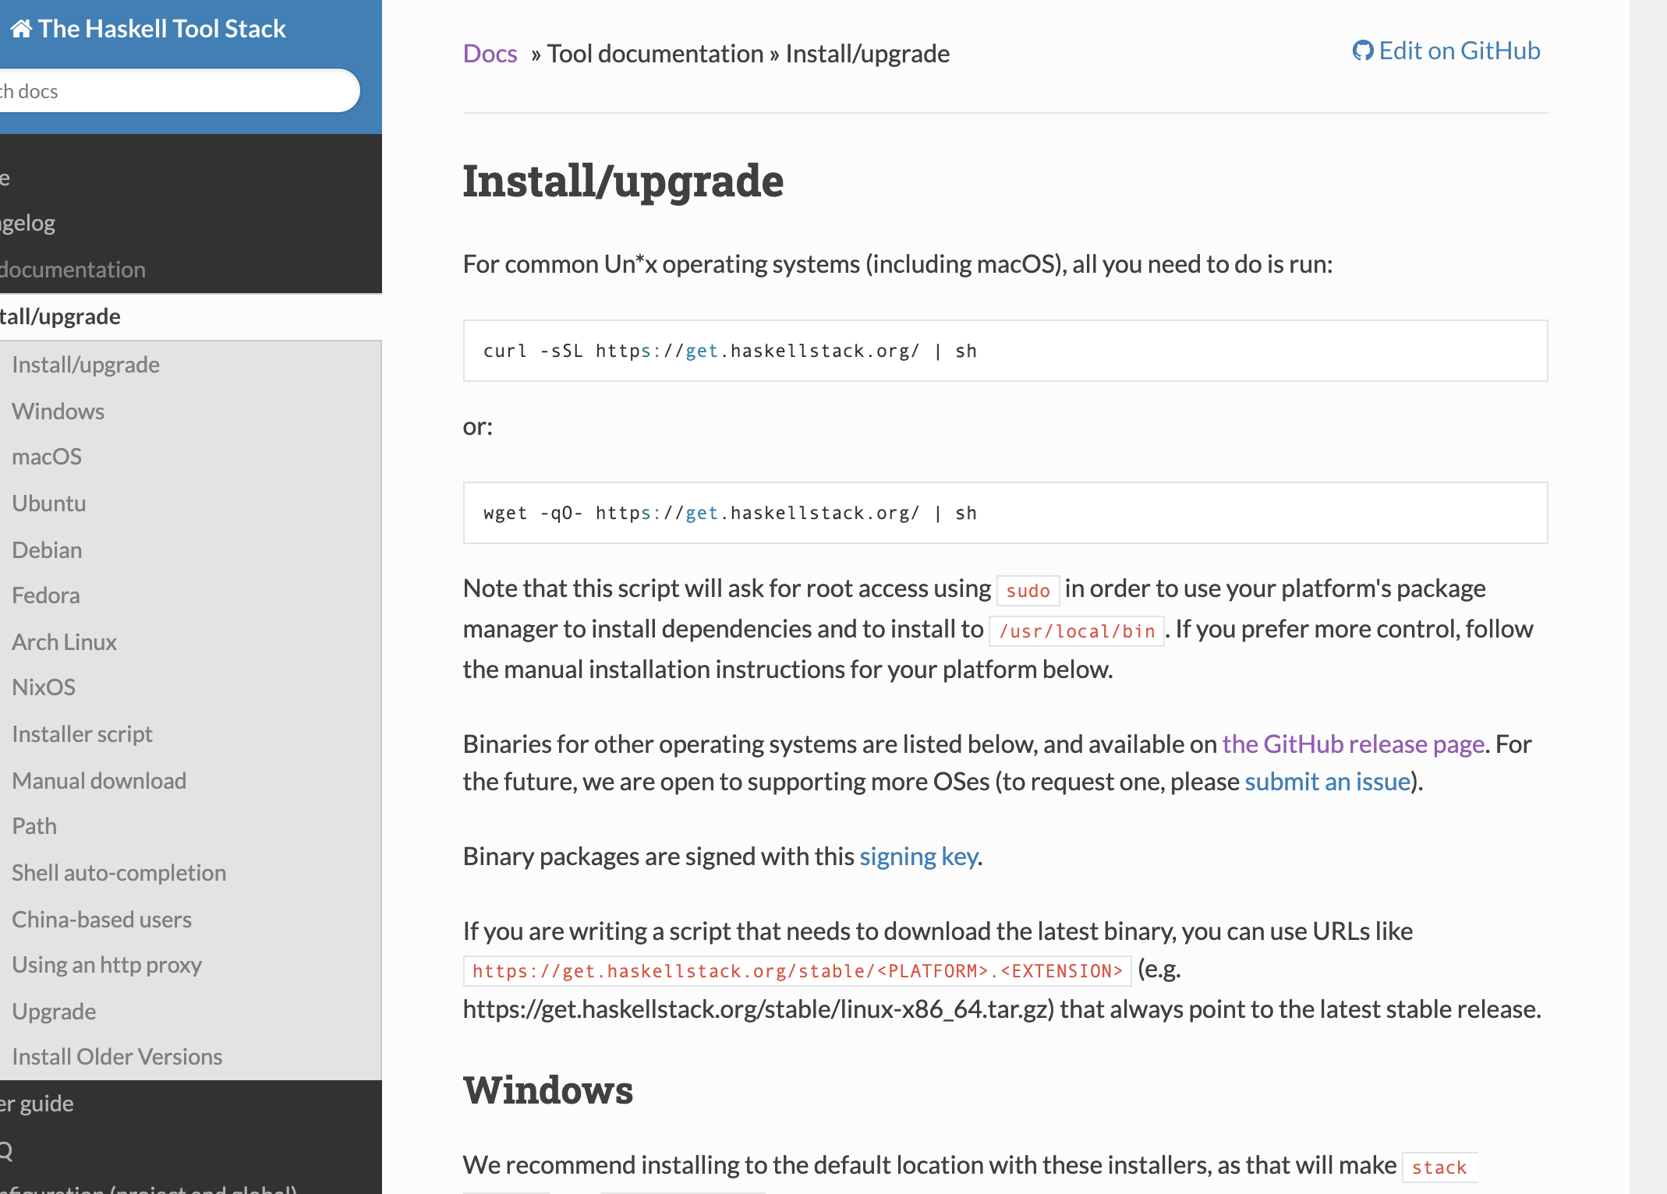
What is Stack? - installation
You will need to install stack on your machine.
Clear instructions are available from here and more details are in this topics’ labs.

Slide 4
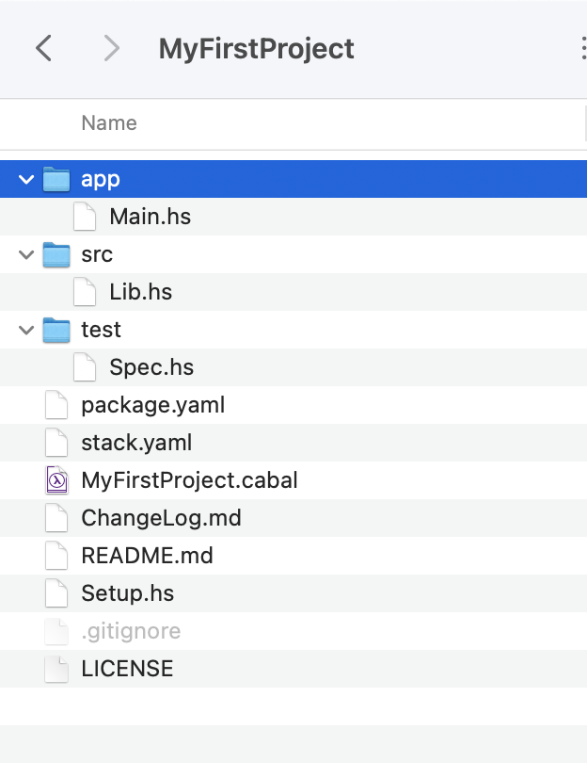
What is Stack? - structure
We will use the standard project structure in our projects as provided in the default installation, i.e.
‘stack new MyFirstProject’

Slide 5
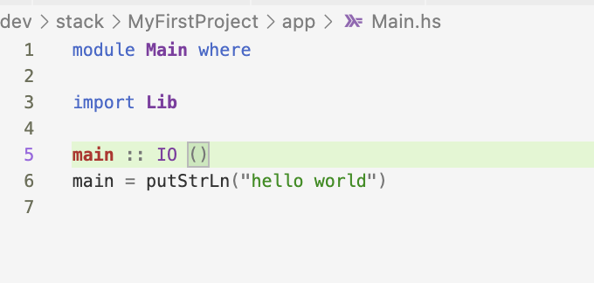
Using Stack 1/3
$ stack new MyFirstProject
Make a small change to
app/Main.hs

Slide 6

Using Stack 2/3
$ stack build – builds/rebuilds project with updated code
$ stack install – copies executable into common location
$ MyFirstProject-exe – runs executable

Slide 7
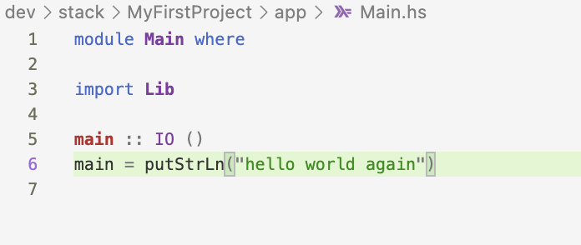
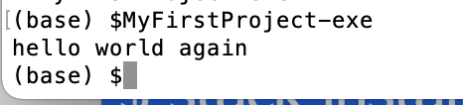
Using Stack 3/3
Updating project
You may need to add this common location to your system path
$ stack build –rebuilds project with updated code
$ stack install – copies updated executable into common location
$ MyFirstProject-exe – runs updated executable

Slide 8
Where is everything in Stack structure?
Driver code – we talk to world here
Library code – functions here (‘heavy lifting’)
Don’t need to change these
Testing section
Where we define dependencies – allows us to sandbox

Slide 9
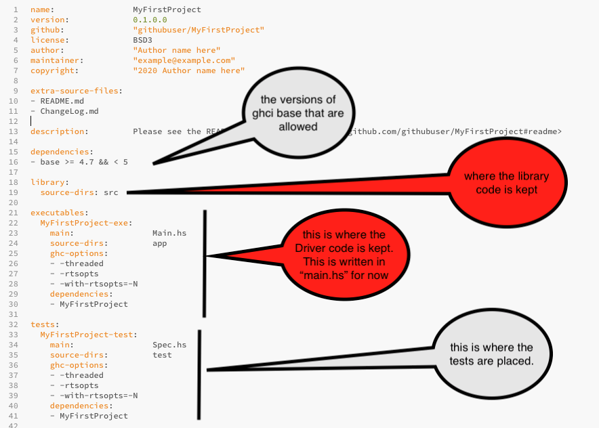
properties.yaml - contents

Slide 10
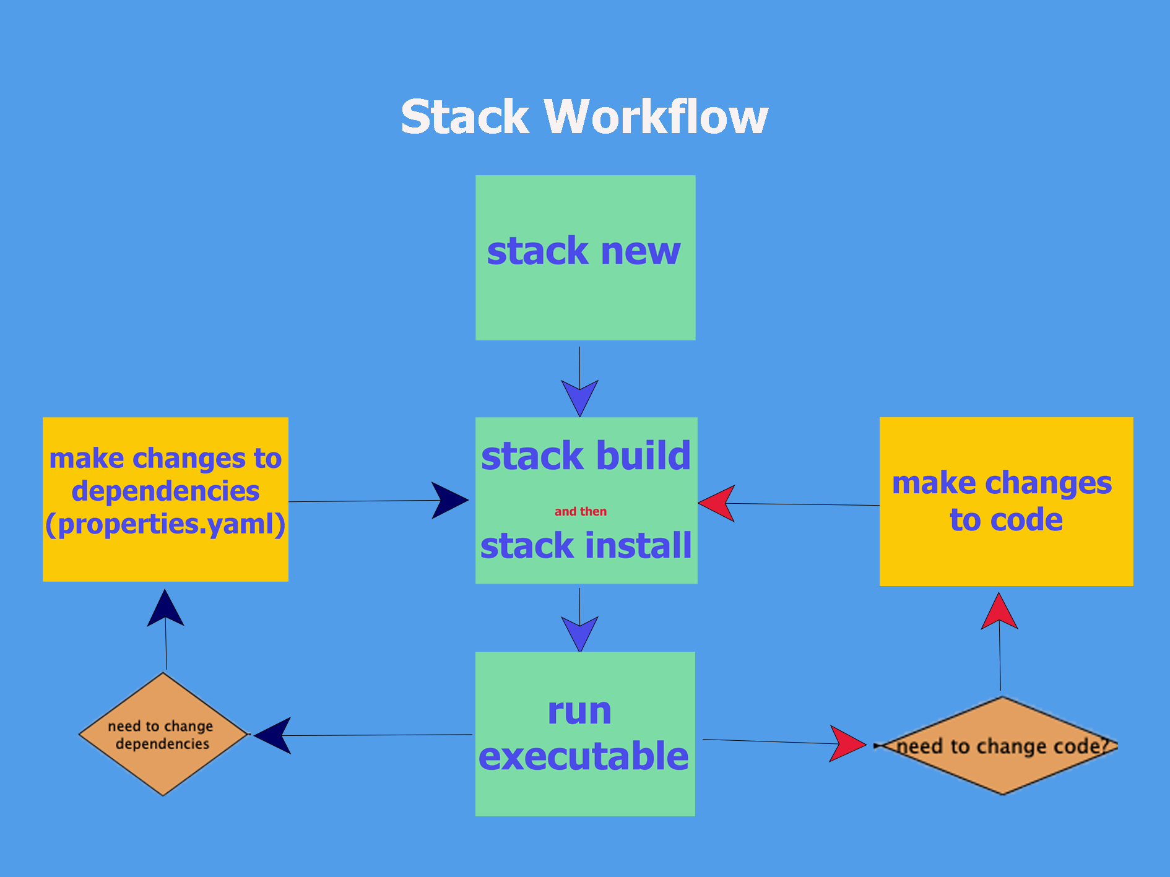
Workflow of Stack

Slide 11
Updating package.yaml 1/2
We need to update package.yaml for two reasons:
1. When we are structuring our code as seen in the
default stack structure, we may write many functions,
then curate these related functions into (files in) folders
of related functions,
For example, if we had a lot of sorting functions,
we might put all such code in (files in) a Sort folder.
To use this code we need to tell package where code
is situated.

Slide 12
Updating package.yaml 2/2
2. Writing Haskell programs will involve using using
standard Haskell packages. We update package.yaml to include any packages we need (these are the dependencies)
Stack helps us to manage these dependencies by:
Downloading a particular version (as defined in package.yaml) of a package
Once the dependency is mentioned in package.yaml, Stack takes care of the rest. (downloads, installs etc)
This project will use this snapshot of the package from now on so once the program works once(with this version of the package), it will not need to be updated because of those packages being changed.

Slide 13
Labs
During the labs, you will see how to use an outside package (‘split’) and create our own library code.
We will see how to to make ‘split’ available to our code
We will see how to structure our code to be used in the ‘driver’/’app’ code
We will rewrite the app code (from the default code) to use our library code

Slide 14


