Slide 1
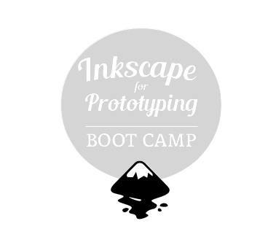


presented by
Máirín Duffy
Principal Interaction Designer, Red Hat, Inc.

Slide 2


FAST. FURIOUS. FUN.
Of course you can.
YOU CAN DO IT!
Can I really do all of
this? I don't know...
Notes:
Fedora has everything you need to produce awesome mockups.
Fedora needs your help to get better. We need to cultivate a culture in which mockups are used as a design tool much more than we are today.

Slide 3
TODAY'S TOPICS:
#1 Let's snag some artwork!
#2 Hack the evil computer!
#3 Some more basics.
#4 Working with shapes
#5 Shapes vs. paths
#6 Working with text
#7 Fill and stroke
#7 Save and export
Notes:
Fedora has everything you need to produce awesome mockups.
Fedora needs your help to get better. We need to cultivate a culture in which mockups are used as a design tool much more than we are today.

Slide 4
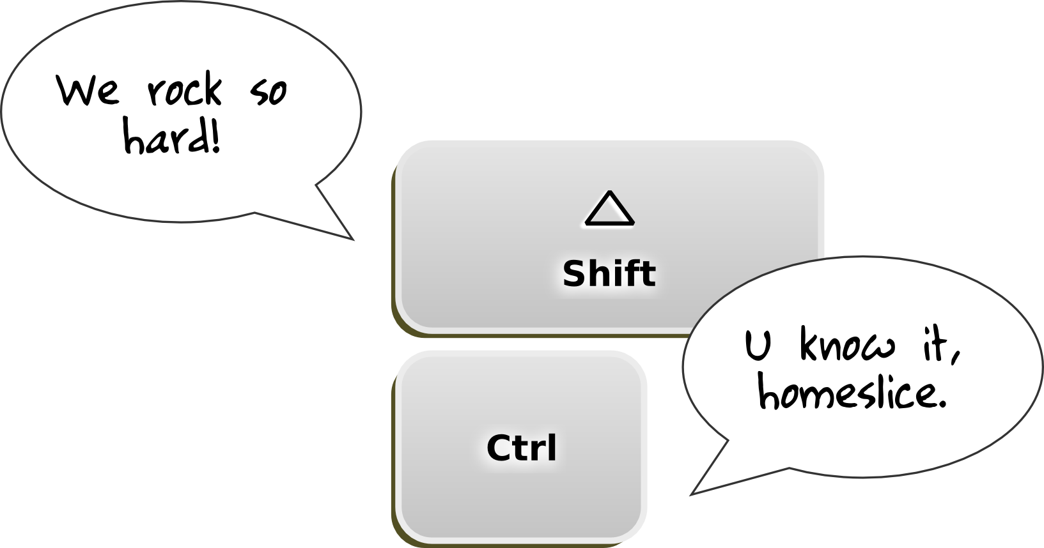
BRIEF INKSCAPE UI PUBLIC SERVICE MESSAGE #1:
Ctrl & Shift are magic!
WHEN IN DOUBT, TRY THEM OUT!
SCALING, ANGLES, ROTATION, MOVING, UNDO, STROKE v. FILL ...

Slide 5
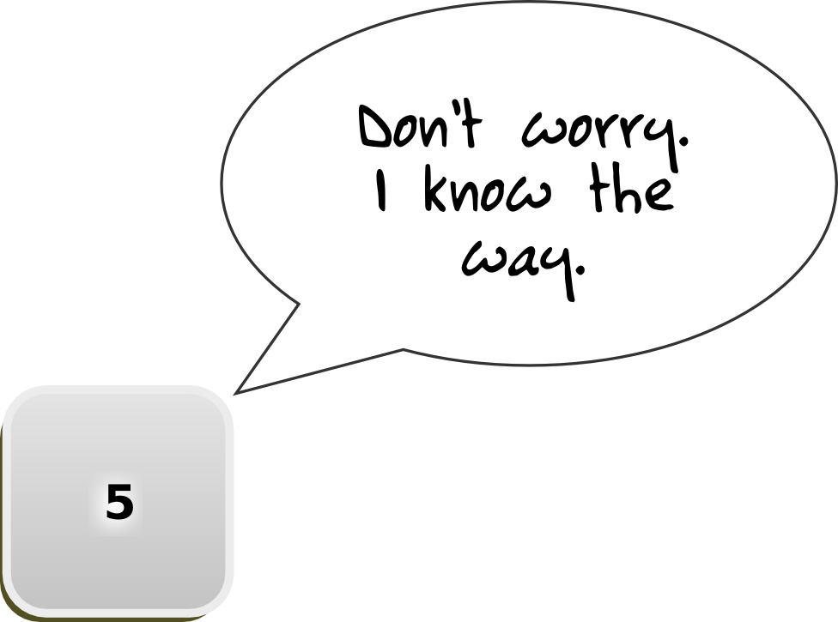
BRIEF INKSCAPE UI PUBLIC SERVICE MESSAGE #2:
Don't get lost!
STUCK IN LALA LAND? HITTING '5' WILL BRING YOU BACK TO CENTER.

Slide 6

#1
Let's snag some artwork!
It's public domain
artwork too, so
we can use it freely!
Notes:
Fedora has everything you need to produce awesome mockups.
Fedora needs your help to get better. We need to cultivate a culture in which mockups are used as a design tool much more than we are today.

Slide 7
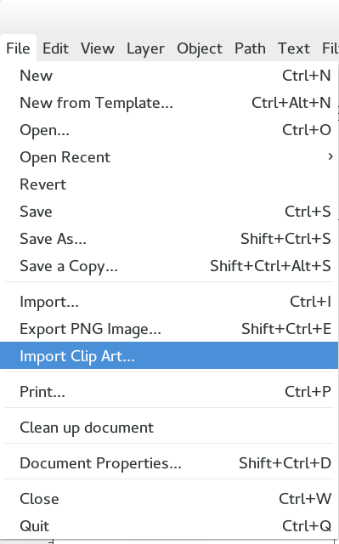
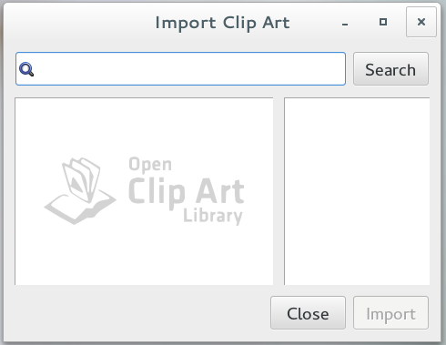
File > Import Clip Art

Slide 8
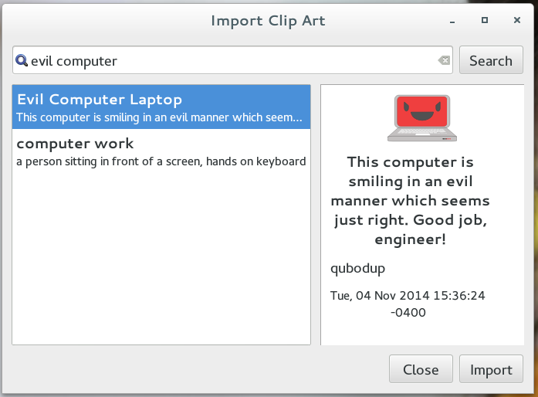


Import the Evil Computer!
You don't scare
me, dude.
MUAH HA HA HA HA!!
WAAAAAHAHAHAHAHA!

Slide 9

#2
Hack the evil computer!
Yeah!
Notes:
Fedora has everything you need to produce awesome mockups.
Fedora needs your help to get better. We need to cultivate a culture in which mockups are used as a design tool much more than we are today.

Slide 10
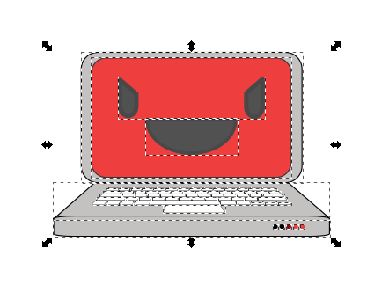
Grouping makes many into one.
Click on the evil computer, and drag him around in Inkscape. He seems like a single solid object right? But, wait:
Select the little beastie, then hit Ctrl+Shift+G (or go to Object > Ungroup.) What happens?

Slide 11
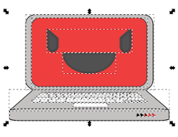

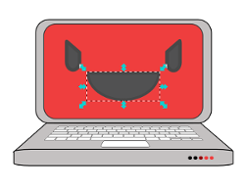

Selecting Objects
Notice the dotted boxes with around various parts of Beastie.
The boxes show all of the different objects that are selected.
Click the blank area outside of Beastie. The boxes disappear.
All of the various Beastie parts are no longer selected.
Click on Beastie's mouth. Notice the dotted box that appears around it.
This box shows that Beastie's mouth alone is selected.
Click, hold down the button, and drag a box around Beastie, then let go.
This is another way to select an object.
You can hold down shift and click different objects to select multiple objects at once.

Slide 12
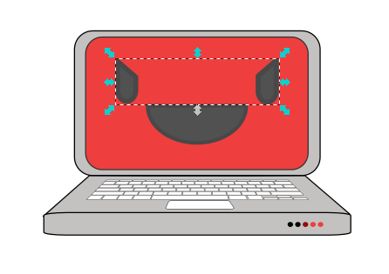

More Ungrouping
Groups may be grouped inside of groups and then all grouped! Sometimes artwork you import will have many layers deep of grouping.
Try to select just one of Beastie's eyes. Can't do it, right?
Ungroup its eyes – Ctrl+Shift+U. Now you can select them separately.

Slide 13

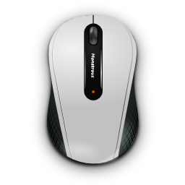
Positioning Objects
There's two main ways to position selected objects:
THE KEYBOARD
Use the keyboard arrow keys to move the object; hold down shift or alt to modify speed.
Slow, but precise.
#1
THE MOUSE
Click and drag the object where you want.
Quick, easy, imprecise.
#2

Slide 14


Beastie's Makeover
Let's practice selecting and positioning objects. Rearrange Beastie's face however you like. Try selecting by clicking, and selecting by dragging. Try positioning with the mouse, and positioning with the keyboard.
BEFORE
AFTER

Slide 15
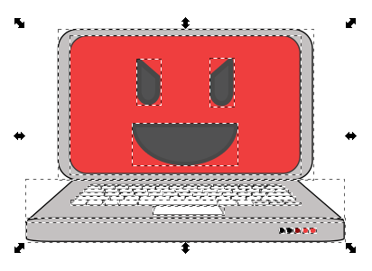
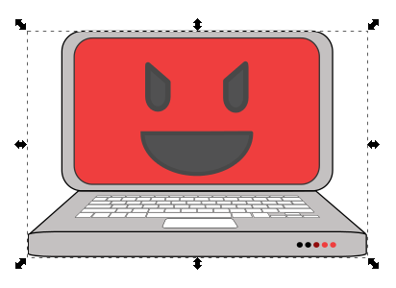
Put Beastie Back Together
What if you want to move all of Beastie around now? You'll have to regroup it. Hit Ctrl+G to make it whole again!
UNGROUPED
GROUPED

Slide 16
Inside the Group
You can go inside a group without ungrouping it!
INSIDE THE GROUP
OUTSIDE THE GROUP
Double-click on the grouped object. It will act as if it is ungrouped.
Double-click outside of the object to go back outside of the group.

Slide 17
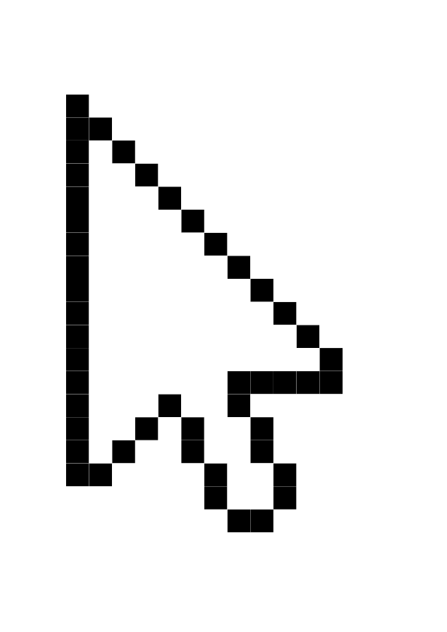

BRIEF INKSCAPE UI PUBLIC SERVICE MESSAGE #3:
Things acting wacky?
You may be in a group!
DOUBLE-CLICK THE BLANK SPACE OUTSIDE OF THE OBJECT YOU'RE WORKING WITH TO EXIT THE GROUP!

Slide 18

#3
Some more basics.
LET'S DO IT!
Notes:
Fedora has everything you need to produce awesome mockups.
Fedora needs your help to get better. We need to cultivate a culture in which mockups are used as a design tool much more than we are today.

Slide 19
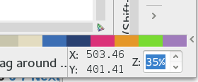
Zoom zoom!
Helpful keyboard shortcuts:
100% zoom
Center canvas, fill screen
Zoom In
Zoom Out
There's also a zoom level indicator / changer in the bottom right:
Zoom around a bit now! Practice!
1
5
+
-

Slide 20
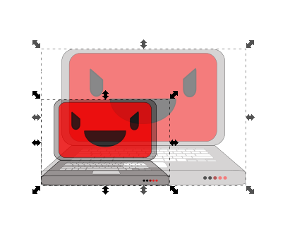
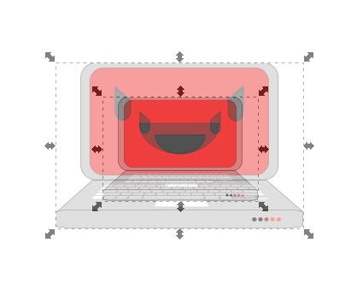
Scale the evilness up (or down)
SCALE FROM THE LOWER LEFT
(CLICK & DRAG)
SCALE FROM THE CENTER
(SHIFT + CLICK & DRAG)
Try it on your own! Size it up, size it down! Double-click to go inside the group and scale Beastie's eyes, then exit the group.

Slide 21

BRIEF INKSCAPE UI PUBLIC SERVICE MESSAGE #4:
Don't forget this lock.
IF YOUR DRAWINGS AND TEXT ARE GETTING STRETCHED, TRY CLICKING IT!

Slide 22


Now, spin it!
Click on an object twice until you see curved arrows at the corners. Drag on the curved arrows to rotate it! Hold down Ctrl while you spin to rotate at regular angles!
Spin the computer on your own now! Now double-click to go inside the group and rotate Beastie's mouth into a frown.

Slide 23
BRIEF INKSCAPE UI PUBLIC SERVICE MESSAGE #5:
Don't fear mistakes.
MAKE A MISTAKE? OR 3? PRESS CTRL+Z UNDO. (CTRL+Y WILL REDO)
Keep pressing me until you get back to where you were!
Ctrl
Z

Slide 24
Flip out!
Select an object, then press one of these:
Flip Horizontally
Flip
Vertically
It's that simple – try these now!
H
V

Slide 25

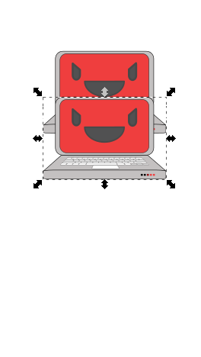

The Magic of Ctrl+D
(Duplicate)
SELECT OBJECT &
HIT CTRL+D
HOLD DOWN SHIFT
AND KEEP PRESSING
ARROW DOWN
A PERFECTLY-ALIGNED COPY.

Slide 26


On Top of the World
There's a stacking order to everything on the Inkscape document area. Things can be moved on top of or below each other.
Move to the Top
Select the left Beastie and press the 'Home' key. Or, press PgUp a lot.
Move to the Bottom
Select the left Beastie and press the 'End' key. Or, press PgDn a lot.

Slide 27
#4
Working with shapes
I'll use shapes to make a hat for Beastie.
Notes:
Fedora has everything you need to produce awesome mockups.
Fedora needs your help to get better. We need to cultivate a culture in which mockups are used as a design tool much more than we are today.

Slide 28
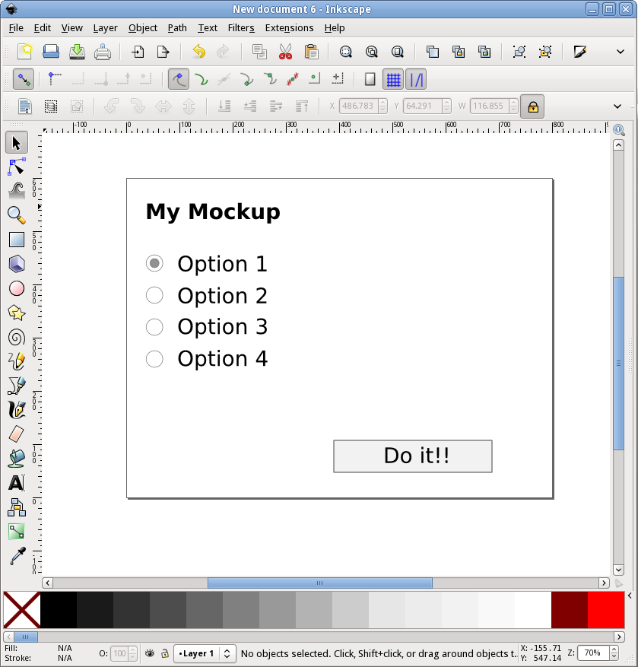
RECTANGLE
ELLIPSE
STAR/POLYGON
SPIRAL
These are the
basic Shape tools.

Slide 29


Creating Shapes
Select the shape tool you want from the toolbar. Click and drag, or hold down Ctrl while you click and drag to make the shape evenly-sized.
This circle is a little squished.
It was dragged out without using Ctrl.
This circle is perfectly round; it was creating by holding down Ctrl while dragging.
Ctrl

Slide 30
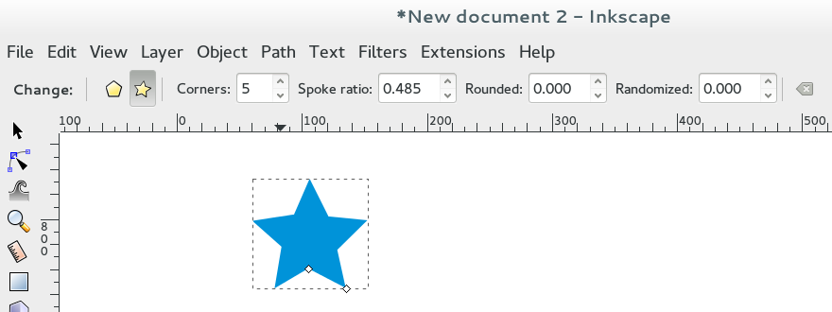

Modifying Shapes
Select the shape tool you want from the toolbar. Look at the long toolbar just above the main document / canvas. There are special controls there that will let you modify the shape.
Pentagon
Triangle
Star
Starburst
Mode:
Corners:
Mode:
Corners:
Spoke Ratio:
Star
5
0.5
Mode:
Corners:
Spoke Ratio:
Star
20
0.3
Mode:
Corners:
Polygon
5
Polygon
3
All of the shapes have their own options bar.

Slide 31

Try it Out
Make a party hat for Beastie using a triangle (polygon / 3 corners) and a starburst (star, 15 corners, 0.3 spoke ratio.)

Slide 32
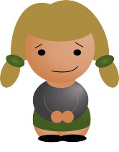
#5
Shapes vs. paths
Time to make
Some bunny ears!
Notes:
Fedora has everything you need to produce awesome mockups.
Fedora needs your help to get better. We need to cultivate a culture in which mockups are used as a design tool much more than we are today.

Slide 33
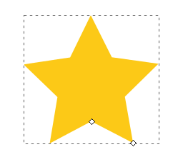
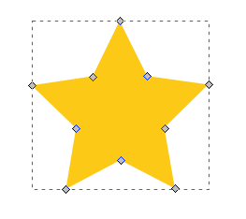


Star Shape vs. Star Path
You can control shapes in different, special ways, while paths are pretty much just points with lines between them.
STAR SHAPE
STAR PATH

Slide 34
Star Shape vs. Star Path
The little gray diamond-shaped boxes are called “nodes.” Select nodes by clicking on them with the node tool; select multiple by holding down shift (or drag-selecting.)

Slide 35
Shapes vs. Paths
Are Beastie's eyes paths or shapes? How about Beastie's mouth?
Try clicking on his parts using the node selector tool (second tool from the top in the toolbox.)

Slide 36



Combining Paths + Shapes
Let's make some bunny ears for Beastie.
Draw a circle, and color it pink.
Duplicate the circle (Ctrl+D), then move it a little down and make it black.
Select both the pink and black circles, and select “Difference” from the Path menu. This is the base.
With “Difference,” the shape on top acts like a hole punch.

Slide 37

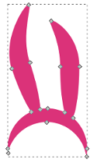
Combining Paths + Shapes
Let's make some bunny ears for Beastie.
Draw a skinny circle
(an ear.) Duplicate it so that you have two.
Place the two ears on the base. Rotate one of the ears if you like. Select all and select “Union” from the Path menu.
Using the node selector, grab the nodes at the tip of the ears and drag to further refine their shape.
With “Union,” all shapes and paths are converted to paths and added together into one single path.

Slide 38

A Gift for Beastie
Hope you like them, Beastie!

Slide 39

#6
Working with text
Text helps you
Share your ideas.
Notes:
Fedora has everything you need to produce awesome mockups.
Fedora needs your help to get better. We need to cultivate a culture in which mockups are used as a design tool much more than we are today.

Slide 40
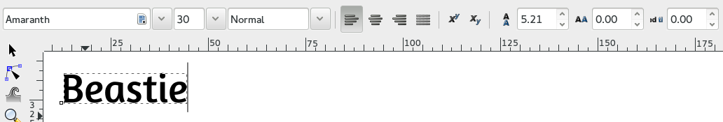
Creating & Modifying Text
The text tool has its own options bar, just like the shape tools.
Select the text tool, click on the canvas, and start typing.
Make modifications in the options bar, including font and font size.
Hover over the options in the options bar to learn
More about them!

Slide 41
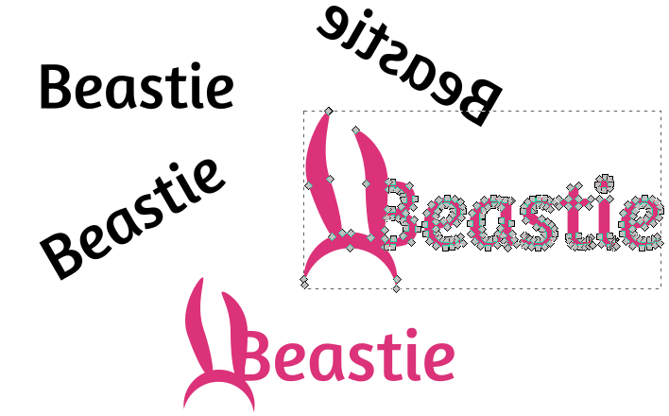
Text is a shape, too.
You can do all the things to text we did to Beastie – you can scale it up and down, you can flip it, you can rotate it... you can even combine it with other shapes and paths.

Slide 42
#7
Fill and stroke
Let's play with
Some Style!
Notes:
Fedora has everything you need to produce awesome mockups.
Fedora needs your help to get better. We need to cultivate a culture in which mockups are used as a design tool much more than we are today.

Slide 43
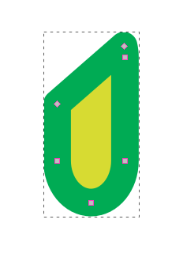
Fill vs. Stroke
Fill is the center of a shape or path; the stroke is an outline around it. They can be different colors. Either can also be transparent.
FILL
(YELLOW)
STROKE
(GREEN)

Slide 44
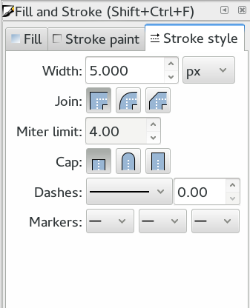
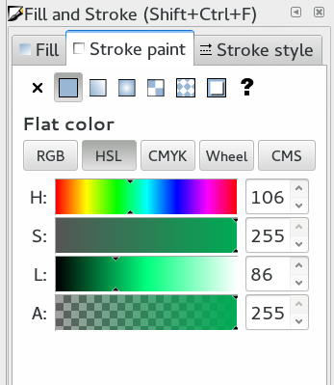
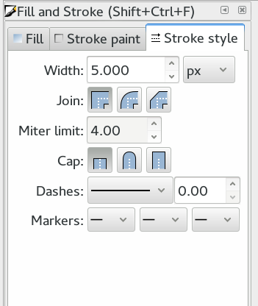
Fill & Stroke Dialog
Open it up via Ctrl+Shift+F or the Object > Fill & Stroke menu item.
You can also set the fill by clicking on a color along the bottom of the screen (fill,) or shift+clicking a color (stroke.)

Slide 45
#8
Save and export
Share your work
by exporting it.
Notes:
Fedora has everything you need to produce awesome mockups.
Fedora needs your help to get better. We need to cultivate a culture in which mockups are used as a design tool much more than we are today.

Slide 46
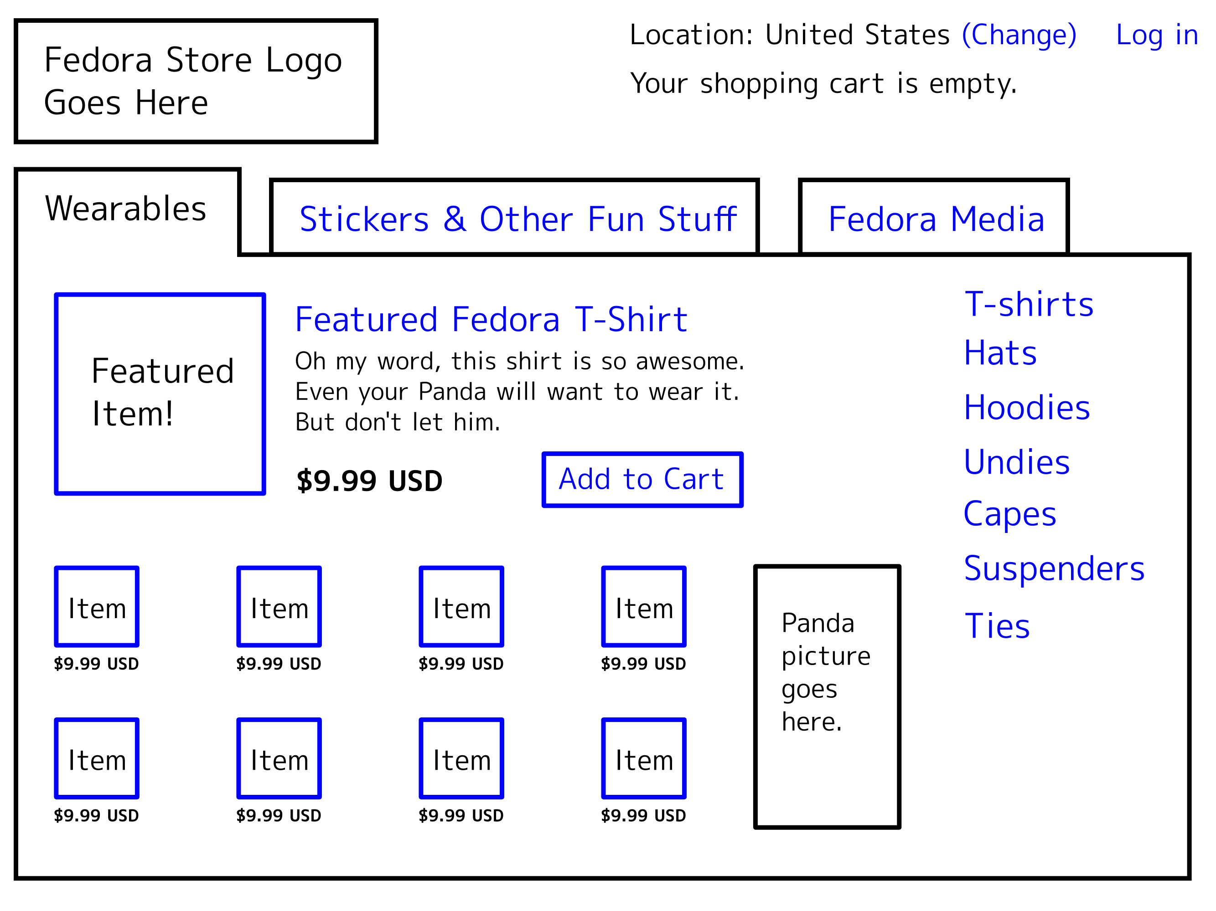
No fancy tricks. Just text & rectangles.

Slide 47
Questions?
Thanks to my Fedora Design Team pal María 'Tatica' Leando for designing the cute characters throughout these slides. :)

