Slide 1



presented by
Máirín Duffy
Principal Interaction Designer, Red Hat, Inc.

Slide 2
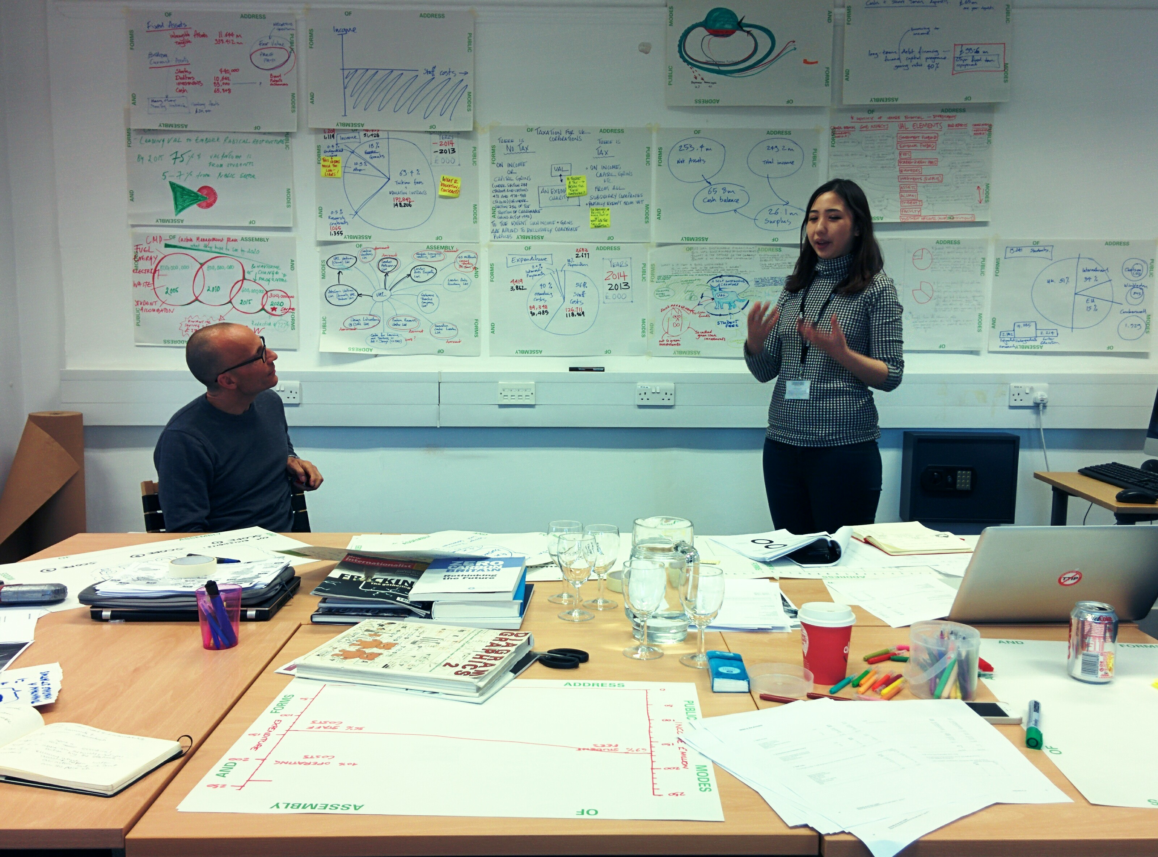
THE DESIGN THINKING PROCESS
DEFINE
RESEARCH
IDEATE
PROTOTYPE
CHOOSE
IMPLEMENT
LEARN
Photo Credit: “Tracing relations” by Neil Cummings on Flickr, used under a Creative Commons Attribution-ShareAlike License
Notes:
Fedora has everything you need to produce awesome mockups.
Fedora needs your help to get better. We need to cultivate a culture in which mockups are used as a design tool much more than we are today.

Slide 3
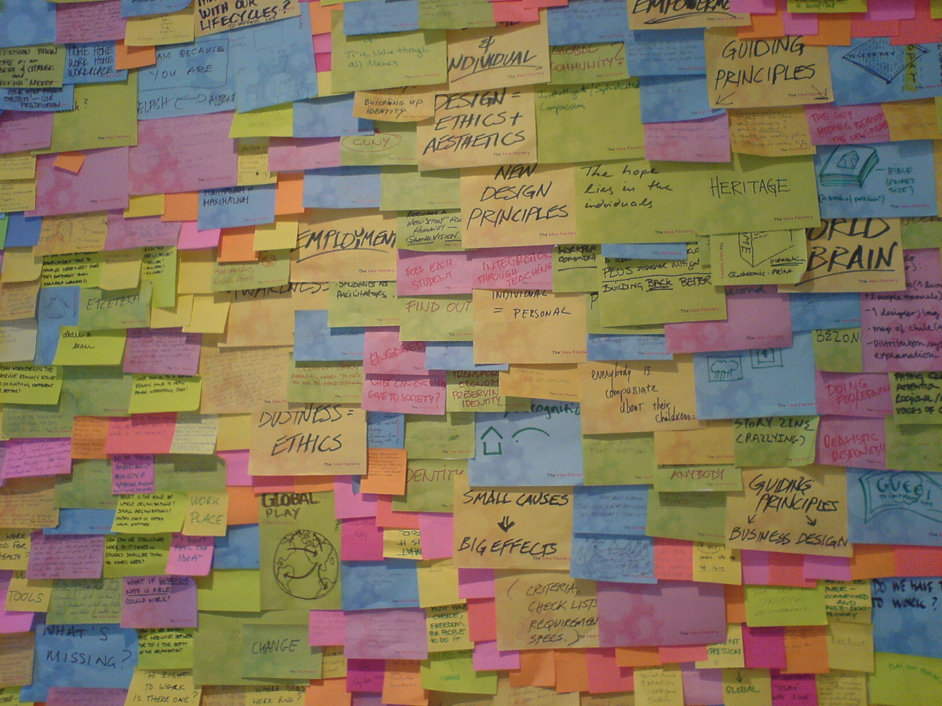
HOW DOES THIS WORK?
RESEARCH
IDEATE
IMPLEMENT
IDEATE
PROTOTYPE
PROTOTYPE
LEARN
LEARN
CHOOSE
Generate lots of ideas!
Synthesize / sort through ideas
Make decisions / plan next steps
Photo Credit: “Brainstorms at INDEX: Views” by Jacob Bøtter on Flickr, used under a Creative Commons Attribution License
Notes:
Fedora has everything you need to produce awesome mockups.
Fedora needs your help to get better. We need to cultivate a culture in which mockups are used as a design tool much more than we are today.

Slide 4
But first, let's warm up.
We're going to draw.
Notes:
Fedora has everything you need to produce awesome mockups.
Fedora needs your help to get better. We need to cultivate a culture in which mockups are used as a design tool much more than we are today.

Slide 5
What?
You can't draw?
Notes:
Fedora has everything you need to produce awesome mockups.
Fedora needs your help to get better. We need to cultivate a culture in which mockups are used as a design tool much more than we are today.

Slide 6
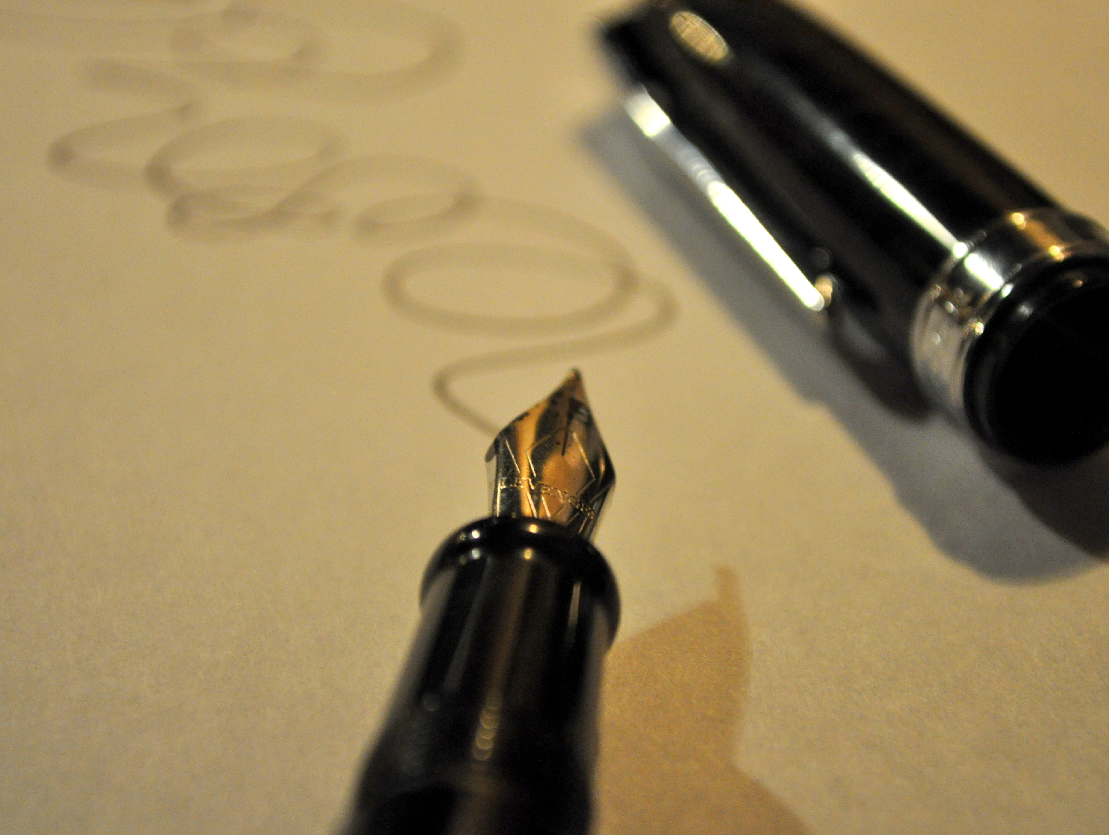
DEFINE
Visual Thinking Exercise
RESEARCH
(~5 minutes)
IDEATE
PROTOTYPE
CHOOSE
IMPLEMENT
LEARN
Photo Credit: “squiggle” by Heather on Flickr, used under a Creative Commons Attribution License
Notes:
Fedora has everything you need to produce awesome mockups.
Fedora needs your help to get better. We need to cultivate a culture in which mockups are used as a design tool much more than we are today.

Slide 7
DEFINE
THE PROBLEM-TO-SOLVE
RESEARCH
IDEATE
As an exercise, let's think of ways to make Fedora better.
• Have you had any new insights or
“Aha!” moments here at Flock for things we need to do?
• What gripes or problems-to-solve have you taken note of?
Let's do a little bit of research and share our experiences.
PROTOTYPE
CHOOSE
IMPLEMENT
LEARN
Notes:
Fedora has everything you need to produce awesome mockups.
Fedora needs your help to get better. We need to cultivate a culture in which mockups are used as a design tool much more than we are today.

Slide 8
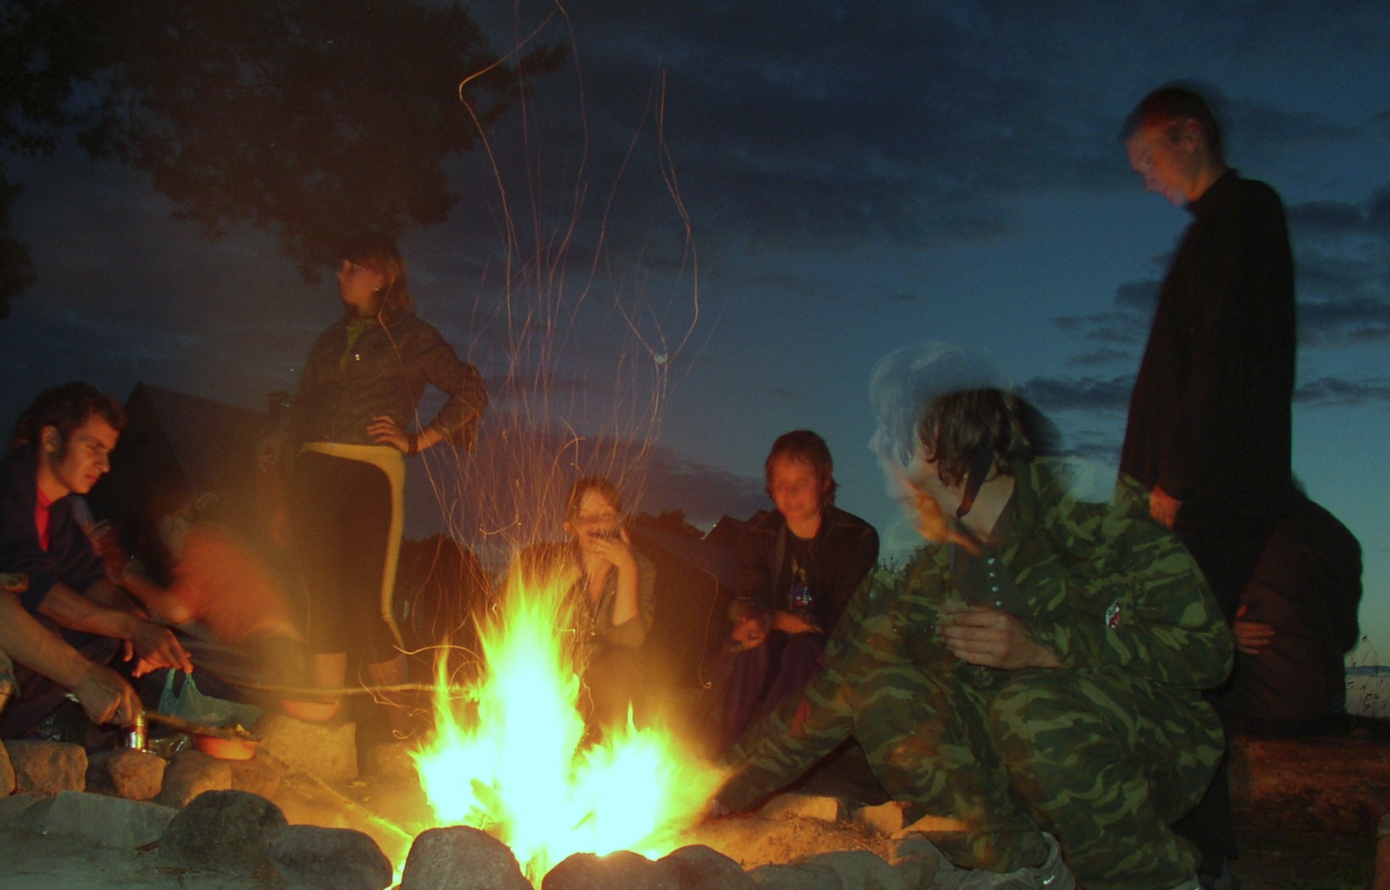
DEFINE
Campfire
RESEARCH
(~20 minutes)
IDEATE
PROTOTYPE
CHOOSE
RULES OF THE GAME:
• I'm going to start with a story, then call for a volunteer.
• The volunteer will grab a 'wall of words' note, place on the 'story thread'
• Tell us why you chose that note and tell us about an experience you had with Fedora related to it
• While you listen to others tell their story, jot a word or a phrase on a sticky note that reminds you of another Fedora-related story.
• Next volunteer's turn; repeat.
IMPLEMENT
LEARN
Photo Credit: 'Campfire' by Jelle S. on Flickr, used under a CC-BY-SA license
Notes:
Fedora has everything you need to produce awesome mockups.
Fedora needs your help to get better. We need to cultivate a culture in which mockups are used as a design tool much more than we are today.

Slide 9

DEFINE
Challenge Cards
RESEARCH
(~30 minutes)
IDEATE
PROTOTYPE
RULES OF THE GAME:
We're going to break into 2 teams: the “solution team” and the “challenge team.”
• Solution team:
Brainstorm new or existing features / strengths of Fedora, one per card. (5 min)
• Challenge team:
Brainstorm potential problems or challenges holding Fedora back, one per card. (5 min)
• Game play:
Challenge team draws one of their cards, explains the challenge. If solution team has a solution card for it, they get a point. If they don't, challenge team gets a point. (10-20 min)
CHOOSE
IMPLEMENT
LEARN
Photo Credit: 'Window' by Jelle S. on Flickr, used under a CC-BY-SA license
Notes:
Fedora has everything you need to produce awesome mockups.
Fedora needs your help to get better. We need to cultivate a culture in which mockups are used as a design tool much more than we are today.

Slide 10

DEFINE
Flip It
RESEARCH
(~30 minutes)
IDEATE
PROTOTYPE
RULES OF THE GAME:
We're going to fill out 3 lists:
• Fear (~5 minutes)
On sticky notes, write out concerns, issues, fears you have about Fedora. Tack them up.
We'll quickly walk through them together.
• Hope (~10 minutes)
Take a look at the issues that are tacked up and rewrite the fear in terms of hope.
• Traction (~10 minutes)
We'll vote on which hopes are those we can take the most practical action on. We'll take the top 5-10 hopes and start brainstorming potential action items for each.
CHOOSE
IMPLEMENT
LEARN
Photo Credit: 'Triple Flip' by Taylor Hand on Flickr, used under a CC-BY-SA license
Notes:
Fedora has everything you need to produce awesome mockups.
Fedora needs your help to get better. We need to cultivate a culture in which mockups are used as a design tool much more than we are today.

Slide 11
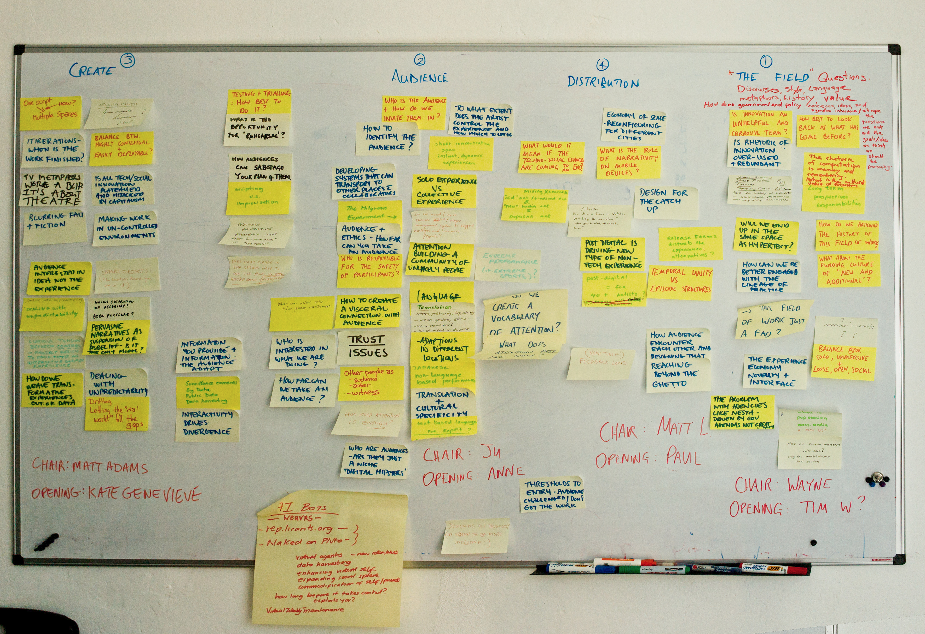
DEFINE
Affinity Mapping Exercise
RESEARCH
IDEATE
(~30 minutes)
PROTOTYPE
CHOOSE
IMPLEMENT
RULES OF THE GAME:
• We just processed a lot of information in the last exercise. What problems-to-solve or ideas stood out the most to you?
• Fill out sticky notes with your impressions from the information we just processed and tack them up on the whiteboard.
• We'll go through all of the sticky notes and process them using the affinity mapping technique.
LEARN
Photo Credit: “act otherwise” by foam on Flickr, used under a Creative Commons Attribution-ShareAlike License
Notes:
Fedora has everything you need to produce awesome mockups.
Fedora needs your help to get better. We need to cultivate a culture in which mockups are used as a design tool much more than we are today.

Slide 12
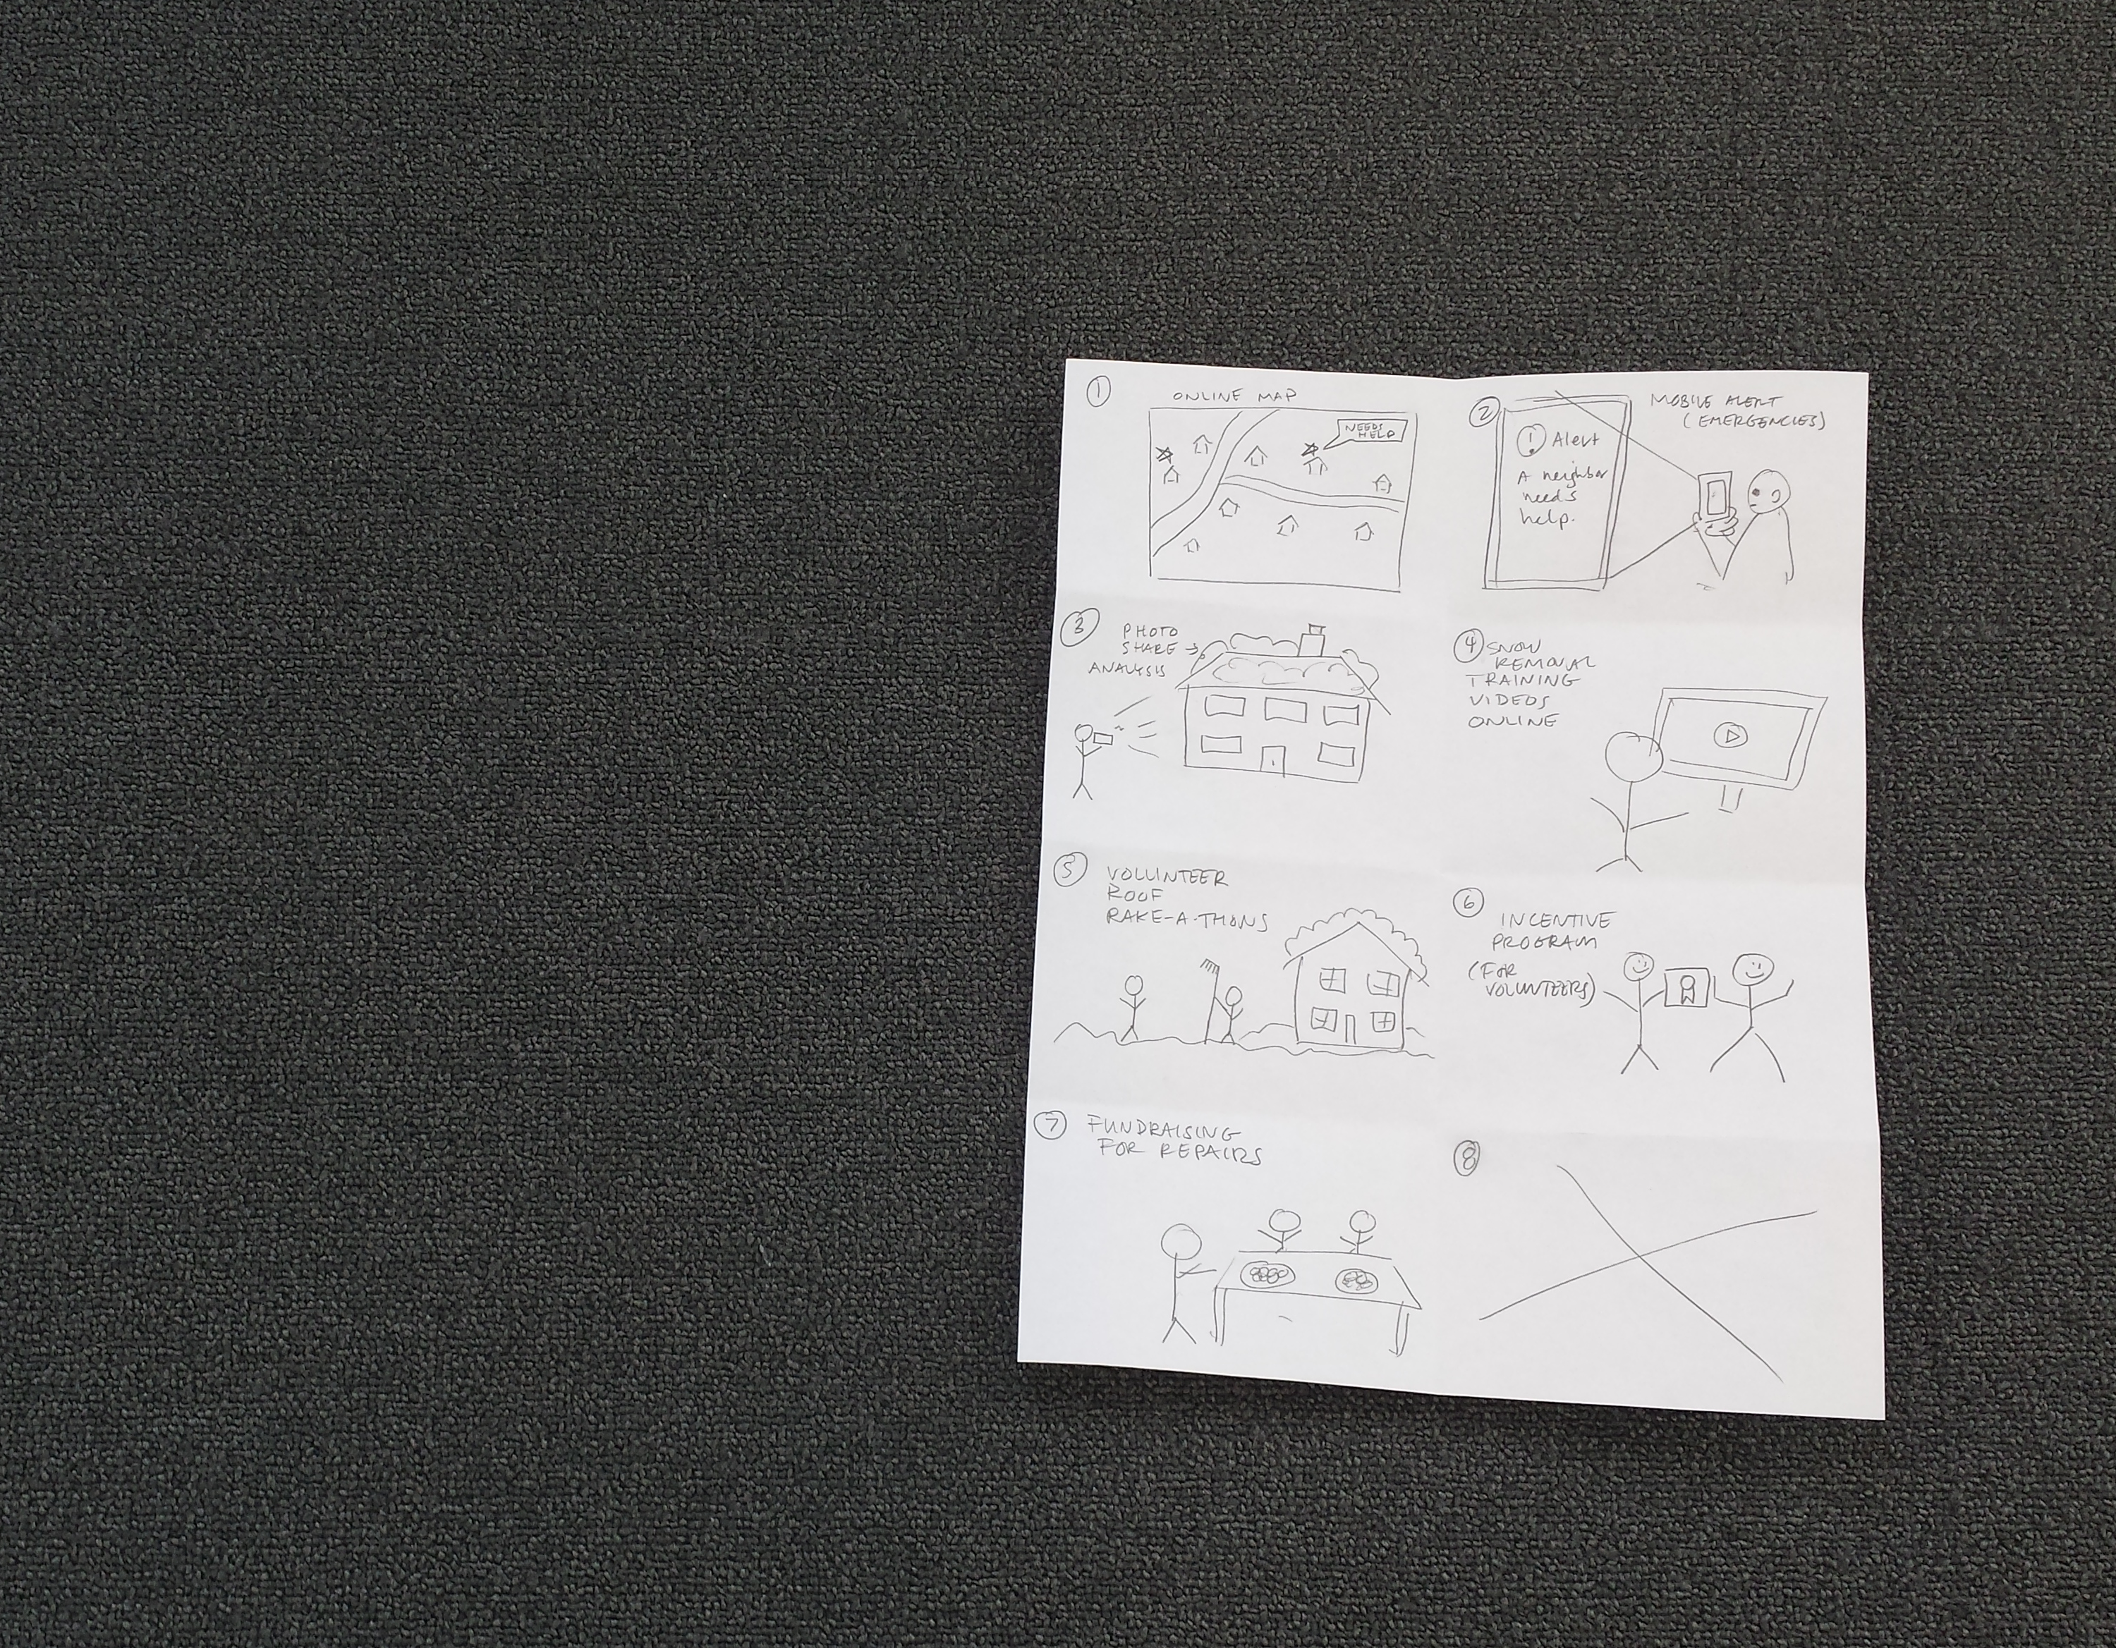
DEFINE
6-8-5 Brainstorm
RESEARCH
(5 minutes)
IDEATE
PROTOTYPE
CHOOSE
IMPLEMENT
LEARN
RULES OF THE GAME:
• QUANTITY not quality!
• Silly ideas make great brain food!
• Don't worry about the details.
• Quick sketches – not fine art!
• Stick figures are awesome.
Photo Credit: '6-8-5 Brainstorm' by Máirín Duffy, feel free to use under a CC-BY 3.0 license
Notes:
Fedora has everything you need to produce awesome mockups.
Fedora needs your help to get better. We need to cultivate a culture in which mockups are used as a design tool much more than we are today.

Slide 13
DEFINE
Share Your Ideas
RESEARCH
(10 minutes per partner)
IDEATE
PROTOTYPE
CHOOSE
• Which ideas seem most promising?
• What could make them better?
• Are there existing products / services you could draw inspiration from?
IMPLEMENT
LEARN
Notes:
Fedora has everything you need to produce awesome mockups.
Fedora needs your help to get better. We need to cultivate a culture in which mockups are used as a design tool much more than we are today.

Slide 14
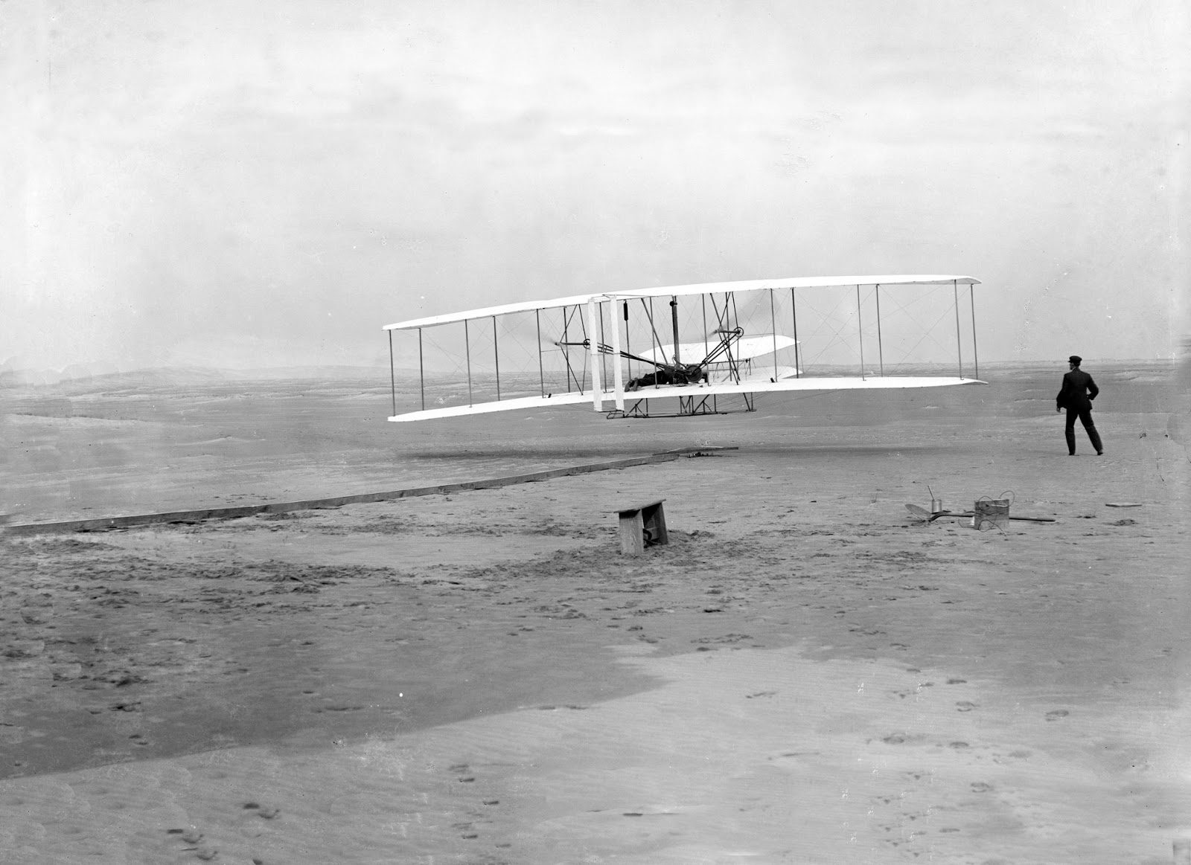
DEFINE
RESEARCH
PROTOTYPE
IDEATE
PROTOTYPE
CHOOSE
(the next step)
IMPLEMENT
LEARN
Photo Credit: Public Domain image, US Library of Congreess.
First flight of the Wright Flyer I, December 17, 1903, Orville piloting, Wilbur running at wingtip.
“A rough proof-of-concept to see if an idea is worth it to (continue to) pursue.”
Notes:
Fedora has everything you need to produce awesome mockups.
Fedora needs your help to get better. We need to cultivate a culture in which mockups are used as a design tool much more than we are today.

Slide 15
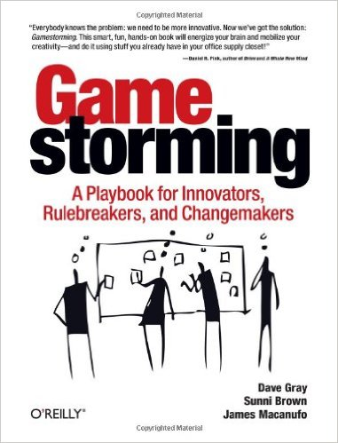
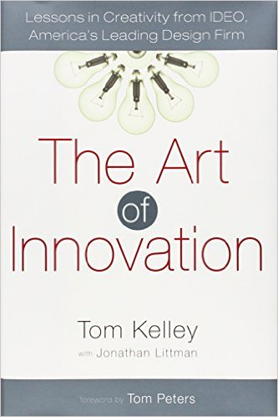

DEFINE
LEARN MORE / RESOURCES
RESEARCH
IDEATE
Gamestorming by Dave Gray, Sunni Brown, and James Macnufo is a great resource and all of the exercises we did today are covered in this book (along with many others!)
PROTOTYPE
CHOOSE
IMPLEMENT
Gamestorming.com is run by the book authors, covers many of the same exercises as the book and several new ones!
LEARN
The Art of Innovation by Tom Kelley with Jonathan Littman is a good primer on design thinking in general, written by one of the founders of the IDEO design firm.
Design Thinking for Educators is a free toolkit offered by IDEO; it's focused towards educators but is honestly applicable to anybody. It has a step-by-step instructional booklet as well as a workbook you can fill out as you plan out projects. The materials are CC licensed and provided in a printable PDF format. designthinkingforeducators.com
Notes:
Fedora has everything you need to produce awesome mockups.
Fedora needs your help to get better. We need to cultivate a culture in which mockups are used as a design tool much more than we are today.

Slide 16

Questions?
Artwork Credit: Maria 'Tatica' Leandro, used with permission

