Slide 1
Recursion
CSE 103
Ashikur Rahman

Slide 2
Recursion main logic
Find Recursive Definition (RD) of the problem
Find Base case where we do not need any recursion
Put Base case inside if block and recursive part under else block.

Slide 3
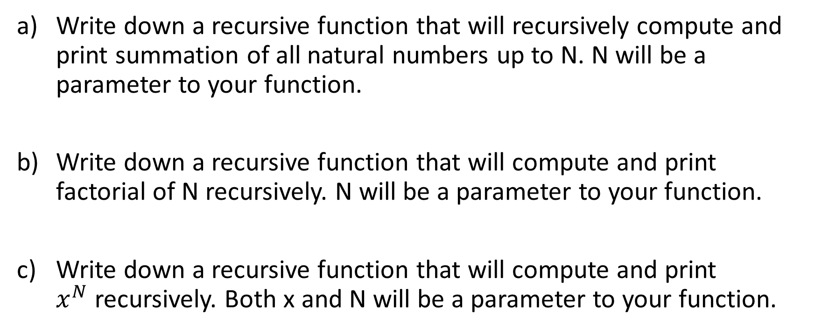
Recursion Problem Solving
Write down a recursive function that will recursively compute and print summation of all natural numbers up to N. N will be a parameter to your function.
Write down a recursive function that will compute and print factorial of N recursively. N will be a parameter to your function.
Write down a recursive function that will compute and print $x^{N}$recursively. Both x and N will be a parameter to your function.

Slide 4
Recursion Problem Solving
Write down a recursive function that will recursively compute and print summation of all natural numbers up to N. N will be a parameter to your function.
Solution:
sum(N) = 1 + 2 + 3 +…….(N-1) + N
Recursive Definition: sum(N) = N + sum(N-1)
Base Case: sum(1) = 1

Slide 5
Recursion Problem Solving
int sum(int N){
int r;
if(N == 1) r = 1;
else r = N+sum(N-1);
return r;
}
int main(){
int y = sum(4);
printf(“%d”, y); //prints 10;
}

Slide 6
Recursion Problem Solving
Write down a recursive function that will compute and print factorial of N recursively. N will be a parameter to your function.
Solution:
fact(N) = 1X2X3X…….(N-1)XN
Recursive Definition: fact(N) = NXfact(N-1)
Base Case: fact(1) = 1
fact(0) = 1

Slide 7
Recursion Problem Solving
int fact(int N){
int r;
if(N == 1 || N == 0) r = 1;
else r = N*fact(N-1);
return r;
}
int main(){
int y = fact(3);
printf(“%d”, y); //prints 6;
}

Slide 8
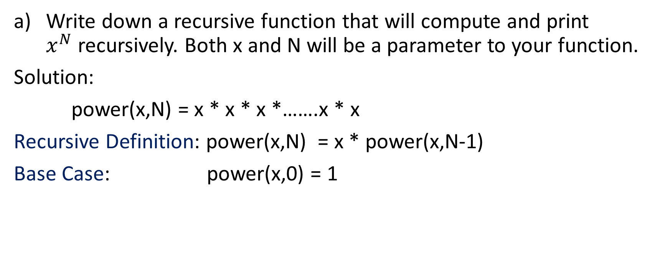
Recursion Problem Solving
Write down a recursive function that will compute and print $x^{N}$recursively. Both x and N will be a parameter to your function.
Solution:
power(x,N) = x * x * x *…….x * x
Recursive Definition: power(x,N) = x * power(x,N-1)
Base Case: power(x,0) = 1

Slide 9
Recursion Problem Solving
int power(int x, int N){
int r;
if(N == 0) r = 1;
else r = x*power(x,N-1);
return r;
}
int main(){
int y = power(2,3);
printf(“%d”, y); //prints 8;
}

